Slide 1
Muffle – Chat Application
Pavan Raj, Ethan Moore, Sai Ganesh
Department of Computer Science
CS 5600: Computer Networks Project
Notes:
Line Numbers x
Title Capt X

Slide 2
Presentation Outline
Introduction
Motivation & Objectives
Technologies
Current progress & Plan of action
Stretch work
Conclusion
Notes:
Make Titles one line

Slide 3
Introduction
What is Muffle?
Muffle is a chat application that targets Web, Android, IOS, Windows and Mac.
Has uniquely customizable notification settings
Set who you will be notified by, when
Send automated replies in do not disturb mode
Set who can override it
Notes:
Increase font size 3 -4

Slide 4
Motivation and Objective
People often get disturbed by the messages?
Want to ignore work during freetime.
But it’s to get interrupted by some of the people in any situation?
Example a message from your parent.
You might be doing some important work and prefer no distractions?
Yes, we do have priorities set.
Notes:
Increase font size 3 -4

Slide 5
Technologies
Peer-to-Peer vs Client-Server
Initially going to integrate Project Tox.
Now using Client Server Approach.
Flutter (Client Project)
Code once and ship it to multiple platforms i.e., Mac, IOS, Android, Windows, Web applications.
Firebase as backend along with DotNet
SQL Server, Firebase Cloud Storage for data management.
Notes:
Increase font size 3 -4

Slide 6
Current Progress
Creating user accounts and retrieving created accounts.
Server can route messages between connected users..
Sign in with email.
Push notifications for android client.
Notes:
Increase font size 3 -4

Slide 7
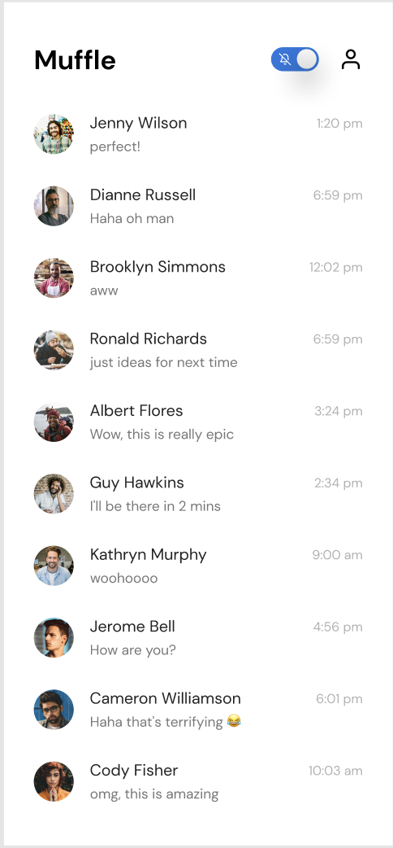
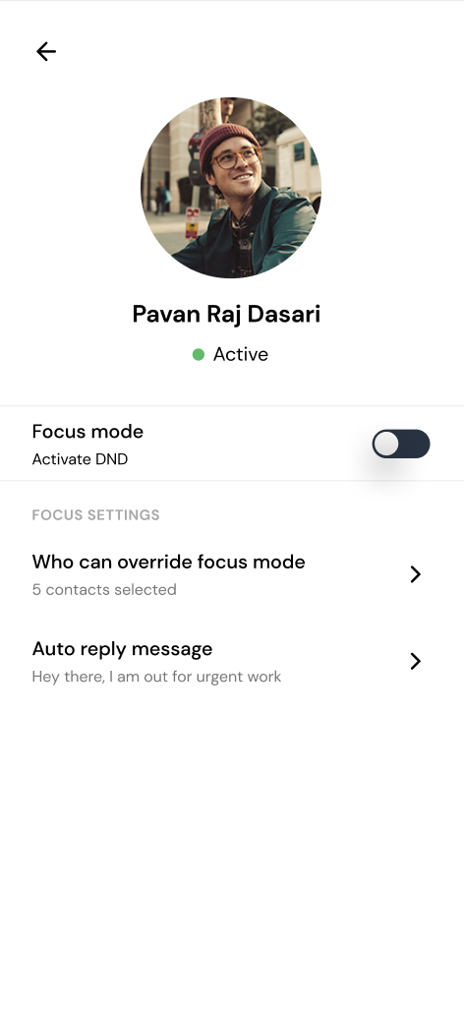
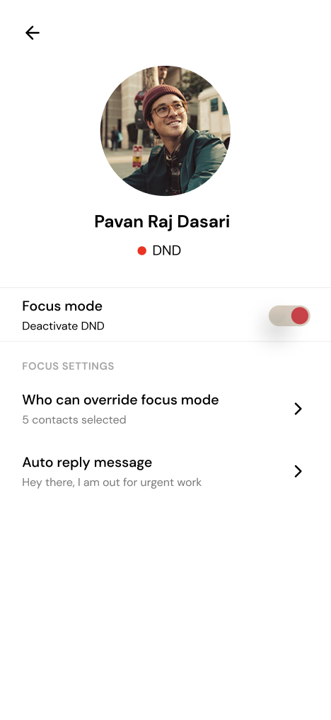
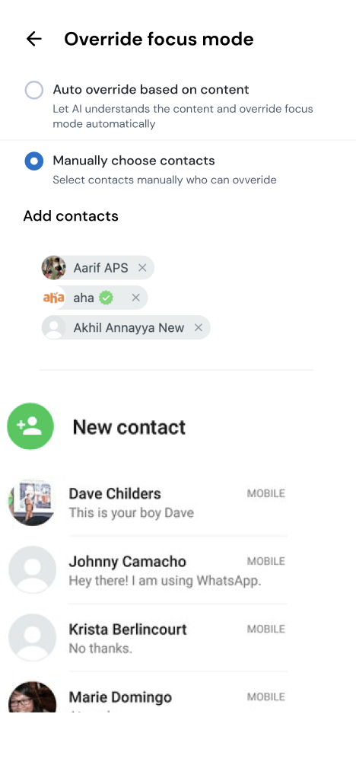

Slide 8
Server Plan Flowchart
Store the messages upon receiving them
Send stored messages to users when the connect to the server
Integrate a proper login with Google Sign-in

Slide 9
Client Plan Flowchart
Create a fully featured client with a user interface
Push notifications whenever receiving a message
Give users control over notifications

Slide 10
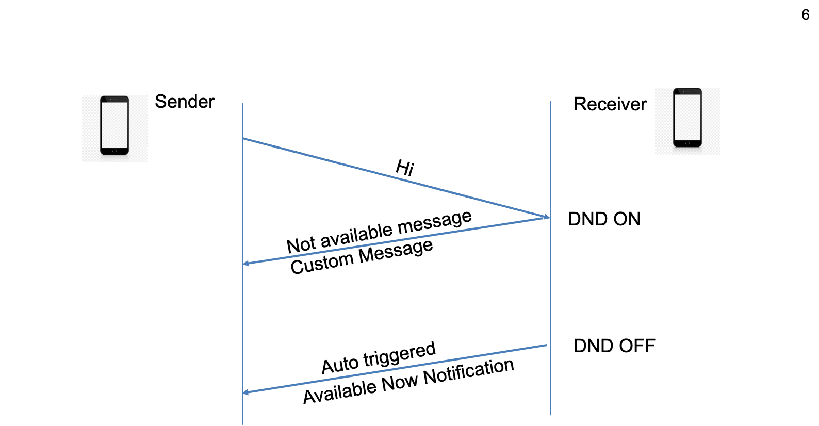
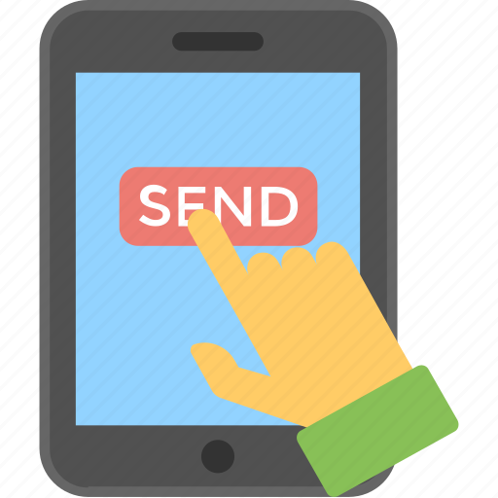


Slide 11
Stretch Goals
We might end up by integration it with some machine learning algorithms which will get your pulse and replies instantly.
Most probably it will act as your personal assistant.
Migrating from client server to peer-to-peer architecture.
Encryption and security
Notes:
Talk about results

Slide 12
Questions?

