Slide 1


Special Project under
WEB ENABLED TECHNOLOGIES
(CS205) Course
FIX MY ROADS
G PAVAN SANTHOSH
21STUCHH010345
Under the Guidance of
DR. MADHU BANDARI

Slide 2

Abstract
AMIS TO FIX PUBLIC ROADS.
BUILT A SLIDESHOW OF PICTURES
WORKS BY FINDING A PROBLEM->UPLOAD ON WEBSITE
ABOUT US
INTRESTED PEOPLE CAN DONATE IN SAVING LIVES .
(SUSTAINABLE FUNDING MECHANISMS)

Slide 3
Requirements
Software requirements
Any browser with an internet connection
Programming language : written in HTML , CSS , JAVASCRIPT.
Text Editors: VS Code , Edit Plus 3 , notepad++ etc.. Can be used .
Hardware Requirements
Hard disk: Minimum 40GB
RAM: 4GB or Above
Processor: Min i3 and max. any latest processor

Slide 4
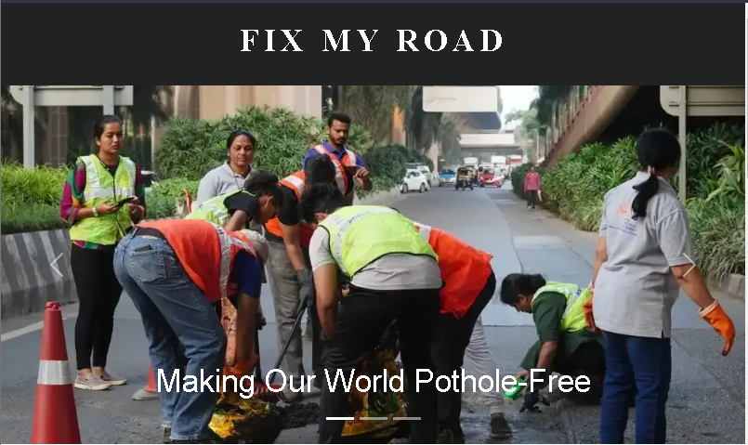
WEBPAGE

Slide 5
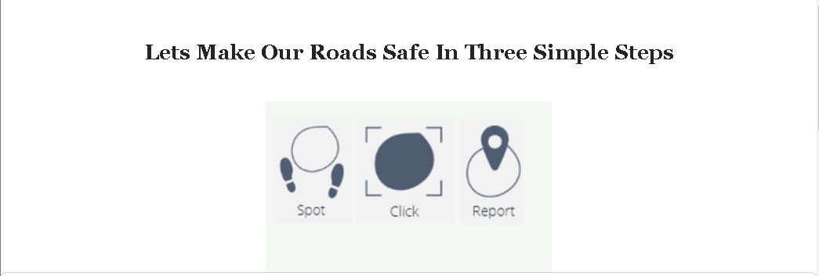
WEBPAGE

Slide 6
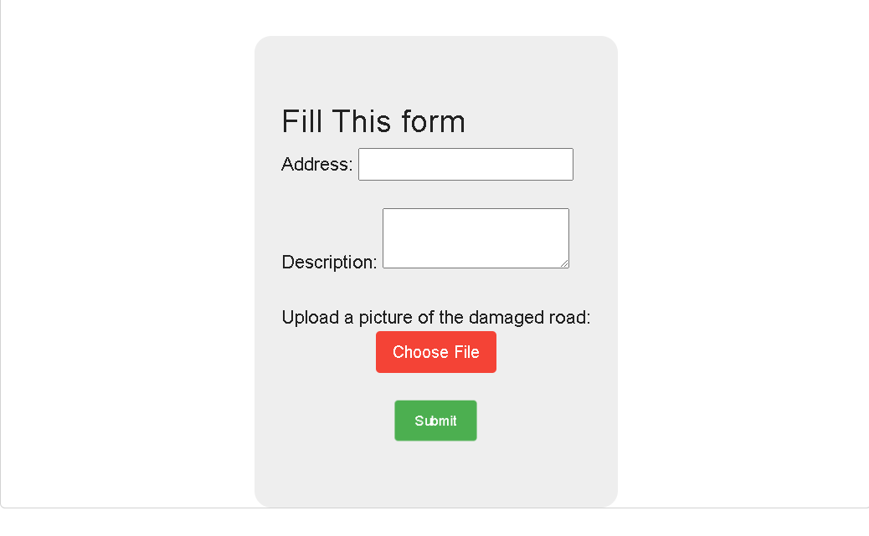
WEBPAGE

Slide 7
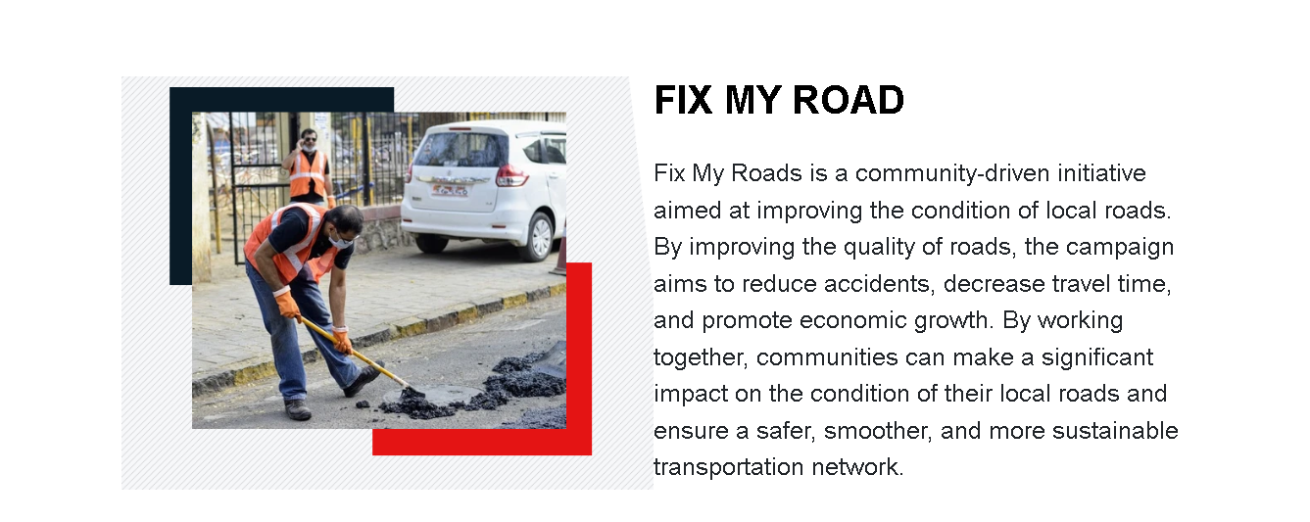
WEBPAGE

Slide 8
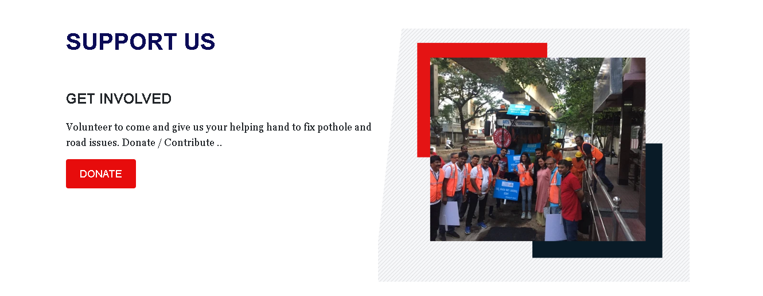
WEBPAGE

Slide 9
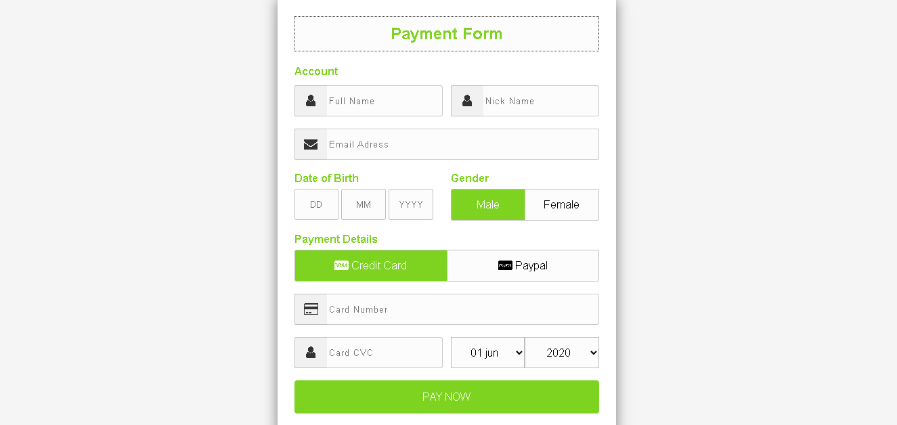
WEBPAGE

Slide 10
THANK YOU

