Slide 1

Age and Gender Detection : Blurring-Based Approach
Group Number : 41
231IT030, 231IT046
Dept of IT, NITK

Slide 2
Table of Contents
1. ​Introduction​
2. Literature Survey​
3. Problem Statement and Objectives​
4. ​ Methodology​
5. ​ Experimental Setup​
6. Results and Analysis​
7. ​Conclusion​ and Future work
8. ​References​

Slide 3
Introduction
Role of Images and Videos
Crucial for security, personalized ads, and social media insights.
Enhances user experience, aids authorities.
Adience Benchmark Dataset
Source: Kaggle.
Real-world, labeled images (Age & Gender).
Age groups: (0-2), (4-6), (8-12), (15-20), (21-24), (25-32), (38-43), (48-53), (60-100).
Challenges: Pose, lighting, background variations.

Slide 4
Applications
Retail: Personalized promotions.
Social media: Audience insights.
Security: Demographic identification.
Core Process
Facial feature analysis using CNNs.
Preprocessing Techniques
Gaussian Blur: Noise reduction.
Bilateral Filtering: Preserves edges, enhances accuracy.

Slide 5
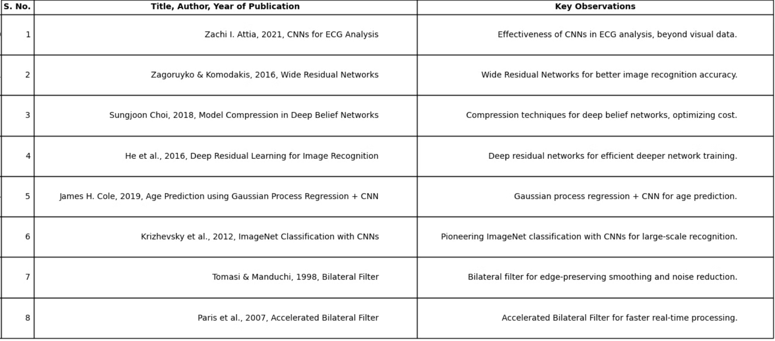
Literature Survey
Key Studies on Blurring Techniques for Image Enhancement Using Deep Learning

Slide 6
Problem Statement and Objectives
Problem Statement
Limited exploration of combined effects of Gaussian Blur and Bilateral Filtering on age and gender detection accuracy.
Research aims to assess their effectiveness in real-world conditions like noise and lighting variations.
Objectives
Objective 1: Study the impact of Gaussian Blur on age and gender detection, focusing on noise reduction and prediction performance.
Objective 2: Analyze the effect of Bilateral Filtering on edge preservation and accuracy, with emphasis on critical facial features.

Slide 7
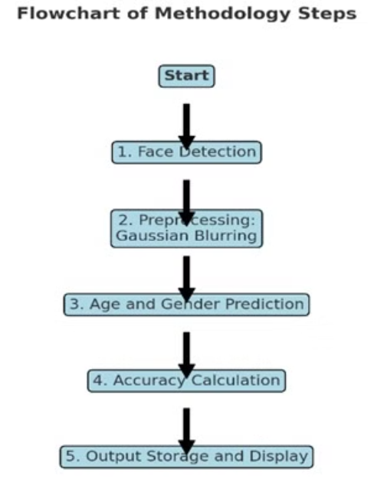
Methodology
Objective - 1:
Steps in Age and Gender Detection Using Gaussian Blurring Technique

Slide 8
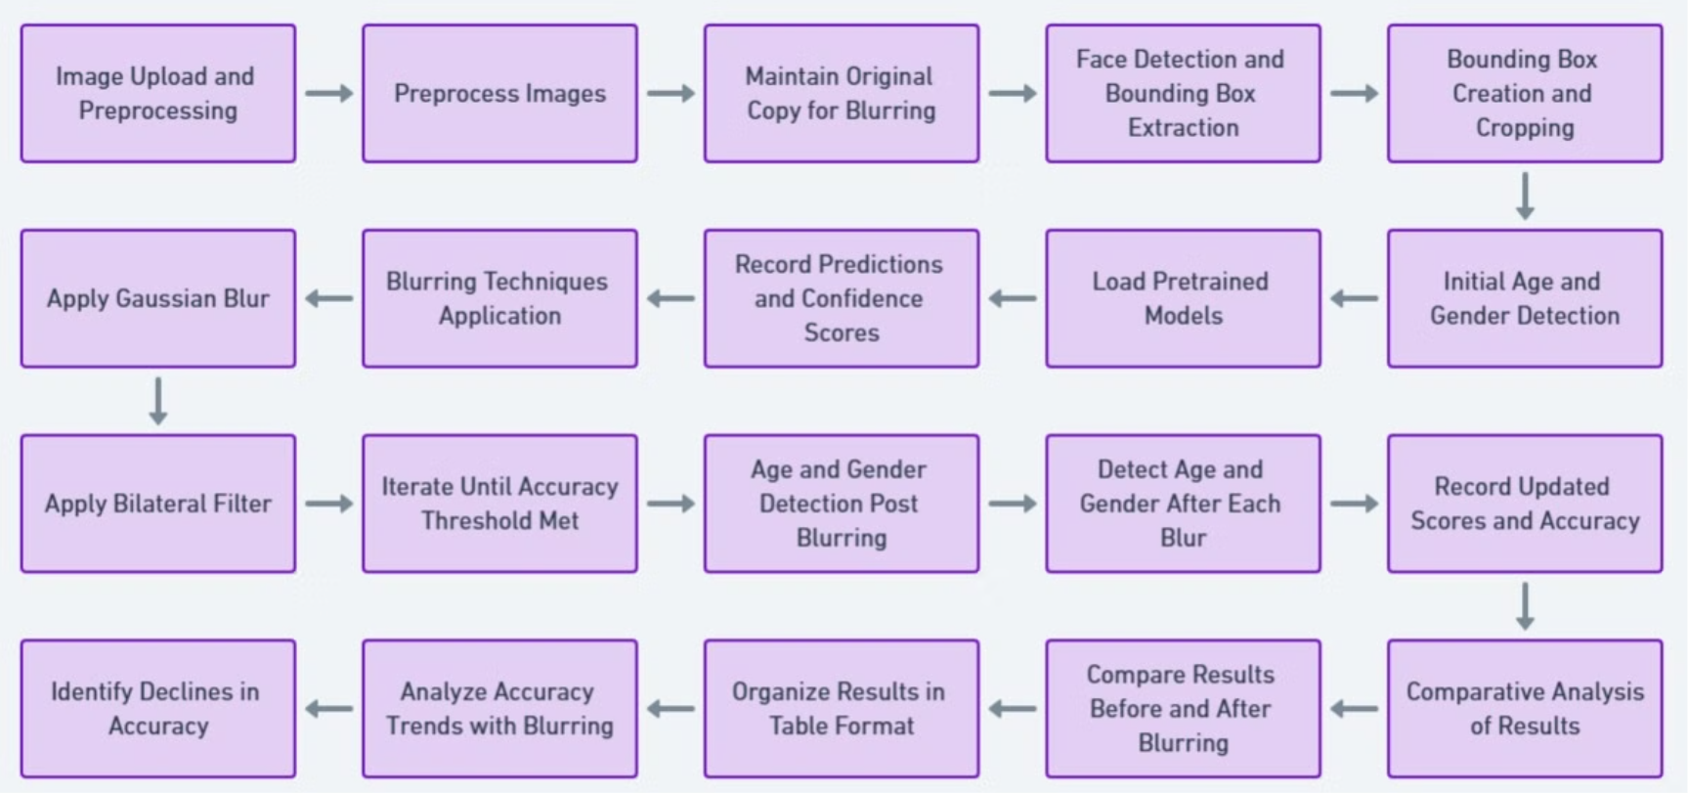

Objective - 2 :
Step-by-Step Guide to Age and Gender Detection with Image Blurring

Slide 9
Experimental Setup
Objective 1:
Packages Used:
OpenCV: Face detection, Gaussian & Bilateral Filters
TensorFlow/Keras: Pre-trained models for classification
NumPy, Matplotlib: Image manipulation & visualization
Configuration:
Model: Pre-trained CNN (e.g., VGG-16)
Image Size: 224x224 px
Preprocessing:
Optional: Grayscale conversion
Blurring Techniques: Gaussian Blur & Bilateral Filtering with varied parameters

Slide 10
Objective 2: Blurring Techniques Impact
Packages Used:
Pandas: Data organization
Seaborn: Accuracy trends visualization
Scikit-learn: Metrics calculation (Accuracy, Precision, Recall)
Blurring Parameters:
Gaussian Blur: Kernels (3x3, 5x5, 7x7), Sigma (1, 2, 3)
Bilateral Filter: Diameters (9, 15, 25), Sigma (75)
Metrics:
Accuracy, Precision, Recall: Assessed across different blur levels

Slide 11
Results and Analysis
Objective 1 - Results:
Initial Model Performance (No Blurring):
Accuracy: 60%–80% (varied with image quality: noise, background complexity).
Challenges: Variability in predictions under low lighting and complex backgrounds.
Pre-trained CNN tested on unprocessed facial images.
After Applying Gaussian Blurring:
Accuracy Increased: 70%–90% for most images.
Effective in Noisy Environments: Little improvement for already clear images.
Improved Consistency: Reduced high-frequency noise.

Slide 12
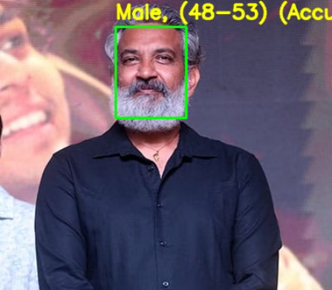

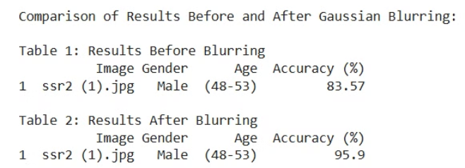
OUTPUT (Objective - 1):
Before Blurring(Gaussian):
After Blurring(Gaussian) :
Comparison of Results Before and After Gaussian Blur :

Slide 13
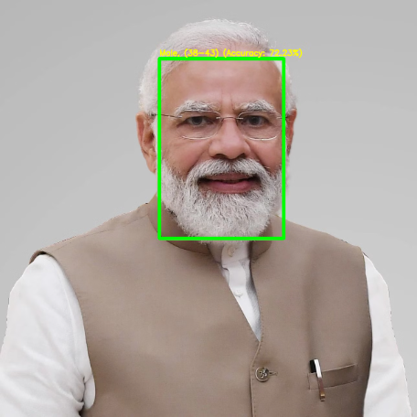
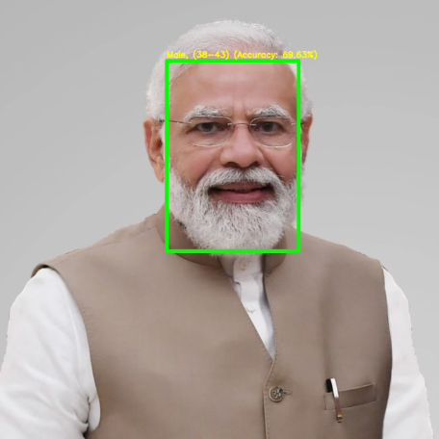
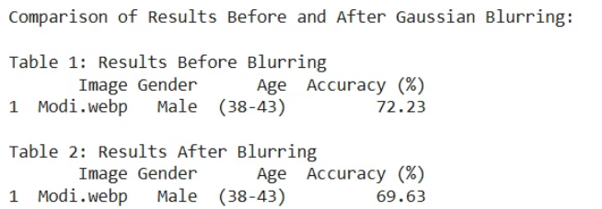
Before Blurring(Gaussian) :
After Blurring(Gaussian) :
Comparison of Results Before and After Gaussian Blur :

Slide 14
Objective 2 - Results:
Initial Accuracy (Before Blurring):
Gender Predictions: More accurate, less affected by noise.
Age Predictions: Lower accuracy for noisy or low-contrast images.
Accuracy Improvement with Blurring:
Gaussian & Bilateral Filters: Improved accuracy by 10-15%.
Bilateral Filtering: Preserved facial structure, boosting performance.
Diminishing Returns with Excessive Blurring:
Over-smoothing: Lost key facial details, reducing accuracy.
Age Predictions: More adversely affected than gender.

Slide 15

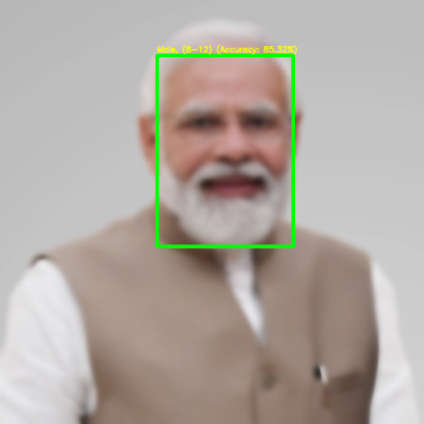
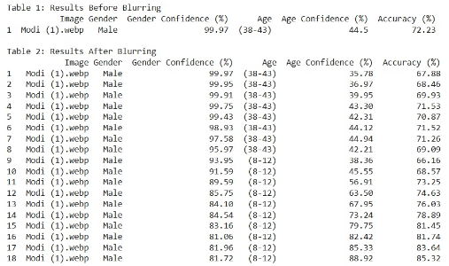
OUTPUT (Objective - 2):
Before Blurring :
After Blurring :
Comparison of results:

Slide 16
Conclusion
Built a system for age and gender prediction from facial images.
Gaussian Blur reduces noise but can blur key features.
Bilateral Filter preserves edges and reduces noise effectively.
Evaluated using accuracy and precision metrics.
Future Work
Explore advanced denoising techniques (e.g., Median Filtering).
Implement dynamic blur adaptation for varying image quality.
Investigate Vision Transformers and EfficientNet for better accuracy.

Slide 17
References
S. Choi, T. Lim, and S. Oh, "Model Compression for Deep Belief Networks by Selective Knowledge Transfer," IEEE Transactions on Neural Networks and Learning Systems, vol. 24, no. 10, pp. 1574–1585, 2019.
K. He, X. Zhang, S. Ren, and J. Sun, "Deep Residual Learning for Image Recognition," in Proceedings of the IEEE Conference on Computer Vision and Pattern Recognition (CVPR), 2016, pp. 770–778.
C. Tomasi and R. Manduchi, "Bilateral Filtering for Gray and Color Images," in Proceedings of the IEEE International Conference on Computer Vision (ICCV), Bombay, India, 1998, pp. 839–846.
A. Krizhevsky, I. Sutskever, and G. E. Hinton, "ImageNet Classification with Deep Convolutional Neural Networks," _NIPS_, vol. 25, pp. 1097–1105, 2012.
J. H. Cole et al., "Gaussian Process Regression for Age Prediction of Healthy Brains," NeuroImage, vol. 150, pp. 200–212, 2017.
G. Levi and T. Hassner, "Age and Gender Classification Using Convolutional Neural Networks," in _CVPRW_, 2015, pp. 34–42.
S. Paris, P. Kornprobst, J. Tumblin, and F. Durand, "A Gentle Introduction to Bilateral Filtering and its Applications," in _SIGGRAPH_, 2009, vol. 12, pp. 1–50.

