Slide 1

Bank Management System
This project aims to design and implement a banking system where account holders can securely access their accounts, perform transactions, and track transaction history. The focus is on using efficient data structures for managing multiple accounts and storing transaction history.

Slide 2

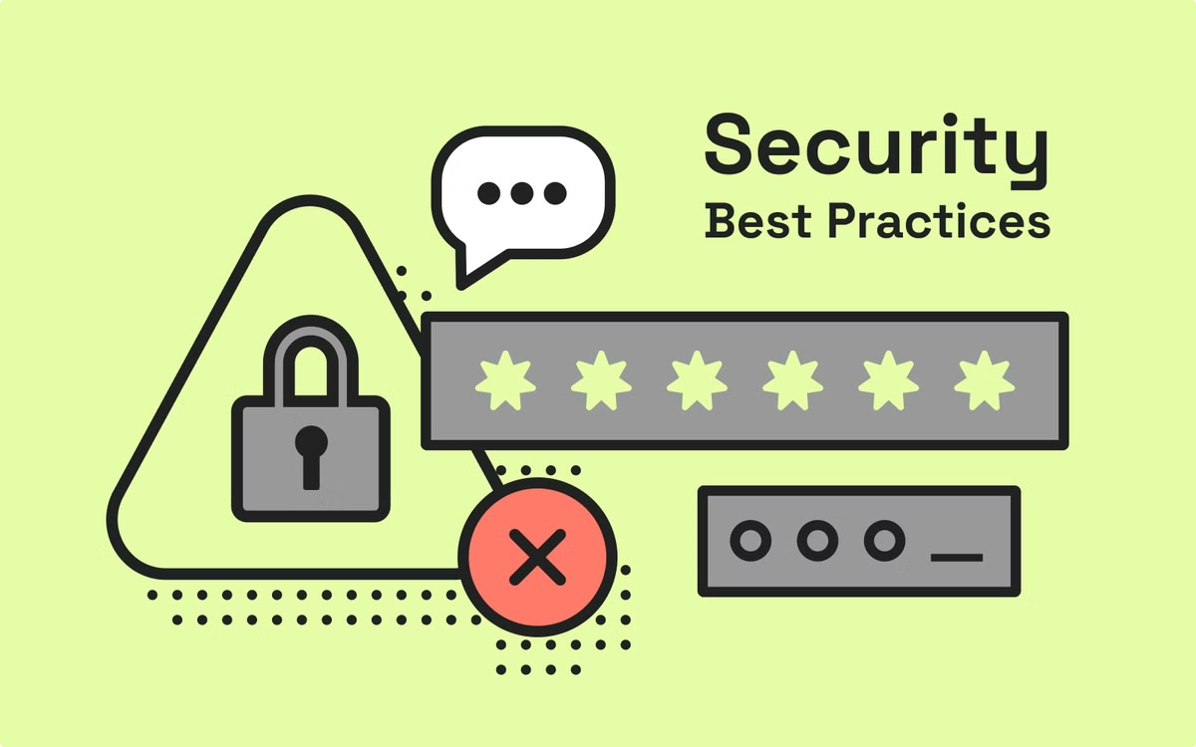

Challenges
Account Management
Banks need to manage and access multiple accounts securely and efficiently.
Secure Access
The system must ensure secure access to account details, preventing unauthorized access and protecting sensitive information.

Slide 3
Background and Motivation
Background
Modern banking systems handle millions of user accounts and transactions.
To manage this efficiently, we need to store and access account details quickly and securely.
It is essential to maintain a record of all transactions performed by users for accountability and transparency.

Slide 4
Motivation
The system needs to prioritize security, ensuring only authorized users can access account details using a token and PIN system.
Efficiency is also crucial, with the system needing to perform lookups quickly even with a large number of accounts.

Slide 5

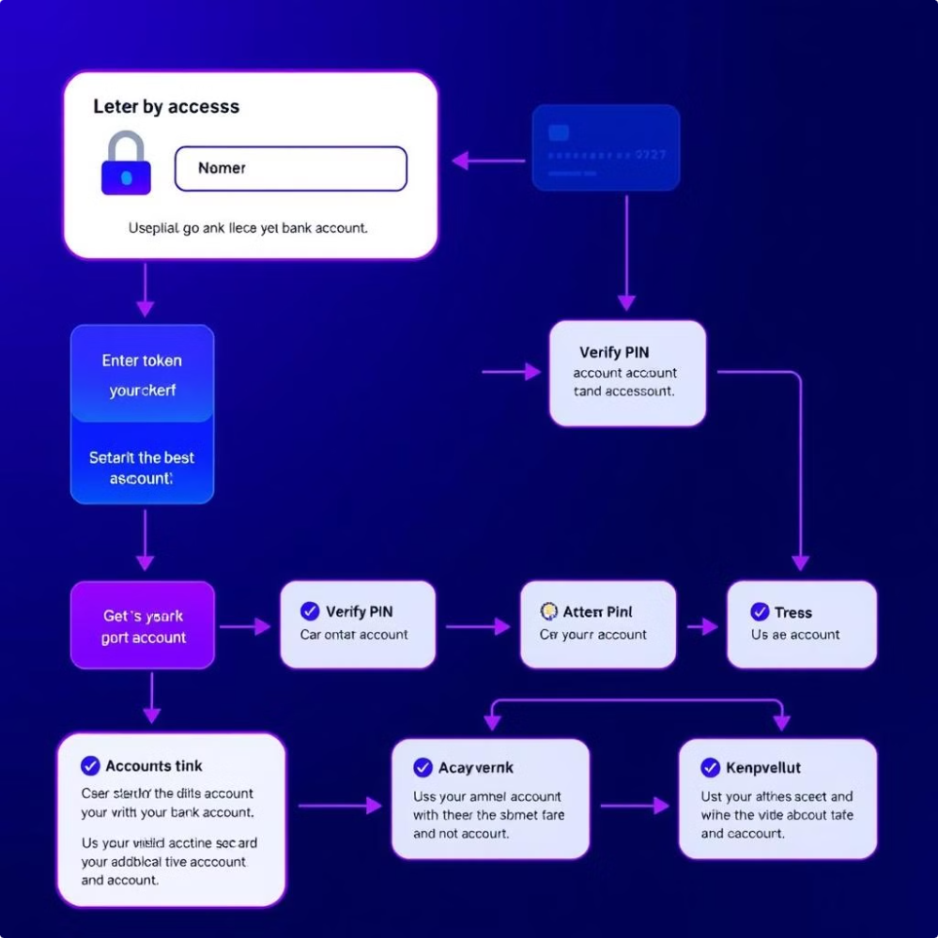
General Solution
Approach
The system utilizes maps to manage accounts, associating a unique token with each account. This allows for efficient access and retrieval of account information.
Account Class
Accounts are defined in a class with private members for name, account number, and balance.
Sensitive information can only be accessed or modified through specific public methods, enhancing security.

Slide 6




System Features
Account Creation
Users create a new account by providing details such as a token, name, account number, initial balance, and a PIN. This process ensures secure and unique account identification.
Transactions
Users can deposit or withdraw money, and each transaction will be recorded in a linked list. This provides a detailed and chronological record of all account activity.
Transaction History
Users can view their past transactions in the order they were made. This feature allows
for easy tracking and verification of account activity.

Slide 7


Data Structures Used
Map for Account Management
The system uses a unordered_map < token, class > to store account information.
Reason :
This data structure provides an average time complexity of O(1) for lookups, making it efficient to access any account by token.
This allows the system to scale to a large number of users while maintaining quick access times.

Slide 8

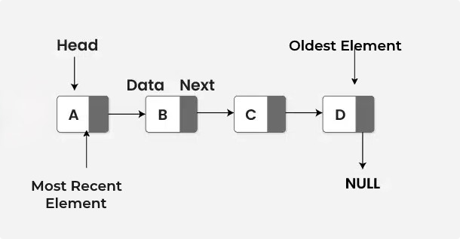
Linked List for Transaction History
Each account has a linked list to store the history of transactions (deposits and withdrawals).
Reason :
Linked lists are ideal for dynamically adding new transactions in the beginning (head).
Transaction history can grow as needed, and the order of transactions is preserved.

Slide 9

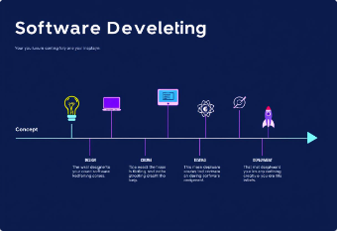
Implementation Phases
Phase 1
Create a class for accounts using unordered maps for efficient access and storage. This phase focuses on defining the account class and implementing the map for account management.
Phase 2
Implement secure access logic to validate token and PIN for account retrieval. This phase ensures secure access to accounts by verifying user credentials.
Phase 3
Use linked lists to manage and store transaction history (including deposits and withdrawals) for each account. This phase focuses on implementing the linked list for transaction history management.

Slide 10
Expected Outputs
Intuitive User Interface
Efficient System Performance
The system should provide an easy-to-navigate interface. This ensures a user-friendly experience for all users.
The system should smoothly manage multiple users and transactions, minimizing lag during account access and transactions. This ensures quick task completion with minimal waiting time.

