Slide 1
E-Commerce Customer Churn Prediction
End-to-End Machine Learning System
Pavan Teja
Data Science Project – 2026

Slide 2
Business Problem
Customer churn impacts long-term revenue
Goal: Predict churn before disengagement
Enable proactive retention strategies
Improve customer lifetime value

Slide 3
Dataset Overview
Source: UCI Online Retail II
Original Rows: 525,461
Cleaned Rows: 342,273
Final Customers: 3,059
Churn Window: 3 Months

Slide 4
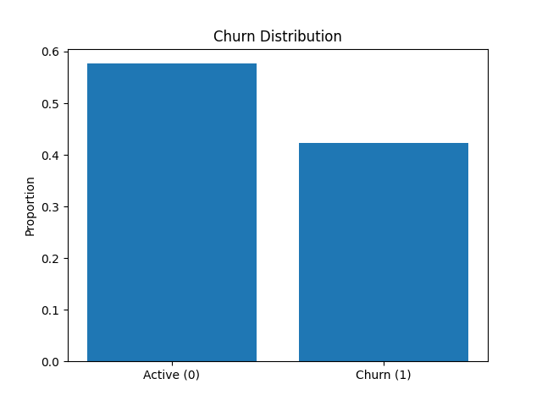
Churn Distribution

Slide 5
Feature Engineering
RFM Features (Recency, Frequency, Monetary)
Behavioral Metrics
Temporal Activity Features
Product Diversity Indicators
25+ Engineered Features

Slide 6
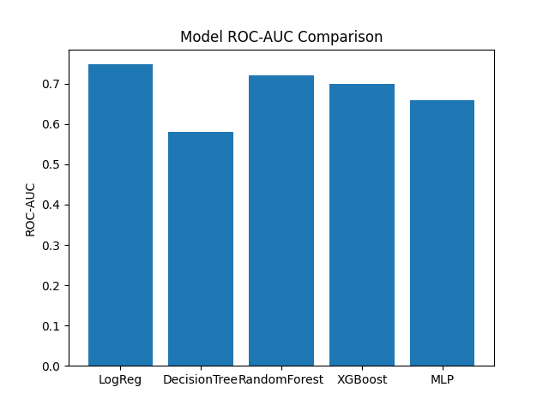
Model Performance Comparison

Slide 7
Final Model Performance
Selected Model: Logistic Regression
Accuracy: ~0.69
Precision: ~0.58
Recall: ~0.58
ROC-AUC: ~0.748

Slide 8
System Architectue
Collecting Raw Data
Data Cleaning and Preprocessing
Feature Engineering
Model Training
Model Evalution
Final/Best model selection
Streamlit App

Slide 9
Deployment
Prediction API (predict.py)
Streamlit Multi-Page Application
Docker Containerization
Deployed on Streamlit Cloud

Slide 10
Live Application Features
Single Customer Prediction
Batch CSV Upload
Dashboard Analytics
Downloadable Predictions

Slide 11
Key Learnings
End-to-End ML Pipeline Development
Impact of churn window definition
Cross-validation importance
Production-grade deployment

Slide 12
Conclusion
Full ML lifecycle implemented
Cloud deployed solution
Business-aligned churn prediction system

