Slide 1
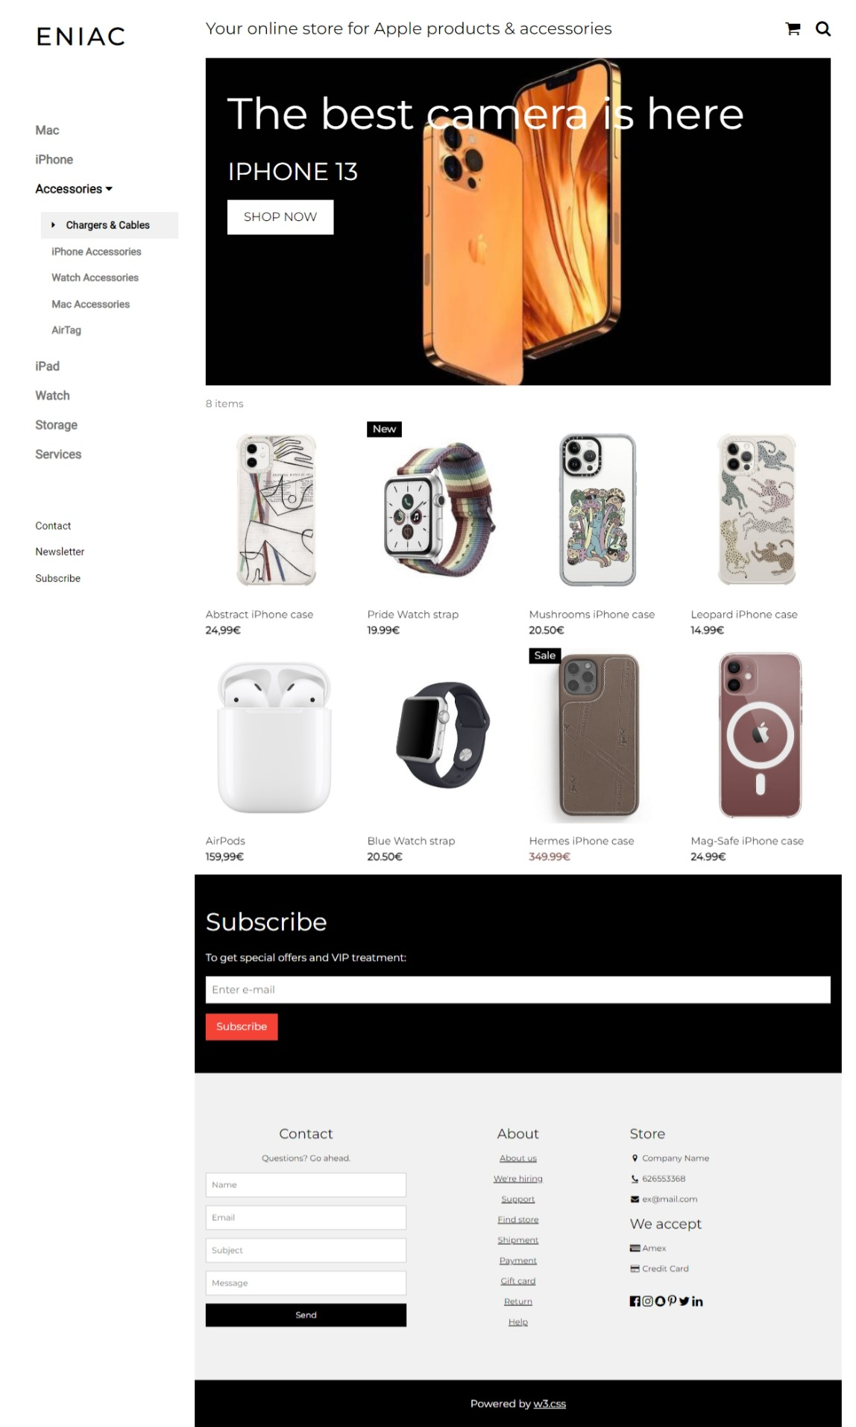
Magist - Eniac Analysis
Sales - Discounting Strategy
Published by: Pavana Kumari

Slide 2
Business Problem:
How many products are being discounted?
How large are the offered discounts as a percentage of product prices?
How do seasonality and special dates (Christmas, Black Friday) affect sales?
How should products be classified into different categories to simplify reports and analysis?
What is the distribution of product prices across different categories?
How could data collection be improved?

Slide 3
Our recommendation:
Eniac should continue discounting products with a more disciplined strategy than it uses today:
Cap discounts at a maximum of 20%.
Rebalance discounts toward high-end products and away from budget items.
Plan campaigns around the calendar.

Slide 4
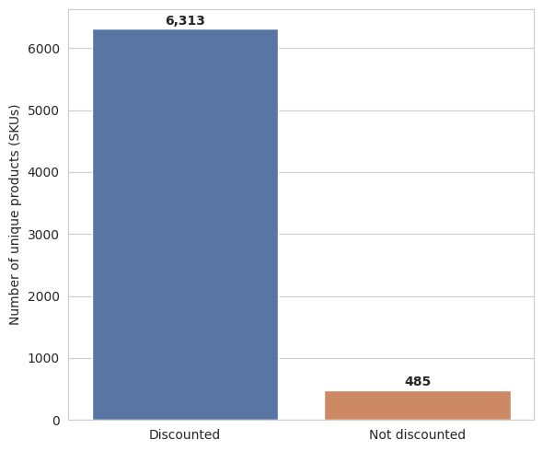
How many products are being discounted?
• 92.9% of products are discounted
• 7.1% are non-discounted
Most of the catalogue is sold at full price; only a minority of SKUs are ever discounted

Slide 5
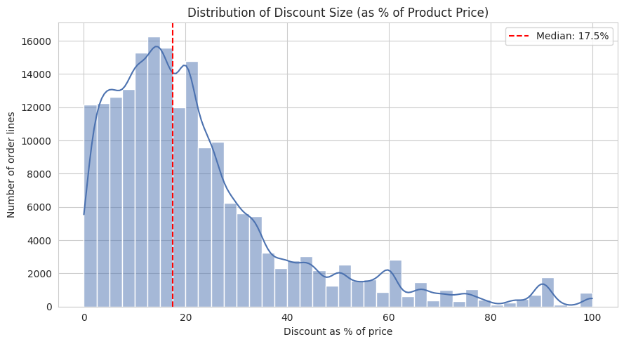
How big are the discounts?
Discount sizes cluster around 17.5% of the price, with a long tail of steeper markdowns
Most discounts are modest — small promotional nudges rather than deep clearance pricing
Outliers worth flagging separately if they're clearance/liquidation items

Slide 6
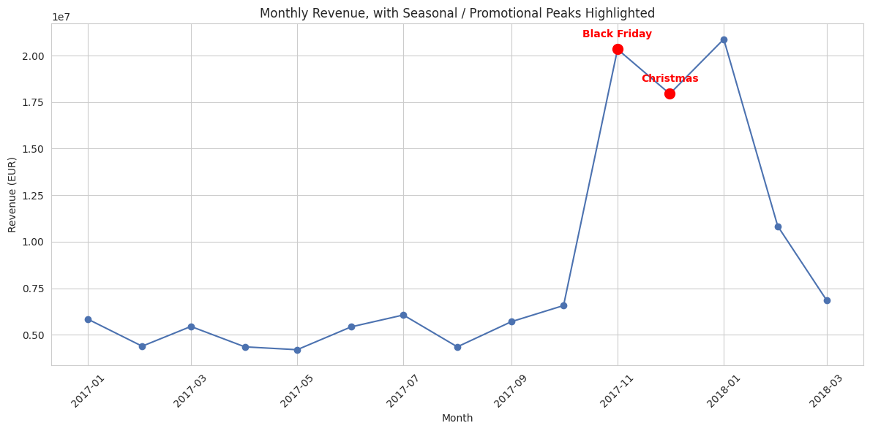
Seasonality and special dates
Revenue peaks visibly around November (Black Friday) and December (Christmas)
Business implication: inventory and staffing should be planned around these two months specifically, not spread evenly across the year
Notes:
same story for revenue. Higher discounts leads to less revenue

Slide 7
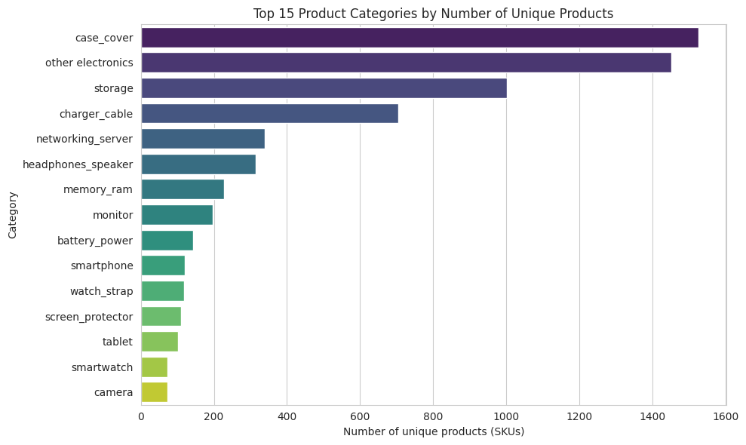
Product categorization
Top categories by product count are case_cover, other electronics, storage, and charger_cable.
Trade-off to mention: multi-category products are assigned only to their first matched tag — a modelling simplification worth flagging to stakeholders

Slide 8
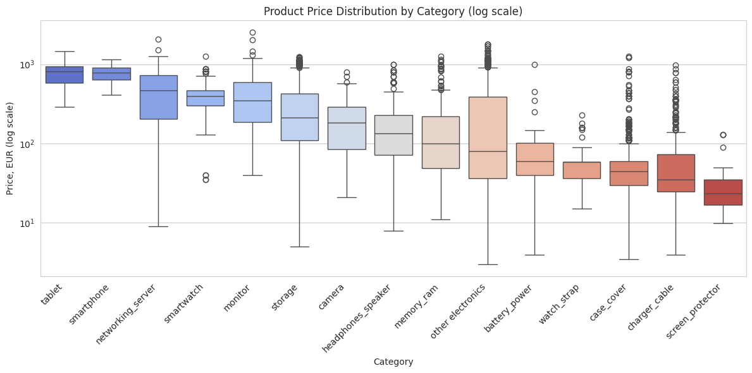
Price distribution by category
Price ranges vary enormously by category — from accessories at a few euros to smartphones/laptops in the hundreds
Useful for pricing strategy and category-level margin analysis

Slide 9
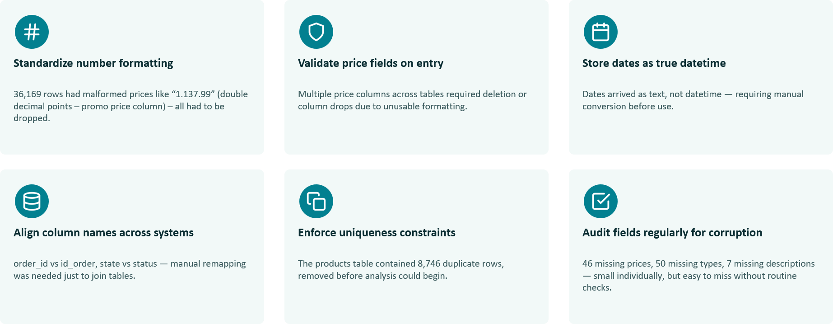
Data collection improvements

Slide 10
Recommendation:
Based on the overview of discounts and performance of different product categories, a discount cap at 20% is recommended.
Budget items already receive the highest discount yet generate the least revenue; high-end items are barely discounted despite producing half of the revenue.
Demand varies by calendar, like Black Friday and holidays, so plan campaigns around the calendar.
Eniac’s should go to Discount Strategy

