Slide 1

ENTITY PULSE
Presented by
T Jayashree Indrani
G579
23BD1A051Z

Slide 2
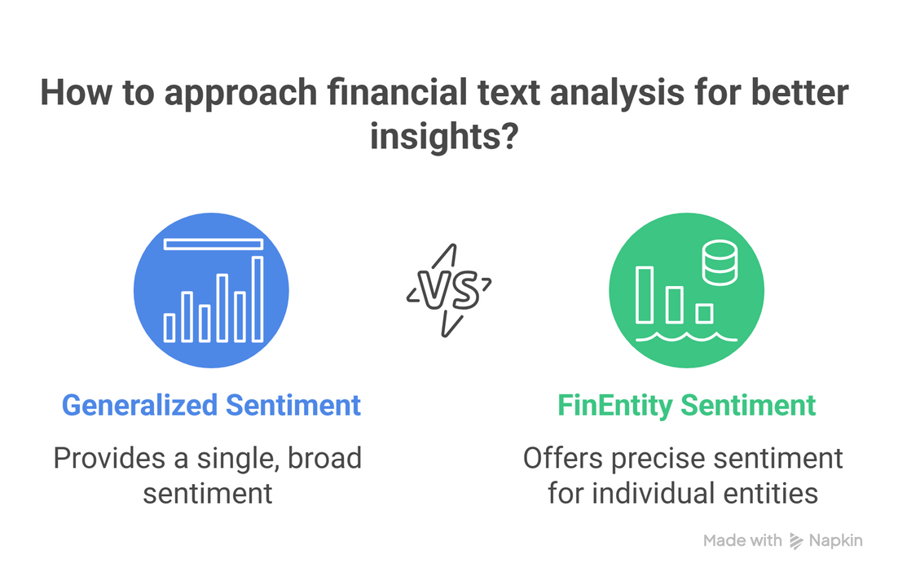
PROJECT OVERVIEW
The project aims to interpret sentiments from financial news by identifying how individual companies, sectors, or assets are portrayed within a text.
PROBLEM IN EXISTING SYSTEMS
PROPOSED SOLUTION
Most financial sentiment tools read the headline, not the story.
They capture the overall tone of a news piece, missing how each company or stock is individually portrayed.
Financial news often mentions multiple entities with opposite sentiments, reducing accuracy.
Example: “Apple’s stock climbed, while Google and Spotify saw slight declines.”
Positive for Apple, Negative for Google and Spotify.
A model that detects each financial entity in news text and determines whether the sentiment toward it is Positive, Neutral, or Negative.

Slide 3
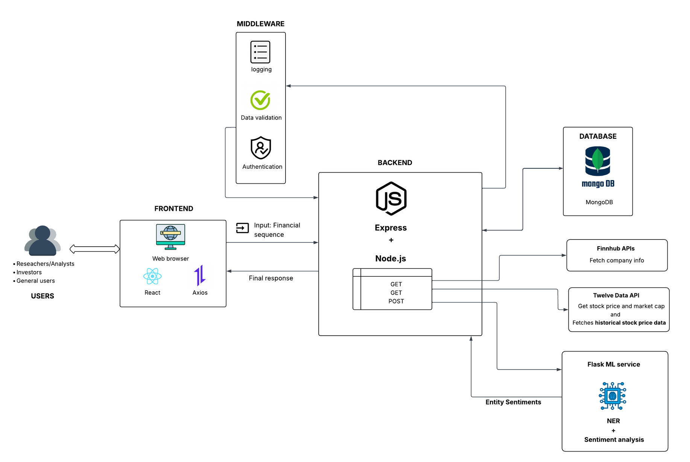
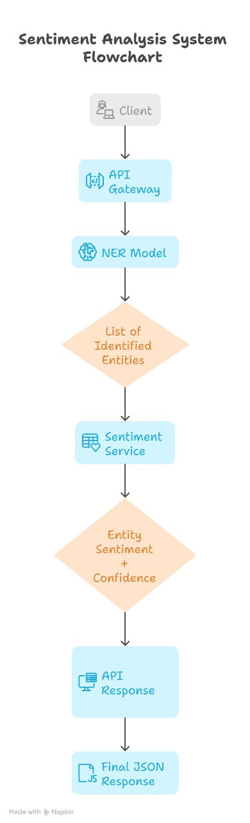
ARCHITECTURE DIAGRAM
SENTIMENT ANALYSIS FLOWCHART

Slide 4


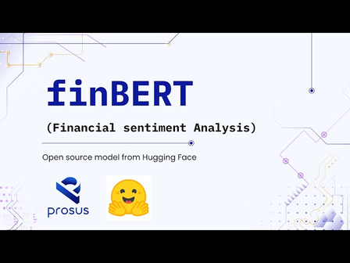






TECHNOLOGY STACK
Programming Languages: Python, JavaScript (Node.js)
Libraries & Frameworks: PyTorch, Hugging Face Transformers, SeqEval, NumPy, Pandas, Express.js, React.js
Development Tools: Jupyter Notebook, Visual Studio Code (VS Code), GitHub
Databases: MongoDB
External APIs: Finnhub API, Twelvedata API
Deployment Platforms: Flask API, Node.js + Express Backend, GitHub Repository

Slide 5
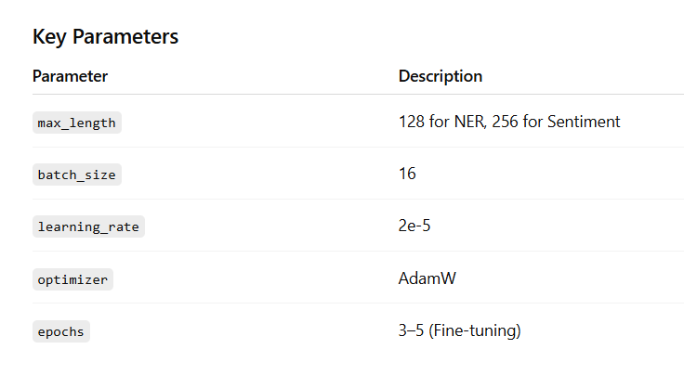
Importance of FinEntity in This Research
MODEL SIGNIFICANCE
FinBERT Backbone: captures domain-specific financial embeddings.
Classification Head: converts embeddings into entity/sentiment labels.
Softmax Layer: provides interpretable probability scores for predictions
Feature | Traditional Dataset | FinEntity
Sentiment-Scope | Entire Sentence | Each financial Entity
Entity Identification | Often missing | Precise BILOU tagging
Domain | General Text | Finance specific
Output | One sentiment for each input | Multiple sentiments for each sentence
KEY PARAMETERS

Slide 6

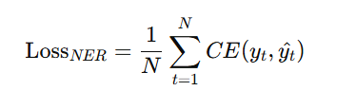
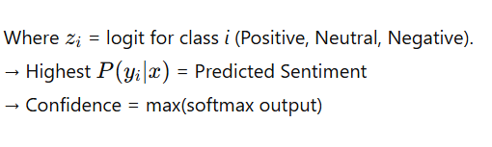
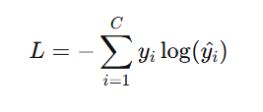
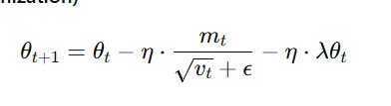
MATHEMATICAL FOUNDATION
Softmax Function for Sentiment Probabilities
NER Sequence Labeling Objective
Each token is labeled using the BILOU scheme → B (Beginning), I (Inside), L (Last), U (Unit), O (Outside).
Cross-Entropy Loss (used during fine-tuning)
AdamW (Weight Decay Optimization)
Ensures the model minimizes misclassification between true and predicted sentiments.
It’s an improved version of Adam that adds weight decay (λ) to reduce overfitting.

Slide 7
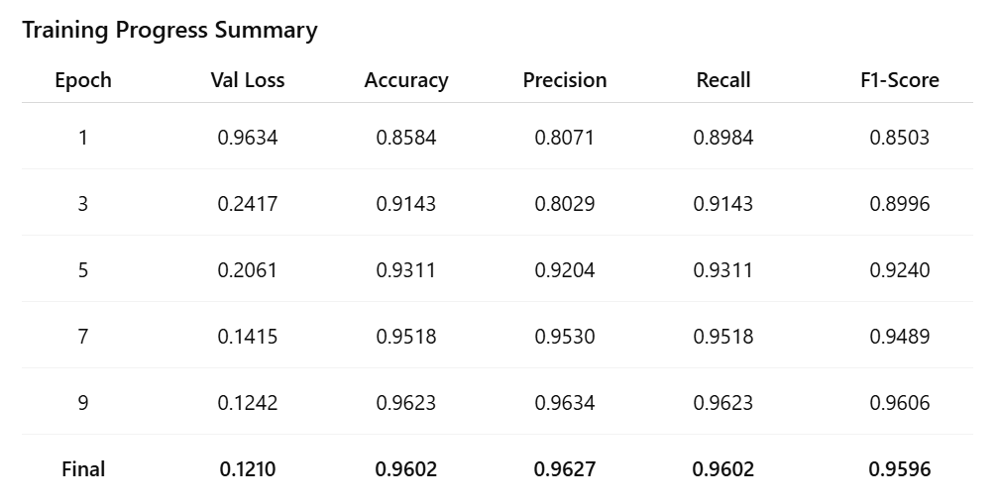
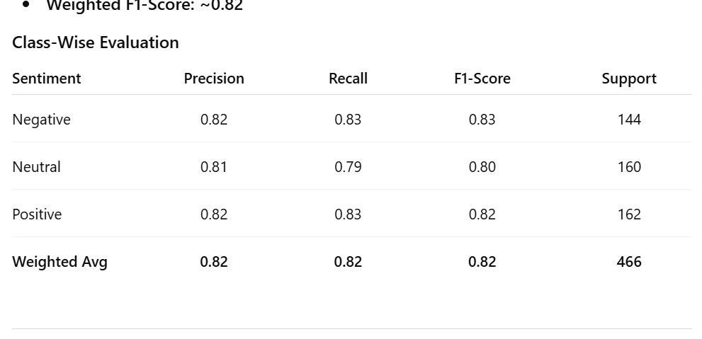
PERFORMANCES METRICS
NER Model Performance (FinBERT Token Classifier)
Validation Loss reduced from 0.96 → 0.12
Accuracy reached 96.02%
F1-Score: 0.9596
Demonstrates strong entity tagging without a CRF layer.
Model generalized well - no overfitting observed.
Sentiment Classification Model - FinBERT Sequence Classifier
Final Training Loss: ~0.86
Validation Loss: ~1.24
Final Accuracy: ~82%
Weighted F1-Score: ~0.82

Slide 8
KEY LEARNINGS
REAL-WORLD APPLICATIONS
Gained practical experience in fine-tuning FinBERT for entity-level sentiment analysis.
Understood the importance of BILOU tagging for precise entity recognition.
Learned to integrate Flask (ML model) with Node.js backend for seamless communication.
Improved skills in evaluating NLP models using accuracy, loss, and F1-score metrics.
Realized the impact of domain-specific datasets (like FinEntity) on model performance.
Helps investors track sentiment on companies and assets.
Assists regulators in monitoring financial risks and trends.
Supports analysts in understanding global market behavior.
Aids media and fintech in summarizing large-scale news sentiment.
Useful for cryptocurrency trend and price prediction.
LIMITATIONS OF IMPLEMENTATION
Works only on English financial texts; lacks multilingual support.
Requires high computational resources for model fine-tuning.
Limited training data can affect generalization on unseen domains.
Current version lacks aspect-level sentiment interpretation.

Slide 9






CHALLENGES FACED & RESOLUTIONS
1.High Requirements
2. Annotation Mismatch
3. CORS and Timeout
4. Dataset Incompatibility
5. Overfitting
Reduced batch size optimizes GPU usage
Offset mapping ensures proper label alignment
CORS middleware optimizes request payloads
Custom script maps entity spans
Dropout layers prevent overfitting
RESEARCH CONTRIBUTIONS AND PLANNED IMPROVEMENTS
We plan to extend our model to handle multilingual financial texts, so it can analyze news from global markets, not just English sources.
We also aim to add aspect-level sentiment detection to identify what specifically drives each sentiment, like product growth, market changes, or company performance, making the analysis more detailed and useful.

Slide 10
LIVE DEMO

Slide 11
THANK YOU

