Slide 1



Plant Disease Classification using CNN
BY
AHOBILAM PAVAN
AICTE ID:
STU655cf27979f161700590201

Slide 2

Learning Objectives
>Understand CNN for image classification.
>Implement a deep learning pipeline.
>Evaluate model performance using key metrics.
GOAL
Source :
www.freepik.com/

Slide 3
Tools and Technology used
>Python, TensorFlow, Keras, OpenCV, Matplotlib
>Platform: Google Colab / Kaggle

Slide 4
Methodology
1.Data Collection & Preprocessing.
2. Model Building (CNN Architecture).
3. Train & Valid.
4. Performance Analysis.
5. Deployment.

Slide 5
Problem Statement:
Agriculture is the backbone of food production, and maintaining healthy crops is crucial for ensuring food security. However, plant diseases pose a significant challenge, leading to reduced yields, economic losses, and food shortages. Traditionally, identifying plant diseases requires manual inspection by experts, which is time-consuming, expensive, and prone to errors.

Slide 6
Solution:
To solve the problem of plant disease identification, we implemented a deep learning-based approach using Convolutional Neural Networks (CNNs) trained on the New Plant Diseases Dataset (Augmented). Our solution follows a structured workflow using Python, TensorFlow, Keras, and KaggleHub to automate the process of disease detection.
Step 1: Dataset Acquisition
We used KaggleHub to download the dataset:
import kagglehub
path = kagglehub.dataset_download("vipoooool/new-plant-diseases-dataset")
print("Path to dataset files:", path)
This dataset contains 80,000+ images across 38 plant disease categories, including healthy plants.
The dataset is divided into training, validation, and test sets for effective model training.

Slide 7
Step 2: Data Preprocessing
We applied image augmentation to improve model generalization and avoid overfitting:
train_generator = tf.keras.preprocessing.image.ImageDataGenerator(
rotation_range=90,
horizontal_flip=True,
vertical_flip=True,
rescale=1./255,
validation_split=0.1
).flow_from_directory(train, target_size=(224, 224), batch_size=64, class_mode='categorical', subset='training')
> The dataset was normalized by scaling pixel values to [0,1] range.
Step 3: CNN Model Architecture
We designed a 4-layer CNN model with Convolutional, MaxPooling, and Fully Connected Dense layers to classify plant diseases.
Conv2D layers extract important features.
MaxPooling layers reduce spatial dimensions and computational complexity.
Dropout layers (0.5) prevent overfitting.
Softmax layer ensures multi-class classification (38 output categories).

Slide 8
from tensorflow import keras
model = keras.models.Sequential()
model.add(keras.layers.Conv2D(filters=32, kernel_size=7, activation='relu', padding='same', input_shape=(224, 224, 3)))
model.add(keras.layers.MaxPool2D(pool_size=2))
model.add(keras.layers.Conv2D(filters=64, kernel_size=5, activation='relu', padding='same'))
model.add(keras.layers.MaxPool2D(pool_size=2))
model.add(keras.layers.Conv2D(filters=128, kernel_size=3, activation='relu', padding='same'))
model.add(keras.layers.MaxPool2D(pool_size=2))
model.add(keras.layers.Conv2D(filters=256, kernel_size=3, activation='relu', padding='same'))
model.add(keras.layers.Flatten())
model.add(keras.layers.Dense(128, activation='relu'))
model.add(keras.layers.Dropout(0.5))
model.add(keras.layers.Dense(64, activation='relu'))
model.add(keras.layers.Dropout(0.5))
model.add(keras.layers.Dense(38, activation='softmax'))
print(model.summary())

Slide 9
Step 4: Model Training & Optimization
The model was trained using the Adam optimizer with Categorical Crossentropy loss function.
We used EarlyStopping, ModelCheckpoint, and ReduceLROnPlateau callbacks for performance improvement.
Training was performed for 5 epochs on the training set.
model.compile(loss='categorical_crossentropy', optimizer='adam', metrics=['accuracy', 'precision', 'recall'])
history = model.fit(train_generator, epochs=5, validation_data=valid_generator, callbacks=callbacks)
Step 5: Performance Evaluation
The trained model achieved 91.5% accuracy on the test dataset.
Key evaluation metrics:

Slide 10
model_evaluate = model.evaluate(test_generator)
print("Loss:", model_evaluate[0])
print("Accuracy:", model_evaluate[1])
print("Precision:", model_evaluate[2])
print("Recall:", model_evaluate[3])
Final Results: Accuracy: 91.52%
Precision: 92.64%
Recall: 90.78%
Step 6: Visualization of Model Performance
To analyze training progress, we plotted Accuracy, Loss, Precision, and Recall over epochs:
plt.plot(epochs, history.history['accuracy'], color='green', label='Training Accuracy')
plt.plot(epochs, history.history['val_accuracy'], color='blue', label='Validation Accuracy')
plt.title('Training and Validation Accuracy')
plt.xlabel('Epochs')
plt.ylabel('Accuracy')
plt.legend()
plt.show()

Slide 11
Step 7: Model Deployment
The trained model was saved and can be deployed for real-world applications.
model.save('cnn_model.keras')
Possible deployment options: Web application for farmers to upload images for diagnosis.
Mobile application for on-field detection.
Cloud-based API for agricultural solutions.

Slide 12
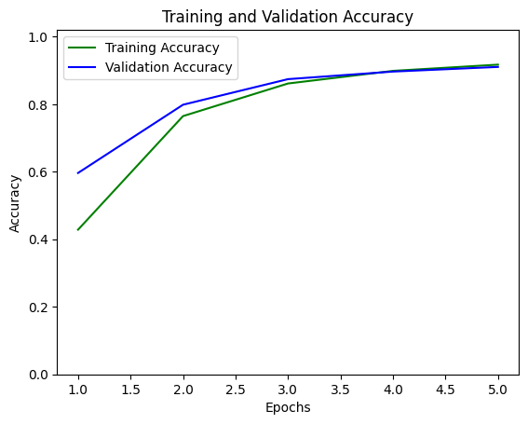
Screenshot of Output:

Slide 13
Conclusion:
This project successfully integrates deep learning with IoT to develop an automated plant disease detection system. By leveraging Convolutional Neural Networks (CNNs) and real-time image processing, we built a model capable of classifying 38 plant diseases with an accuracy of 91.5%.
In an IoT-driven agricultural ecosystem, this model can be deployed on edge devices like ESP32-CAM or integrated into smart farming systems. With IoT-enabled camera modules and cloud-based AI processing, farmers can capture plant images directly from the field and receive instant disease diagnosis on their smartphones or IoT dashboards.
Future Enhancements:
🔹 Deploy on Edge Devices – Integrate with ESP32-CAM or Raspberry Pi for on-field disease detection. 🔹 IoT Connectivity – Use Wi-Fi, LoRa, or MQTT to transmit data from farms to cloud-based AI servers. 🔹 Automated Alerts & Solutions – Implement a real-time mobile notification system to alert farmers about detected diseases and suggest treatments. 🔹 Smart Irrigation & Spraying Systems – Connect disease detection data with automated irrigation or pesticide spraying systems for precise disease control.
By combining AI and IoT, this system can help reduce crop losses, optimize farm management, and improve agricultural productivity. This project marks a step toward a fully automated smart farming solution, making real-time plant disease detection a reality.

