Slide 1

Presentation on
How Computers Learn to Make Decisions:
The Power of Conditional Statements
Presented by :
Deekonda Pavan
Batch no: 522

Slide 2

About me
Background:
I completed my MBA from Lingaya’s Vidyapeeth University
Why you want to learn Data Science:
I want to build a career in Data Science and use data to solve real-world problems.
LinkedIn : https://www.linkedin.com/in/pavandeekonda/
Github : https://github.com/Pavandeekonda

Slide 3
Agenda
Introduction to Conditional Statements
Objective of the Topic
Key Concepts
Types of Conditional Statements
Flowchart Representation
Real-World Examples
Applications (Use Cases)
Advantages & Challenges
Conclusion
Experience / Challenges
Q&A

Slide 4
Introduction to Conditional Statements
Conditional statements are used to make decisions in programming
They allow different actions based on conditions
They evaluate expressions that return True or False
Help in controlling the execution flow of programs
Real-life example:
If it rains → take umbrella
Else → don’t take umbrella
Programming example:
If marks ≥ 40 → Pass
Else → Fail

Slide 5
Objective of the Topic
To understand the concept of conditional statements
To learn how programs make logical decisions
To explore different types like if, else, elif, nested if ,Ternary Method
To implement conditional logic using examples
To apply these concepts in real-world and data science problems

Slide 6
Key Concepts
Condition → Expression that returns True/False
Comparison Operators → >, <, ==, !=, >=, <=
Logical Operators → AND, OR, NOT
Boolean Values → True, False
Arithmetic Operators → +, -, *, / (used within conditions)
Control Flow → Order of execution

Slide 7
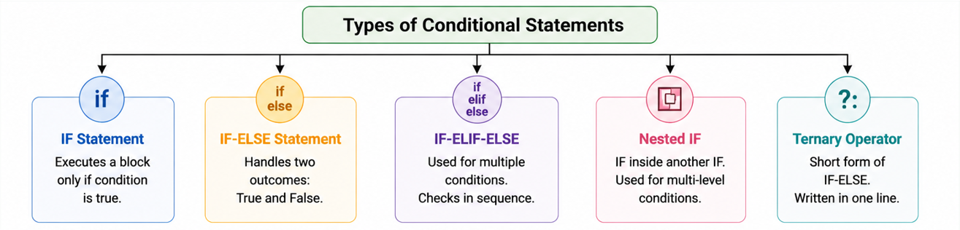
Types of Conditional Statements
IF Statement → Executes when condition is true
IF-ELSE Statement → Handles both true and false cases
ELIF Ladder → Checks multiple conditions step by step
Nested IF → IF inside another IF for complex logic
Ternary Operator → Short form of IF-ELSE

Slide 8
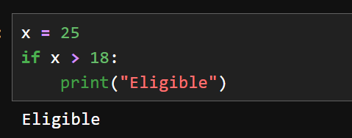
IF Statement
Simplest conditional statement
Executes only when condition is true
No action taken if condition is false
Used for single condition checking

Slide 9
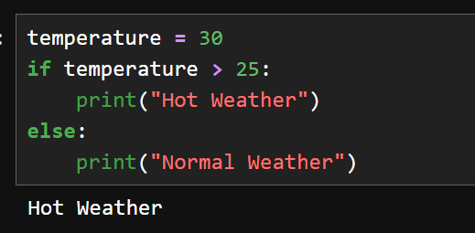
IF-ELSE Statement
Used when there are two possible outcomes
One block executes if condition is true
Another block executes if condition is false
Ensures one block always runs

Slide 10
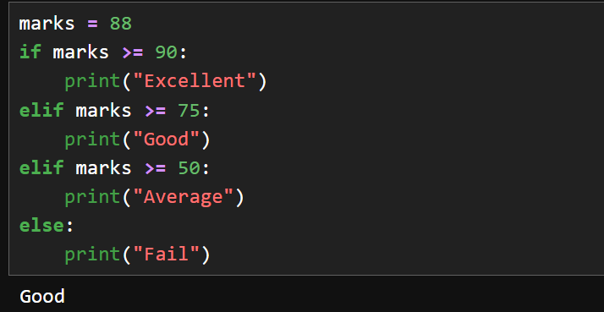
ELSE-IF (ELIF Ladder)
Used for multiple conditions
Conditions are checked one by one
First true condition is executed
Avoids writing multiple separate IF statements

Slide 11
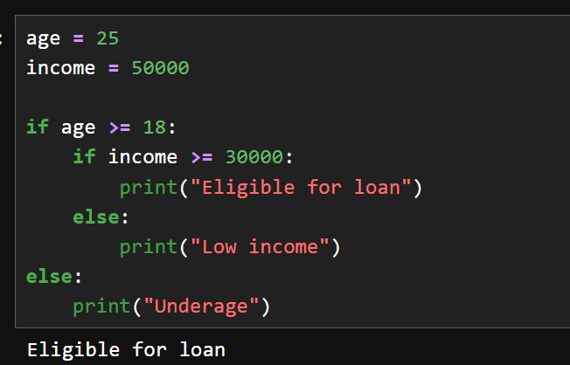
Nested IF
IF statement inside another IF
Used when decisions depend on multiple levels
Useful in real-world logic systems
Increases complexity but powerful

Slide 12
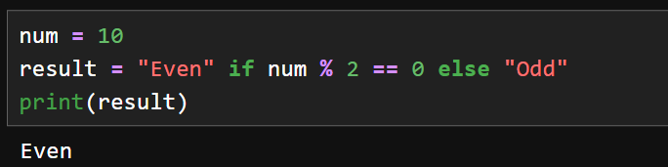
Ternary Operator
Expressing IF-ELSE in a single line
Used for simple conditions
Improves code readability for small logic

Slide 13
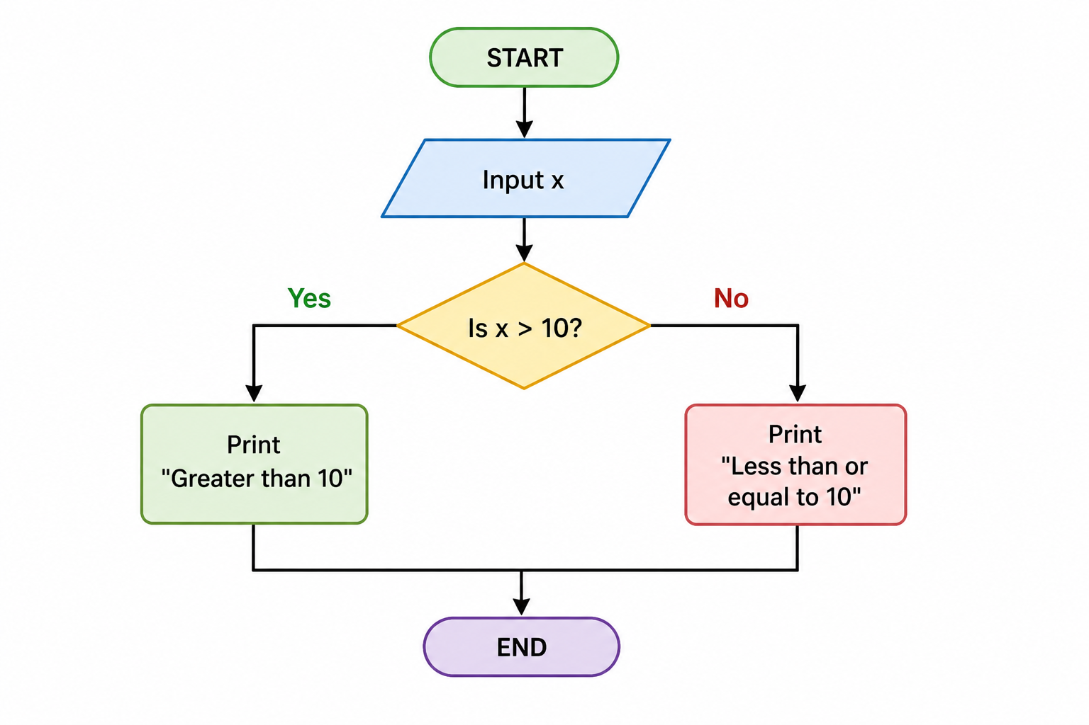
Flowchart Representation of Conditional Statement
Shows how a program checks a condition and follows different paths
If condition is true → one action, else → another action

Slide 14
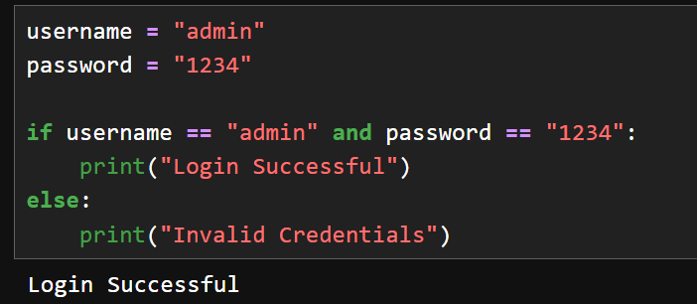
Real-World Example – Login System
In daily bases we will be seeing every where in the offices the login system (we will be having biometrics or enter the password or scanning ).
So when the user enters the correct password based on his user name then only he will get a login successful message other wise it give the warning invalid credentials

Slide 15
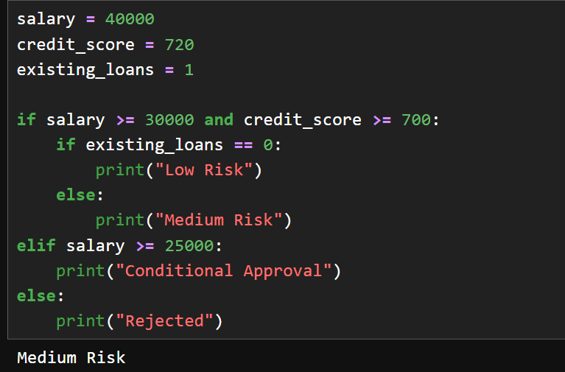
Real-World Example – Loan Eligibility
In daily life, when we apply for a loan in a bank, the system does not approve it directly. It checks multiple factors like salary, credit score, and existing loans.
If all conditions are satisfied, the loan is approved; otherwise, it may be rejected or approved with conditions.

Slide 16
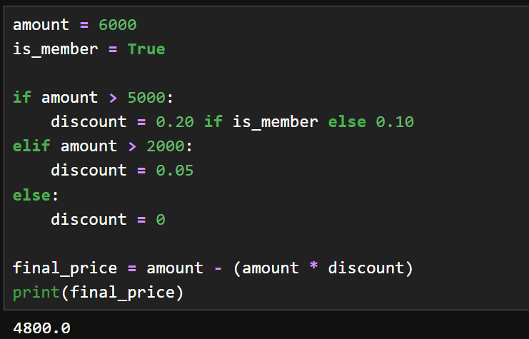
Real-World Example – E-commerce Discount
In online shopping websites, discounts are not the same for every customer.
The system checks conditions like purchase amount and membership status.
Based on these conditions, it applies different discounts and calculates the final price.

Slide 17
Applications (Use Cases)
Login authentication systems
ATM transactions
Loan approval systems
E-commerce pricing and discounts
Customer segmentation in data science
Fraud detection systems
AI/ML decision making

Slide 18
Advantages
Enables decision making
Controls execution flow
Improves logical thinking
Makes programs dynamic
Easy to implement

Slide 19
Challenges
Writing correct conditions
Logical errors
Complex nested logic
Debugging difficulty
Maintaining readability

Slide 20
Conclusion
Conditional statements are fundamental in programming
They allow programs to make intelligent decisions
Widely used in real-world applications
Important for data science and software development

Slide 21
Experience / Challenges
Initially struggled with logic building
Nested conditions were confusing
Speaking in English was challenging
Improved through practice and examples
Gained confidence in explaining concepts

Slide 22


Slide 23


