Slide 1


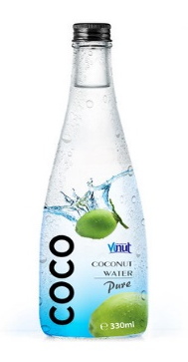
coconari
Sri Lanka’s No.1 Coco water Suppliers
Home | Products | About Us | Contact Us
Cash On Delivery
100 ml
250 ml
Price : Rs.300.00
Price : Rs.575.00
View More…

Slide 2
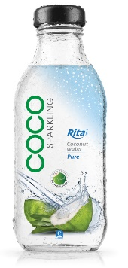
Our Products
coconari
Home | Products | About Us | Contact Us
100 ml
250 ml
500 ml
1 L
Price : Rs.200.00
Price : Rs.375.00
Price : Rs.750.00
Price : Rs.1450.00
View
View
View
View

Slide 3

Product review
coconari
Home | Products | About Us | Contact Us
Description.
01
02
03
04
05
Price : Rs.750.00
Cash On Delivery. (Island wide free delivery within one week)
500 ml
Back
Order Now

Slide 4
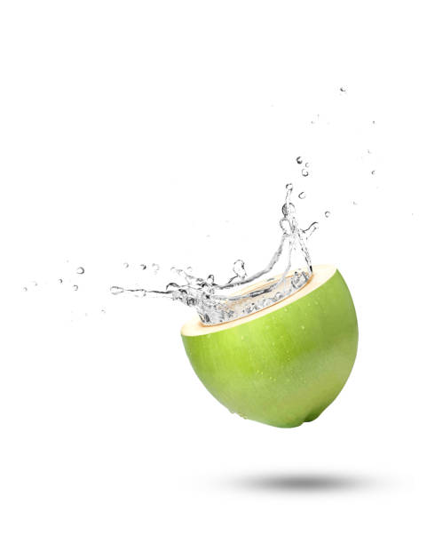
Login
coconari
Home | Products | About Us | Contact Us
Username :
Password :
SIGN IN
Create your own account.

Slide 5
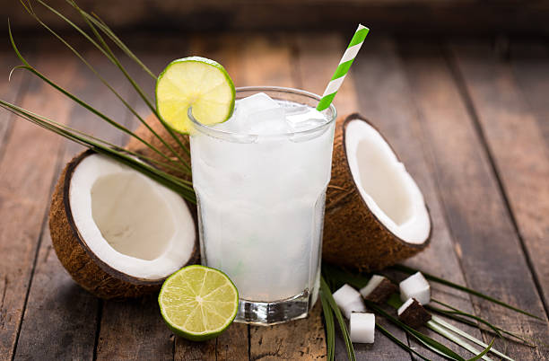
ABOUT US
coconari
Home | Products | About Us | Contact Us
WHO WE ARE

Slide 6



CONTACT US
coconari
Home | Products | About Us | Contact Us
VISIT US
CALL US
CONTACT US
Coconari pvt(ltd), Near Southern Express Way Entrance, Baddegama, Galle.
+94754332480
+94773443963
paanigamya2001@gmail.com
paanigamya98@gmail.com

Slide 7



