Slide 1
Website Live Visitor Tracking System
Cloud Computing project Group 6
Vishnuvivek Balya(700747108)
Yerramilli Srivalli Vaishnavi(700741755)
Padarthi Pavani Sri(700741955)
Deepak Reddy Mailuru(700740099)

Slide 2
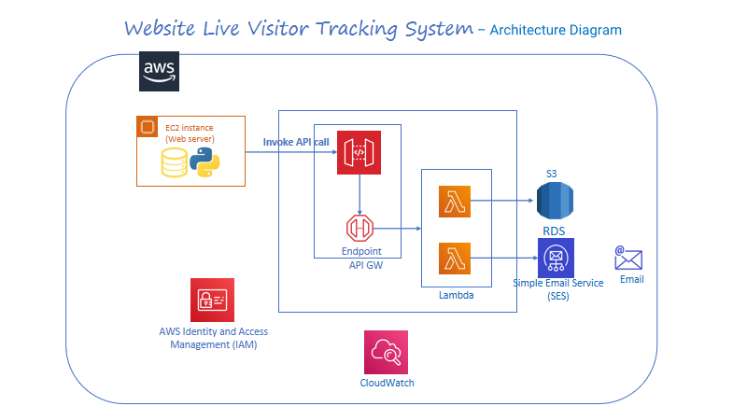
Website

Slide 3
Project Overview :
A live visitor tracking system for your website can be valuable in creating a cohesive and revenue-generating engine that accelerates sales growth. By collecting and analyzing data from the system, you can identify which content is attracting potential customers, how visitors are finding your website, and which of your marketing campaigns are generating the most attention. This information can then be used to diagnose any issues and make improvements to optimize your sales strategy.
To integrate with the backend system, the application will use an API that will be created and published using API Gateway. Requests to the API Gateway will then be forwarded to Lambda for processing.
The application has been built using HTML, CSS & JS and it is being hosted on S3.
When comes to Database we are using MySQL to store all the generated data.

Slide 4
Services Used:
AWS API GW
AWS SES
AWS S3
AWS Lambda
AWS IAM
AWS Kenesis
AWS Cloud Watch
AWS RDS

Slide 5
AWS API GW – Through APIs, applications can gain access to data from backend services. It acts as an intermediate for these requests, allowing for secure and efficient communication between the application and backend systems.
AWS Lambda - AWS Lambda is a service that enables you to run code for various types of applications or backend services without the need to manage servers, making it a serverless and event-driven computing solution. It provides a flexible and scalable way to execute code based on events and requests, allowing you to focus on writing and deploying your code, rather than managing infrastructure.
AWS CloudWatch - CloudWatch is an Amazon Web Services (AWS) service that collects and stores monitoring and operational data in various forms such as logs, metrics, and events.
AWS SES - Amazon Simple Email Service (SES) is a versatile and cost-effective email service that provides the capability to send emails from within any application in a scalable and flexible manner.
AWS IAM - AWS Identity and Access Management (IAM) is a powerful web service that allows you to manage access to your AWS resources in a secure and scalable way.
AWS RDS - Amazon RDS is a comprehensive suite of managed services that simplifies the process of setting up, managing, and scaling databases in the cloud.
AWS S3 - A object storage solution with remarkable scalability, dependability, data availability, security, and performance is Amazon Simple Storage Solution (Amazon S3).
AWS Kenesis- is a highly scalable, cloud-based service that enables real-time processing of large volumes of streaming data per second. It is specifically designed for real-time applications and provides developers with the ability to ingest any amount of data from multiple sources while scaling up or down as needed.

Slide 6
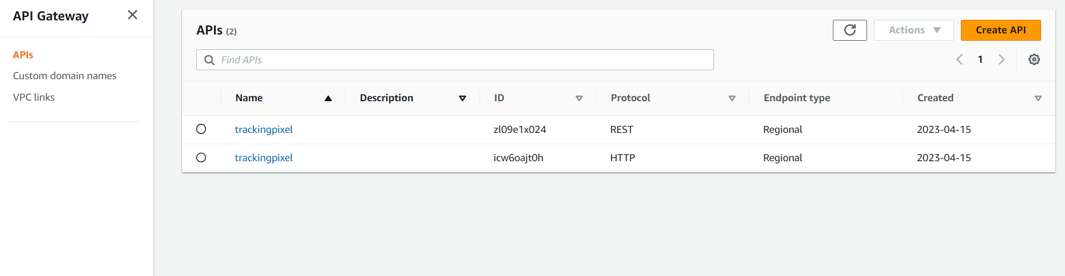
AWS API GW
In our website live tracking system, we are hosting a static server less webpage over S3.
There are two web pages on our website i.e., the Home and Contact Us pages.
When user clicks on Home Page, HTTP API is invoked and integrates with the corresponding Lambda function.
When user clicks on Contact Us Page, REST API is invoked and integrates with the corresponding Lambda function.

Slide 7
AWS Lambda
AWS Lambda is a compute service that operates on an event-driven, serverless architecture, enabling you to execute code for a wide range of applications or backend services without the need for server provisioning or management.
We have created two lambda functions i.e., trackingpixel and trackingpixel-1. In AWS Lambda, code runs in response to some events i.e., HTTP/REST requests from the API gateway these events trigger the lambda function to execute the code.
Whenever the user visits the home page, this event invokes the HTTP API gateway which is integrated with the lambda function(pixel1) with the help of kinesis transfers the client requests i.e., streaming data, and dumps the data into the S3 bucket.
Correspondingly, Whenever the user contacts the client through the Contact Us page to enquire/resolve their queries, this event invokes the REST API gateway which is integrated with the other lambda functions (pixel), It transfers the client requests i.e., the data to store in the SQL database i.e., AWS RDS

Slide 8
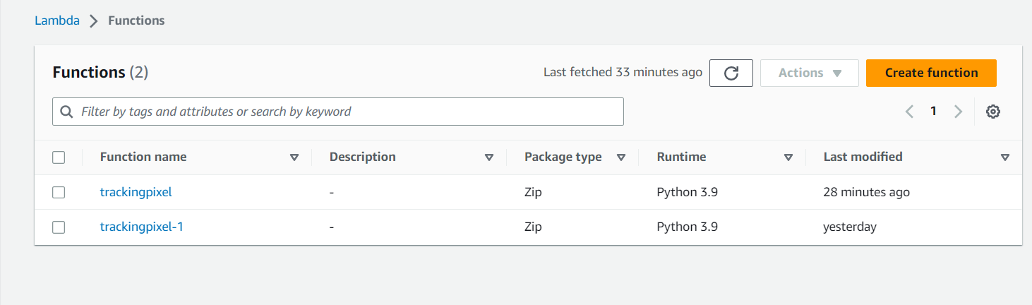

Slide 9
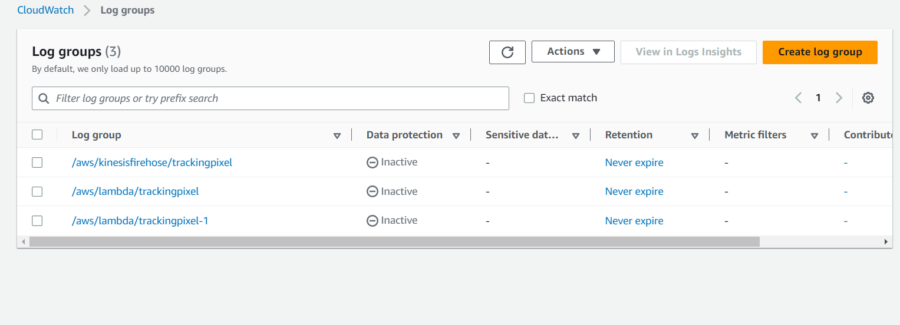
AWS Cloud Watch
AWS Cloud Watch is used in order to detect the anomalies in the website if it persists or to extract the data insights from the user to track, improve and smooth the functioning of the website.
All the logs which have been generated from Lambda & Kinesis is stored in the Cloud Watch

Slide 10
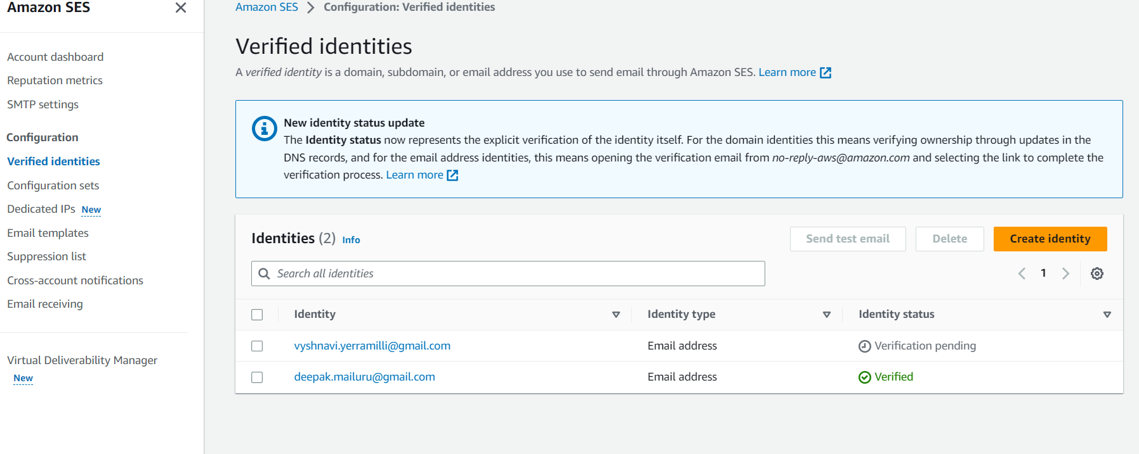
AWS SES
Amazon Simple Email Service (SES) is an email service that is both cost-effective and flexible, allowing developers to send emails from any application in a scalable manner.
We have set up an AWS SES configuration that gives the client mail id administrator privileges and verified identity. This means that whenever a user tries to contact the client through the contact us page, the client will receive a notification no matter when it is sent.
This helps the client address any issue right away and makes the process much more efficient. It also helps to ensure better customer service, as any queries can be dealt with quickly.

Slide 11
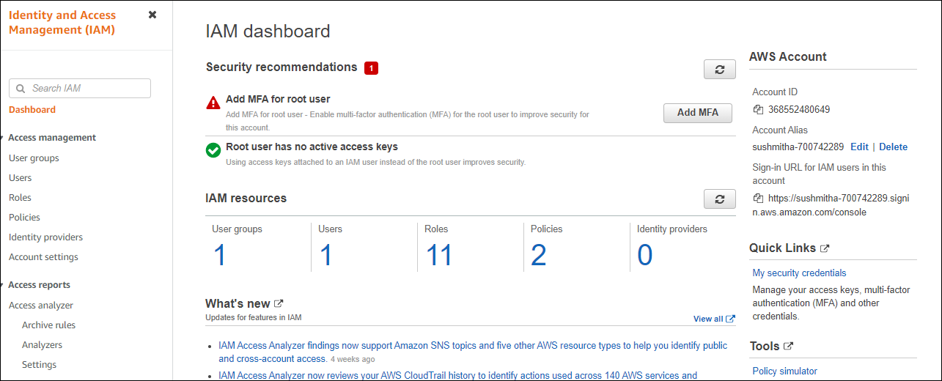
AWS IAM
AWS Identity and Access Management (IAM) is a service provided by AWS that enables secure management of access to resources on their platform.
Using this service, we have tried to set restriction on different users with various roles and policies.
Created IAM users with permissions to access an Amazon S3 bucket where visitor tracking data is stored, or an IAM role with permissions to access an Amazon RDS database where visitor information is stored.

Slide 12
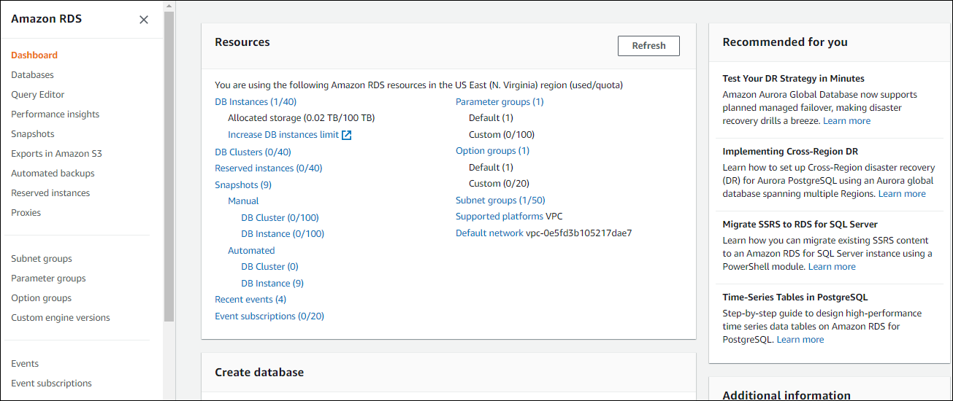
AWS RDS
Amazon RDS is one of the web services provided by AWS that simplifies the setup, operation, and scaling of relational databases in the cloud.
We used RDS in this project to store the data generated from the second webpage CONTACT. Rest API is invoked when the user tries to contact the ADMIN and then integrates with lambda to connect to the database which is MYSQL. The database connection/port details are mentioned in the lambda function using python.

Slide 13
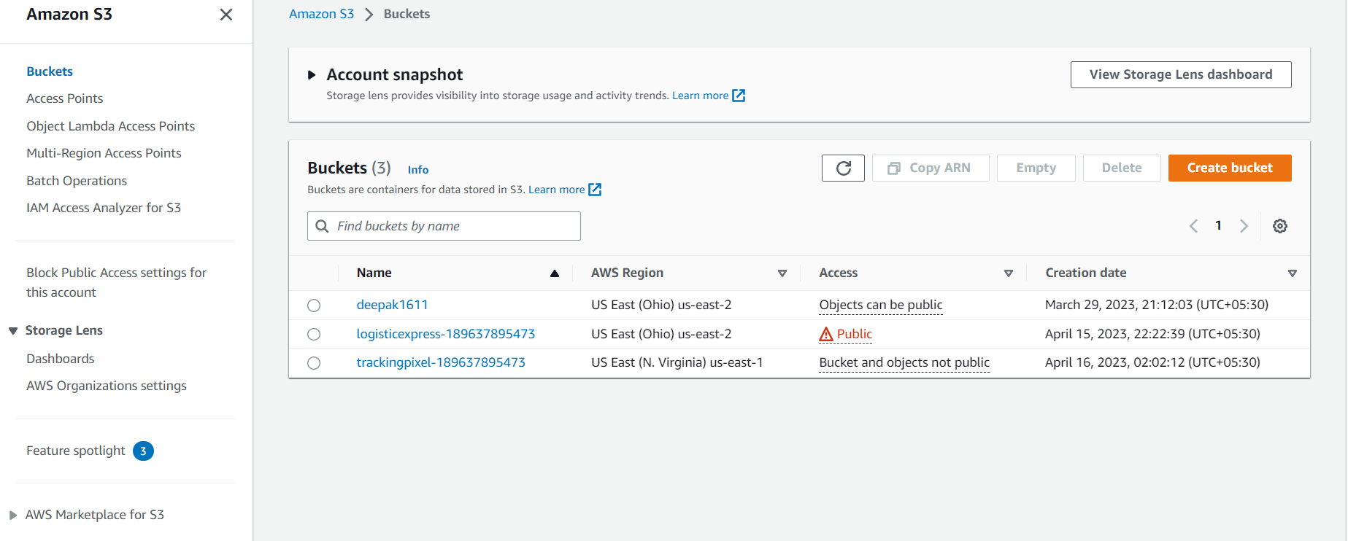
AWS S3
Simple storage service is an object storage service that provides highly secured and scalable storage which can be accessed from anywhere over the internet. In this project, the application is hosted on an S3 bucket.
With the help of kinesis data firehose, which transforms and delivers the streaming data to the destination i.e., user data is pushed into this S3 bucket. In the S3 bucket, Where the data is classified into object files, can be downloaded to view the user data. Details such as type of browser, IP address, page visited can be seen.

Slide 14
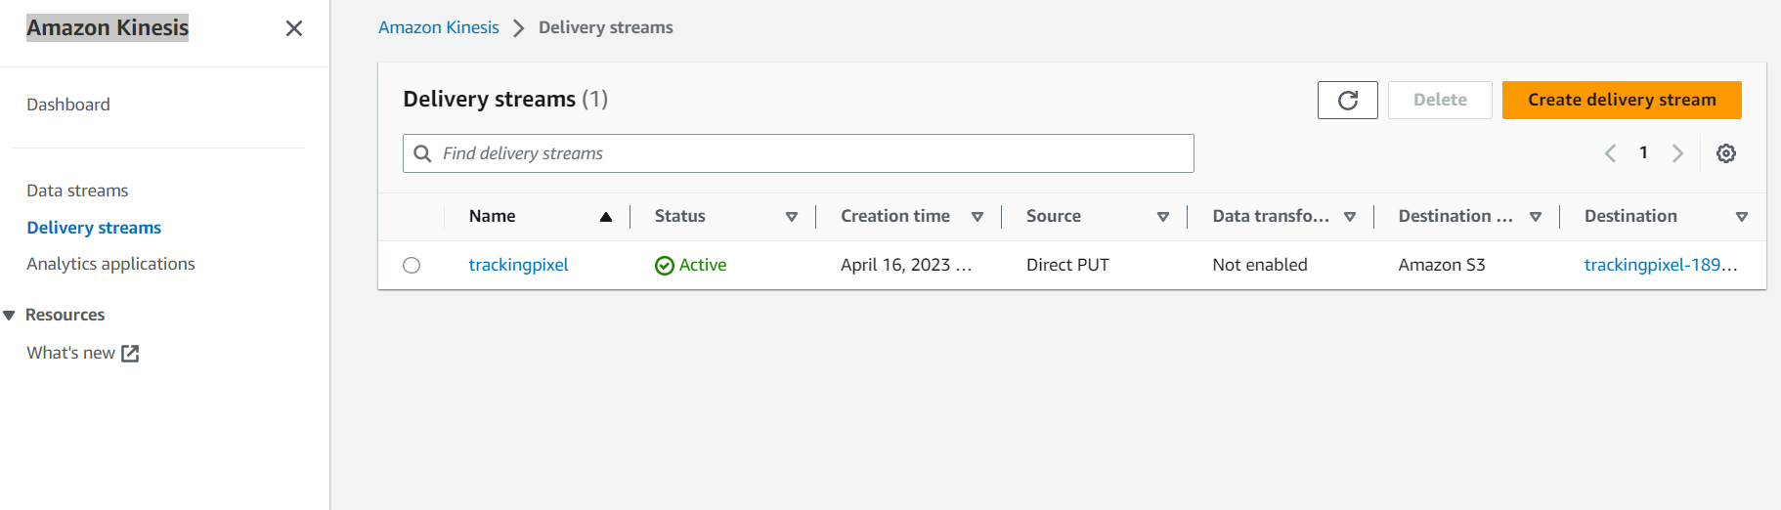
AWS KENESIS
Kinesis can record, save, and analyze data from distributed streams, such as activity logs i.e., event logs and online feeds. Once processed, Kinesis can distribute the data to multiple consumers simultaneously, making it a highly efficient tool for real-time data processing and analysis.
Here when the user visits the webpage it triggers the HTTP API which then connects to the lambda. Lambda then sends the information to kinesis for data processing. Kinesis now pushes the data to the S3 bucket. Lambda is configured in the Delivery streams and the destination for data storage is specified as an S3 bucket.

Slide 15
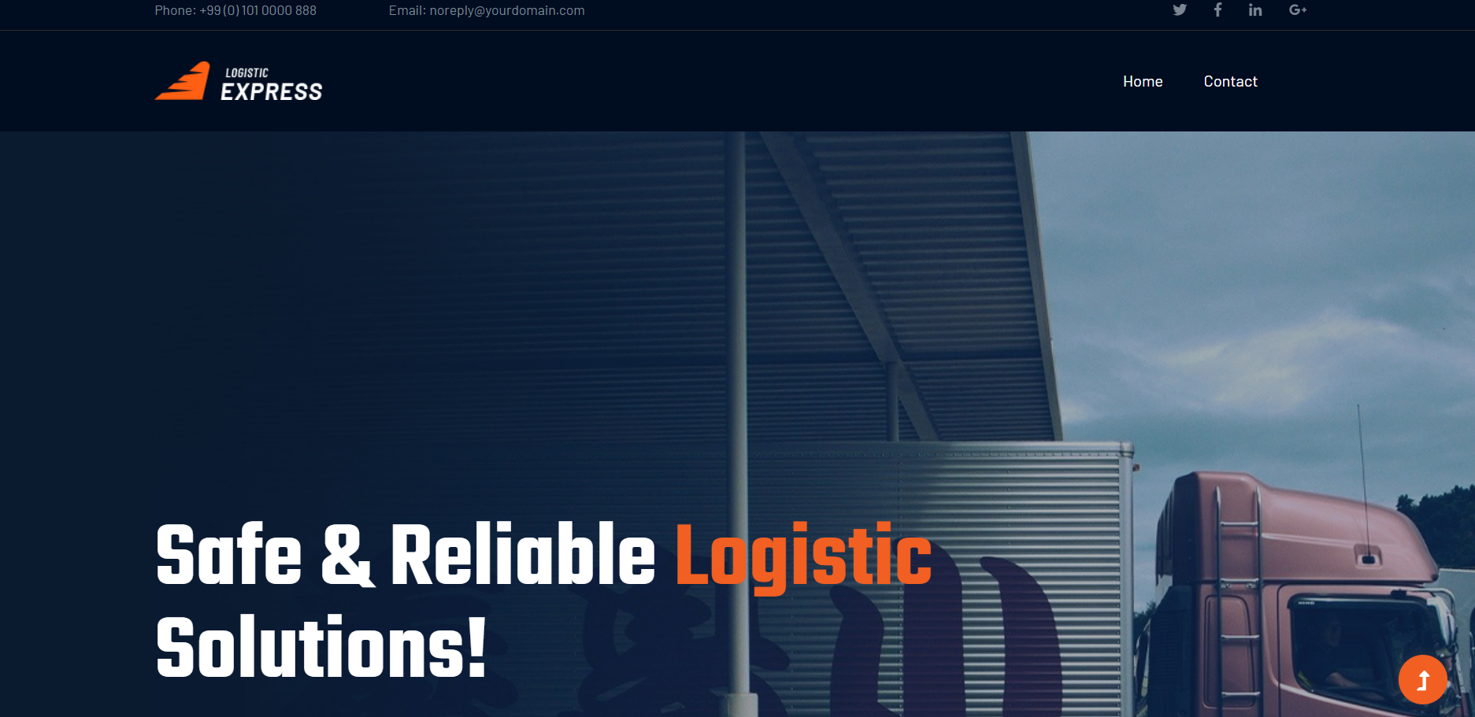
User Interface

Slide 16
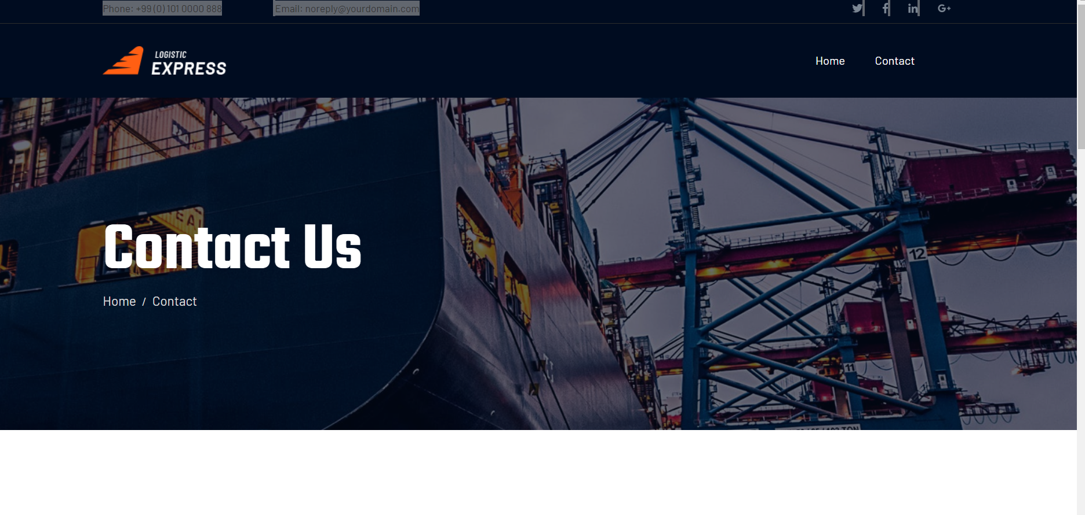
THANK YOU

