Slide 1
Project Title
Subject: Major Project Phase-I, Review-2
Semester: 6th Semester
Name-USN
Name-USN
Name-USN
Name-USN
Under the Guidance of
[GUIDE NAME]
[DESIGNATION]

Slide 2
Contents:
Introduction
Problem Statement
Objectives
Extensive Literature Survey
Proposed Methodology
Expected outcomes
SDG,Ethics.
Project Management
Applications
Conclusions
References

Slide 3
Sl. No. | Title of Paper | Author(s) | Year | Methodology & Technology Used | Key Outcome | Limitations
1 | Hand Gesture Controlled Robot | Rishabh et al. | 2018 | Accelerometer-based hand tilt detection using ATmega328P microcontroller and L298N motor driver. | Achieved efficient, responsive motion using simple tilt gestures. | No safety features like collision avoidance or feedback mechanisms.
2 | Hand Gesture Controlled Robot | Vikas Singh et al. | 2019 | Accelerometer + Arduino with RF module and L293D motor driver for basic robotic movement. | Demonstrated basic gesture control for robotic movement. | Limited range due to RF module; lacks obstacle avoidance.
3 | Gesture Controlled Robot Using Flex Sensors | Hidayat et al. | 2021 | Flex sensors interfaced with Arduino and Bluetooth module, driving servo motors for movement. | Improved accuracy in gesture detection using flex sensors. | More expensive components; flex sensors prone to wear and tear.

Slide 4
4 | Smart Glove for Gesture Controlled Robotics | A. Permana et al. | 2022 | MPU6050 + ESP32 for motion tracking with Wi-Fi for real-time gesture transmission. | Enabled remote control with real-time data transmission. | Complex setup; high power consumption for wearable use.
5 | A Review on Wearable Sensors for Gesture Control | Multiple (MDPI Journal) | 2023 | Comprehensive review of IMUs, flex sensors, and wireless communication in wearable gloves. | Summarized strengths of modern wearable gesture-sensing techniques. | Lacks real-world implementation and performance validation.

Slide 5
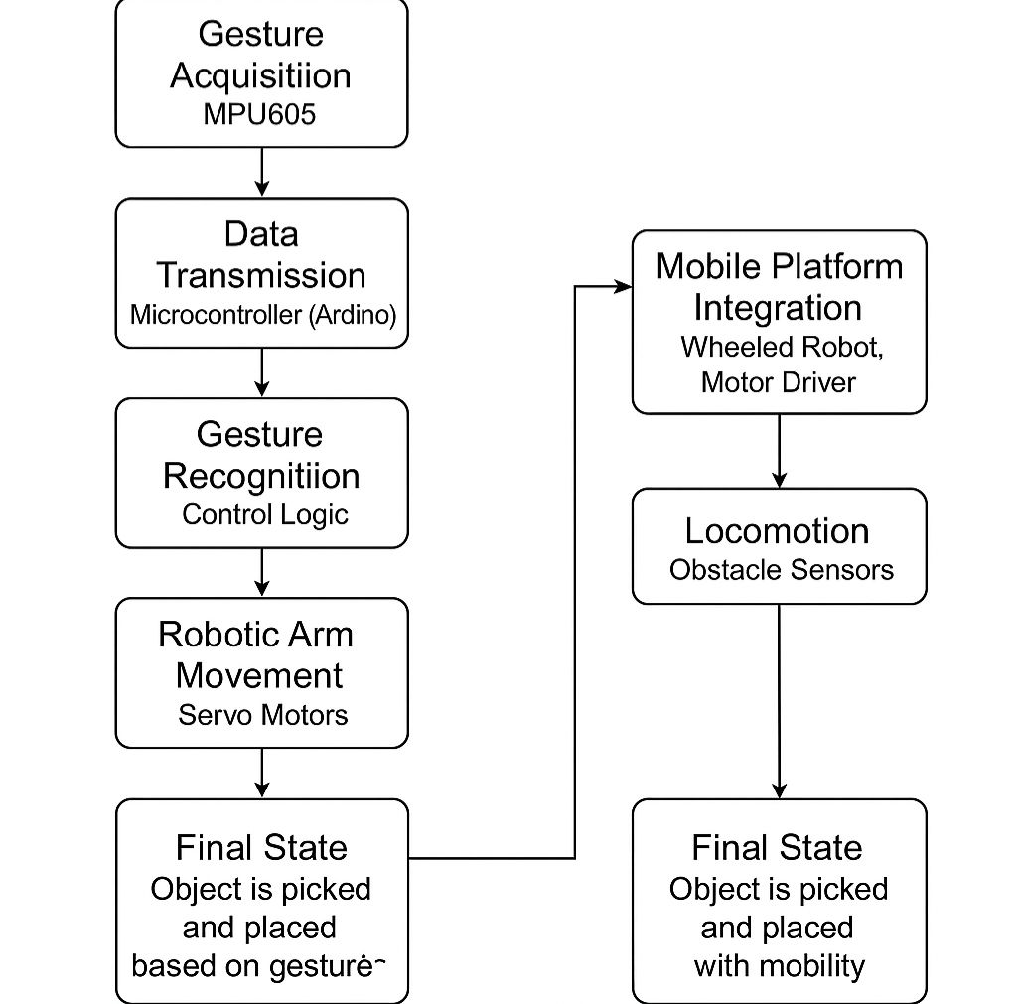
Methodology

Slide 6
1. Requirement Analysis
Identify hardware components: Accelerometer (e.g., MPU6050), Arduino Uno, Motor Driver (L298N), DC motors, RF/Bluetooth modules (e.g., HC-05), obstacle sensors (e.g., Ultrasonic Sensor), and robotic gripper (optional).
Define functional requirements: gesture recognition, movement control (forward, backward, left, right, stop), object handling (pick/drop), and obstacle detection.
2. System Design
Gesture Module:
Mount an accelerometer on a glove or hand-band to detect hand tilt/gesture.
Program the Arduino to convert tilt angles into directional commands.
Control Module (Transmitter):
Arduino reads accelerometer data and interprets gestures.
Sends the corresponding command wirelessly via Bluetooth or RF.
3. Robot Module (Receiver):
Receives signals using a Bluetooth/RF module.
Arduino on the robot decodes signals and drives the motors accordingly.
Includes a robotic arm (servo-controlled) for pick/drop actions.
4. Obstacle Avoidance:
Integrate ultrasonic sensors on the robot.
If an object is detected ≤10 cm ahead, the robot either stops or reroutes.

Slide 7
3. Implementation
Interface accelerometer with Arduino and calibrate for different gestures.
Use conditional statements to map gesture angles to actions: e.g., Tilt forward = move forward, tilt left = turn left, etc.
Establish wireless communication using HC-05 Bluetooth or RF module.
Mount components on a chassis and test robotic arm stability.
4. Testing and Calibration
Test gesture detection accuracy.
Fine-tune angles and thresholds to improve gesture recognition.
Measure communication range and signal latency.
Calibrate ultrasonic sensors for reliable obstacle detection.
5. Optimization
Reduce response time between gesture and robot action.
Improve gesture stability and false gesture rejection.
Minimize power consumption and increase wireless range.

Slide 8
Sample Code:( Transmitter Side Code (Glove with Accelerometer))
#include <Wire.h>
#include <MPU6050.h>
MPU6050 accel;
void setup() {
Serial.begin(9600); // Bluetooth uses Serial
Wire.begin();
accel.initialize();
if (!accel.testConnection()) {
Serial.println("MPU6050 connection failed");
while (1);
}
Serial.println("MPU6050 connected");
}
void loop() {
int16_t ax, ay, az;
accel.getAcceleration(&ax, &ay, &az);
// Simple gesture mapping based on Y-axis tilt
if (ay > 10000) {
Serial.println("F"); // Forward
} else if (ay < -10000) {
Serial.println("B"); // Backward
} else if (ax > 10000) {
Serial.println("R"); // Right
} else if (ax < -10000) {
Serial.println("L"); // Left
} else {
Serial.println("S"); // Stop
}
delay(200);
}

Slide 9
Receiver Side Code (Robot):
char command;
void setup() {
Serial.begin(9600);
pinMode(8, OUTPUT); // Motor A
pinMode(9, OUTPUT);
pinMode(10, OUTPUT); // Motor B
pinMode(11, OUTPUT);
}
void loop() {
if (Serial.available()) {
command = Serial.read();
switch (command) {
case 'F': // Forward
digitalWrite(8, HIGH);
digitalWrite(9, LOW);
digitalWrite(10, HIGH);
digitalWrite(11, LOW);
break;
case 'B': // Backward
digitalWrite(8, LOW);
digitalWrite(9, HIGH);
digitalWrite(10, LOW);
digitalWrite(11, HIGH);
break;
case 'R': // Right
digitalWrite(8, HIGH);
digitalWrite(9, LOW);
digitalWrite(10, LOW);
digitalWrite(11, HIGH);
break;
case 'L': // Left
digitalWrite(8, LOW);
digitalWrite(9, HIGH);
digitalWrite(10, HIGH);
digitalWrite(11, LOW);
break;
case 'S': // Stop
digitalWrite(8, LOW);
digitalWrite(9, LOW);
digitalWrite(10, LOW);
digitalWrite(11, LOW);
break;
}
}
}

Slide 10
Expected Outcomes
Real-Time Gesture Recognition:
Enabled smooth, real-time robot control using hand gestures captured through an accelerometer-based glove.
Wireless Command Transmission:
Achieved reliable Bluetooth/RF-based communication between the glove unit and robot module with minimal latency.
Accurate Movement Execution:
Mapped hand gestures to robot functions like forward, backward, turning, and stopping with high accuracy.
Obstacle Detection and Safety:
Integrated ultrasonic sensor successfully stopped or redirected the robot within 0.5 seconds of obstacle detection (<10 cm range).
User-Friendly Interface:
Designed an intuitive, wearable glove controller that requires no advanced training to operate.
Low-Cost & Scalable Solution:
Built using affordable components with scope for expanding to advanced robotic operations (e.g., robotic arms).
Let me know if you’d like a visual summary slide, a shortened version for a busy audience, or Hindi/vernacular translation for any specific use!

Slide 11
SDG Alignment
Project contributes to the following United Nations Sustainable Development Goals (SDGs):
SDG 4: Quality Education
Provides a hands-on learning platform for students in STEM, robotics, and embedded systems.
SDG 8: Decent Work and Economic Growth
Encourages the development of low-cost automation solutions, potentially boosting productivity in small industries.
SDG 9: Industry, Innovation and Infrastructure
Promotes innovation by integrating gesture-based technology with robotics, encouraging smart automation.
SDG 10: Reduced Inequalities
Can be adapted for use by differently-abled individuals, offering alternative control interfaces in assistive robotics.
️

Slide 12
Ethics
User Safety:
The system includes obstacle detection to prevent harm or collisions during operation, especially in public or educational spaces.
Accessibility:
Designed with simplicity in mind — the gesture glove can be used by people with limited technical knowledge or mobility constraints.
Privacy & Data Use:
No sensitive personal data is collected or stored; the system only processes gesture data locally on the microcontroller.
Affordability:
Prioritized low-cost components to ensure that the solution remains accessible to schools, universities, and low-resource communities.
Sustainability:
The design minimizes electronic waste and supports modular upgrades instead of full replacements.

Slide 13


