Slide 1
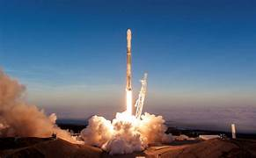
IBM Applied Data Science Capstone
Venkata Pavani Perla
June02, 2024

Slide 2
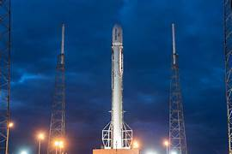
Table of Contents
Executive Summary
Introduction
Methodology
Results
Discussion
Conclusion

Slide 3
EXECUTIVE SUMMARY
In this capstone, we will predict if the Falcon 9 first stage will land successfully using several machine learning classification algorithms.
The main steps in this project include:
Data collection, Data wrangling and formatting.
Exploratory Data Analysis
Interactive Data Visualization
Machine Learning Prediction
Our graphs show that some features of the rocket launches have correlation with the outcome of the launches i.e., success or failure.
It is also concluded that decision tree may be the best machine learning algorithm to predict if the Falcon 9 first stage will land successfully.

Slide 4
INTRODUCTION
In this capstone, we will predict if the Falcon 9 first stage will land successfully. SpaceX advertises Falcon 9 rocket launches on its website with a cost of 62 million dollars; other providers cost upward of 165 million dollars each, much of the savings is because SpaceX can reuse the first stage. Therefore if we can determine if the first stage will land, we can determine the cost of a launch. This information can be used if an alternate company wants to bid against SpaceX for a rocket launch.
Most unsuccessful landings are planned. Sometimes, Space X will perform a controlled landing in the ocean.
The main question we are trying to answer is , for a given set of features about a Falcon 9 rocket launch which include its payload mass, orbit type, launch site, and so on, will first stage of the rocket land successfully?

Slide 5
METHODOLOGY
The overall methodology includes:
Data collection, Data wrangling, and formatting, using:
SpaceX API
Web Scraping
2. Exploratory Data Analysis (EDA), using:
Pandas and Numpy
SQL
3. Data Visualization, using:
Matplotlib and Seaborn
Folium
Dash
4. Machine Learning prediction, using:
Logistic Regression
Support Vector Machine (SVM)
Decision Tree
K-nearest neighbors (KNN)

Slide 6
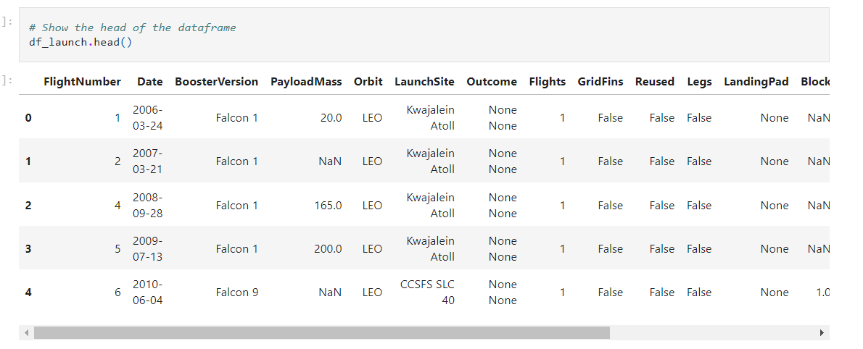
METHODOLOGY 1. Data collection, Data Wrangling and Formatting
SpaceX API:
The API used is "https://api.spacexdata.com/v4/launches/past"
The API provides data about many types of rocket launches done by Space X, the data is therefore filtered to include only falcon 9 launches.
We end up with 90 rows or instances and 17 columns or features. The below snapshot shows the first few rows of data:

Slide 7
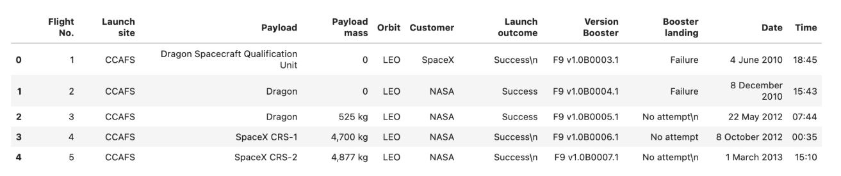
METHODOLOGY 1. Data collection, Data Wrangling and Formatting
Web scraping
The data is scraped from
"https://en.wikipedia.org/w/index.php?title=List_of_Falcon_9_and_Falcon_Heavy_launches&oldid=1027686922"
The website contains only the data about Falcon 9 launches.
We end up with 121 rows or instances and 11 column or features. The below snapshot shows the first few rows of the data:

Slide 8
METHODOLOGY 1. Data collection, Data Wrangling and Formatting
The data is later processed so that there is no missing entries and categorical features are encoded using one-hot encoding.
An extra column called 'class' is also added to the data frame. The column 'class' contains '0' if a given launch is failed and '1' if it is successful.
In the end, we end up with 90 rows or instances and 83 columns or features.

Slide 9



METHODOLOGY​ 2. Exploratory Data Analysis (EDA)
Pandas and NumPy - Functions from the Pandas and NumPy libraries are used to derive basic information about the data collected, which includes:
The number of launches in each site.
The number of occurrences in each orbit.
The number of occurrences of each mission outcome.
SQL- The data is queried using SQL to answer about the data such as:
The names of the unique launch sites in the space mission.
The average and total payload mass carried by boosters launched by NASA.

Slide 10



METHODOLOGY 3. Data Visualization
Matplotlib and Seaborn – Functions from the Matplotlib and Seaborn libraries are used to visualize the data through scatterplots, bar charts and line charts.
The plots and charts are used to understand more about the relationships between several features such as:
The relationship between flight number and launch site.
The relationship between payload mass and launch site.
The relationship between success rate and orbit type.
Folium – Functions from the folium libraries are used to visualize the data through interactive maps.
The Folium library is used to:
Mark all launch sites on a map.
Mark the succeeded launches and failed launches for each site on a map.
Mark the distances between a launch site to its proximities such as nearest city, railway or highway.

Slide 11

METHODOLOGY 3. Data Visualization
Dash – The functions from dash are used to generate an interactive site where we can toggle the input using a dropdown menu and a ranger slider.
Using a pie chart and a scatter plot, the interactive site shows:
The total success launches from each site.
The correlation between payload mass and mission outcome (success or failure ) for each launch site.

Slide 12

METHODOLOGY 4. Machine Learning Prediction
Functions from Scikit-learn library are used to create our machine learning models. The machine learning prediction phase include the following steps:
Standardizing the data
Splitting the data in to training and test data.
Creating machine learning models such as, Logistic Regression, Support Vector Machine, Decision tree, K nearest neighbors
Fit the models on the training set.
Find the best combination of hyper parameters for each model.
Evaluate the models based on their accuracy scores and confusion matrix.

Slide 13
RESULTS
The results are split in to 5 sections:
SQL (EDA with SQL)
Matplotlib and Seaborn
Folium
Dash
Predictive Analysis
Note: In all the graphs that follows class '0' represents failed launch outcome and class '1' represents a successful launch outcome.

Slide 14
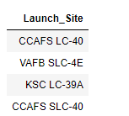
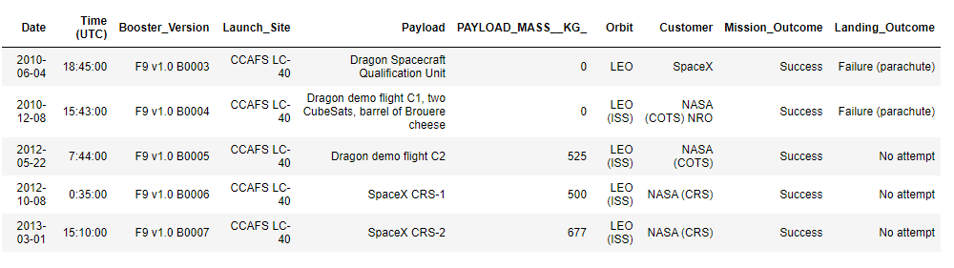
RESULTS SQL (EDA with SQL)
The names of the unique launch sites in the space mission.
5 Records where launch sites begin with 'CCA'

Slide 15



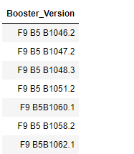
RESULTS SQL (EDA with SQL)
The total payload mass carried by boosters launched by NASA (CRS)
The average payload mass carried by booster version F9v1.1
The date when the first successful landing outcome in ground pad was achieved.
The names of the boosters which have success in drone ship and have payload mass greater than 4000 but less than 6000

Slide 16
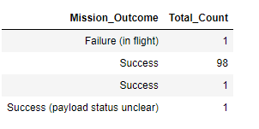
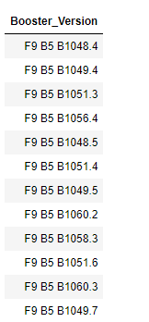
RESULTS SQL (EDA with SQL)
The total number of successful and failure mission outcomes.
The names of the booster versions which have carried the maximum payload mass.

Slide 17
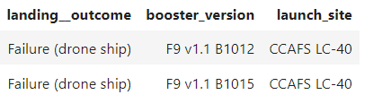
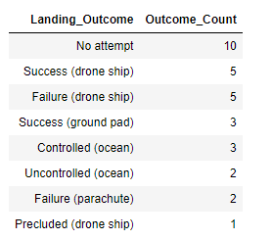
RESULTS SQL (EDA with SQL)
The failed landing outcomes in drone ship ,booster versions, and launch site names in year 2015
The count of landing outcomes between the date 2010-06-04 and 2017-03-20, in descending order

Slide 18
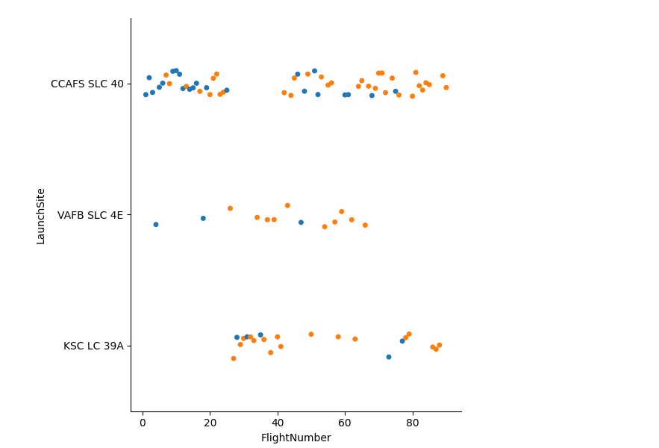
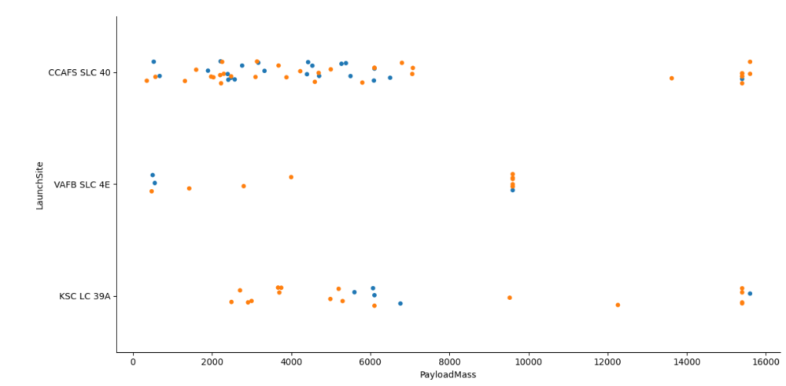
RESULTS​ Matplotlib and Seaborn (EDA with Visualization)
The relationship between flight number and launch site.
The relationship between payload mass and launch site.

Slide 19
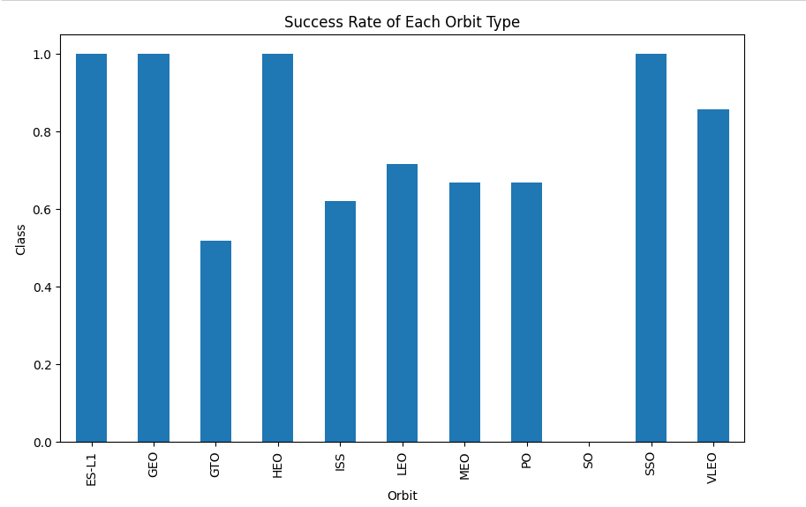
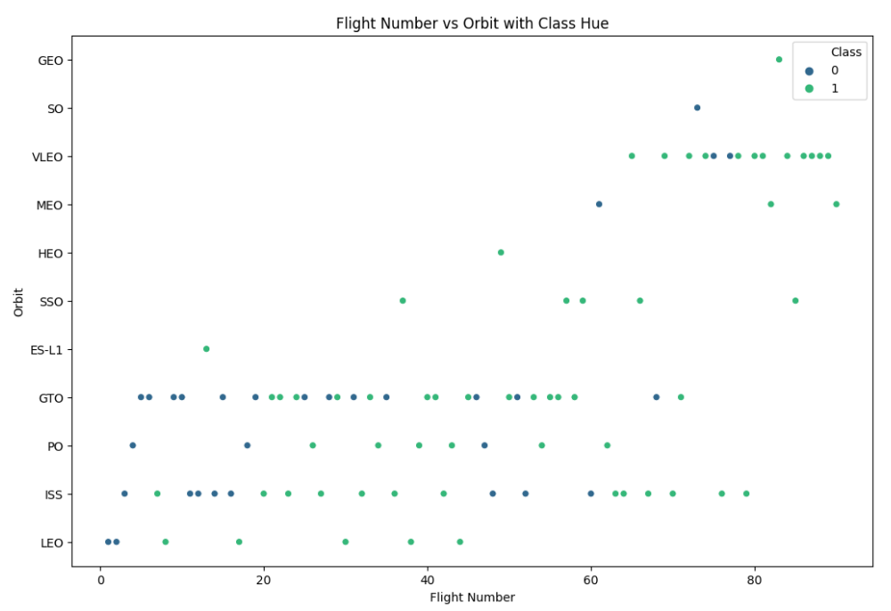
RESULTS Matplotlib and Seaborn (EDA with Visualization)
The relationship between success rate and orbit type.
The relationship between flight number and orbit type.

Slide 20
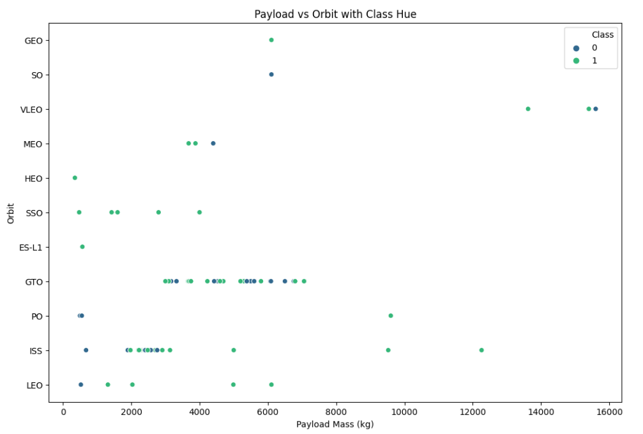
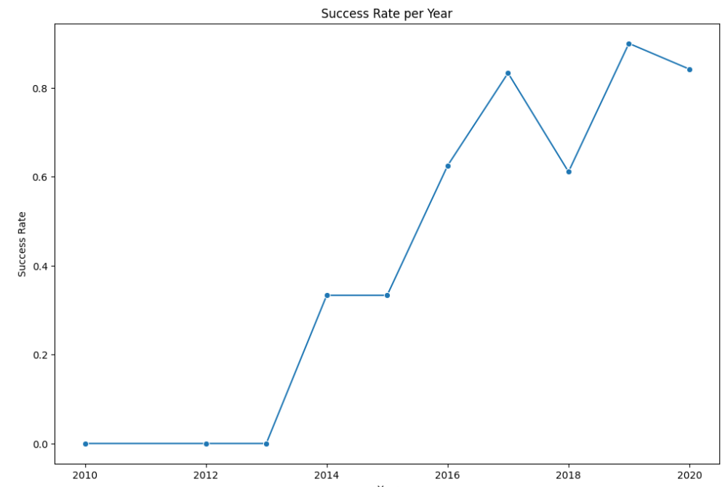
RESULTS Matplotlib and Seaborn (EDA with Visualization)
The relationship between payload mass and orbit type.
The launch success yearly trend

Slide 21
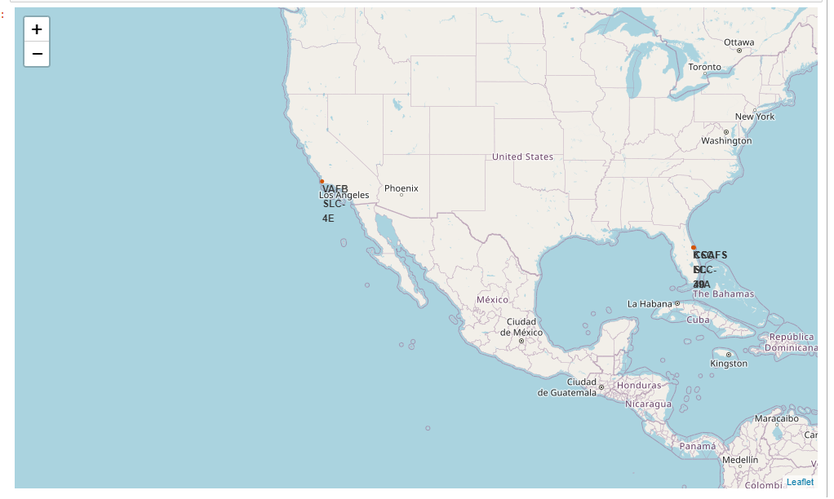
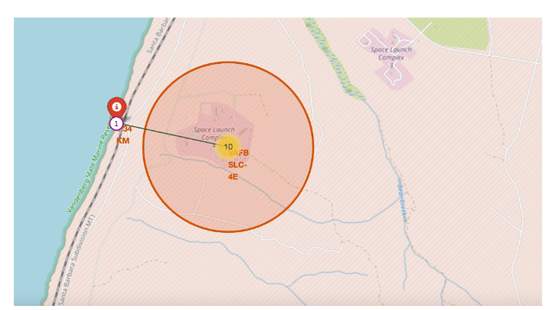
RESULTS Folium
All launch sites on map
The distance between launch site to its proximities such as nearest city, railway or highway

Slide 22
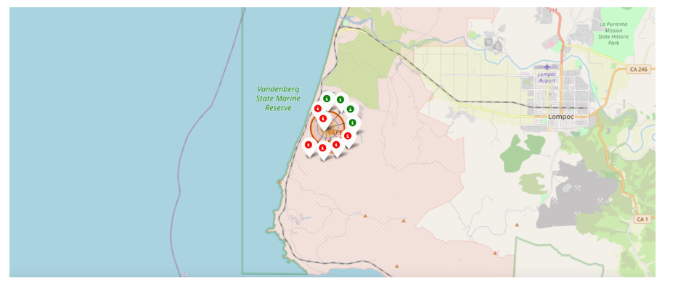
RESULTS Folium
The succeeded launches and failed launches for each site on map.

Slide 23
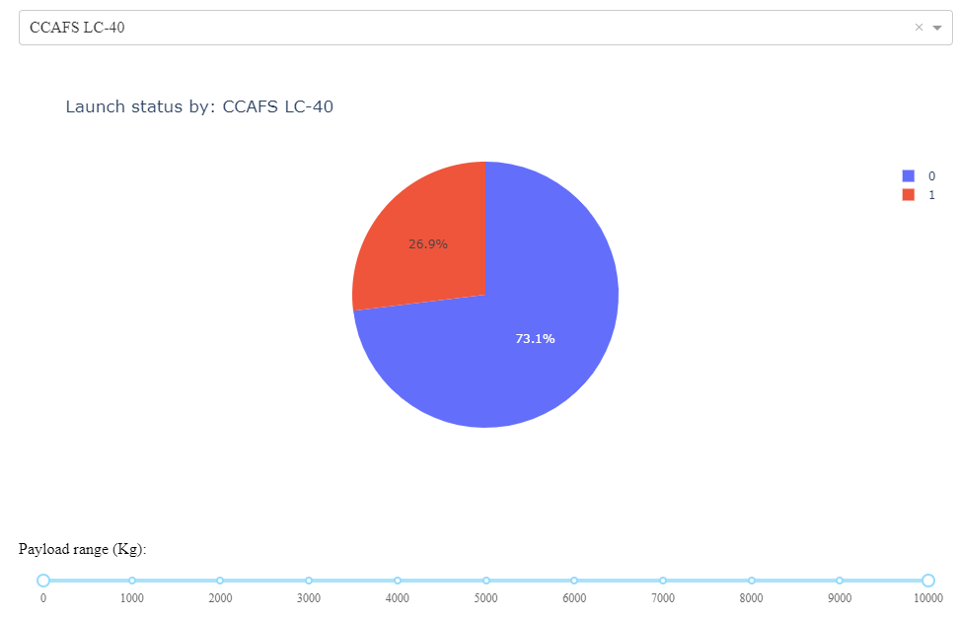
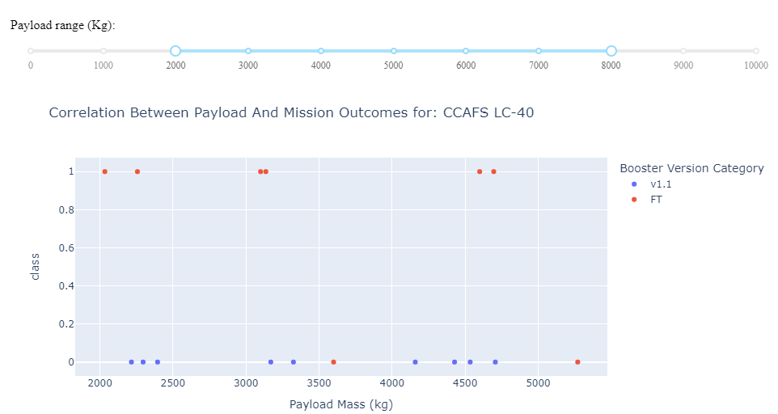
RESULTS Dash
The picture below shows a pie chart when launch site CCAFS LC-40 is chosen.
The picture below shows a scatter plot when the payload mass range is set to be from 2000 kg to 8000 kg

Slide 24
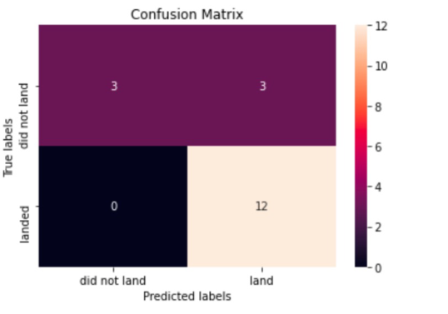
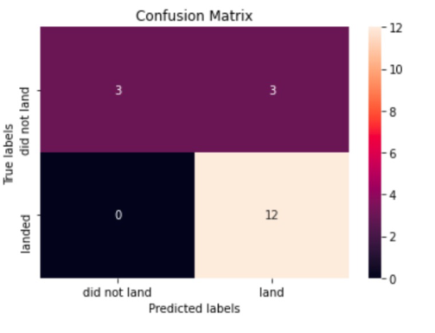
RESULTS Predictive Analysis
Logistic Regression
GridsearchCV best score: 0.8464285714285713
Accuracy score on test set: 0.833333333333334
Confusion Matrix:
Support Vector Machine (SVM)
GridsearchCV best score: 0.8482142857142856
Accuracy score on test set: 0.833333333333334
Confusion Matrix:

Slide 25
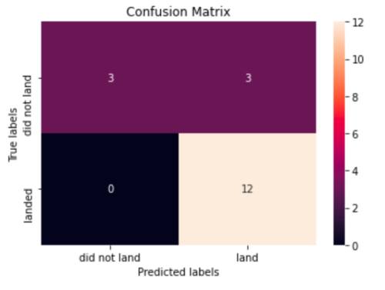

RESULTS ​ Predictive Analysis​
Decision Tree
GridsearchCV best score: 0.8892857142857142
Accuracy score on test set: 0.833333333333334​
Confusion Matrix:
K Nearest neighbors
GridsearchCV best score: 0.8482142857142858
Accuracy score on test set: 0.833333333333334​
Confusion Matrix:

Slide 26
RESULTS Predictive Analysis
Putting the results of all the 4 models side by side, we can see that they all share the same accuracy and confusion matrix when tested on the test set.
Therefore, their GridsearchCV best scores are used to rank them instead. Based on the GridsearchCV best scores, the models are ranked in the following order with the first being the best and the last one being the worst:
1. Decision Tree: 0.8892857142857142
2. Logistic Regression: 0.8464285714285713
3. Support Vector Machine (SVM): 0.8482142857142856
4. K Nearest neighbors: 0.8482142857142858

Slide 27
DISCUSSION
From the data visualization section, we can see that some features may have correlation with the mission outcome in several ways.
Therefore, each feature may have a certain impact on the final mission outcome. The exact ways of how each of these features impact the mission outcome are difficult. However, we can use some machine learning algorithms to learn the pattern of the past data and predict whether a mission will be successful or not based on the given features.

Slide 28
CONCLUSION
In this project, we try to predict if the first stage of a given Falcon 9 will land in order to determine the cost of a launch.
Each feature of a Falcon 9launch, such as its payload mass or orbit type, may affect the mission outcome in a certain way.
Several machine learning algorithm are employed to learn the patterns of past Falcon 9 launch data to produce predictive models that can be used to predict the outcome of a Falcon 9 launch.
The predictive model produced by decision tree algorithm performed the best among the 4 machine learning algorithms employed.

