Slide 1


Slide 2
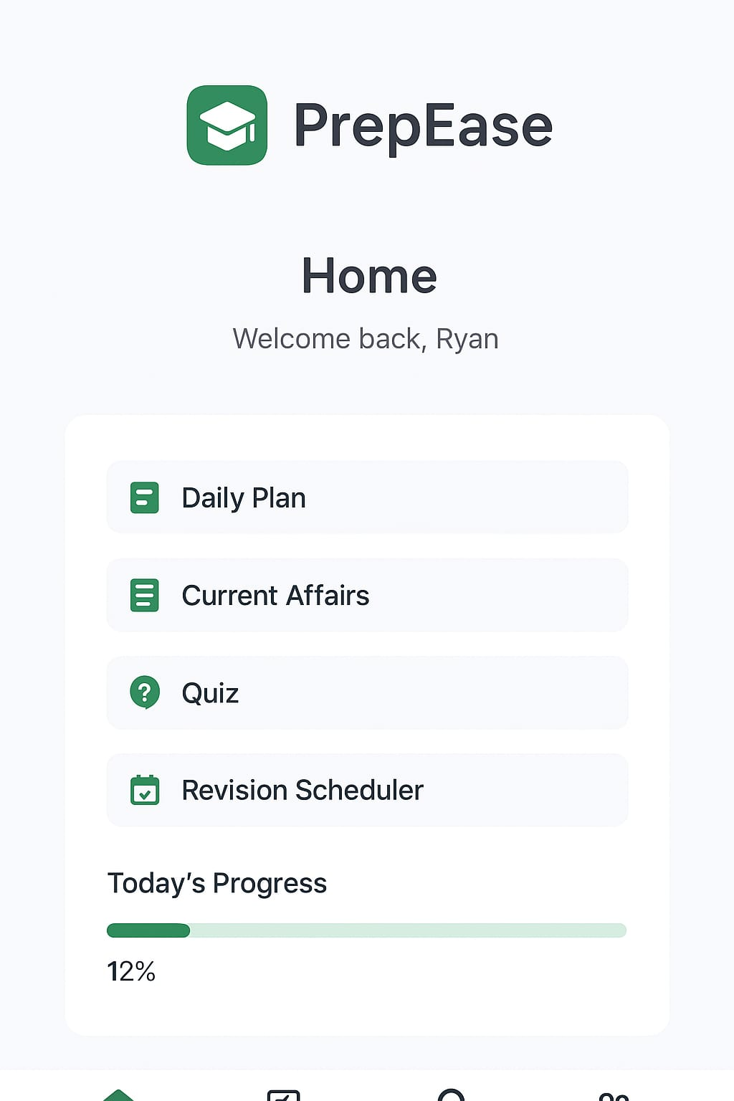
& Study

Slide 3
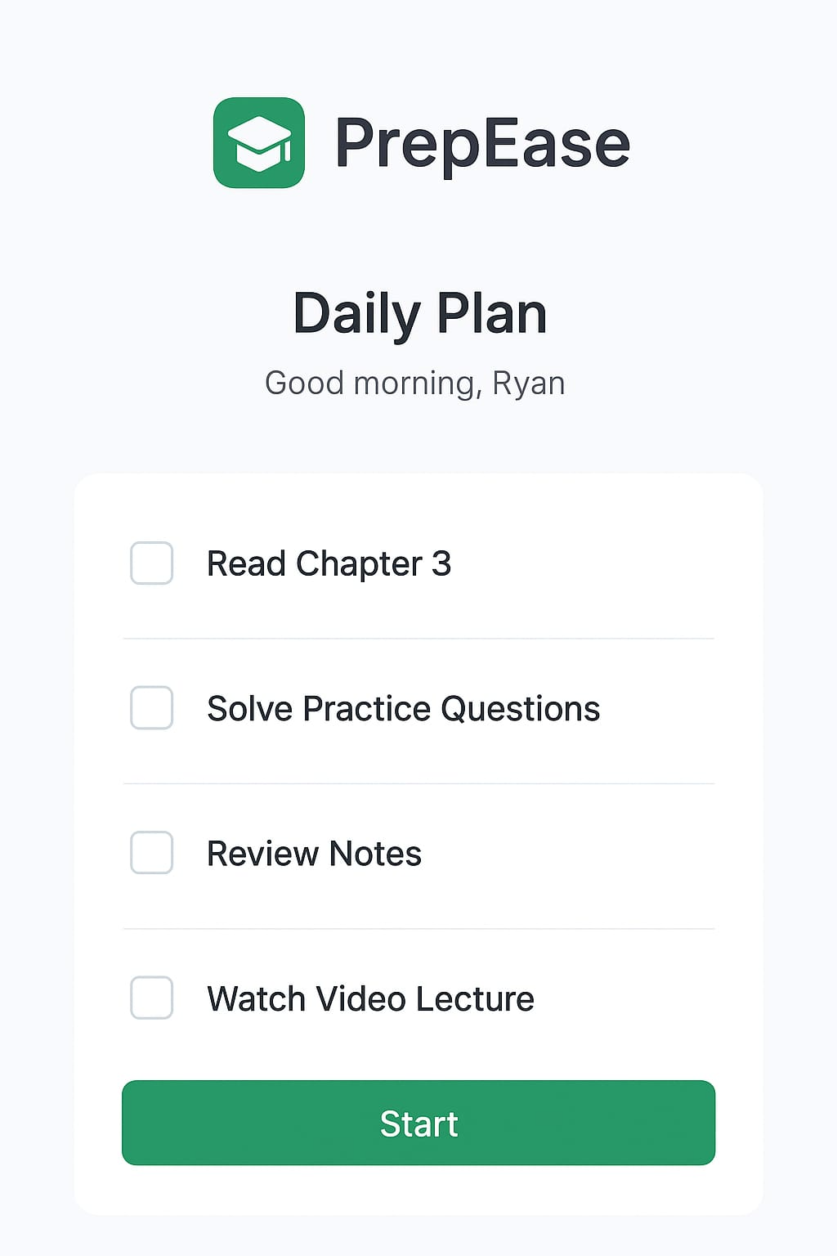

Slide 4
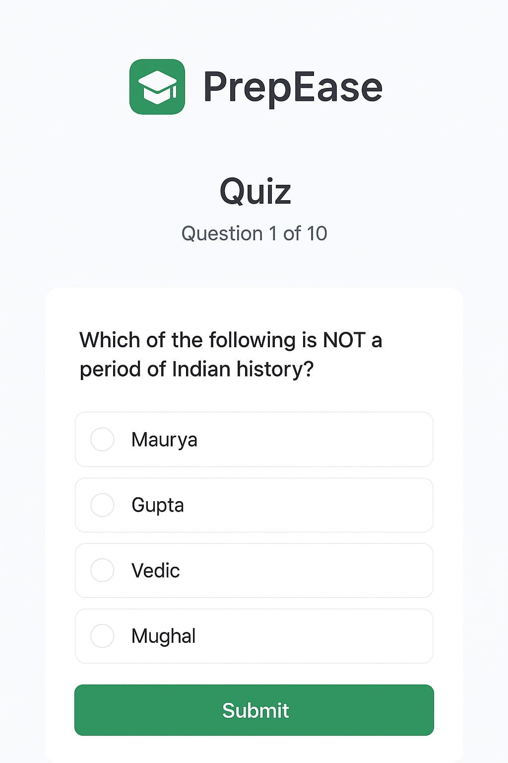

Slide 5
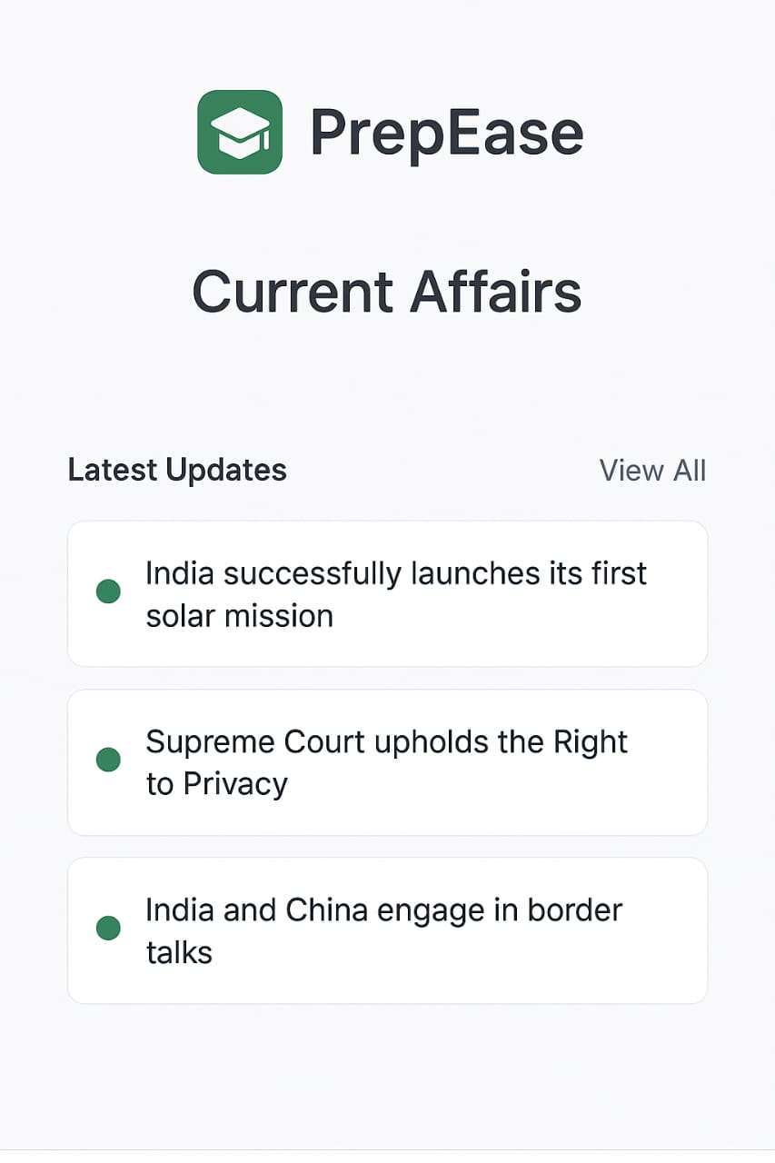

Slide 6


Slide 7
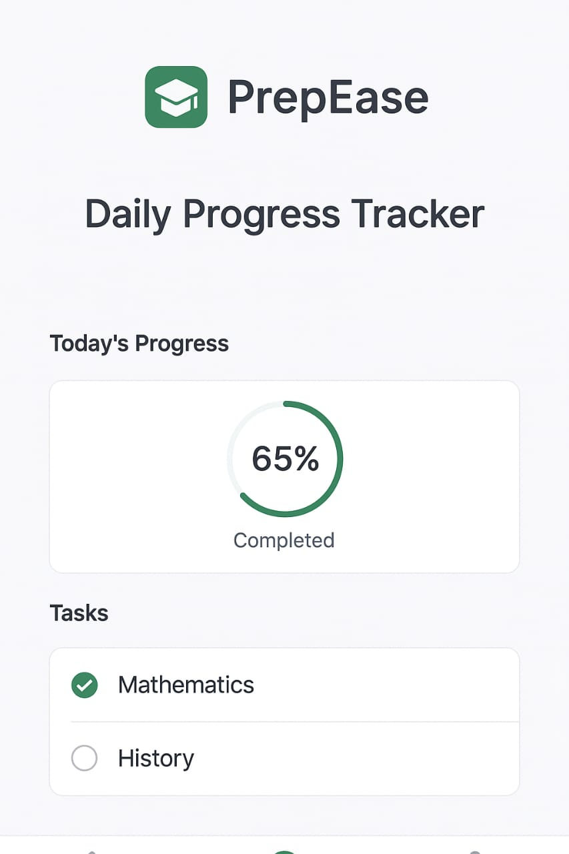

Slide 8
Prepared & Presented by
“ Pavani Chandrapatla “
B-Tech CSE 2-1
JNTUK NRT
Ph.No – 9121653359
E-mail: pavanichandrapatla@gmail.com

Slide 9

THANK YOU

