Slide 1

Movie-Data Exploratory Analysis
By
PAVANI SAI(August 2020)
Email : SAIPAVANI97@gmail.com

Slide 2
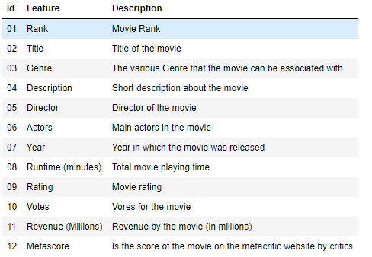
Data Acquisition

Slide 3
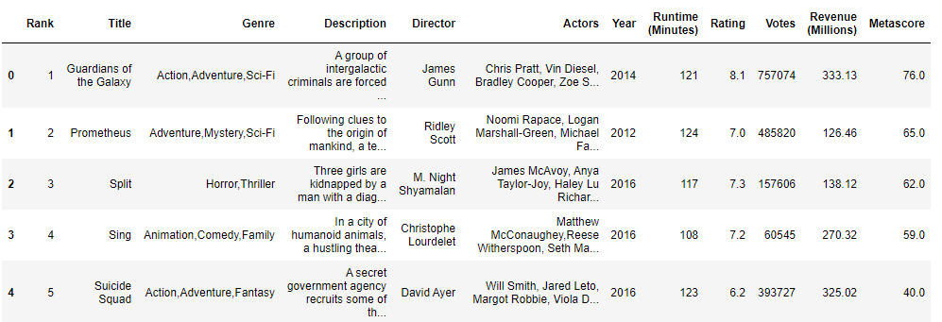
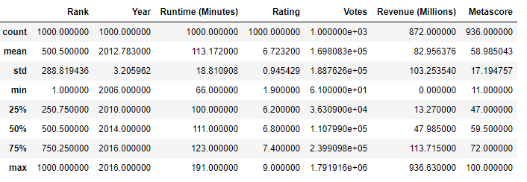
Data Description

Slide 4
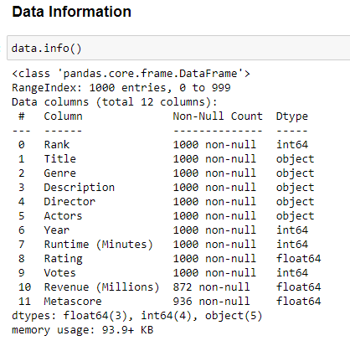
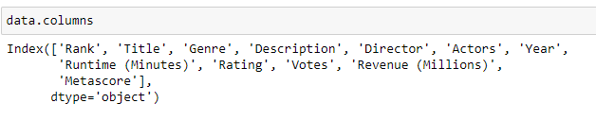
Data Information

Slide 5
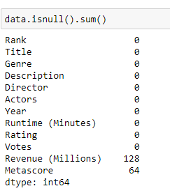
Data Processing
Missing Values

Slide 6
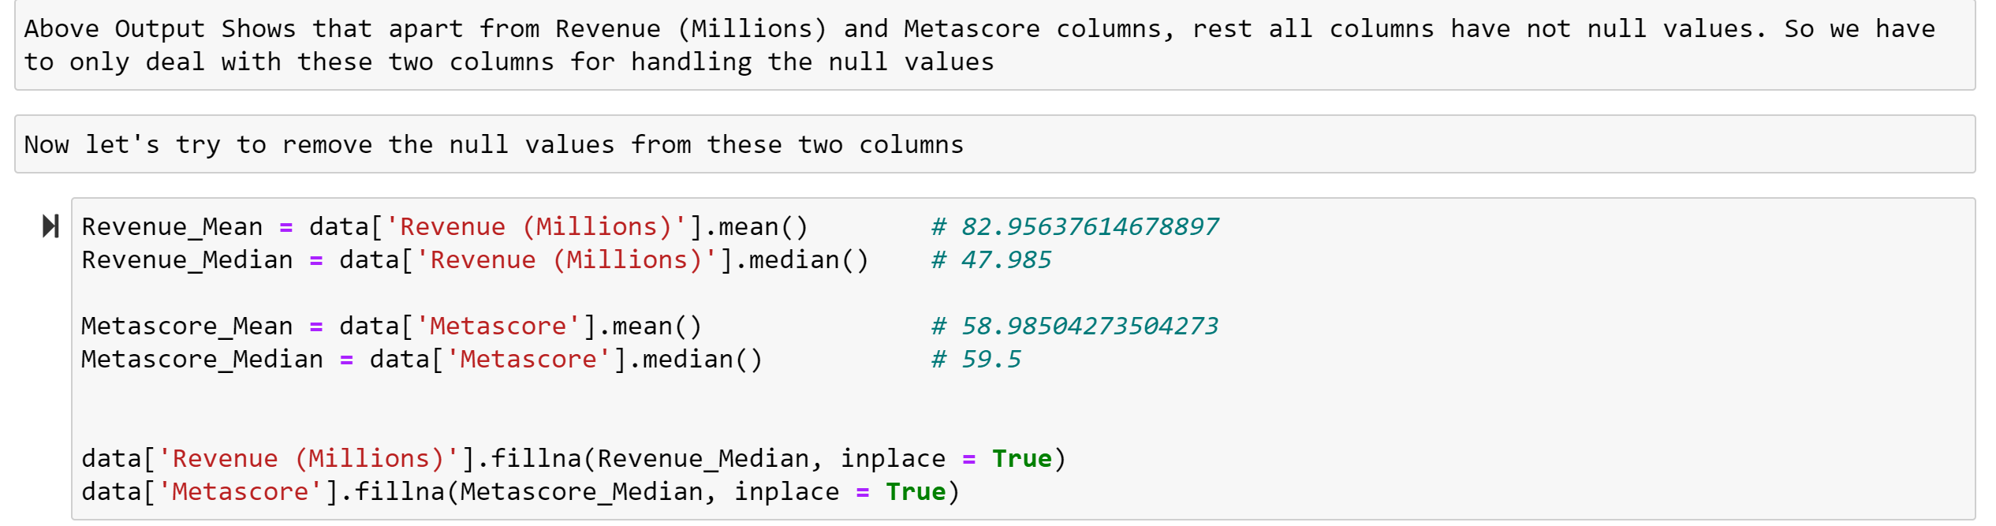
Replaced Missing values with the Median values of that respective feature

Slide 7
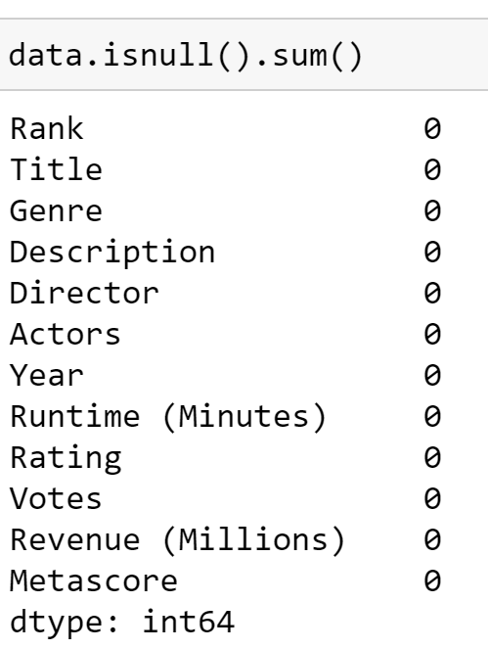
After Data Cleaning, All Null elements are removed

Slide 8
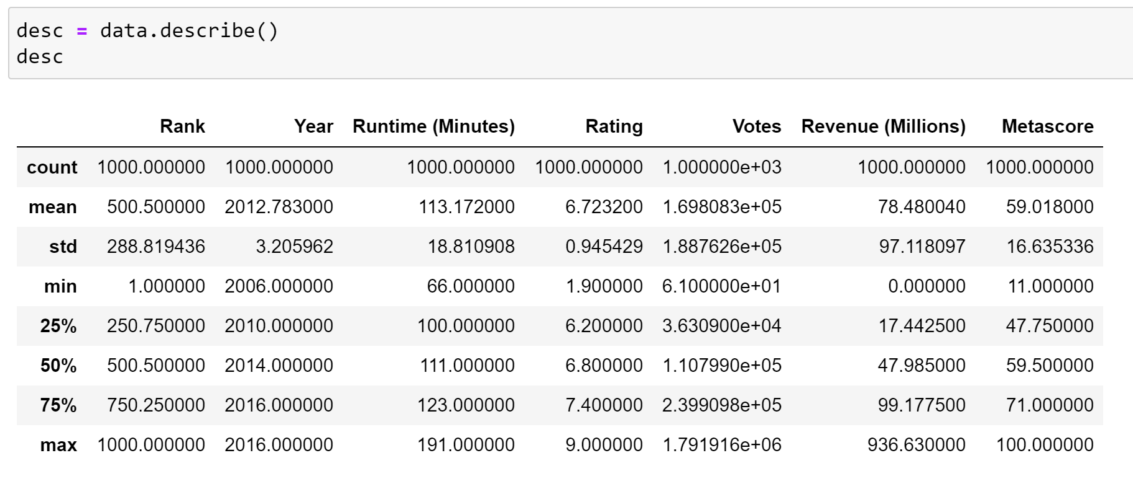

Slide 9
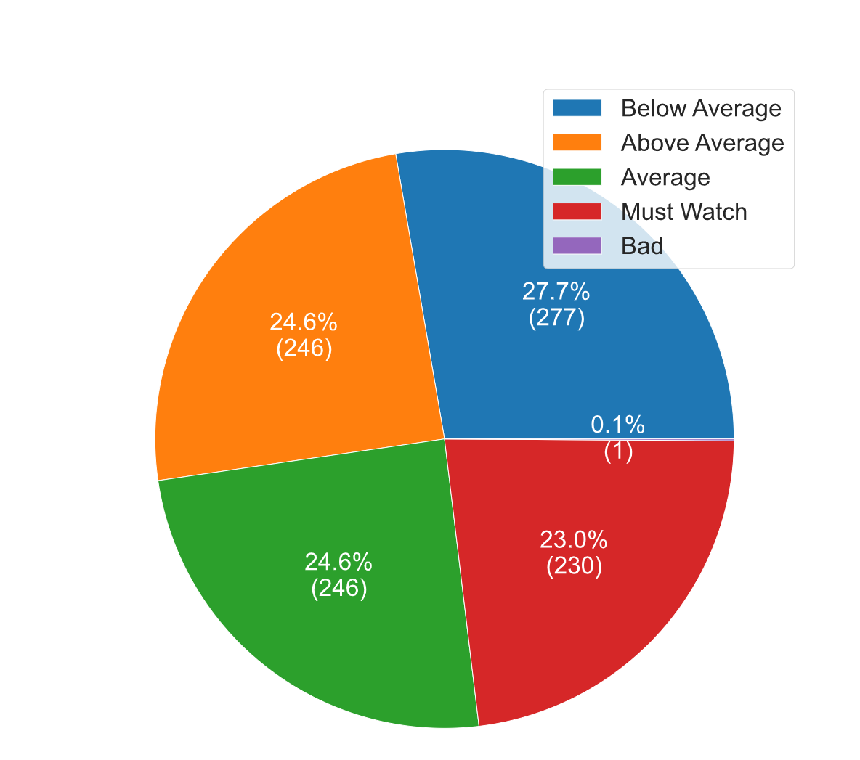
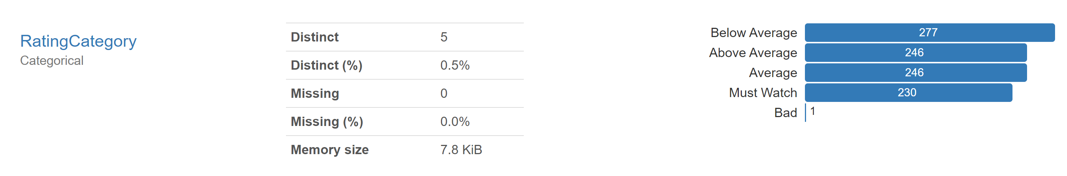
Added New Feature : RatingCategory

Slide 10
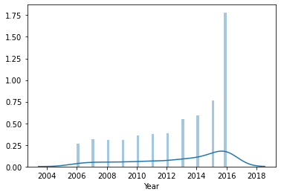
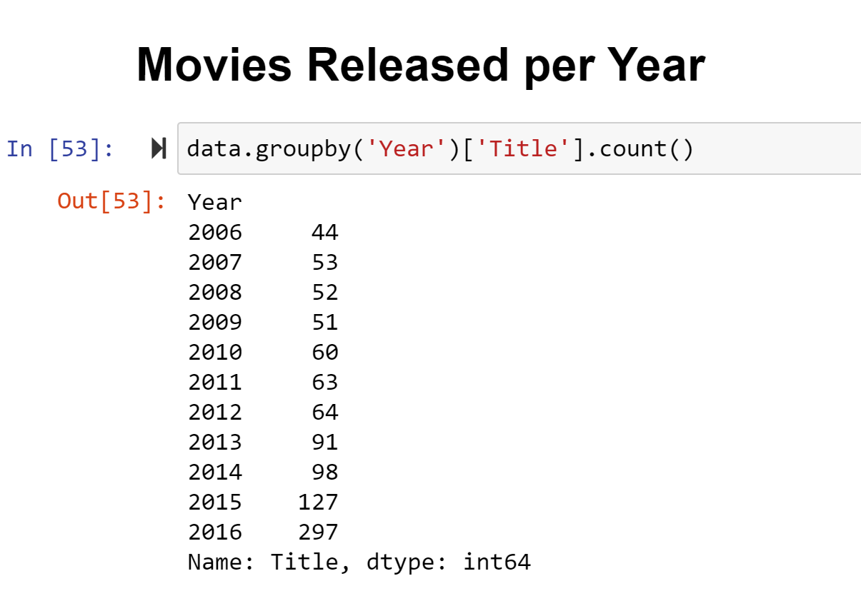
Movies Released per Year

Slide 11
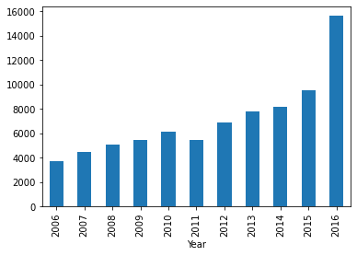
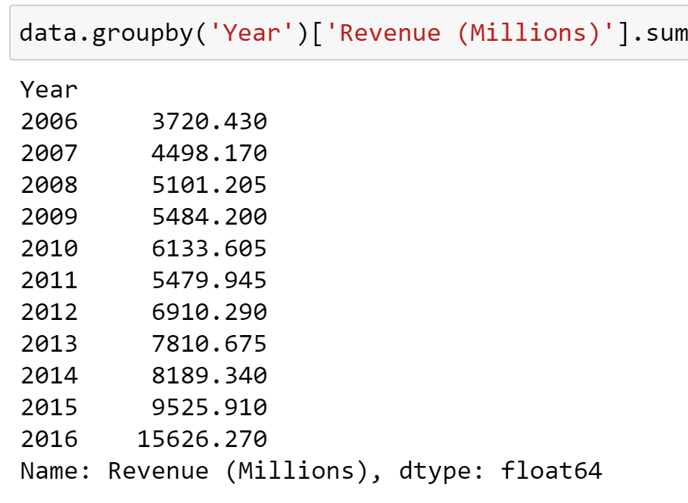
Revenues per year

Slide 12
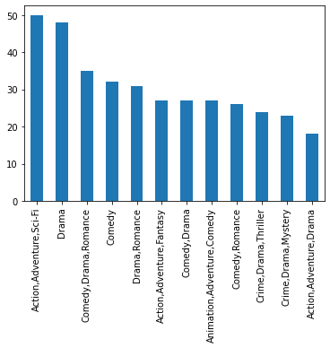
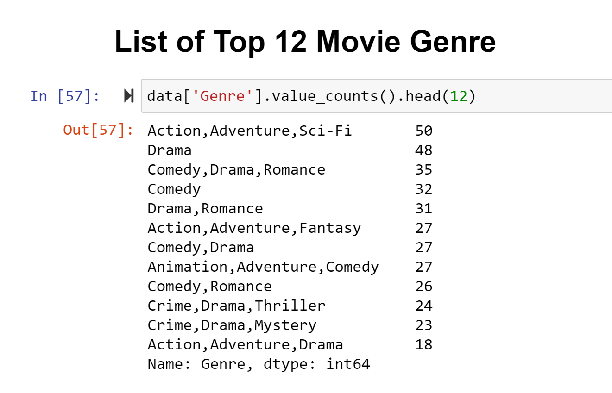

Slide 13
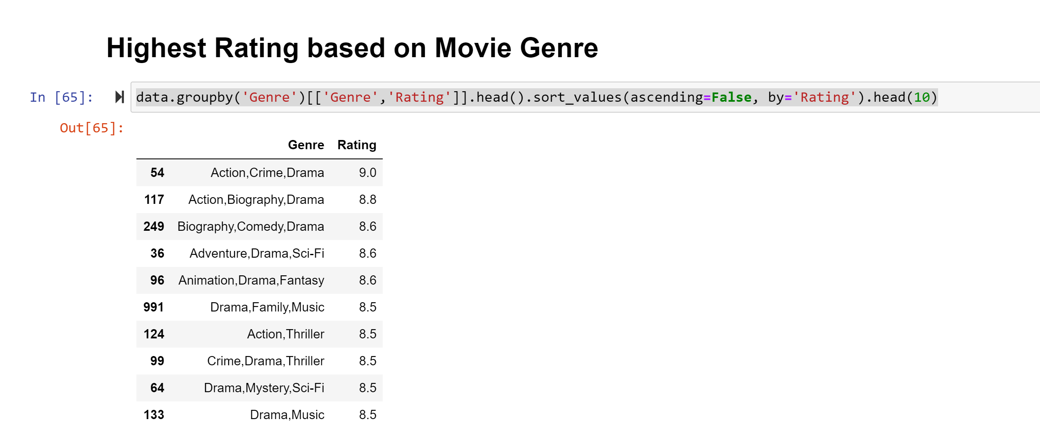

Slide 14
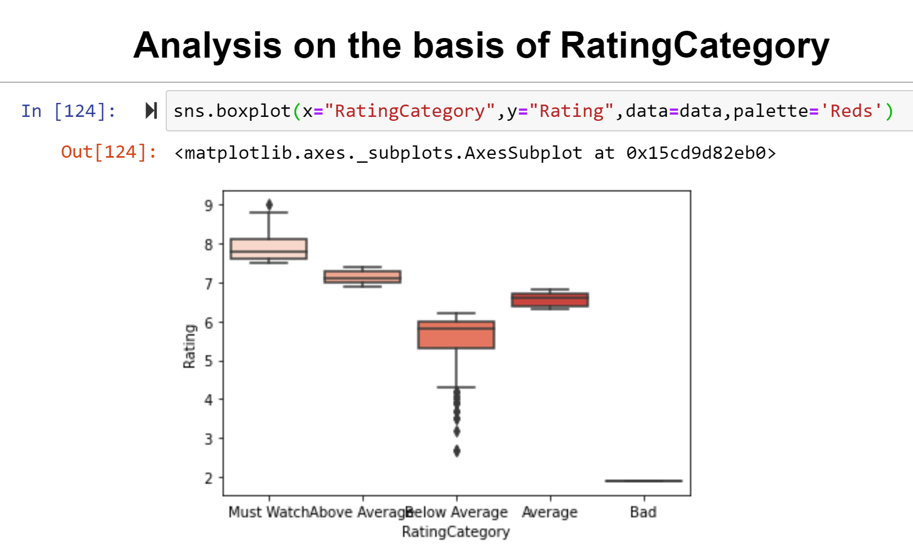

Slide 15
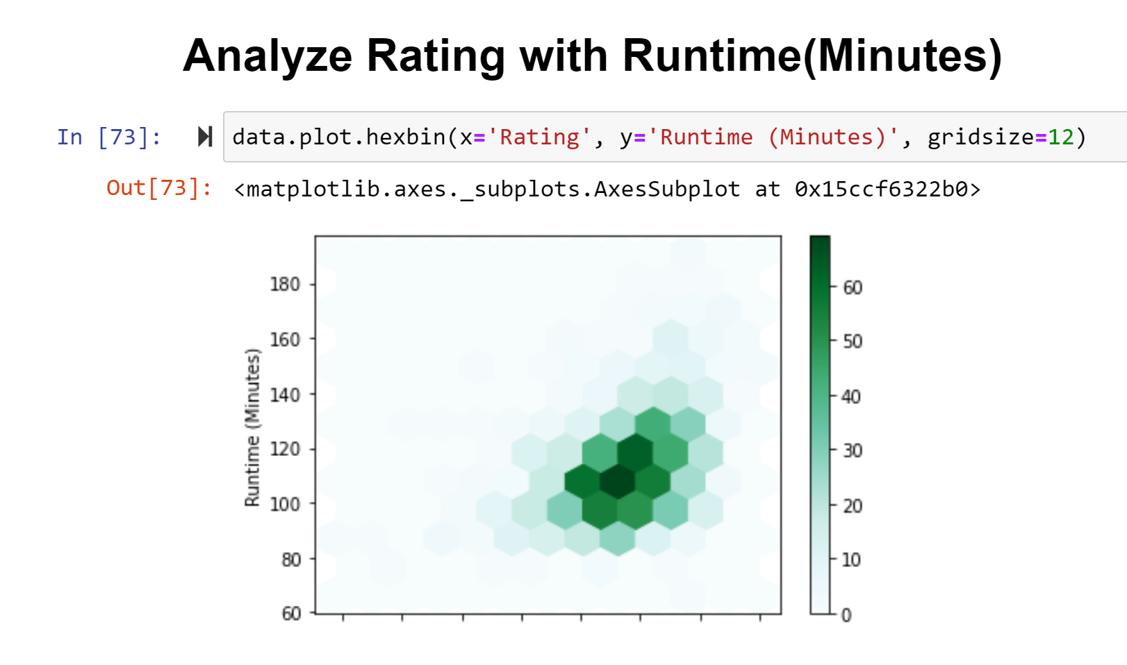

Slide 16
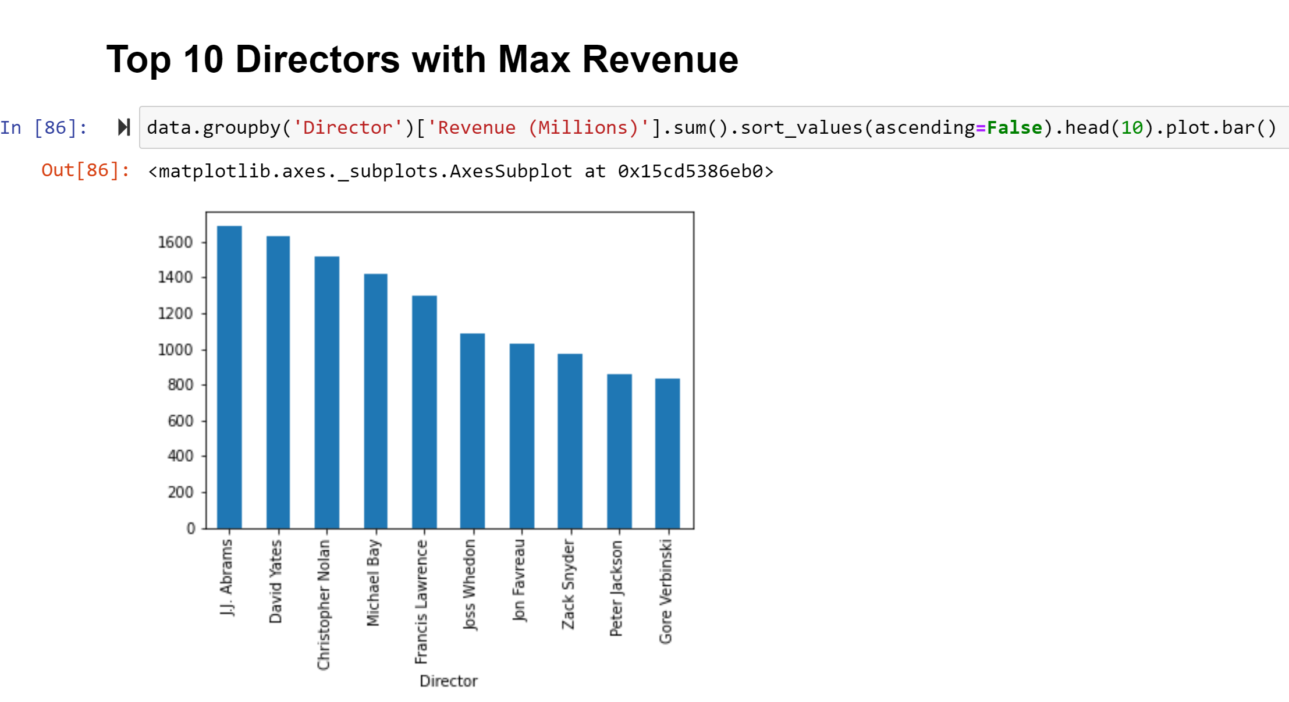

Slide 17
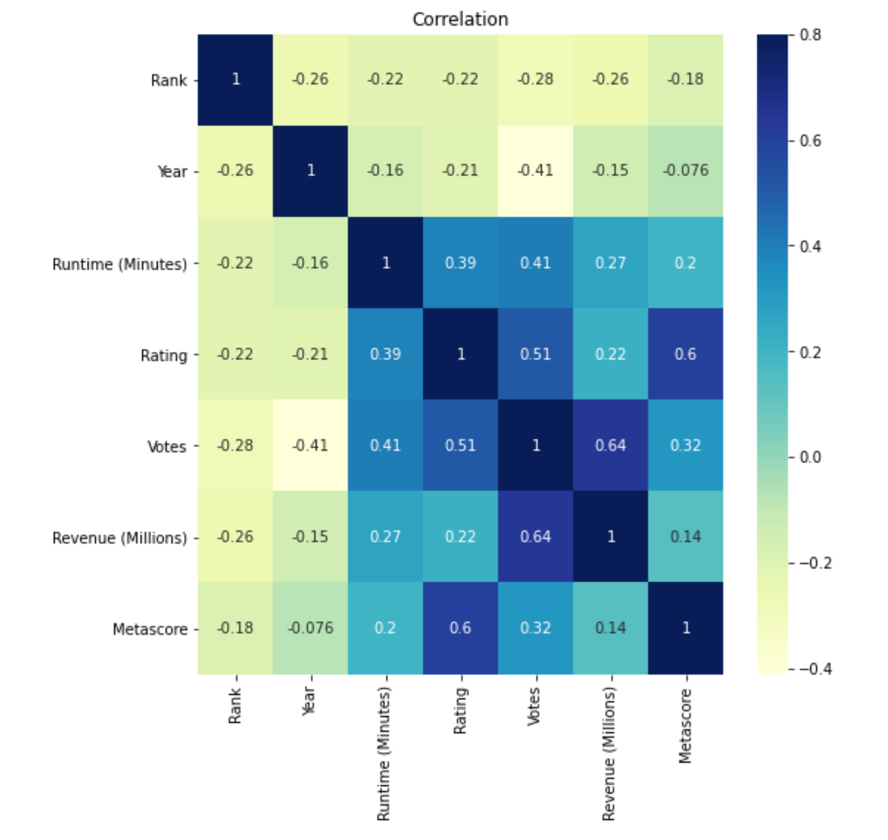

Slide 18
Summary
This Movie Data contains 1000 rows and 12 columns.
The Data had very less missing values and that too in Revenue and Metadata feature only.
Pre and Post Profiling has been done using the panda profiling.
Most of the movies released in 2013, 2014, 2015, and 2016.
Maximum number of movies were released in year 2016.
Most successful year in terms of revenue was year 2016.
Action, Adventure, Sci-Fi is the most revenue generating Movie genre.
Rating Category column was created by categorizing the Rating data, which helped us see how movie can be categorized as 'Bad' , 'Below Average', 'Average', 'Above Average', 'Must Watch', which can give more insight of its quality.
Rating of Movie is highly co-related with Votes and Meta scores of the movie.

