Slide 1

HOUSE SALE PRICE PREDICTION
Submitted By: PAVANI SAI
INSAID Batch: AUGUST 2020

Slide 2
Agenda
Introduction
About Dataset
Exploratory Data Analysis
Random Forest Regression
Visualizing A Single Decision Tree From Our Random Forest Model
Feature Importance
Visualizing The Actual & Predicted Values

Slide 3
1. Introduction
Our goal for this project is to use regression technique in order to estimate the SalePrice (in dollars) for a particular house as a function of 81 explanatory variables describing (almost) every aspect of a house.
We want to find a function that given input data for these 81 explanatory variables predicts the SalePrice of a house.
Which feature contribute to saleprice?
Visualize the relationship between the features and the response.

Slide 4
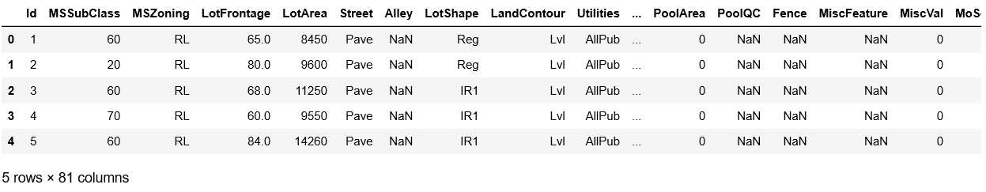
2. About Dataset
The dataset comprises of 1460 observations of 81 columns.
What are the features?
There are 81 features. For example, Id, MSSubclass, MSZoning, LotArea, etc.
What is the response?
SalePrice: property's sale price in dollars (this is the target variable that we are trying to predict)

Slide 5
3. Exploratory Data Analysis

Slide 6
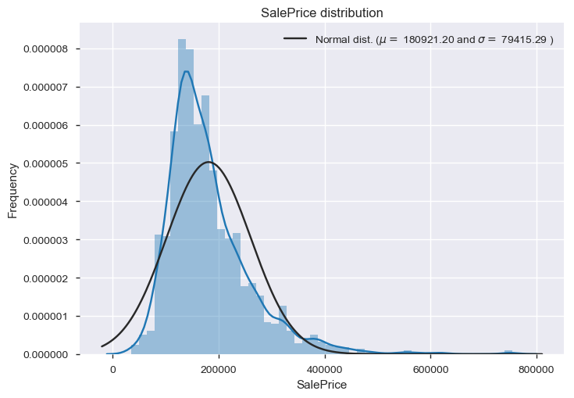
Sale Price Distribution
We can see that there is a very nice peak. However, we can see that the sale prices deviate from the normal distribution.

Slide 7
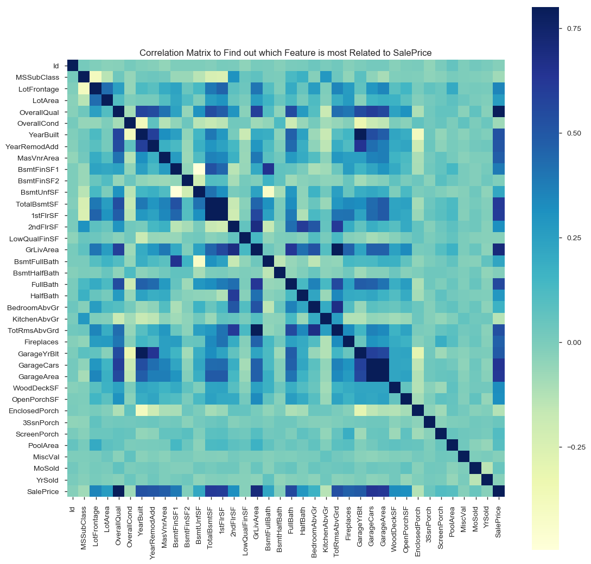
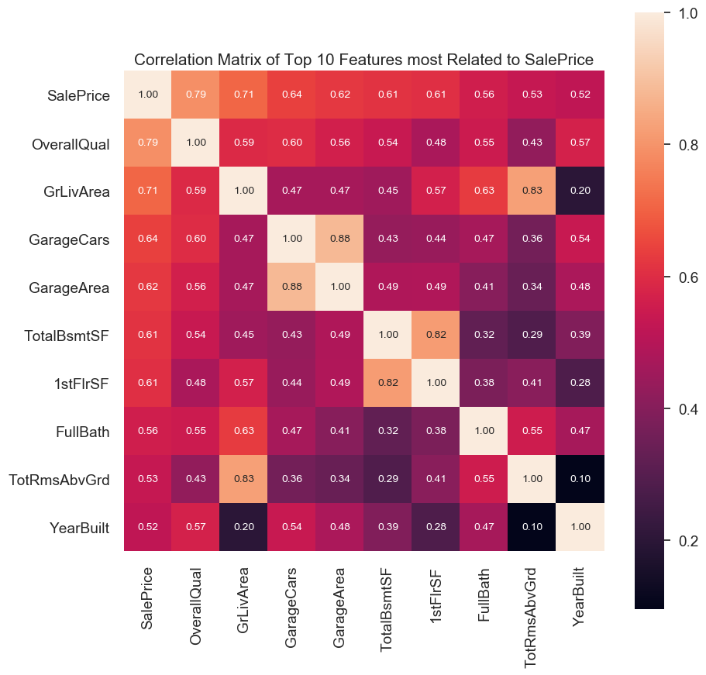
Correlation Matrix to Find out which Features are most Related to SalePrice
All Features
Top 10 Features

Slide 8
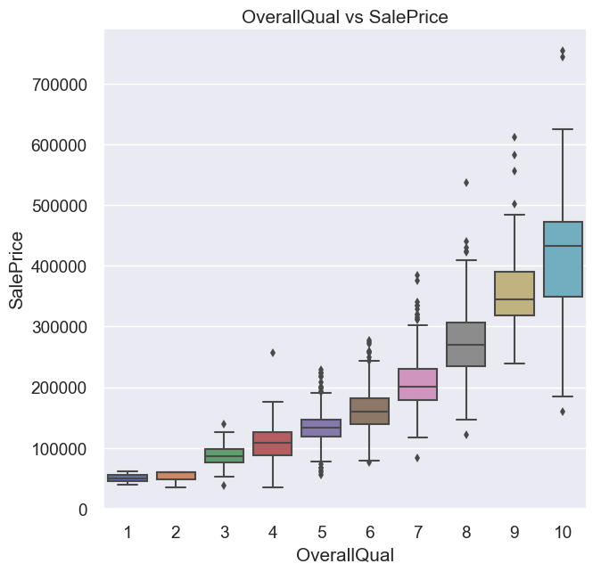
OverallQual vs SalePrice
SalePrice increses with OverallQual. The distribution looks good.

Slide 9
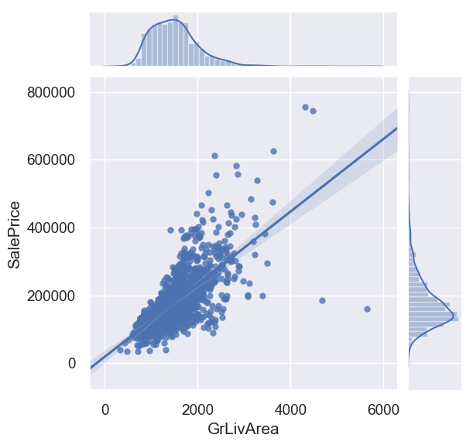
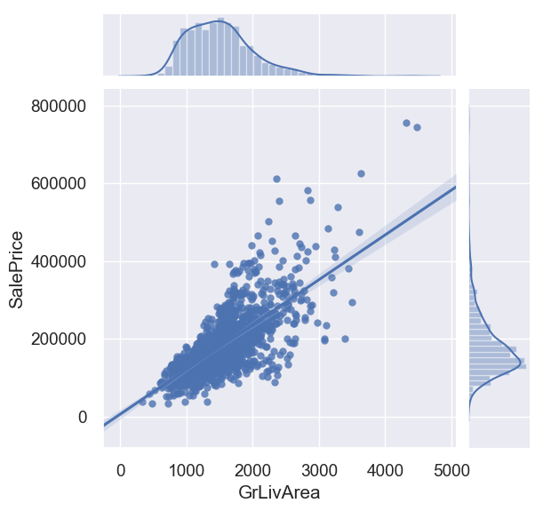
GrLivArea vs SalePrice
After
Before
SalePrice increases with GrLivArea.
There are 2 outliers to this as we can see in the bottom-right of the plot. So, we have to remove these outliers for better data analysis.

Slide 10
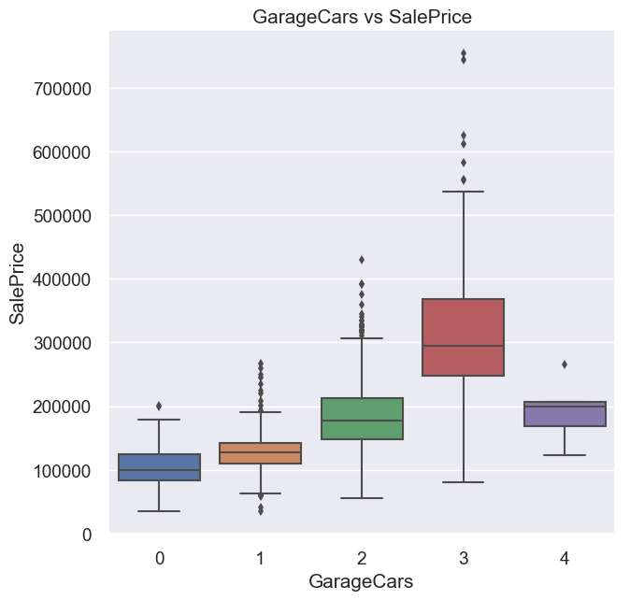
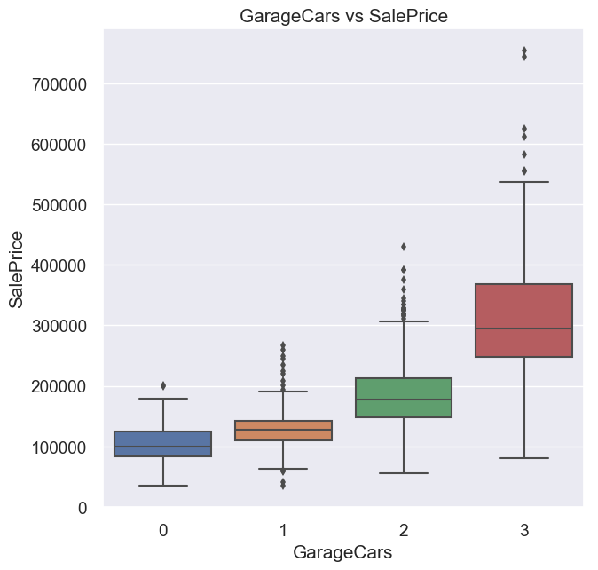
GarageCars vs SalePrice
Before
After
SalePrice increases with GarageCars.
There is 1 outlier to this as we can see in the right-side of the plot that 4-car garages result in less SalePrice. So, we will have to take care of this outlier.

Slide 11
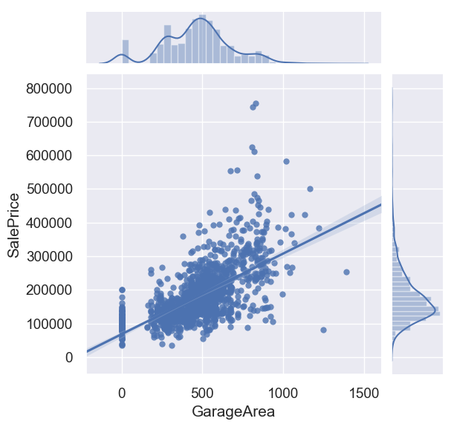
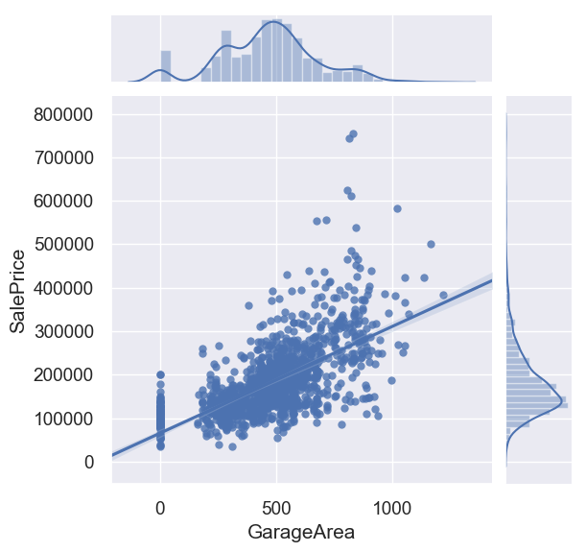
GarageArea vs SalePrice
Before
After
SalePrice increases with GarageArea.
There are 2 outliers to this as we can see in the bottom-right of the plot. Again, we will have to remove these 2 outliers.

Slide 12
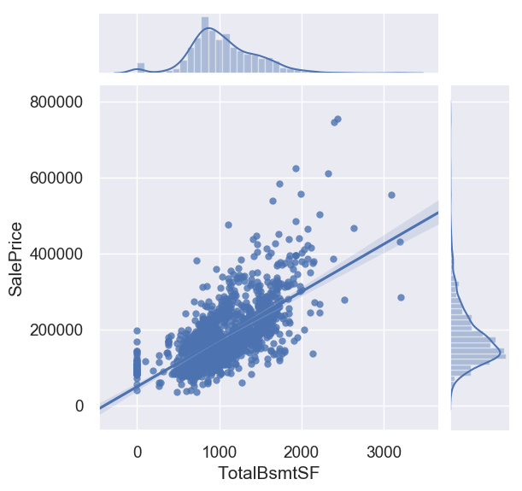

TotalBsmtSF vs SalePrice
Before
After
SalePrice increases with TotalBsmtSF.
There is 1 outlier to this as we can see in the bottom-right of the plot.

Slide 13
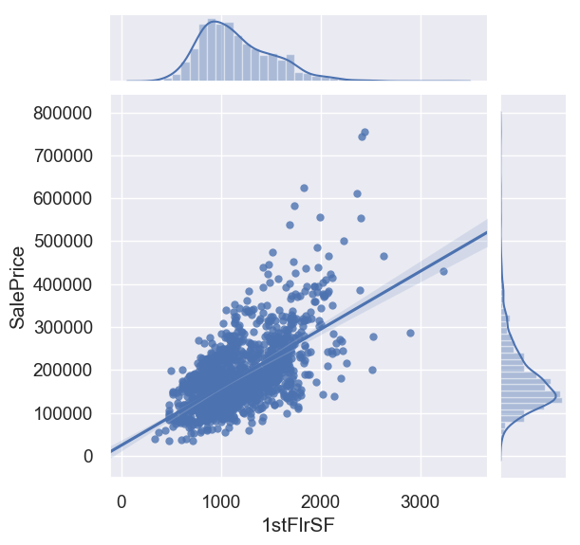
1stFlrSF vs SalePrice
SalePrice increases with 1stFlrSF. The distribution looks good.

Slide 14
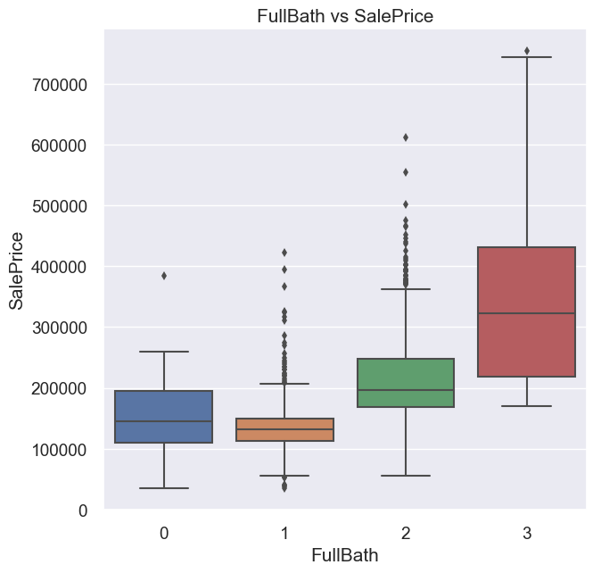
FullBath vs SalePrice
SalePrice increases with number of FullBath. The distribution looks good.

Slide 15
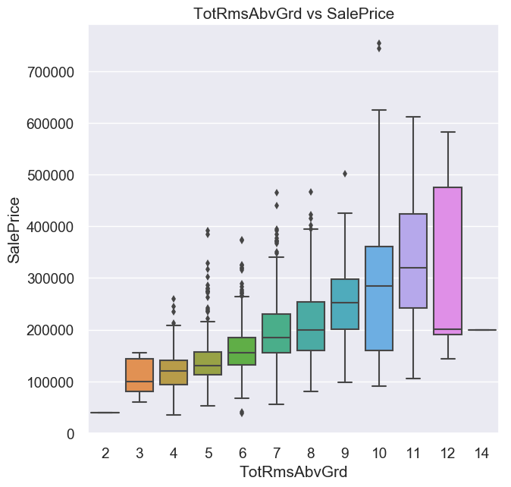
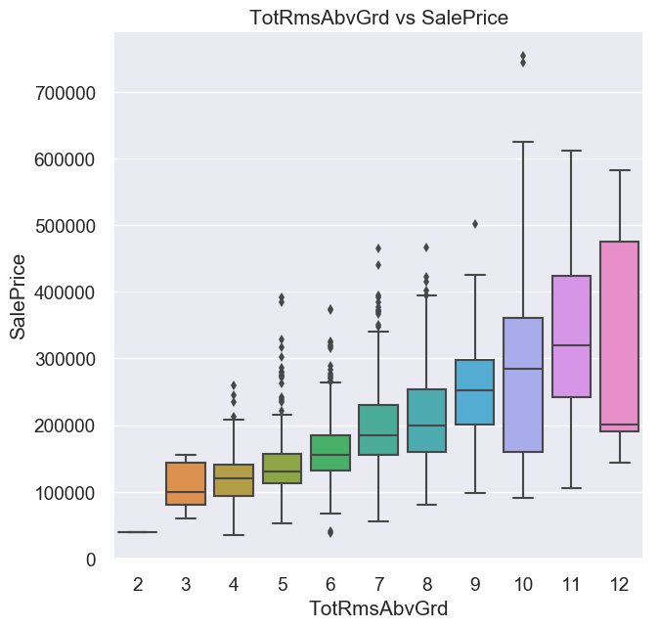
TotRmsAbvGrd vs SalePrice
Before
After
SalePrice overall increses with TotRmsAbvGrd.
There is 1 outlier to this as we can see that 14 Rooms house has a SalePrice less than even 7 Rooms house. So, we will have to take care of this outlier.

Slide 16
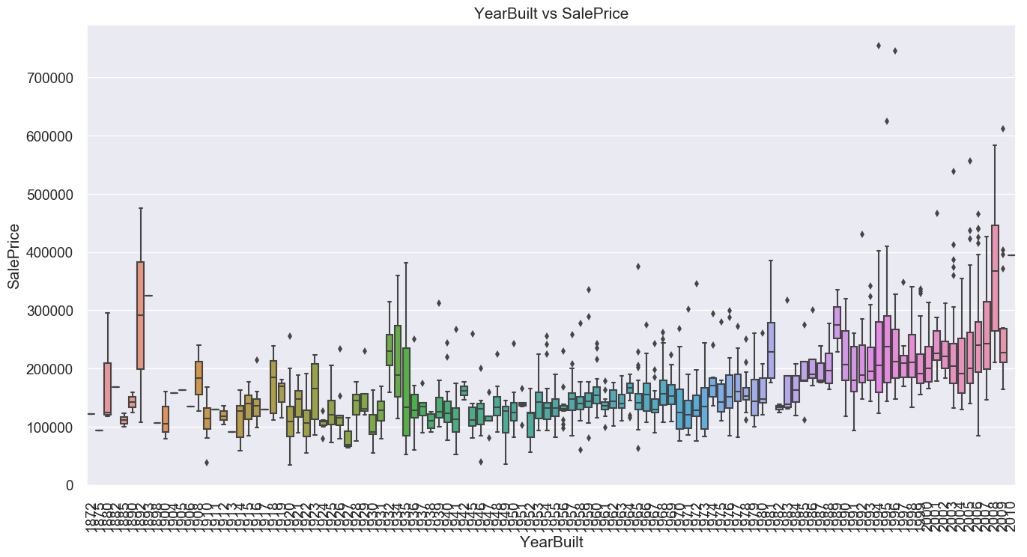
YearBuilt vs SalePrice
SalePrice in general is more for new houses than old houses. The distribution looks good.

Slide 17
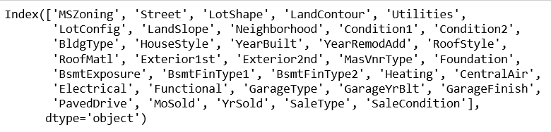
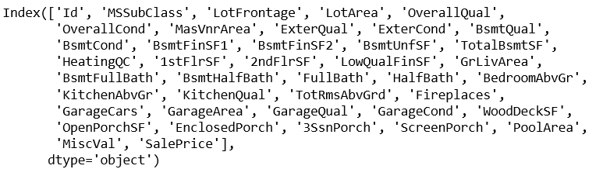
Dealing with Missing Values
Whichever feature column has more than 50% missing values, we have dropped that feature column. List of dropped feature columns are: Alley, FireplaceQu, Fence, MiscFeature, PoolQC.
Whichever feature column has less than 50% missing values, we have kept that feature column.
If the feature column is a numerical column, then we replaced the missing values with the median values.
If the feature column is a categorical column, then we replaced the missing values with the mode value.
Feature Engineering
The Year & Month related features have been interpreted as numerical when they are actually categorical. Thus, we transformed these features from numerical to categorical.
There are some categorical features that actually has a particular order just like in feedback forms (Ex, VGood, Good, Fair, Poor). Few examples of such ordinal categorical features in the dataset are: BsmtQual, KitchenQual, GarageQual etc. So, we transformed the ordinal categorical features to numerical features.
List of Categorical Features after Data Preprocessing
List of Numerical Features after Data Preprocessing

Slide 18
4. Random Forest Regression

Slide 19
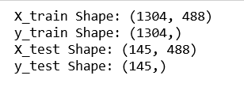
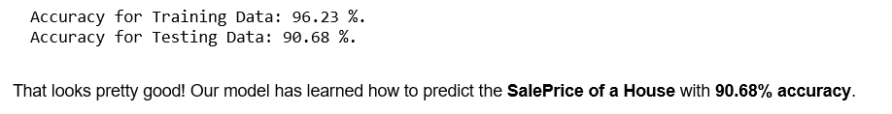
Splitting X (Predictor) & y (Response) Dataset into Train & Test Split
After testing with the parameters, the best result in my case was observed at:
Training : 90 %
Testing : 10 %
Random Forest Regressor
After testing with the parameters, the best result in my case was observed at:
n_estimators : 260
criterion : mse
max_depth : None
min_samples_split : 2
max_features : auto

Slide 20
5. Visualizing A Single Decision Tree From Our Random Forest Model

Slide 21
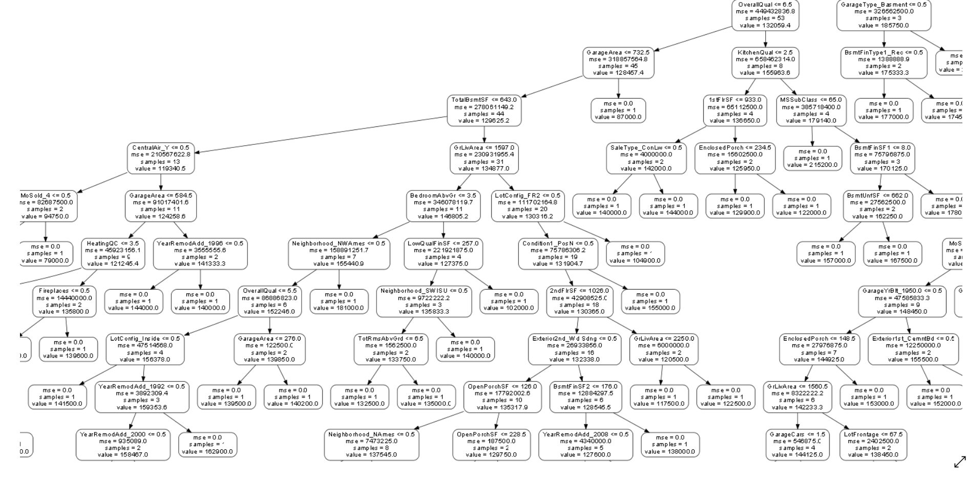
A zoomed-in look at one of the cross-section of the Tree

Slide 22
6. Feature Importance

Slide 23
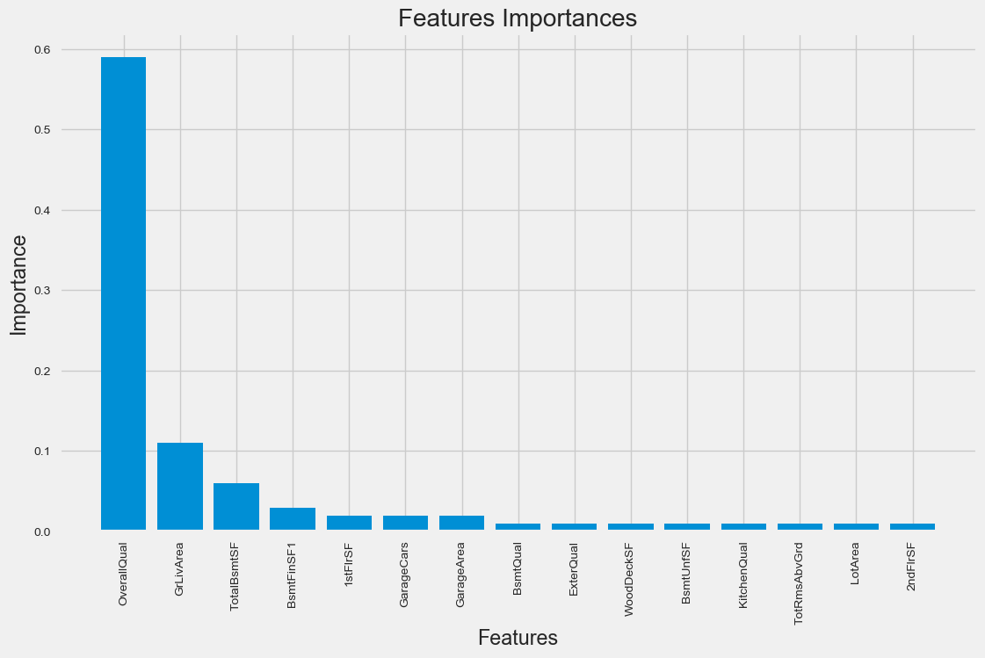
From the above observations we can see that:
OverallQual (with 59% importance among all the features) is the most important feature in determining the SalePrice of a House.
The other features that influence the SalePrice of a House include GrLivArea, TotalBsmtSF, BsmtFinSF1, 1stFlrSF, GarageArea, TotRmsAbvGrd, BsmtUnfSF, BsmtQual, ExterQual, GarageCars, WoodDeckSF, KitchenQual, LotArea & 2ndFlrSF.
The above mentioned 15 features together contribute 93% in determining the SalePrice of a House.
The rest of the features contribute just 7% in determination of SalePrice of a House.

Slide 24
7. Visualizing The Actual & Predicted Values

Slide 25
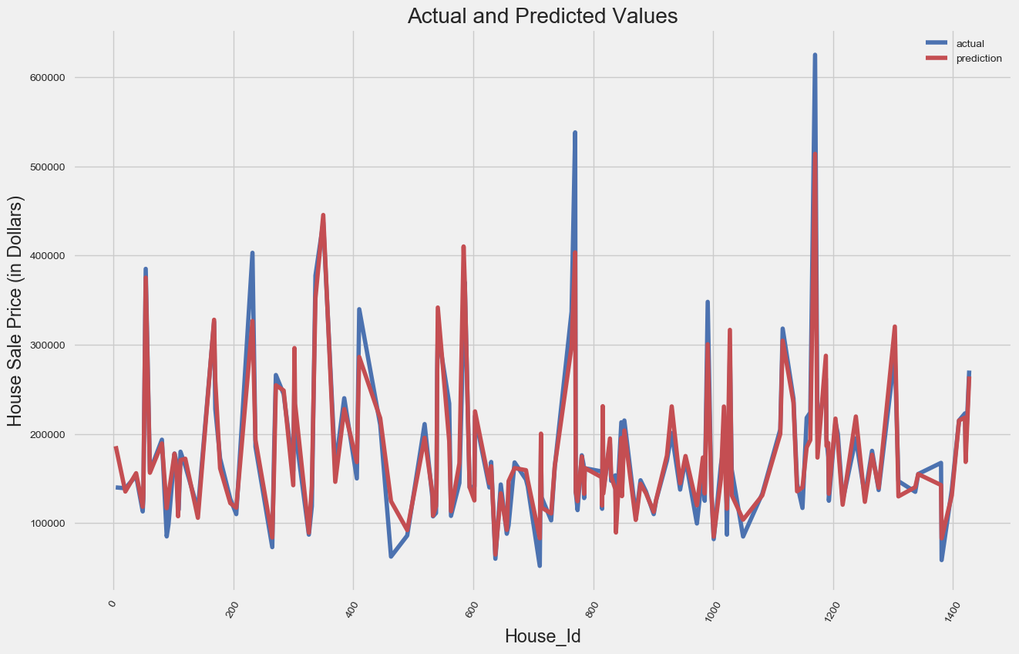
A nice plot to check how our model has performed. By observing the overlapping between the Actual & Predicted values, we can conclude that our model has performed fairly well.

