Slide 1

Text Summarization from Real-Time Speech Recognition
Achala Samudrala –11519259 (Team Lead)
Pavani Mangugari –11542749
Tharun Puri – 11558533
Venkata Sai Preetham Bonthala – 11550407

Slide 2
MOTIVATION
Information retrieval is one of the most widely needed use cases these days. The process of extracting the summary of a video lecture while remembering it and manually writing a summary is a time taking and intensive task for humans.
Speech recognition would mean converting the speech to text in the real-time scenario i.e., exactly converting the words with means of pronunciation.
Text summarization is defined as the process of finding the meanings of difficult words and gets summarized to the shorter version where we can find them easily.
So, we plan to develop a model that would take the lecture and interpret and summarize it.
Additionally, we are using SR with text summarization to get Questions and Answers that would help the students review their knowledge regarding the lecture and automatically check the correctness.

Slide 3
SIGNIFICANCE
In this age where remote education and online videos are becoming hugely popular, the need for a model that can convert speech to text is necessary.
The model would not only help a lot of users, who having problems understanding the language, but it would also help users with disabilities too.
This project aims to ease online learning and help users who are struggling whilst listening to these classes and get a concise overview of the lecture in their native language.

Slide 4
OBJECTIVES
We are implementing all these steps in our project.
Speech to Text
Text Summarization
Q&A module.
We are planning to do the project using speech-to-text, text summarization, and other training models.
We are at the end of the project planning to achieve an interface that would take the video input that converts it to a text summary.
In turn it uses this summary to build a Q/A model and Machine Translator for translating it to another language (Spanish/French).

Slide 5
FEATURES
The video speech is converted into text using the python modules that would allow for the speech to turn into text.
Using a machine translation, we convert the text into French or Spanish. We get the questions and answers from the summary.
The user would be allowed to click for a correct answer.
The answer would then be evaluated by the machine and returns if the user is right or wrong.

Slide 6
RELATED WORK
They have considered that the system should consider the word-by-word from multiple speakers at a time so that it can identify the number of speakers.
In this they have taken isolated word recognition and continuous phoneme recognition in a cued speech.
They got 94% and 89% accuracy for normal hearing and deaf people hearing.
In this paper they have used the Devanagari script for classifying their classes based on phonemes.
They have used the gaussian mixture model (GMM) and deep neural networks (DNN) to map the features. They have converted sign language into both text and speech.
For speech they have used google speech recognition and for object detection, they have used the YOLO V3 algorithm for that.
By considering the linear constraints, it prevents the input from converting features into unrealistic features.

Slide 7
DATASET
In the process of developing the application, we send audio data in the wav format. The application can handle data of long duration.
We tested the dataset of a university lecture about food processing. It is one hour long and has a lecture where there is one speaker.
Using the wave, we find the features of our dataset. We can see that we have 2 channels, with a sample width of 2.
The frame rate is 44100 and the number of frames is 175584384.

Slide 8
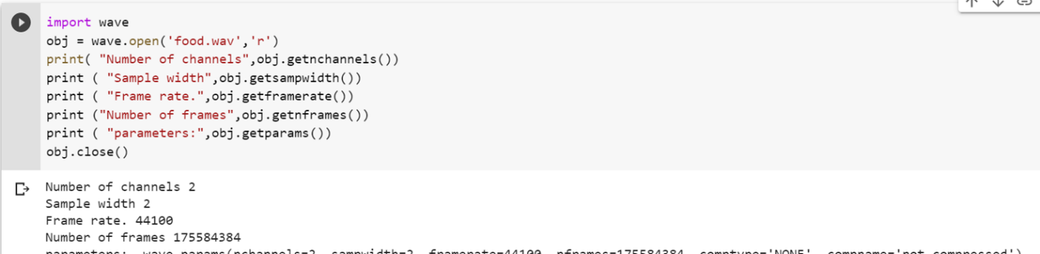
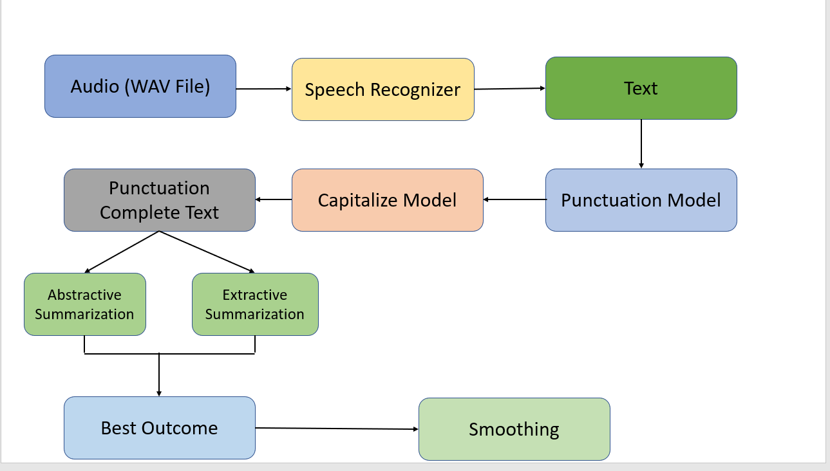
AUDIO FILE

Slide 9
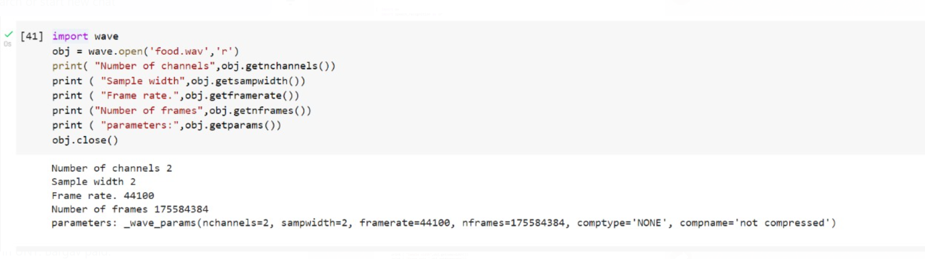
ANALYSIS
In the analysis phase, we try to take the audio input that we have taken and try to analyze it.
Later, we also try to analyze the differences in the word count in the original vs the summarized text in the summarizers that we have used.

Slide 10
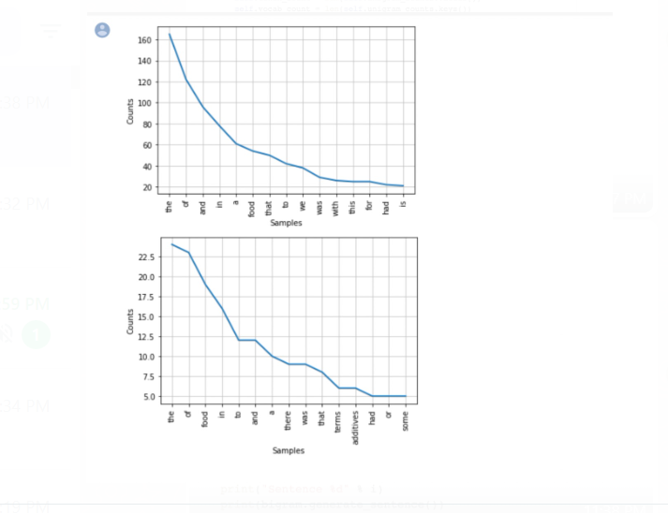
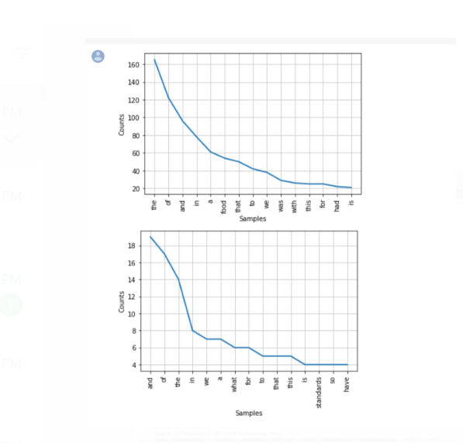
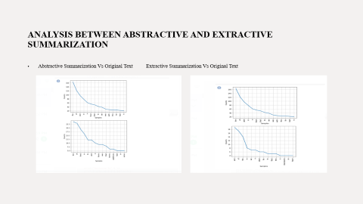
ANALYSIS BETWEEN ABSTRACTIVE AND EXTRACTIVE SUMMARIZATION
Abstractive Summarization Vs Original Text Extractive Summarization Vs Original Text

Slide 11
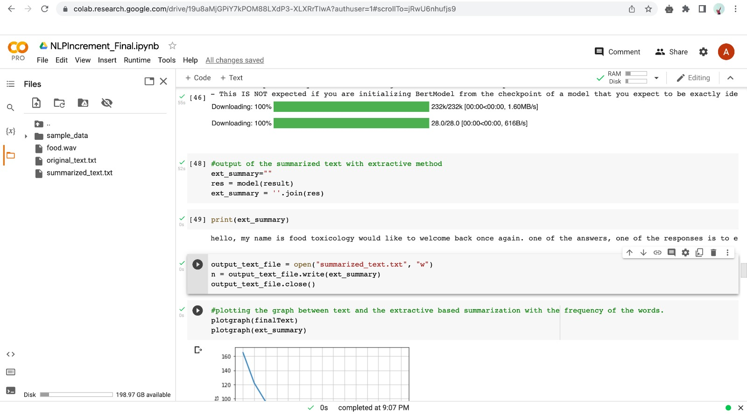
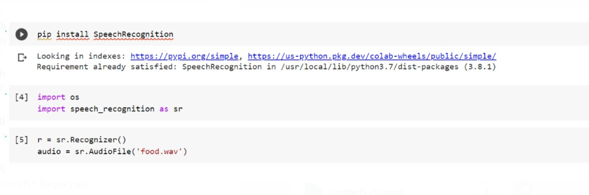
IMPLEMENTATION
Using the speech recognizer module for reading the audio file.

Slide 12
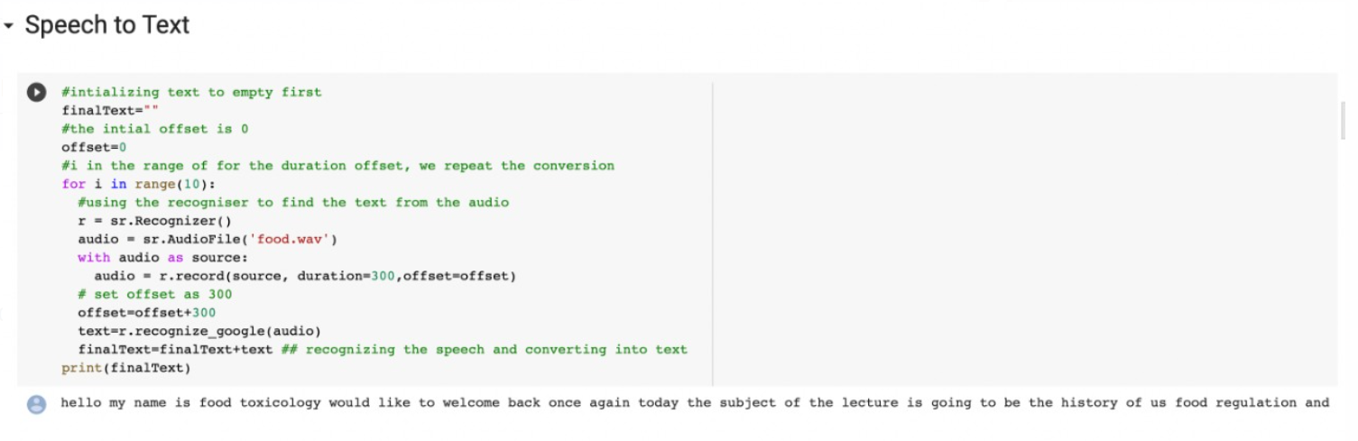
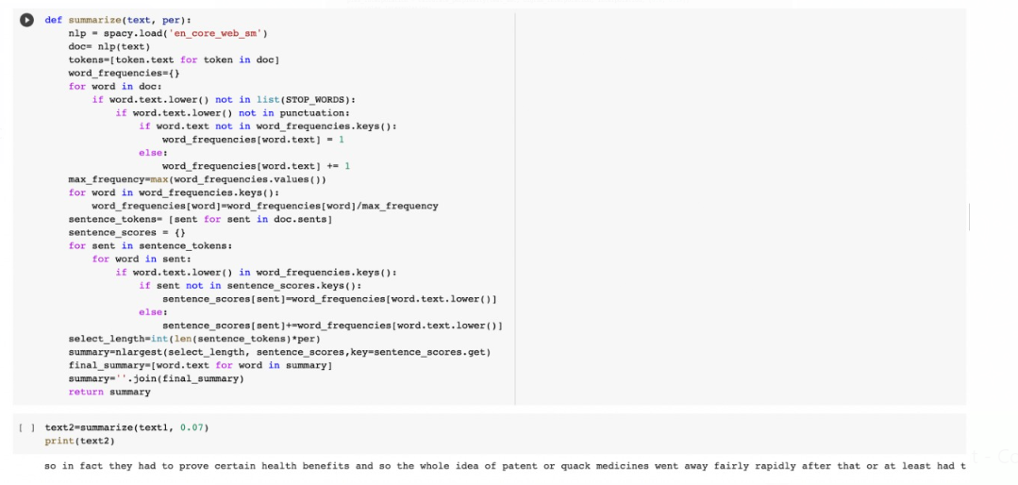
CONTINUED-1 IMPLEMENTATION
Using the speech recognition model, we get converted text We summarize text using abstractive summarization.

Slide 13
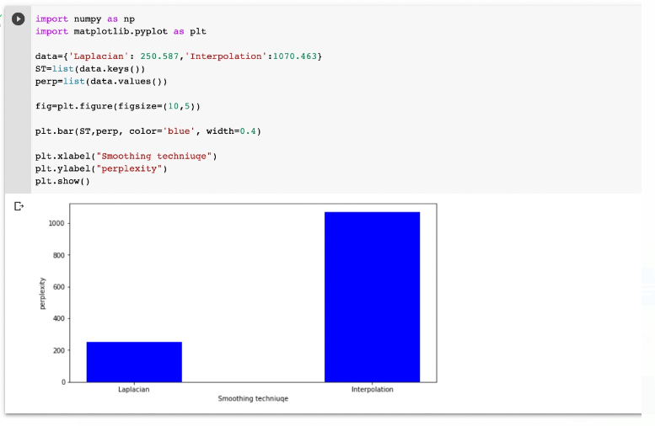
Results
Using the two models i.e., Laplacian and interpolation, we got the perplexities as shown below.

Slide 14
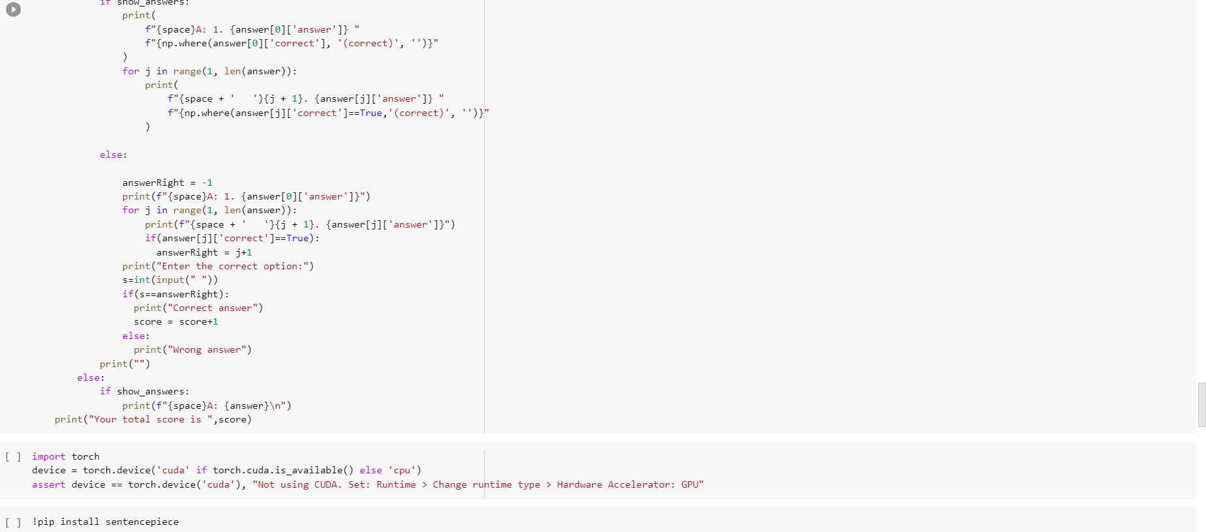
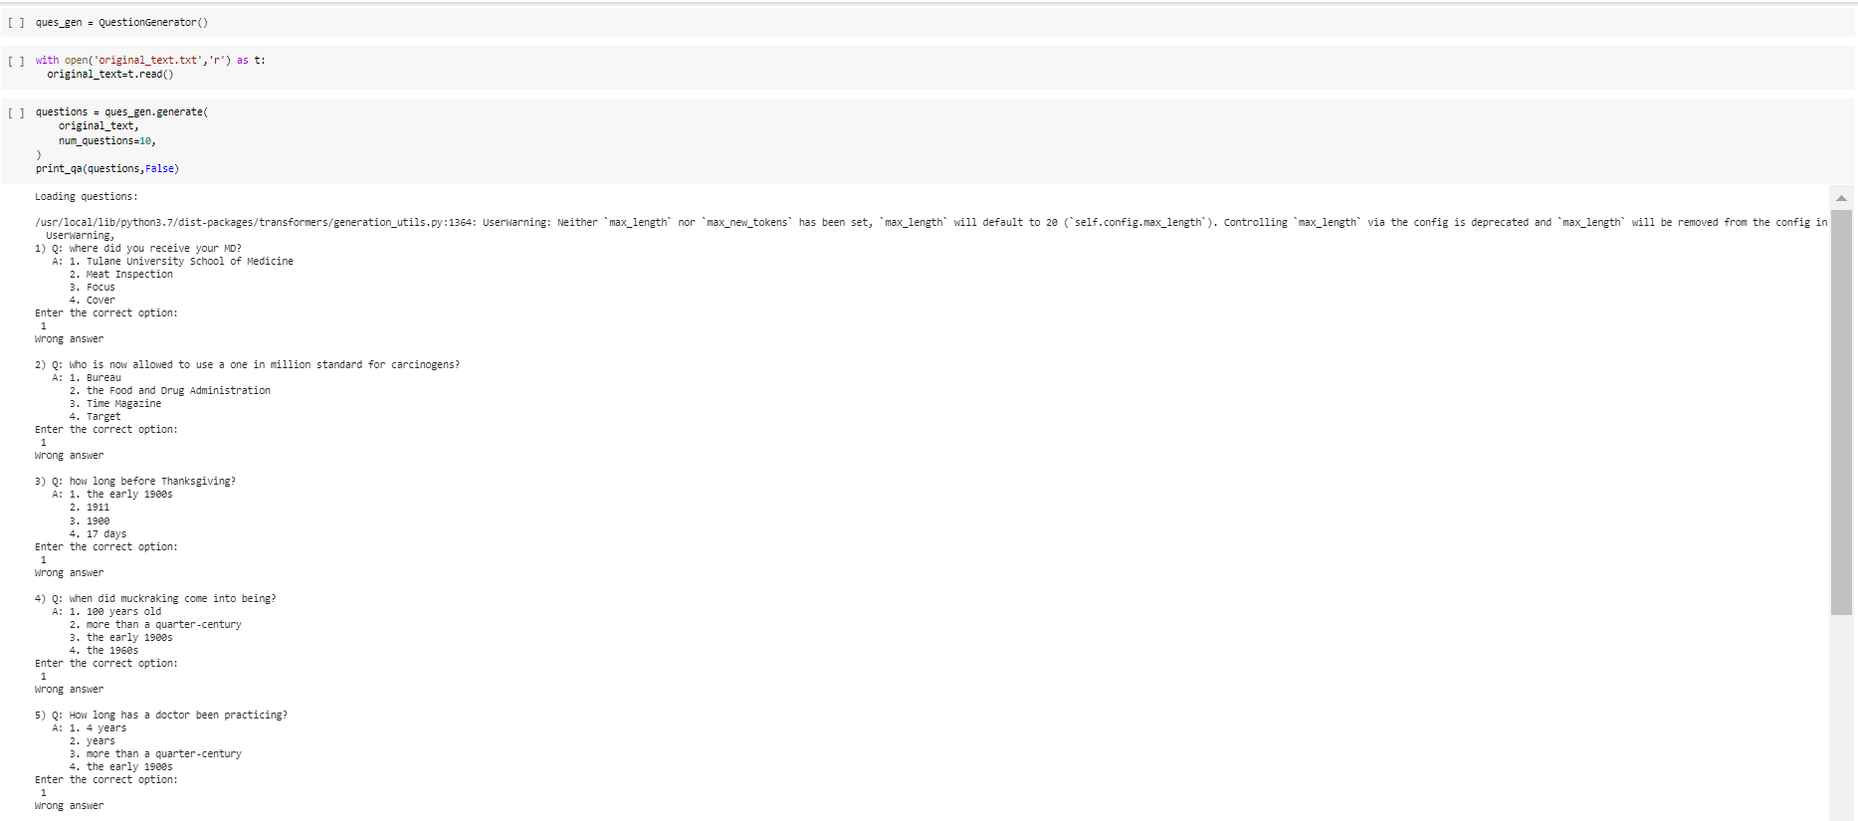
CONTINUED -1 RESULTS

Slide 15
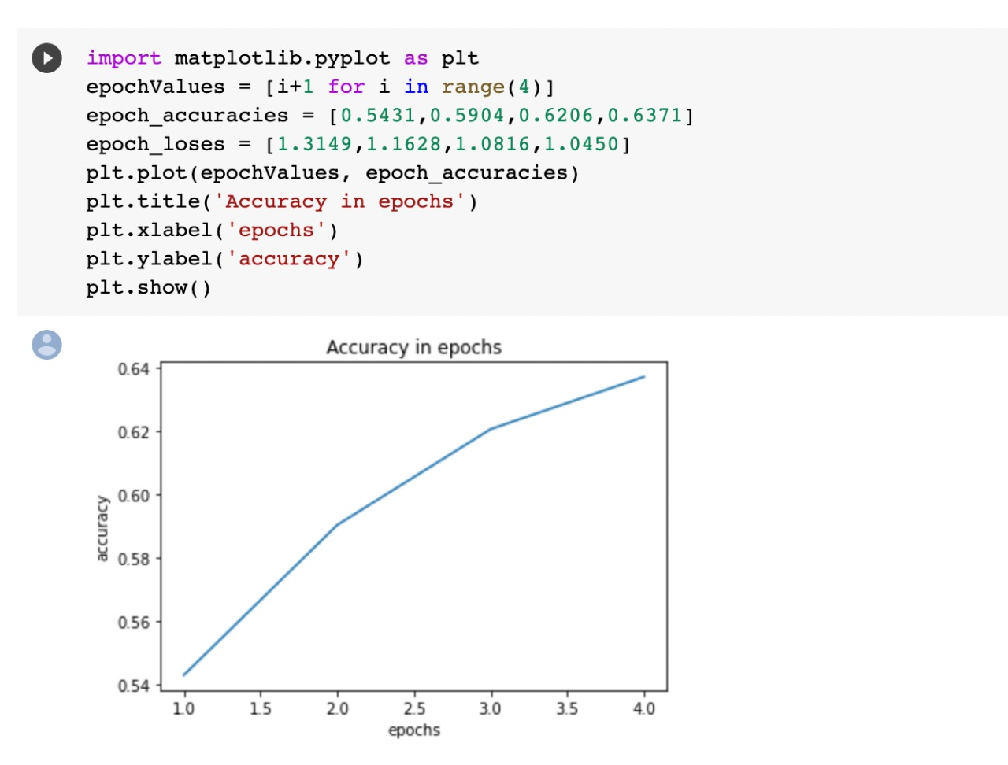
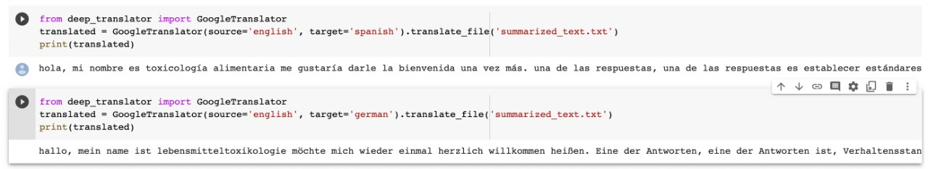
CONTINUED -1 RESULTS

Slide 16


