Slide 1
SecureIAC - Intelligent Multi-Agent Framework for Infrastructure-as-Code Security Analysis
Mentor : Dr. T. Adilakshmi
1602-23-733-026 J.Nithya
1602-23-733-027 D. Pavani
1602-23-733-046 K. Sathyanandam
CLOUD SECURITY · IAC · ARTIFICIAL INTELLIGENCE

Slide 2
Field & Scope
Core Technologies
AWS CloudFormation
Domain
IaC template format used as the primary analysis target for vulnerability scanning
Cloud Security & Artificial Intelligence
Focus
Retrieval-Augmented Generation
Automated vulnerability detection and remediation using Large Language Models
Continuously updated knowledge base of security best practices powering context-aware analysis
Application Domain
CI/CD workflows and cloud infrastructure security
Multi-Agent AI Orchestration
Specialized agents working in pipeline for parsing, detection, report generation and execution

Slide 3
Abstract
A multi-agent, AI-driven strategy employing Large Language Models, retrieval-augmented generation, and a continuously updated knowledge base for the detection and remediation of security vulnerabilities in cloud frameworks.
What the System Does
  Examines IaC templates alongside best-practice snippets from a live knowledge base
  Discerns context-specific misconfigurations commonly overlooked by static tools
  Provides automated remediation guidance anchored in current security standards
  Integrates seamlessly into standard CI/CD workflows

Slide 4
Infrastructure-as-a-Code
What is IaC?
  Infrastructure-as-Code (IaC) means creating and managing cloud infrastructure using code instead of manual configuration.
Example: A configuration file can automatically create:
EC2 Server | S3 Storage | Database | Network | Firewall
Why IaC?
  Automation – Deploy infrastructure in minutes.
  Consistency – Recreate the same environment reliably.
  Version Control – Track infrastructure changes using Git.
  Scalability – Easily add/remove cloud resources.

Slide 5
Problem Definition
  Modern cloud infrastructures are increasingly created and managed using Infrastructure-as-Code (IaC) such as Terraform and AWS CloudFormation.
  Misconfigurations in IaC can introduce serious security vulnerabilities, such as overly permissive IAM policies, publicly accessible resources, unencrypted storage, and insecure network configurations.
  Existing rule-based and static security tools are effective for known vulnerabilities but often struggle to identify context-dependent or complex security issues.
  These tools may also generate false positives and generally require developers to manually understand and remediate the detected issues.
  Therefore, there is a need for an AI-driven, context-aware security system that can detect vulnerabilities, explain their impact, retrieve relevant security guidelines, and provide actionable remediation.

Slide 6
Methodology
LLM-Driven Analysis
LLMs interprets structured and unstructured inputs, detecting nuanced, context-specific misconfigurations
Retrieval-Augmented Generation
Continuously updated vector database of AWS Well-Architected Framework and CIS Benchmarks enables context-aware retrieval at query time
Multi-Agent Orchestration
Specialized AI agents automate vulnerability detection and remediation by scanning code and autonomously generating & applying security fixes in real time.

Slide 7
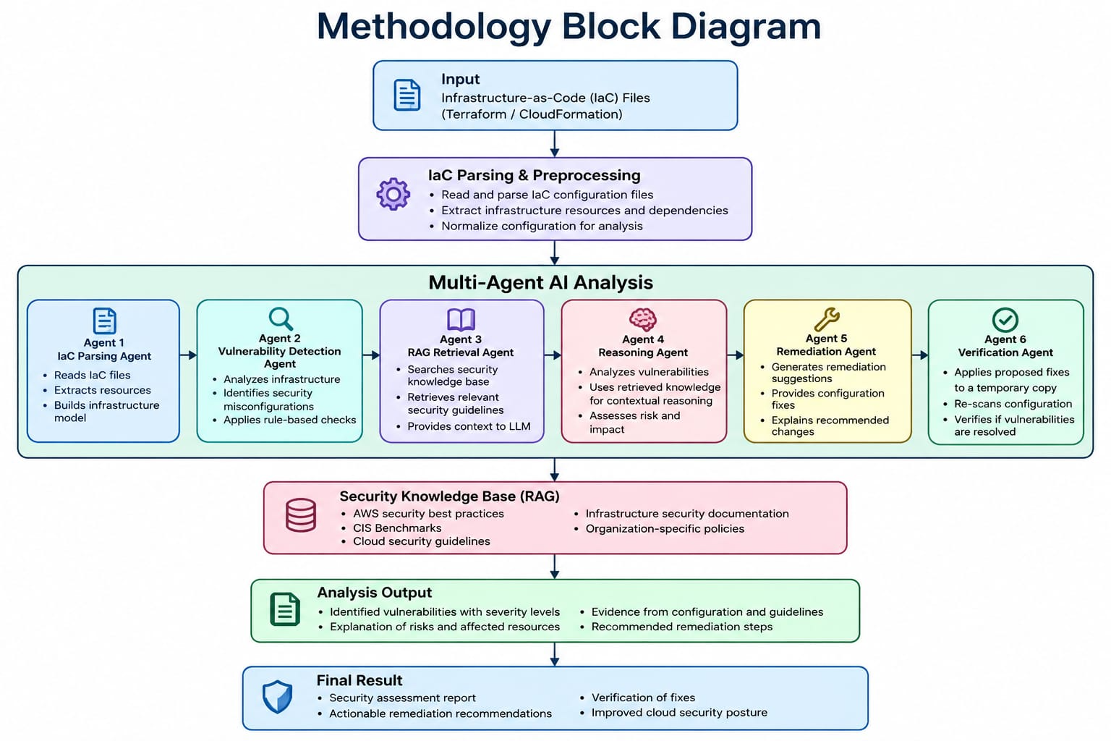

Slide 8
Uniqueness
  Fix–Verify–Close Loop – Detects vulnerabilities, applies fixes, re-scans the IaC, and verifies that the issue is completely resolved.
  Reachability-Aware Risk Analysis – Checks actual network and IAM configurations to determine whether a vulnerability is truly exploitable and reduce false positives.
  Organization-Specific Security Memory – Learns approved exceptions and adapts security recommendations according to the organization’s security policies.
  AI-Generated IaC Security Scanner – Specifically identifies security issues in Terraform and CloudFormation code generated by AI tools.
  Drift & Verification Watchdog – Detects manual cloud configuration changes that cause deployed infrastructure to differ from the last verified secure IaC.
  Explainable Security Findings – Converts complex scanner results into simple explanations, impact analysis, and clear remediation steps.
  Secure AI Remediation Agent – Monitors and restricts the AI agent’s permissions to minimize its potential blast radius and prevent unsafe changes.

Slide 9
Expected Results
  Improved vulnerability detection accuracy by combining rule-based scanning with AI reasoning.
  Reduced manual security effort through automated detection, remediation, and verification.
  Reduced false positives through context-aware analysis and RAG-based security knowledge.
  Actionable remediation suggestions with clear explanations, evidence, and severity levels.
  Successful fix validation by re-scanning the IaC configuration after remediation.
  Safer cloud deployment by identifying and resolving security issues before infrastructure is deployed.
  Adaptable security analysis using organization-specific policies and updated security guidelines.

Slide 10
Future Scope
  Multi-Cloud Support – Extend the system to Azure, GCP and Kubernetes.
  Advanced AI Feedback Loop – Learn from developer feedback to improve detection and remediation.
  Automated Knowledge Updates – Continuously update the security knowledge base with new policies and threats.
  Advanced Automated Remediation – Generate, apply and verify fixes with minimal manual intervention.
  CI/CD Integration – Integrate directly into DevOps pipelines for continuous IaC security monitoring.

