Slide 1
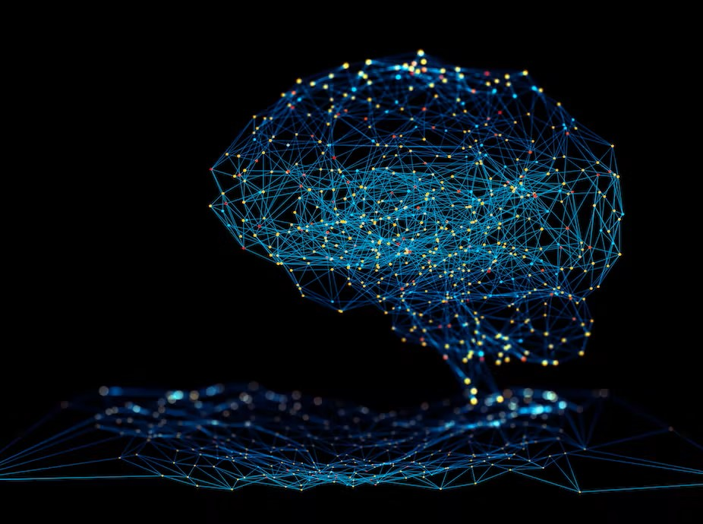
Image Recognition
Method Based on Deep Learning
Image recognition using deep learning has become a popular and effective method in recent years. It’s an advanced technology that is enabling several applications such as security surveillance, medical diagnosis, and driverless cars. Deep Learning has revolutionized the field of Image Recognition, enabling machines to identify objects with incredible accuracy and speed. In this presentation, we will explore how deep learning is changing the world of computer vision. This presentation will explore its motivation, problem statement, objectives, contributions, results, and references.
Video Link : https://drive.google.com/file/d/1tlCBrNsvRhaieS6XAvY4w6EOn9iG2tC8/view?usp=sharing
Name: Pavani Medavarthi
Student ID: 700741643

Slide 2
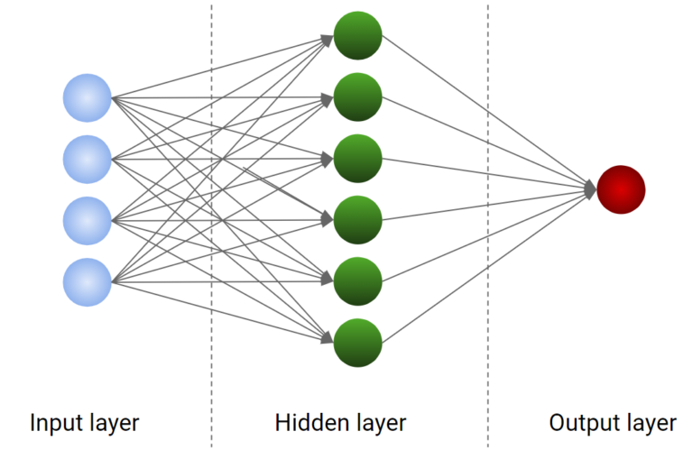
Problem Statement:
The problem addressed in this paper is the need for effective image recognition methods in computer vision.
Traditional methods based on handcrafted features, such as bags of visual words, have limitations in capturing complex visual patterns.
Deep learning algorithms aim to learn hierarchical representations to overcome these limitations and achieve better performance in image recognition tasks.

Slide 3
The Challenge of Image Recognition:
Complexity 🤯
Identifying objects in images is a complex task for computers
due to variations in lighting, background, and position.
Diversity 🌎
Images can contain objects from countless categories, each with its own unique features and challenges.
Accuracy 🎯
Recognizing objects with high accuracy is paramount,
as inaccuracies can dramatically affect applications such
as self-driving cars, medical imaging, and more.
Complexity
Diversity
Accuracy

Slide 4
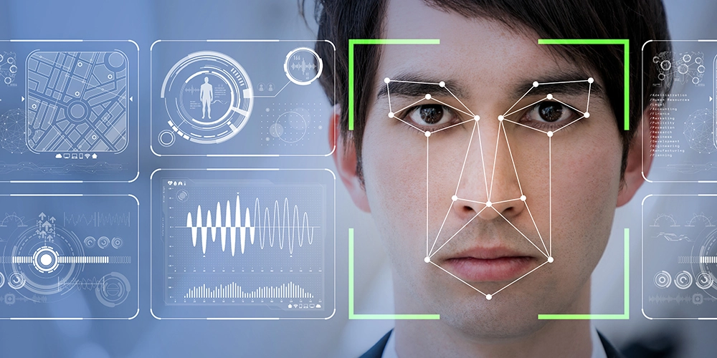
Objectives of Image Recognition:
Classification 🔍
One of the primary goals of Image Recognition is to classify or categorize objects in images accurately.
Detection 👀
Another important goal of Image Recognition is to detect the presence and location of objects within images.
Segregation 🎭
Image Recognition can also help segregate objects within an image and help to understand the various components of those objects.
Localization 📍
Image recognition extensively helps us localize or pinpoint the exact location of a particular object in the image, thus highlighting its features and properties.

Slide 5
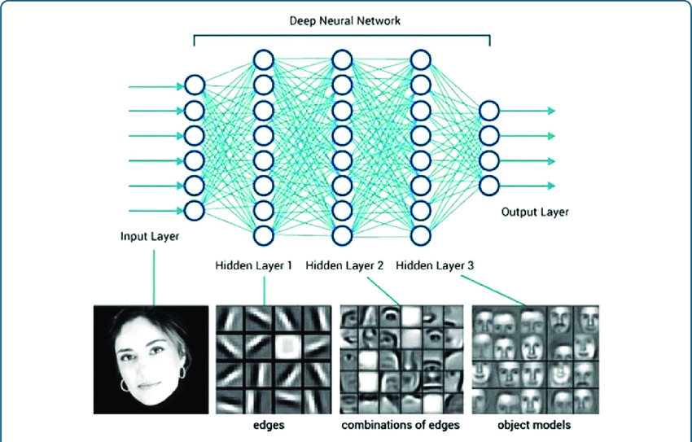
Contributions:
The paper summarizes the achievements of deep learning in various computer vision applications and compares the results on commonly used datasets.
It reviews recent developments and advancements in each of these categories, providing insights into their functions and performance.
This paper categorizes deep learning algorithms into four classes: CNNs, RBMs, Autoencoder, and Sparse Coding, based on their fundamental models.

Slide 6
Contributions:
Applications in Computer Vision: The paper outlines the applications of deep learning in computer vision, including image classification, object detection, image retrieval, semantic segmentation, and human pose estimation. It presents the achievements of deep learning algorithms in these tasks and compares their performance with traditional methods.
Future Trends and Challenges: The paper identifies several future trends in deep learning, such as increasing model capacity, combining information from multiple sources, and designing more specific deep networks. It also addresses the challenges faced in training with limited data and the need for a better theoretical understanding of deep learning algorithms.
Integration of Theoretical and Practical Aspects: The paper effectively combines theoretical insights with practical applications, making it useful for researchers, practitioners, and those interested in neural computing and computer vision.

Slide 7
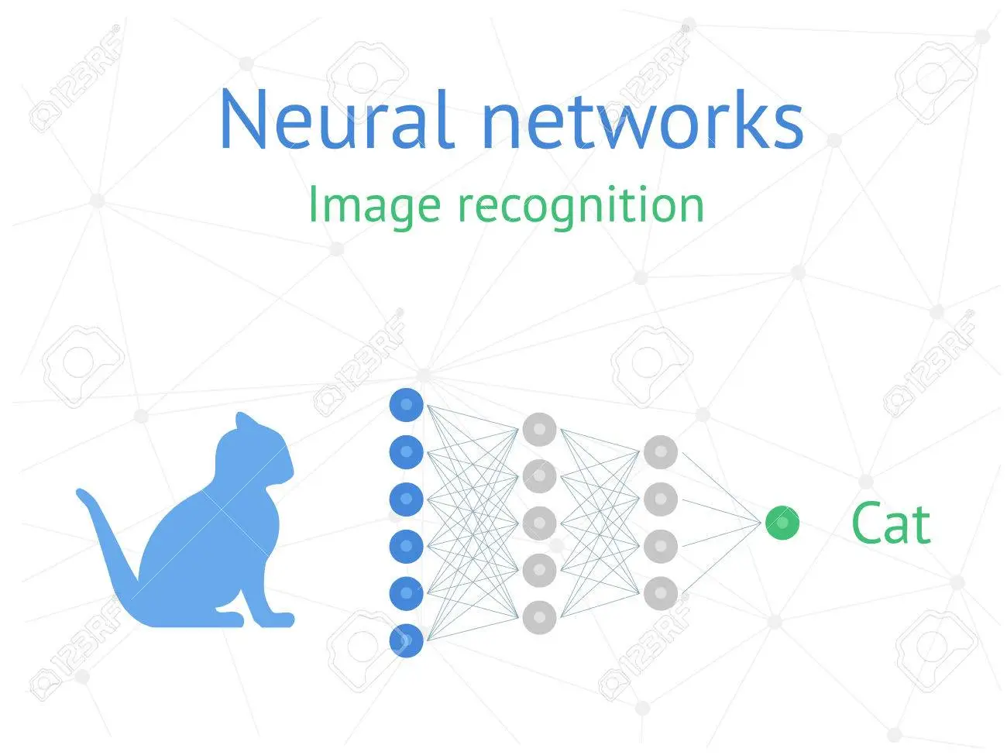
Results:
Deep learning algorithms, particularly CNNs, have achieved state-of-the-art results in various computer vision tasks, surpassing human-level performance in some cases.
CNNs have become the most commonly used and effective approach for image classification tasks, achieving remarkable accuracy scores.
Advances in regularization techniques, data augmentation, and pre-training/fine-tuning have contributed to the success of deep learning models in computer vision.

Slide 8
References:
[1] Bordes A, Glorot X, Weston J, et al. Joint learning of words and
meaning representations for open-text semantic parsing,in:
AISTATS, 2012.
[2] Ciresan D C, Meier U, Schmidhuber J. Transfer learning for Latin
and Chinese characters with deep neural networks, in:IJCNN,
2012.
[3] Ren J S J, Xu L. On Vectorization of Deep Convolutional Neural
Networks for Vision Tasks, in AAAI, 2015.
[4] Mikolov T, Sutskever I, Chen K, et al. Distributed representations
of words and phrases and their compositionality, in:NIPS, 2013.
[5] Srivastava N, Hinton G, Krizhevsky A, et al. Dropout: A simple
way to prevent neural networks from overfitting, The Journal of
MachineLearning Research,15(1): 1929-1958,2014.
[6] LeCun Y. Learning invariant feature hierarchies, in: ECCV
workshop, 2012.
[7] Bengio Y. Deep learning of representations: Looking forward,
Statistical Language and Speech Processing. Springer Berlin
Heidelberg,1-37,2013.
[8] Goroshin R, LeCun Y. Saturating auto-encoders, in: ICLR, 2013.
[9] Li H, Zhao R, Wang X. Highly efficient forward and backward
propagation of convolutional neural networks for pixelwise
classification,in: technical report, 2014.

