Slide 1



MOBILE RECHARGE PORTAL
Creating Values |
Impacting Lives |
Team Members:
Pavani Peddi(TL)
Mohammad Asma
Shaik Muntaaz
Rajeshwari Gannevaram
Navya Sanga
Presented by:
Pavani Peddi

Slide 2
Project Discription/Case study
Creating Values |
Impacting Lives |
Problem Statement
Solution
Online Mobile Recharge is a web-based application developed in to recharge mobile phones. The project focuses at providing an easy and reliable platforms to recharge mobile of any telecommunication company through online without buying recharge card.
Our recharge portal is fully SEO friendly that attracts the more customer for your business and generate more sales. Our professional has wide area of knowledge in the recharge industry and producing the flexible, reliable and accurate software.

Slide 3
Benefits
Creating Values |
Impacting Lives |
This is useful for customer to recharge mobile from anywhere and anytime.
Easy to get information as per requirement.
More user friendly since java is an easy language.
Maintain history of past as well as present recharges.
Reduces paperwork.
Very easy to maintain data and information about data.

Slide 4
Users with functions
Creating Values |
Impacting Lives |
Secure user login and registration with field validation and session management.
Able to add new mobile operator and company name.
Able to add new recharge plan with price and plan details on existing operator.
Able to recharge on mobile number that is associated with operator.
Recharge can be made with existing plan or custom price entered by user.
User can update its account details when logged into system.
User can change login credentials (password) when logged into system.
User can delete there account permanently when logged into system.

Slide 5

PROJECT ROADMAP
Creating Values |
Impacting Lives |
Application will be developed in follows sprints:
HTML
CSS
JavaScript
SQL
RDBMS
Java
Servlet ,JSP

Slide 6

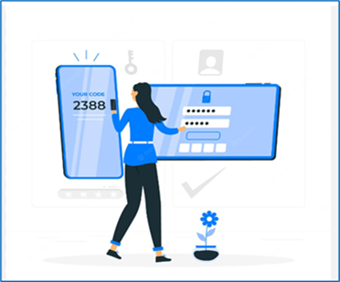






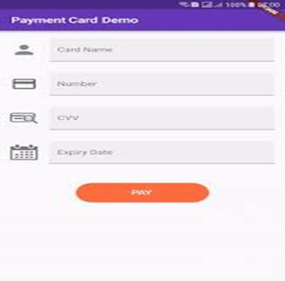
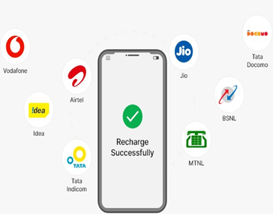
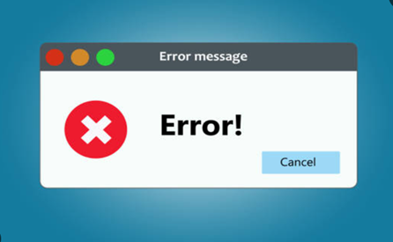
Project: Modules
Creating Values |
Impacting Lives |

Slide 7
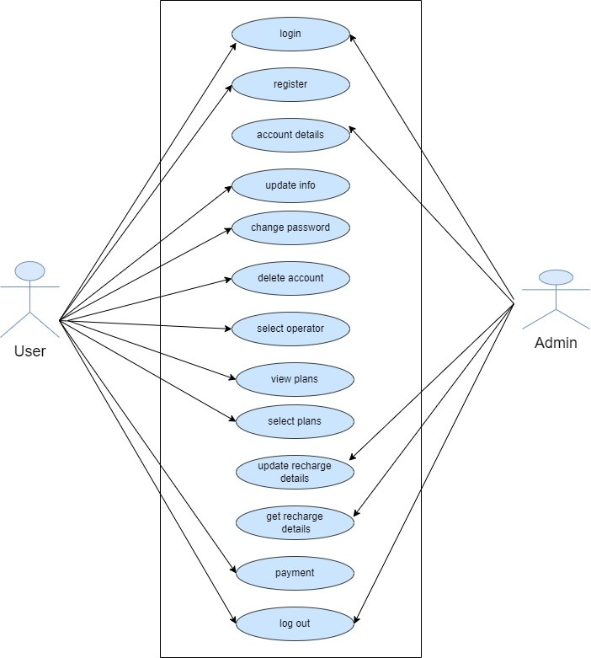
Project : Use Case Diagram
Creating Values |
Impacting Lives |

Slide 8
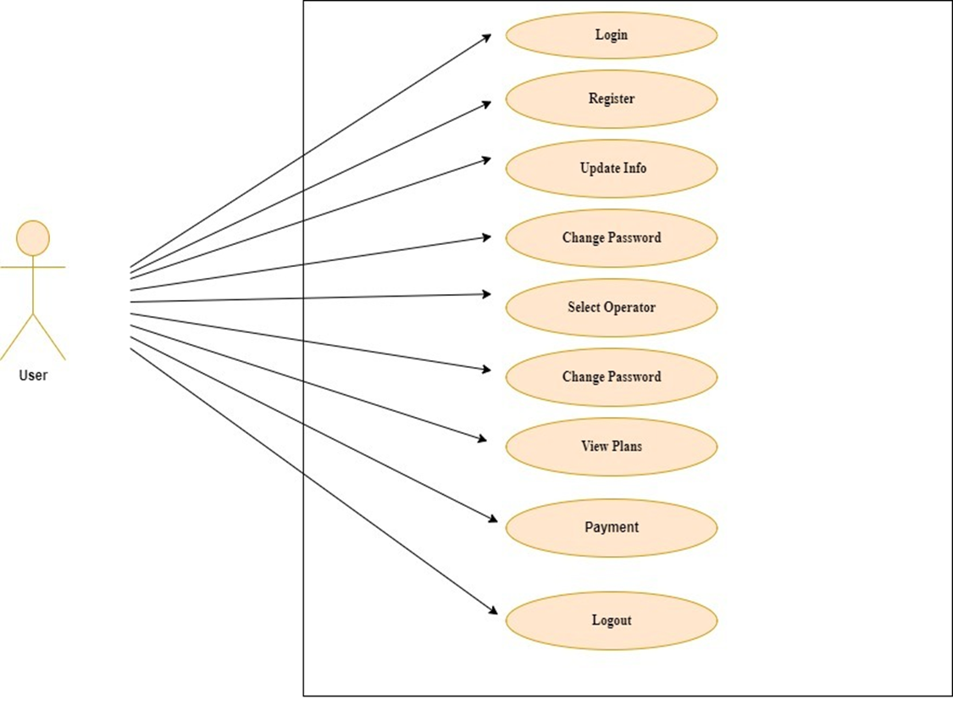
Creating Values |
Impacting Lives |
Project : Use Case Diagram

Slide 9
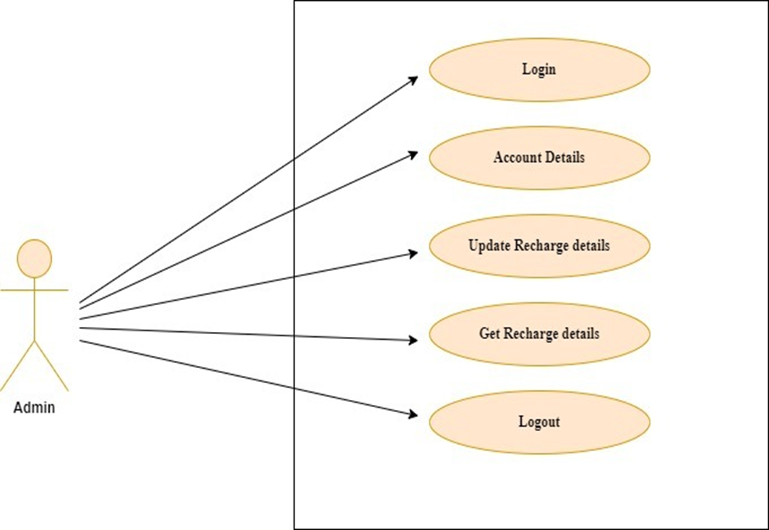
Creating Values |
Impacting Lives |
Project : Use Case Diagram

Slide 10
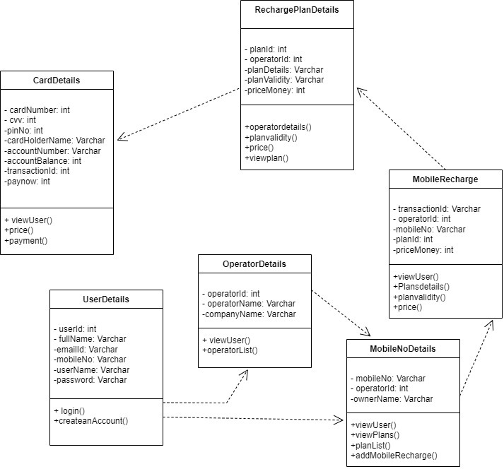
Creating Values |
Impacting Lives |
Project : Class Diagram

Slide 11
Project: Future scope
Creating Values |
Impacting Lives |
Allow customers to edit their profile details and change their password.
Provide a third party security system during transaction.
SMS notification after successful recharge.
Encrypted Webpage to ensure customer privacy
And transaction security.
More User friendly interface also for small screen devices.

Slide 12
Project: Conclusion
Creating Values |
Impacting Lives |
This project has been developed successfully and the performance of the system has been found satisfactory.
Use of this interface helps customer having immediate information about recharge tariff and do recharge without wasting their precious time.
User friendly interface also for the admin to add and delete tariff information

Slide 13

Creating Values |
Impacting Lives |

