Slide 1


Online Student Management System
Presented By-
(Group No-81)
219127-Pavankumar Biradar
219137-Ragini Pandey
External Project guide-
Mr. Milind Arjun
Internal guide-
Mrs. Monica Jadhav

Slide 2
Introduction
It is a system designed especially for a CDAC Institute like IACSD. This system provides complete functionality of student and Teacher login where students can access the marks, attendance and platform to share the feedback with the teachers.
This Portal thinks student as the main target Users and provides the useful services to them at a single place and through a single interface but in customised form.

Slide 3
Requirement
Now a days the system in the institute has the process of making the proper report which is done manually which increases the time requirement .
An existing system for the Institute is all Scattered one.
Student have no access to the internal marks
Students have no access to the Module wise attendance.
Students have to wait for the official feedback form to give the feedback
College uses the third party app for Assignment Submission

Slide 4
Objectives
The main purpose of this system is to be the best medium between the College Management and the Students in all aspects to achieve one to one connection with students.
Simple database is maintained.
A simple and attractive User interface, it can be used in no time.
The aim is to design a college system to update and store all the student data by batch and course wise.

Slide 5

Technologies Used
FrontEnd- ReactJs
Backend- Java Spring Boot API

Slide 6
UML Diagrams
1.ER Diagram
2. Activity Diagram for Admin,Teacher,Student.
3. Use Case Diagram for Admin,Teacher,Student.
4. Zero, One and Second level DFDs.
5.Class Diagram

Slide 7
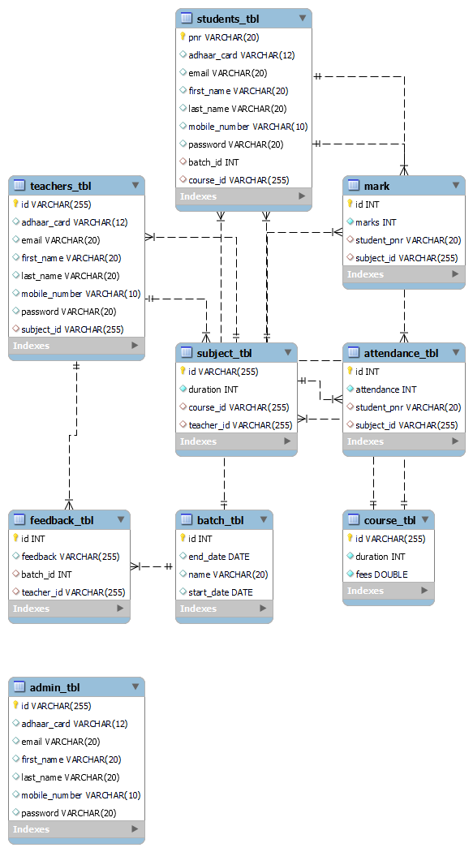
E-R Diagram

Slide 8
Activity Diagram for Admin
Registration
Login
No
Valid
Yes
Add Admin
View Feedback
Post Notice
Add Teacher
Post Timetable
Add Student
View everyOne
Logout

Slide 9
Activity Diagram for Teacher
Login
No
Valid
Yes
Search Student
View Feedback
Mark attend
View Student
Post Assignment
Remarks to student
Logout

Slide 10
Activity Diagram for Student
Login
No
Valid
Yes
View prof
give Feedback
View attend
Update prof
Submit assignment
View remarks
Logout

Slide 11
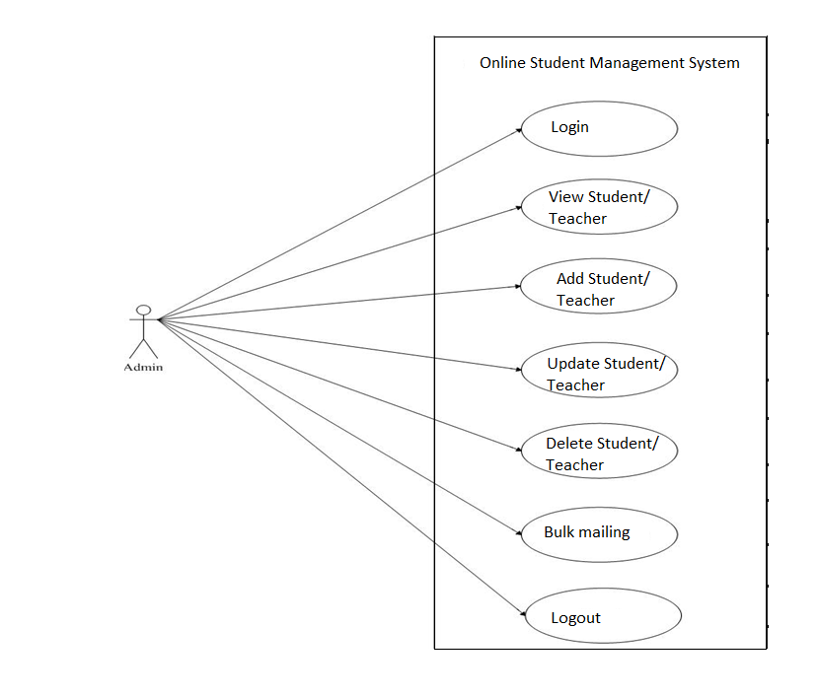
Usecase Diagram for Admin

Slide 12
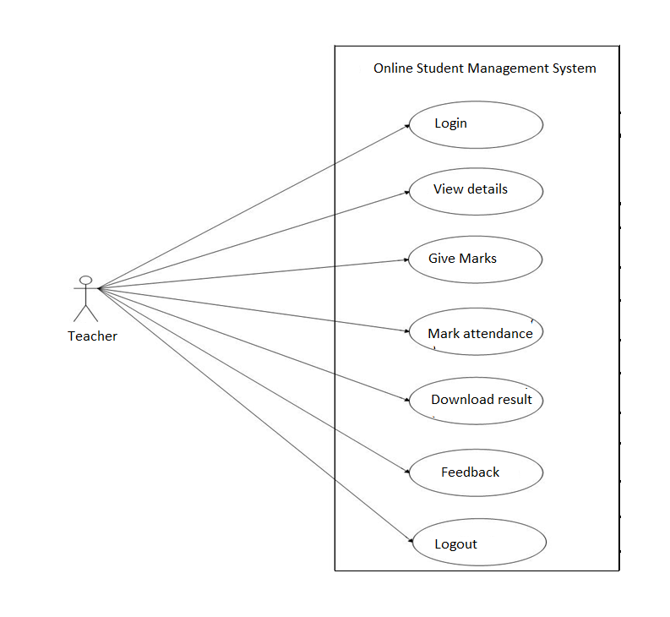
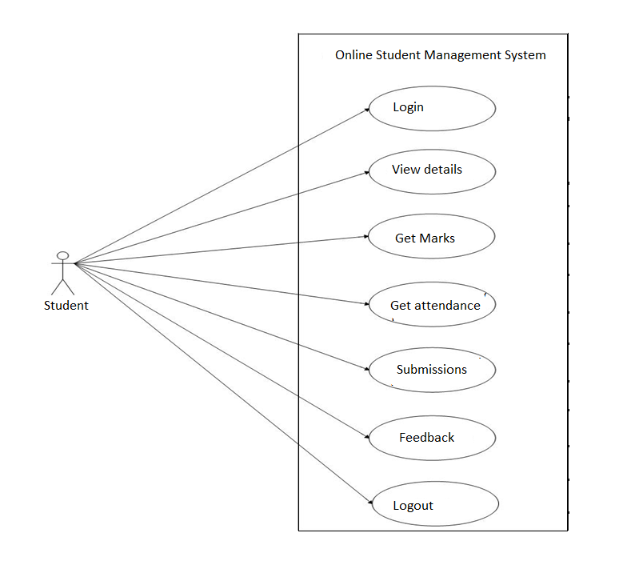
Usecase Diagram for Teacher
Usecase Diagram for Student

Slide 13
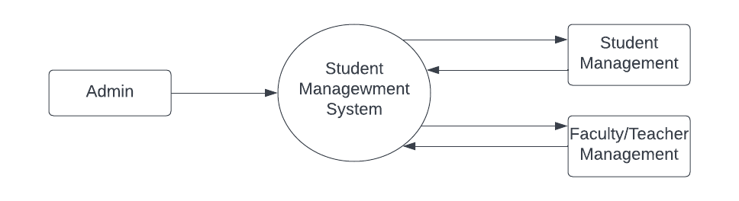
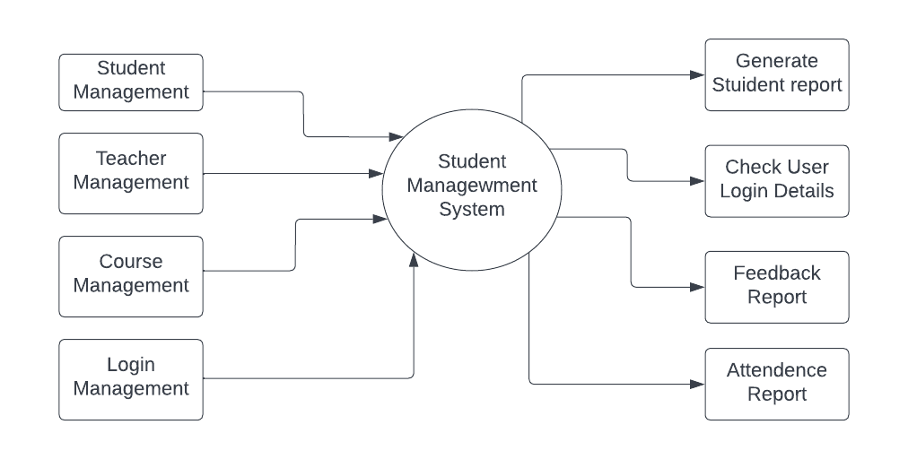
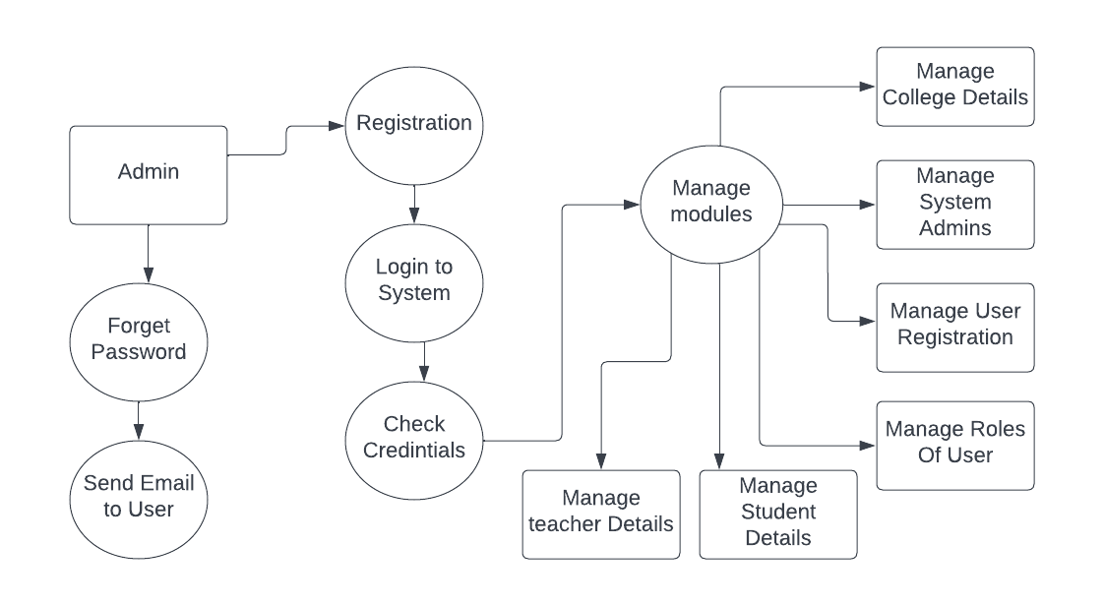
Zero Level Data Flow Diagram
Level One Data Flow Diagram
Level Two Data Flow Diagram

Slide 14
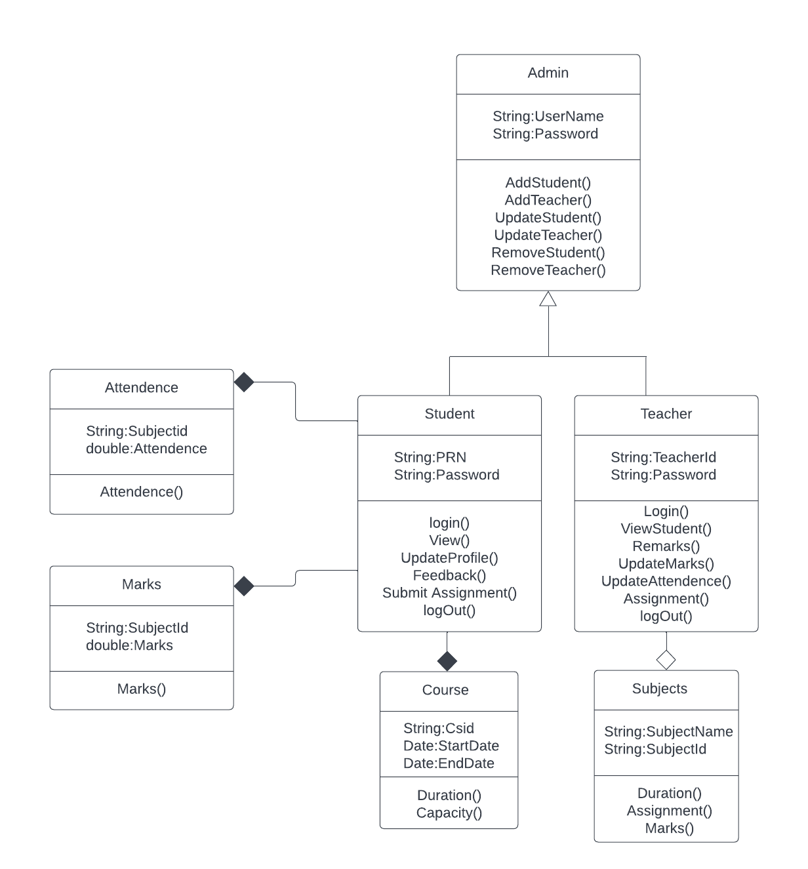
Class Diagram

Slide 15
Screen Shots

Slide 16
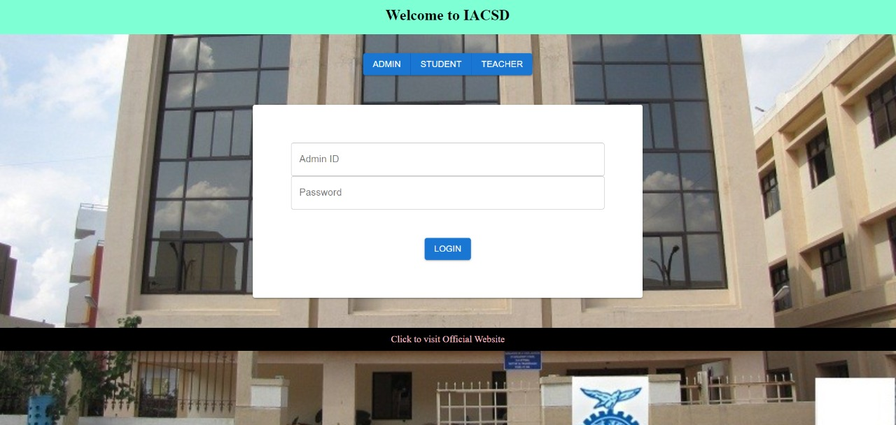
Step 1-Welcome Home Page
Step 2-Login portal for Admin,Student,Teacher provided on HomePage

Slide 17
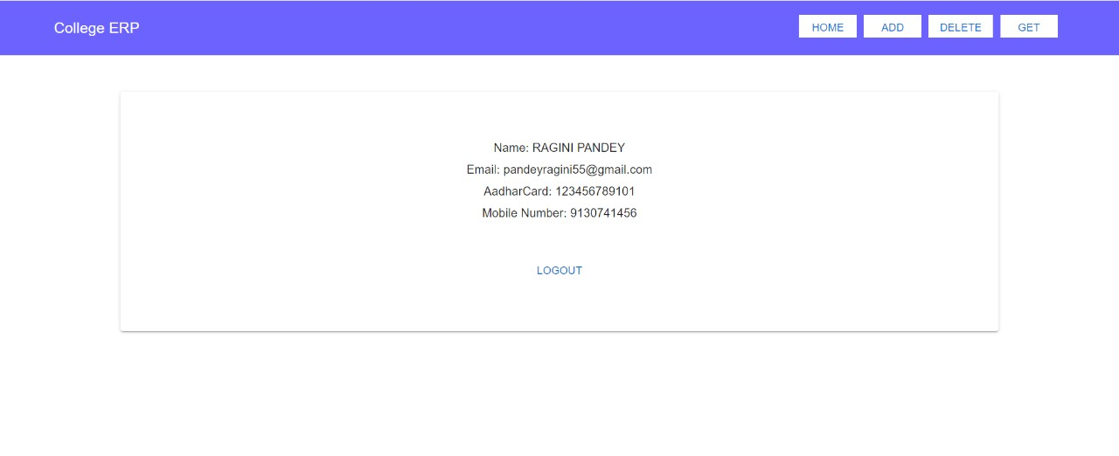
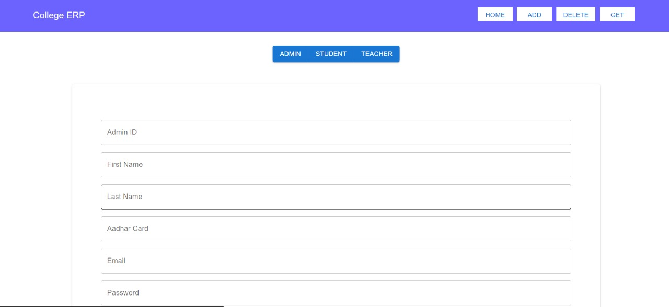
Step 3-Logged in as Admin
Step 4 Add Admin

Slide 18
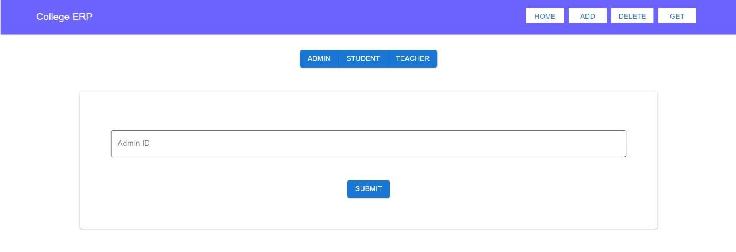
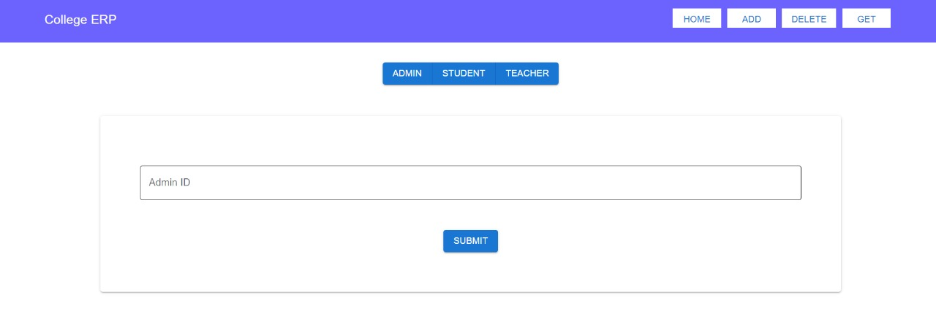
Step 5-Get/Delete Admin

Slide 19
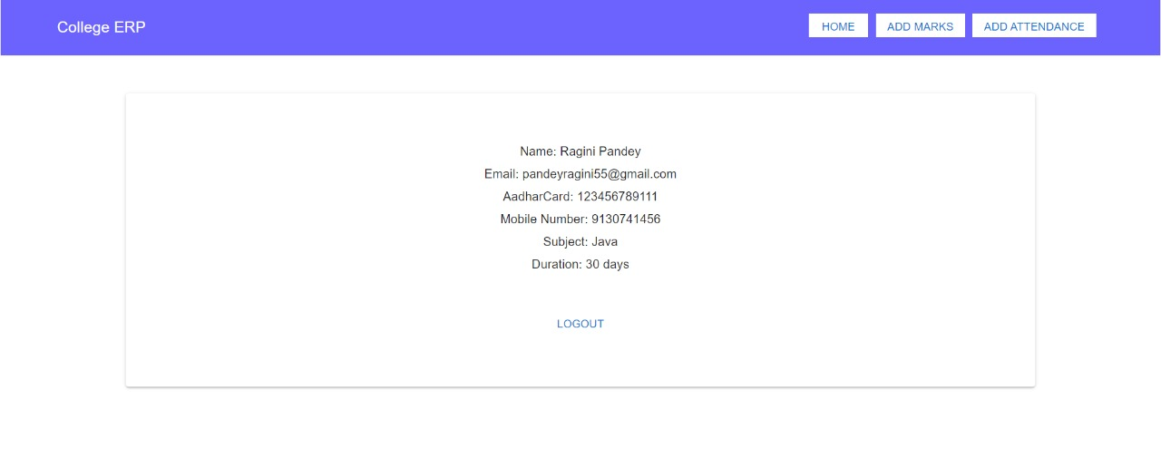
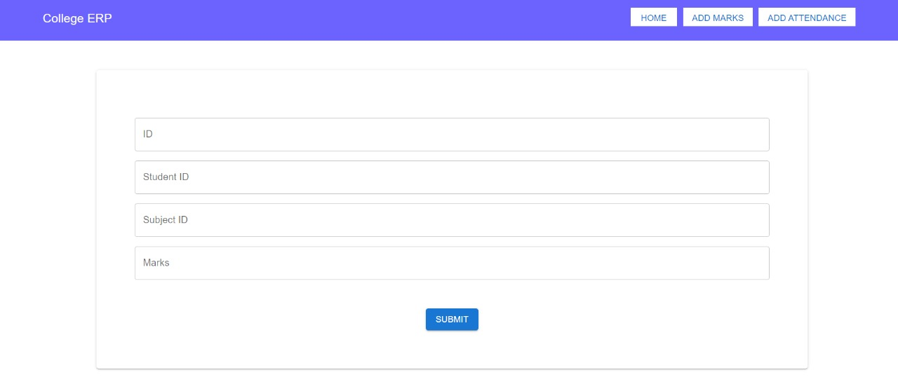
Step 6-Teacher can Login ashe/she is added by Admin
Step 7-Teacher can
Add marks and Attendence

Slide 20
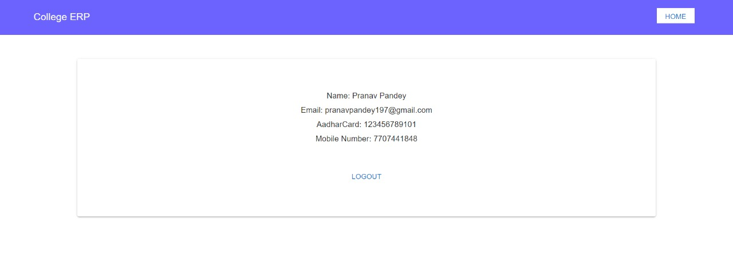
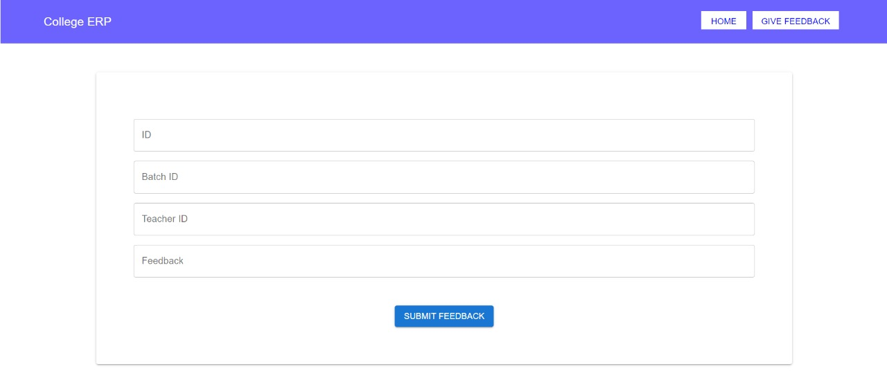
Step 8-Student can View his /her details
Step 9-Student can give
feedback to teacher

Slide 21
Specifications
The application will use JavaScript and css as main web technologies.
HTTP and FTP protocols are used as communication protocols,FTP is used to upload the web application in live domain and client can access it via HTTP protocol.
SMTP protocol used for email communication.
Several types of validations make this web application a secured one.
Since it is a web-based application ,internet connection must be established
It can be opened on any web Browser.

Slide 22
S/W and H/W requirements
Hardware Requirements:
Software Requirements:
Server Side-
RAM | 2 GB
Hard disk | 320 GB
Processor | Dual Core
Web Server | TOMCAT
Server side Language | JAVA(SpringBoot API)
Database Server | MYSQL
Web Browser | Google Chrome or any compatible browser
Operating System | Windows or any equivalent OS

Slide 23
Advantages
Managing student information.
Effortless Communication.
It provides a friendly graphical user interface which proves to be better when compared to the existing system.
It gives appropriate access to the authorized users depending on their permissions.
Updating and viewing of information becomes so easier for Students.

Slide 24
Disadvantages
For now attendance is provided for completion of particular module not on daily basis.
This System failed to achieve complete communication between students and teacher as some of the functionalities remained to add which can be done over the period of time as in future enhancement.
Students depends on other system for giving mock exams and all.

Slide 25
Conclusion
Online Student Management System can be acted as the key medium between the three layers of Institute such as Admin, Teacher and the Student as the prime user .
This system will help institute to organize its data as per the batch.
It provides a friendly graphical user interface which proves to be better when compared to the existing system.
It gives appropriate access to the authorized users depending on their permissions.
Updating of information becomes so easier.
The System has adequate scope for modification in future if it is necessary.
Provides convenience to the students, faculties and management in order to communicate .

Slide 26
Future Scope
We can use Socket.io to add a chat system for Student and Teacher. Student can then ask their doubts to Teachers and they can also talk with other students to know how they learnt a particular skill, etc.
We can give the option of timetable where the Admin can create the timetable for each semester.
The validation can be improved furthermore. I have tried to keep the validation logic correct and there might be few things missing

Slide 27
References
The following books were referred during the analysis and execution phase of the project
Black book by DT Editorial Services
(Coverscss3,Javascript,xml,xhtml,Php,and Jquery)
2. MYSQL by Paul Dubois
WEBSITES: www.google.com

