Slide 1
P PAVAN KALYAN REDDY
Final project:
Keylogger and security
3/21/2024 Annual Review

Slide 2
KEYLOGGER AND SECURITY
A Keylogger is a form of malware or hardware that keeps track of and records your keystrokes
as you type.
It is a type of surveillance technology used to monitor and record each keystroke on a specific
device , such as a computer or smartphone.
There are two types of keyloggers
1.Software Keyloggers
Operating Keyloggers: Installed at the operating system level and can intercept keystrokes
before they reach applications.
2.Hardware Keyloggers
Wireless Keyloggers: Intercept signals from wireless keyboards.
3/21/2024 Annual Review

Slide 3


AGENDA
The main agenda of the keylogger is that are primarily used
by attackers to capture sensitive information without
the victims knowledge.
Some of the key points of the agenda for a keylogger :
Personal communication:
capture text from instant message in
applications and social media.
Behaviour Tracking:
monitor application usage and document
interaction.
3/21/2024 Annual Review

Slide 4

PROBLEM STATEMENT Key loggers present a significant security threat by capturing sensitive user information, leading to unauthorized access and data breaches. This problem necessitates the development of sophisticated security measures,user education ,and robust organizational policies to mitigate the risks associated with keyloggers. The problem in the content of keyloggers and security typically revolves around the following key points: >Unauthorized Access and Data Theft. >User Privacy Violation. >Detection and Prevention. >Impact on Organizations. >Legal and Ethic Issues. >Countermeasures and Security Practices.
3/21/2024 Annual Review

Slide 5

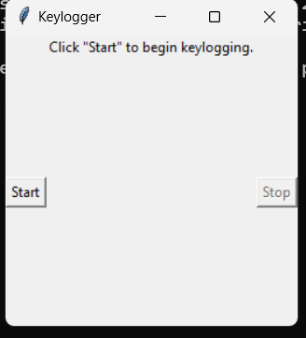
PROJECT OVERVIEW The Overview of the project is: In this project we had a code to execute and use the keylogger and can know the user information everything what they are typing. So, by executing the code the out put will be: by clicking start option the process will begin and the information will be start capturing.
3/21/2024 Annual Review

Slide 6

WHO ARE THE END USERS? The end users are: >Individual Users: Intrested in personal privacy and protection of their sensitive information. >Bussiness and Financial Institutions: Focused on protecting client data,maintaining trust,and ensuring compliance. >IT and Security Professionals: Tasked with implementing ,managing,and improving security measures to safeguard against keyloggers. >Government and regulatory Bodies: Ensure laws and regulations are followed to protect the public and organizational data from cyber threat. >Developers and Technology providers: Innovate and provide solutions to detect and mitigate keylogging threats.
3/21/2024 Annual Review

Slide 7

YOUR SOLUTION AND ITS VALUE PROPOSITION For developing and implementing security solutions against keyloggers,the value proposition includes: > Enhanced Security:Providing robust protection against keyloggers ensures the sensitive information and maintains user trust. >Compilance:Helping organizations comply with data protection regulations and avoid legal penalties. >Operational Integrity:Preventing data breachs and cyber attacks that could distrupt operations and result in significant financial losses.
3/21/2024 Annual Review

Slide 8

THE WOW IN YOUR SOLUTION In this solution i clearly observed that if we try we can easily get the data of the user without their permission.It has advanced detection algorithms,comprehensive protection measures with centric features. Some of the elements that contribute to a compiling keylogger solution is: >Advanced Detection Algorithms. >Comprehensive Protection. >User-Friendly Interface. >Stealth Mode Operation. >Cross-Platform Compatibility. >Educational Resources and Support.
3/21/2024 Annual Review
8

Slide 9
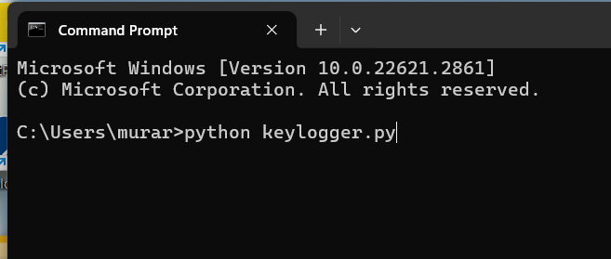
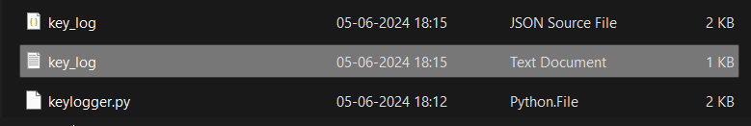
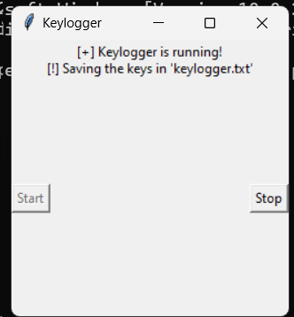
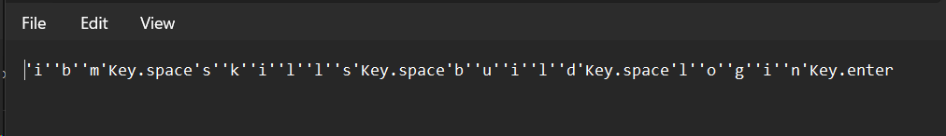
MODELLING
Teams cam add wireframes
3/21/2024 Annual Review
9

Slide 10
RESULTS The results we get in this keylogger is: we can find the data that user use. Keylogger records keystrokes: Legitimate use: Moniter employee productivity. Illegal uses: Steal passwords,usernames,and other personel/corporate data. There are ways to protect yourself: Be aware of what’s installed on your computer. Use caution when surfing the internet. Keep your computer’s security software updated. Example of keylogger’s output:
3/21/2024 Annual Review
10

Slide 11
GIT REPOSITORY PROJECT LINK
https://github.com/Pavankalyan2525/pavankalyanreddy.git

