Slide 1


TASK ON
Regex Matching Web App Development

Slide 2



About me
I am Pavankalyan Thatipamula, a Data Science Trainee at Innomatics Research Labs in Hyderabad. With a passion for data analysis and visualization, coupled with a drive for continuous learning, I am committed to making meaningful contributions in the field of data science.
As a Data Science Trainee at Innomatics Research Labs, I am dedicated to honing my skills in Python programming and MySQL database management. Proficient in crafting compelling data visualizations using Matplotlib, Seaborn, and Tableau, I thrive on transforming complex data into actionable insights. With a foundation in exploratory and statistical data analysis, I utilize tools like MS Excel, MS Office, and PowerPoint to drive informed decision-making. Committed to enhancing corporate profitability in today's competitive global landscape, I am dedicated to continuous learning and skill development.

Slide 3
Scenario:
Develop a web application similar to regex101.com, aimed at providing users with a platform to test regular expressions (regex) against a given input string. Users can input a test string and a regular expression into the application. The application then processes the input, identifies and displays all matches found between the test string and the provided regular expression. This functionality empowers users to efficiently test and validate their regex patterns, aiding in various text processing and pattern matching tasks.

Slide 4
Steps:
Create a new directory for your project and navigate into it.
Set up your virtual development environment.
Initialize a new Flask application.
Create the HTML template.
Define a route to handle form submission.
Render the results.
Test your application.
Implement a new route where a user can validate if a given email id is valid or not.
Deploy the application on AWS Cloud.

Slide 5
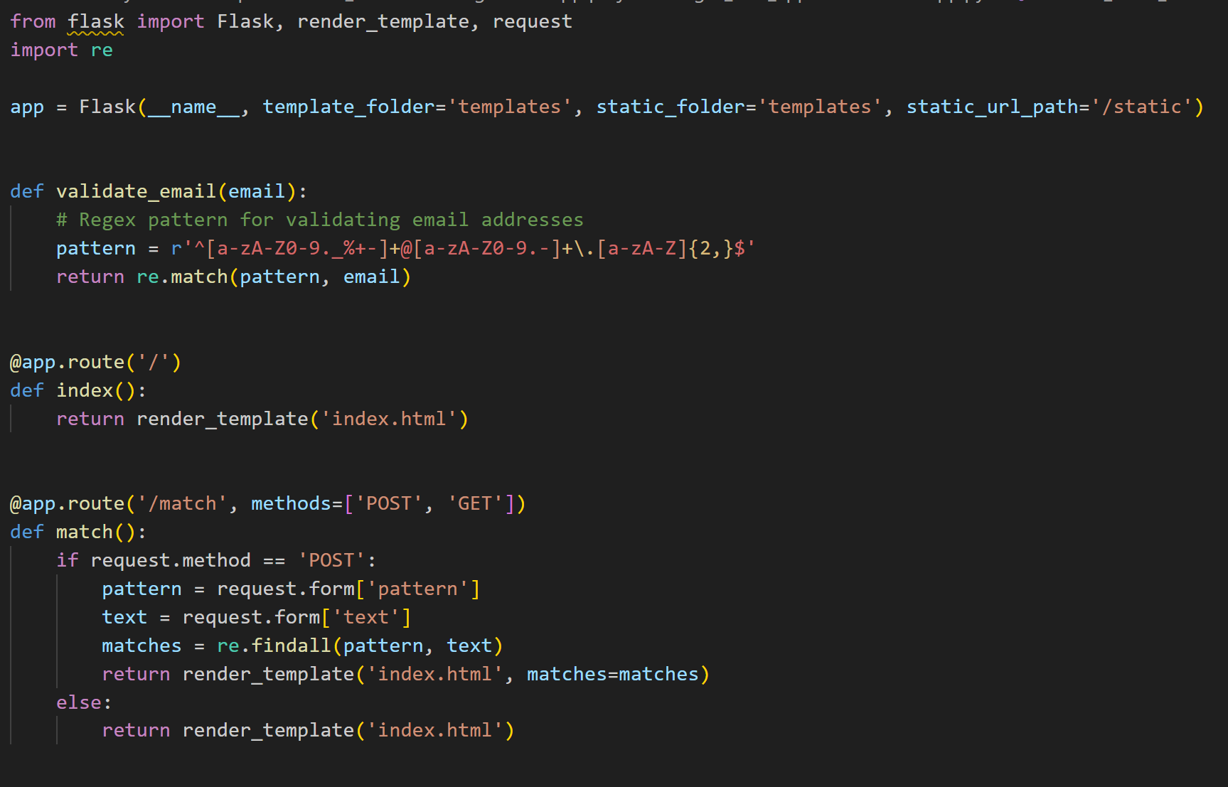
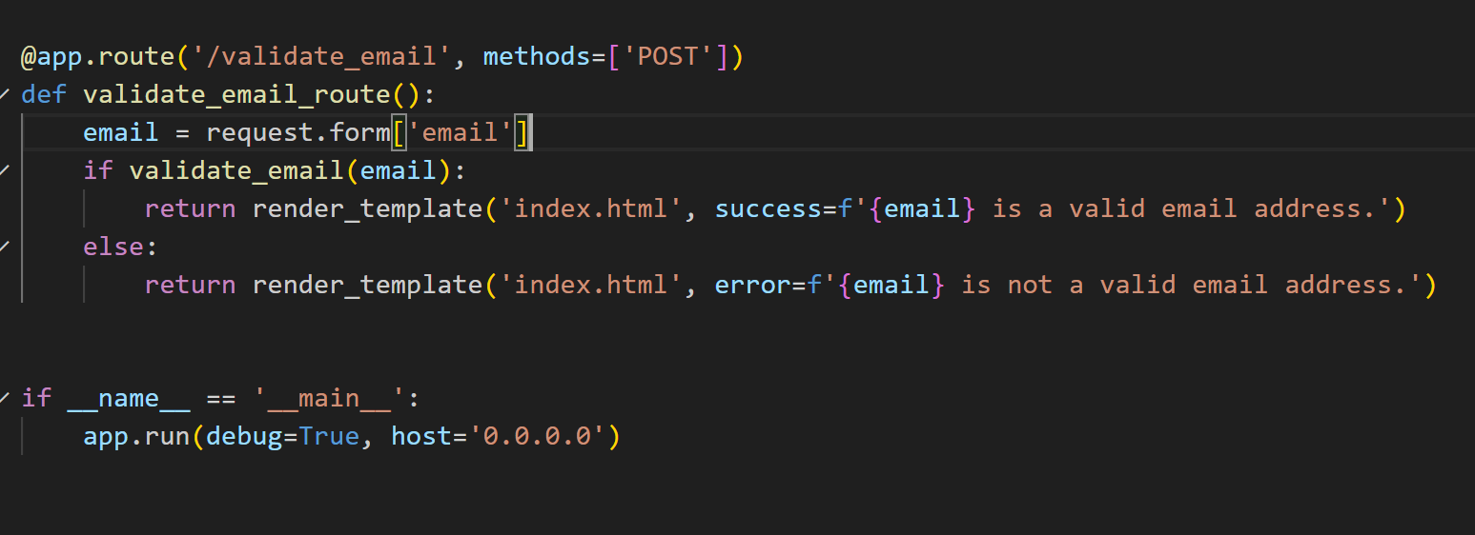
Initialize a new Flask application:-
This Flask application provides a platform for testing regular expressions and validating email addresses. Users input test strings and regex patterns to find matches, while also verifying email validity through a simple regex pattern.

Slide 6
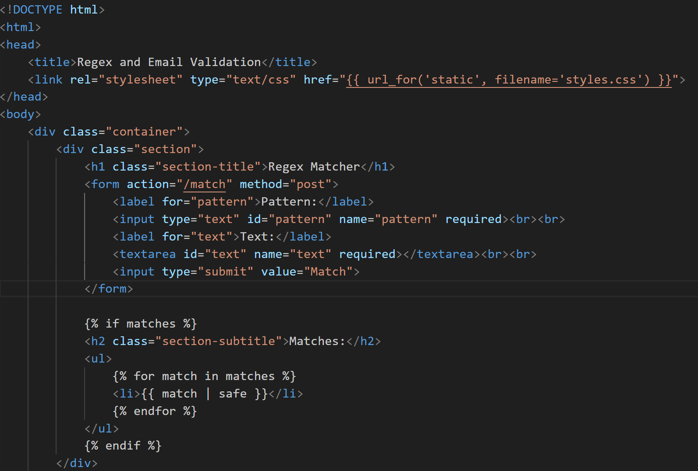
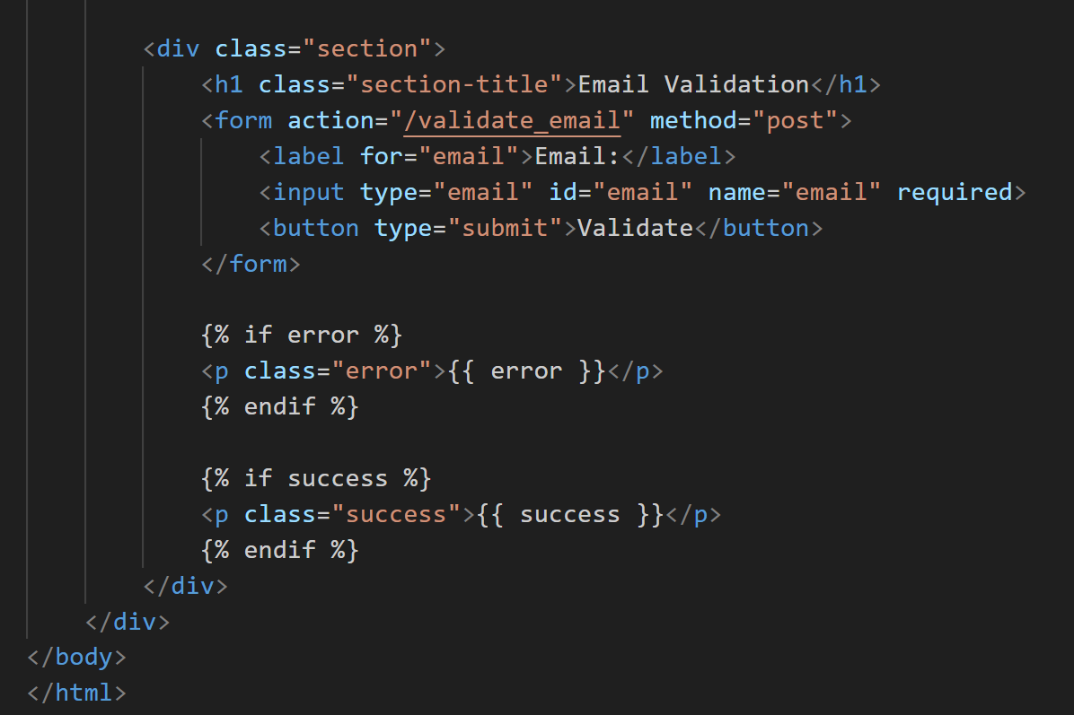
Create the HTML template:-
This HTML template creates a user-friendly interface for a Regex and Email Matcher web application. It includes forms for inputting test strings and regex patterns, as well as for validating email addresses. The design features a clean layout with CSS styling for enhanced readability. Additionally, it dynamically displays regex matches and email validation results based on user inputs, providing a seamless user experience.

Slide 7
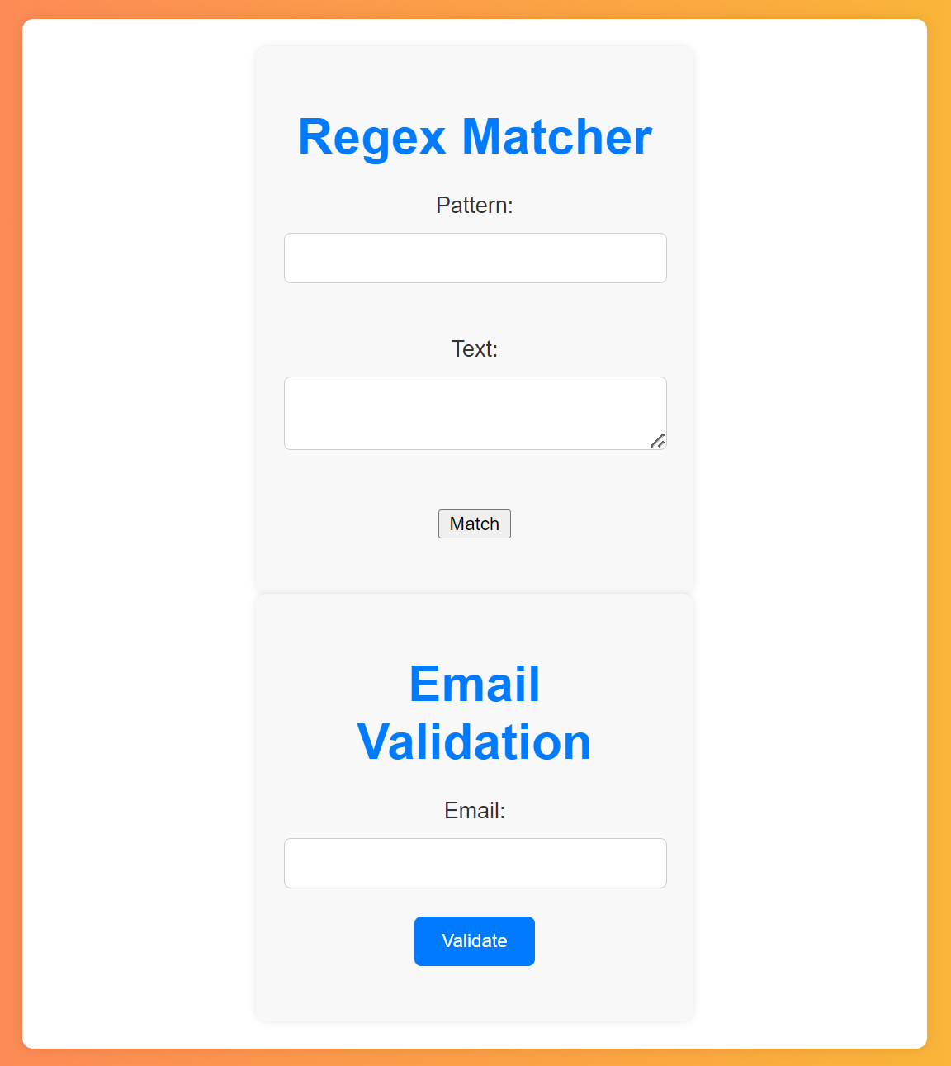
Render the results:-
The result of this application is a web interface where users can input test strings and regular expressions (regex) to perform matching. Upon submission, the application displays the matches found between the test string and the provided regex pattern.

Slide 8
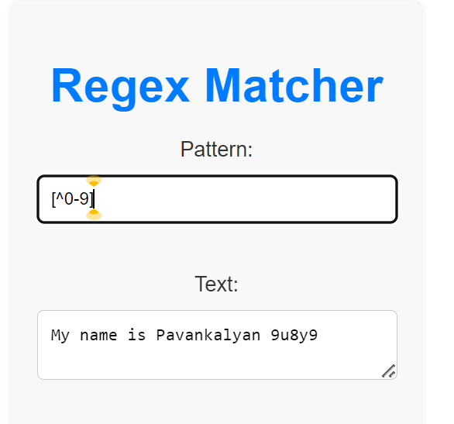
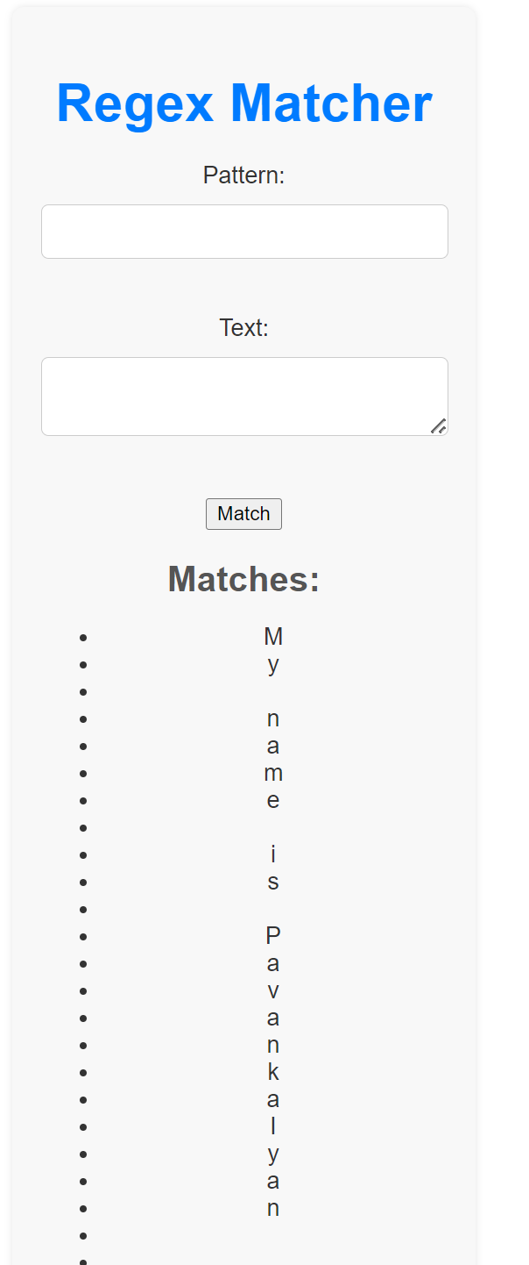
Test your application:-
This intuitive interface aids users in efficiently testing regex patterns enhancing text processing and pattern matching tasks.
Output:-

Slide 9
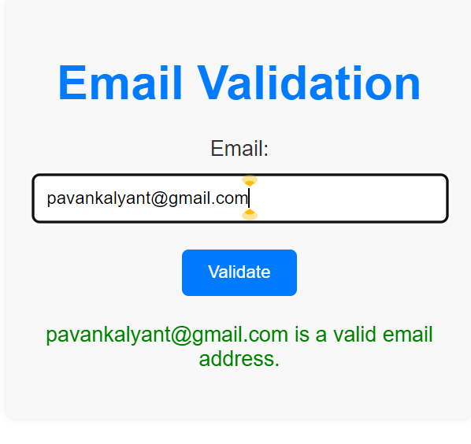
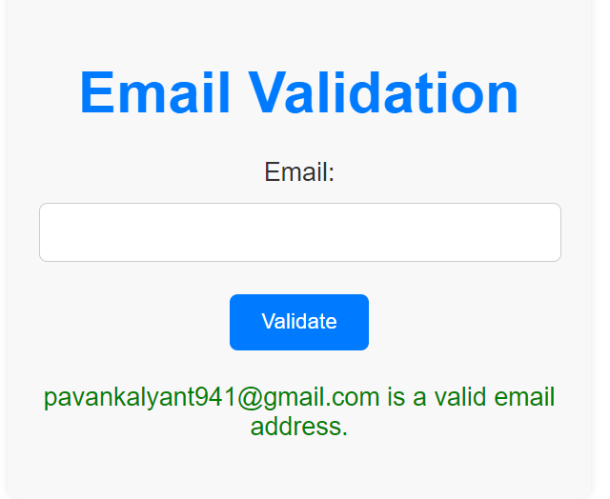
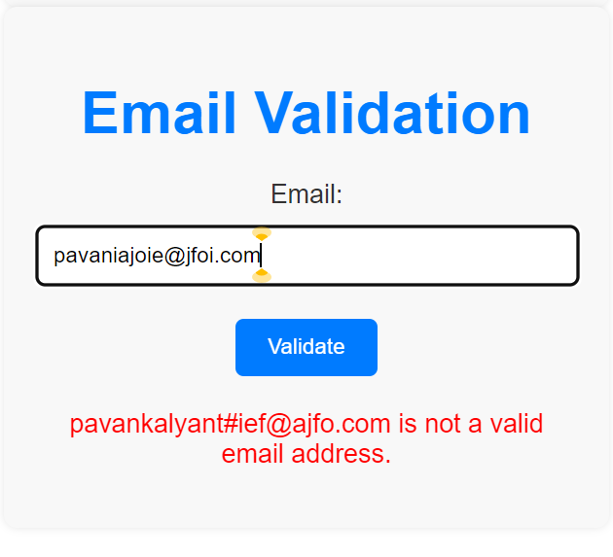
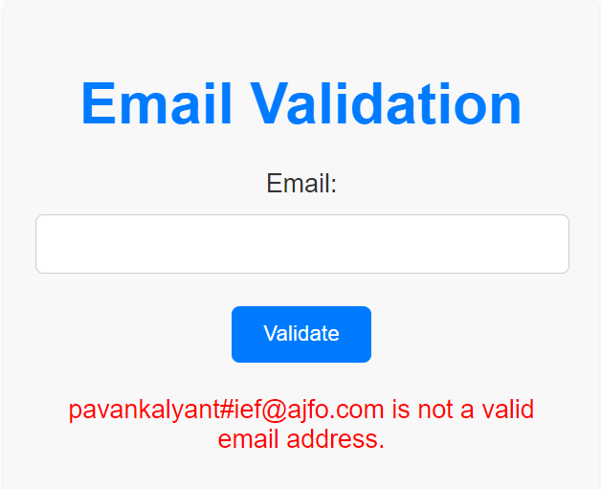
Implement a new route where a user can validate if a given email id is valid or not:-

Slide 10
Conclusion:-
In summary, I've replicated regex101.com's functionality, enabling users to input test strings and regexes to find matches. Utilizing Flask, we created routes for the home page and form submission, leveraging Python's re module for regex matching. We also added an email validation feature and deployed the app on AWS. Testing validated its accuracy, offering users a dependable regex testing tool, enhancing our Flask development skills and regex proficiency.

Slide 11

THANK YOU

