Slide 1


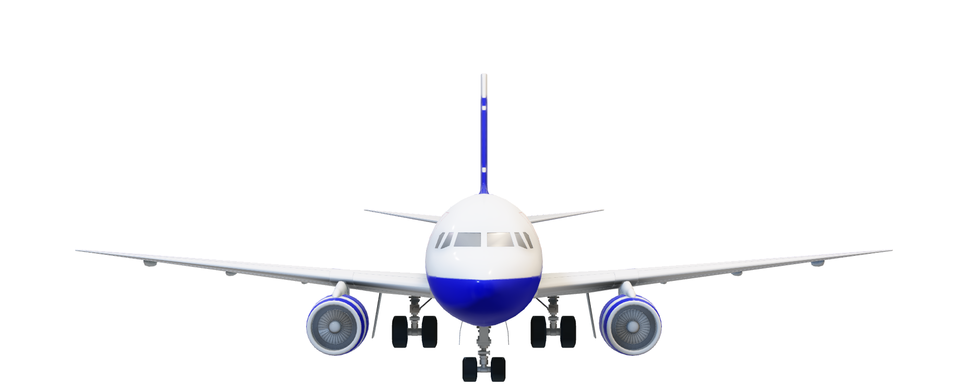
✈️ HIGH CLOUD☁️
🧰ANALYSIS 📊
Group – 2
Riddhi Dand
KAMPALLY SAI PAVAN KUMAR
Ketan Balasaheb Gudaghe
Yogesh Laxman Rajurkar
Tanikonda Laxman Teja

Slide 2



✈️Project Overview – High Clouds Analysis
✈️ The High Clouds Case Study explores real flight data to extract airline KPIs.
📊 Focuses on trends in load factors, route efficiency, and traveler behavior.
🎯 Goal: Enable smarter, data-informed airline decisions.
🧰 Tools: Excel, Power BI, SQL, Tableau used to reveal multi-angle insights.

Slide 3


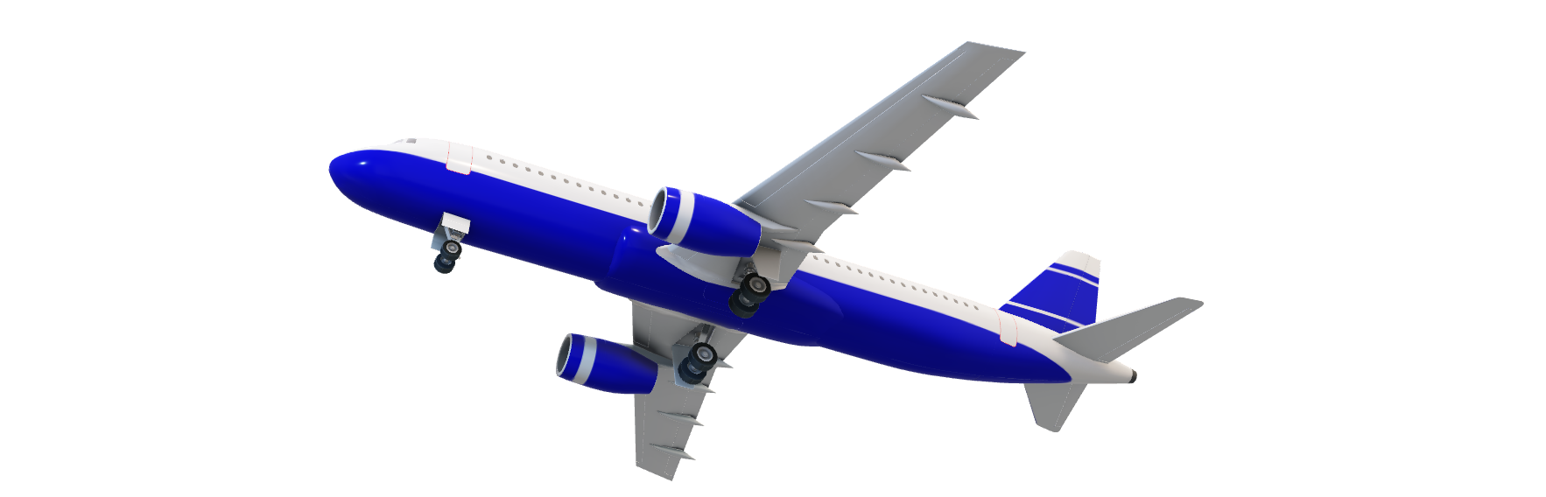
🎯Objectives – High Cloud Analysis
🔍Uncover patterns in airline performance and passenger behavior through data-driven insights.
📅Reveal how Load Factor % shifts across seasons, carriers, and time.
🛫 Spotlight the sky’s busiest corridors and the airlines that own them.
📈Decode traveller behaviour—weekday rush vs weekend wanderlust.
🌍 Compare performance patterns across geographies and markets.

Slide 4

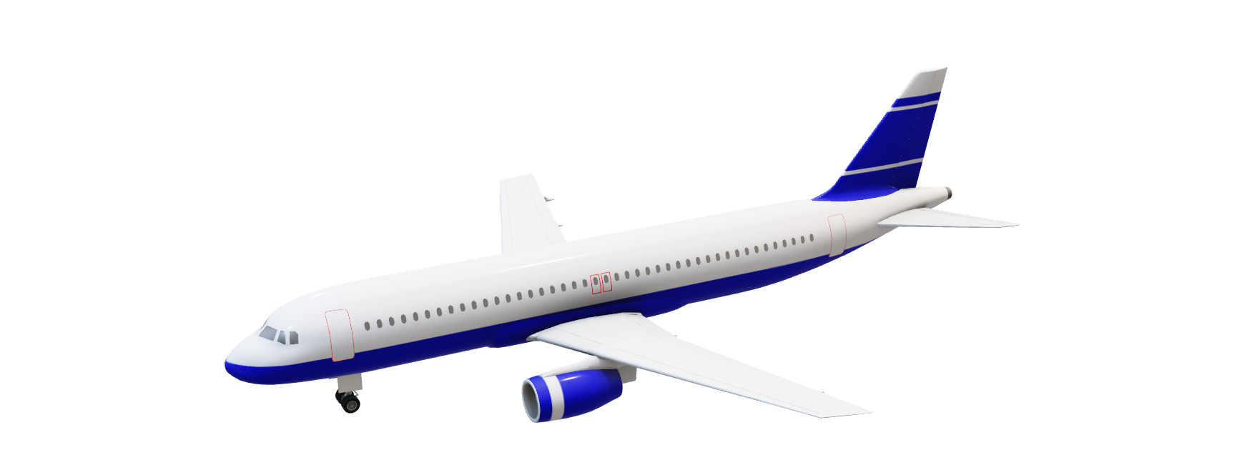
🧪 Methodology – High Cloud Analysis
🟦Excel: Extract KPIs from the given data and craft a compelling dashboard to visualize key insights.
🟨SQL: Structure the necessary data by creating custom columns and pulling the required information through tailored SELECT queries.
🟥Power BI: Build dynamic measures and interactive dashboards to explore and highlight critical performance trends.
🟪Tableau: Use calculated fields to derive insightful KPIs and design dynamic dashboards with engaging KPI cards and filter options for in-depth analysis.

Slide 5

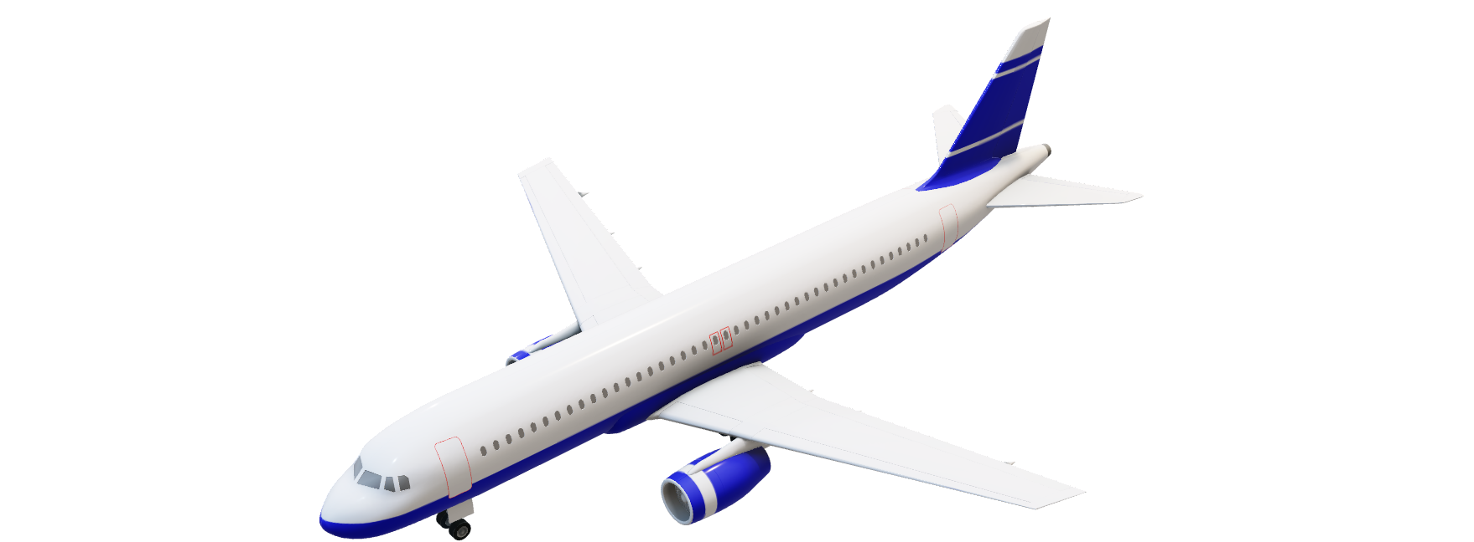
📌 KPIs - Tracked
✅Load Factor % (Time-based)
✅Load Factor % by Carrier
✅Top 10 Carriers by Passenger Volume
✅Top Routes by Flight Count
✅Load Factor: Weekday vs Weekend
✅Flights Distribution by Distance Group
✅Route Lookup via Geography

Slide 6

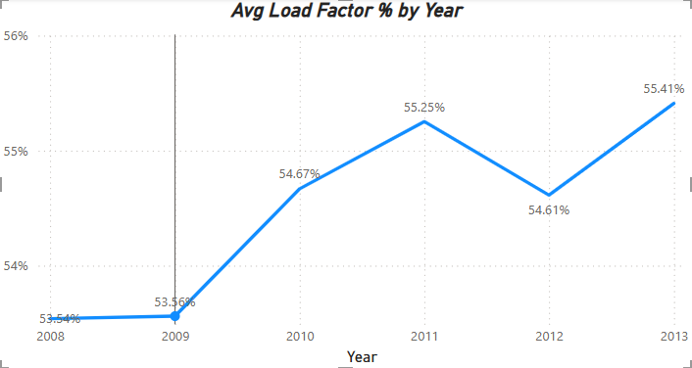
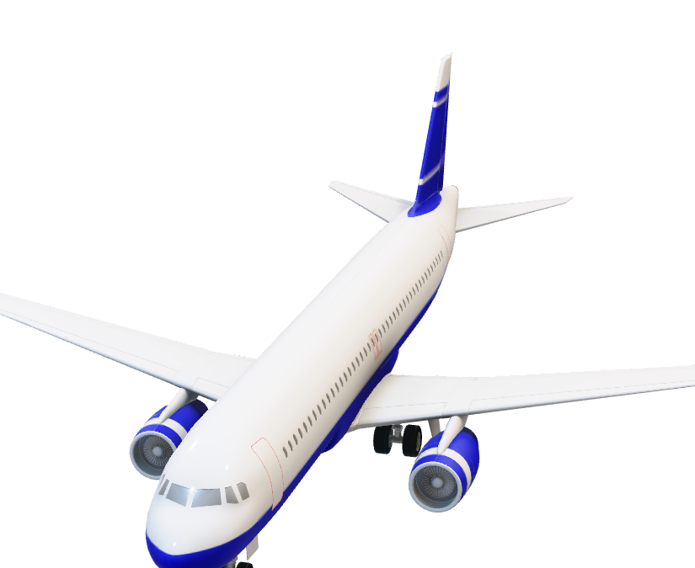
🗓️Load Factor - Yearly/Quarterly/Monthly
Load Factor = Transported Passengers / Available Seats. Insight: Average load factor has shown a steady upward trend from 2009 to 2013, rising from 53.56% to 55.41%. The dip in 2012 suggests a temporary efficiency drop, but the recovery in 2013 indicates renewed growth.

Slide 7

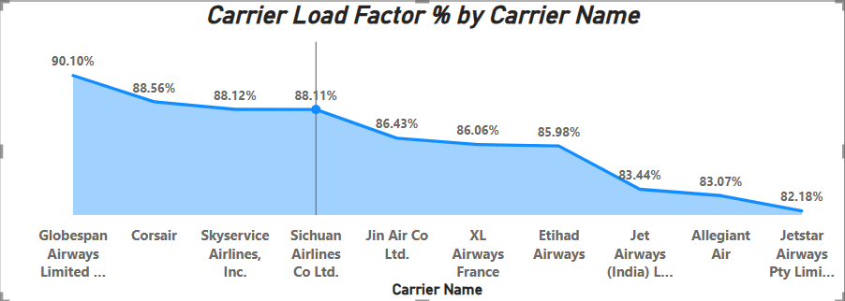
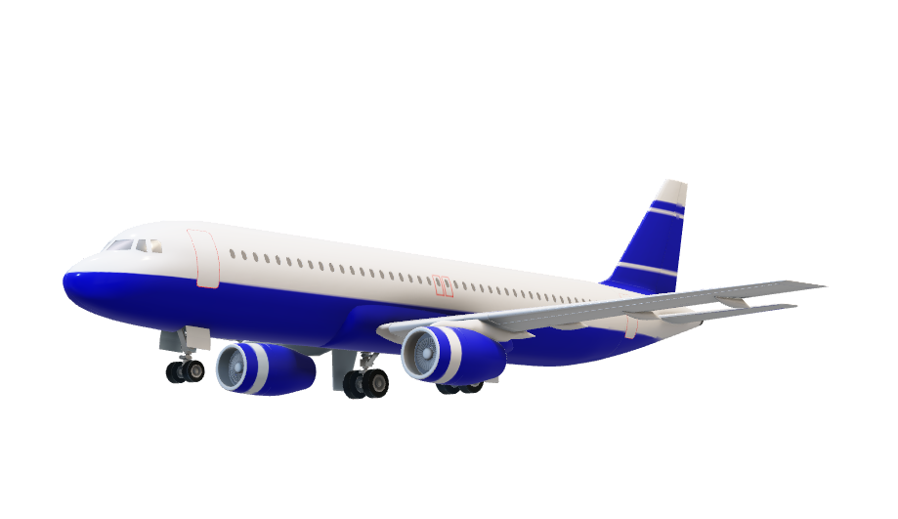
✈️Load Factor % by Carrier Insight
Insight: Globespan Airways leads with a stellar 90.10% load factor, closely followed by Corsair and Skyservice Airlines, all exceeding 88% efficiency. In contrast, carriers like Jetstar Airways and Allegiant Air fall below 83%, highlighting potential areas for operational improvement.

Slide 8

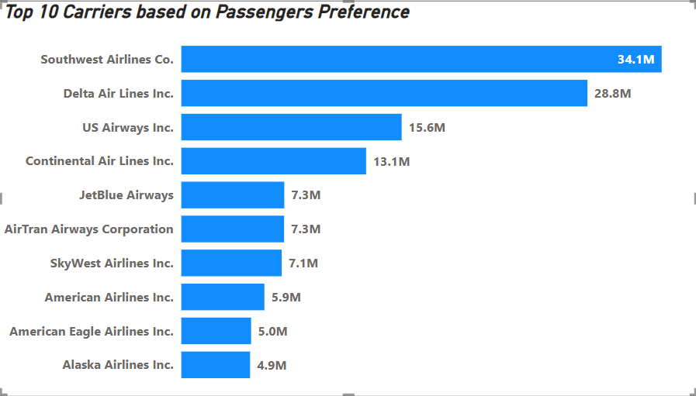
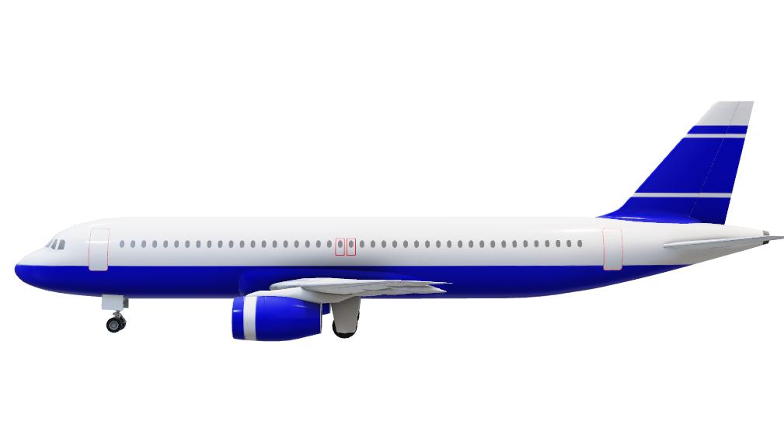
🧑‍🤝‍🧑 Top 10 Carriers by Passenger Preference
The top 5 carriers, led by Southwest Airlines (34.1M passengers) and Delta Air Lines (28.8M), account for the vast majority of total passengers. This dominance underscores strong brand loyalty, extensive route networks, and competitive pricing strategies.

Slide 9

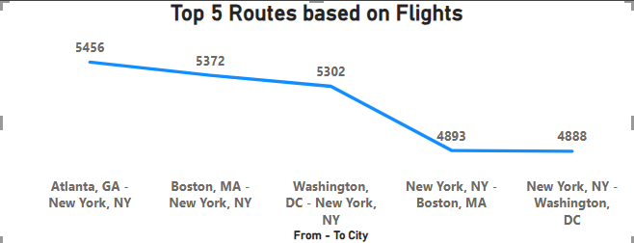
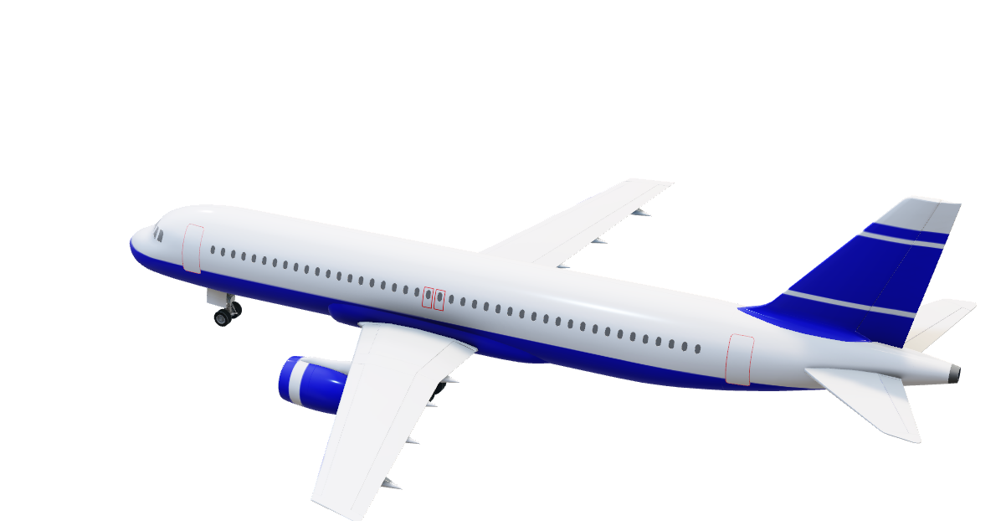
🏆Top Routes (From🛫-To City🛬)
Route analysis of the top 5 Routes pairs reveals that New York City is featured in every route, either as origin or destination. This underscores its dominance in U.S. air traffic and signals strong demand—ideal for route optimization, pricing strategies, and capacity planning.

Slide 10

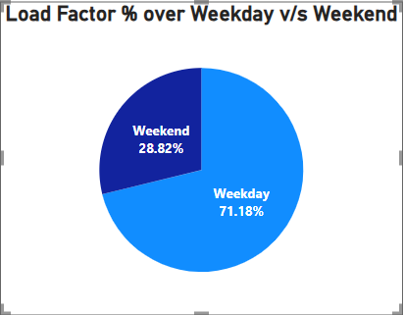
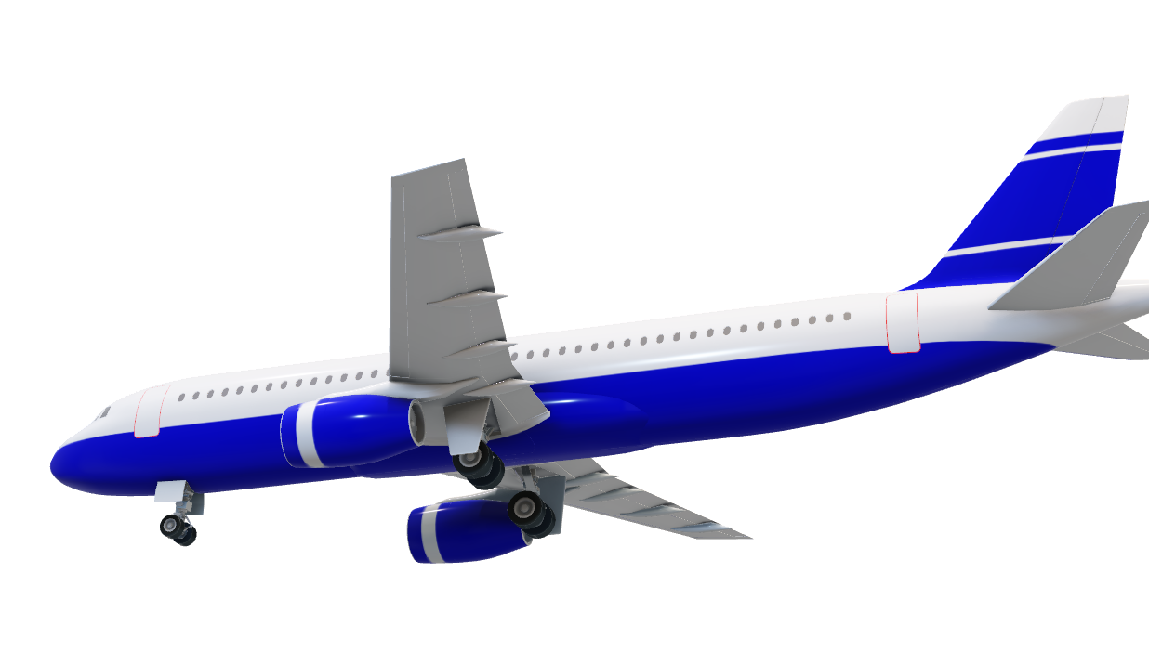
🕒 Weekday vs ⛱️ Weekend Load Factor
Weekday flights account for over 71% of total load, indicating stronger demand likely driven by business travel. In contrast, weekends contribute just under 29%, reflecting a dip in occupancy. This trend highlights an opportunity to boost weekend traffic through targeted leisure promotions.

Slide 11

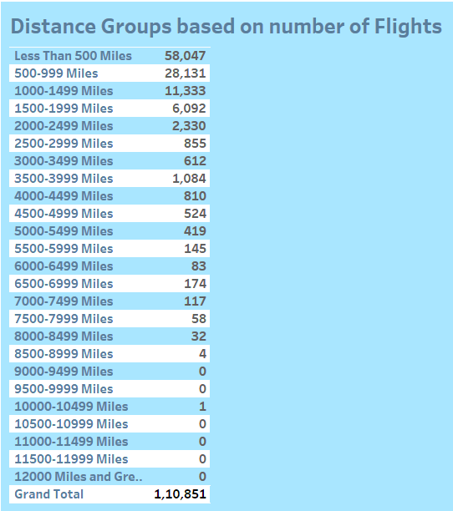
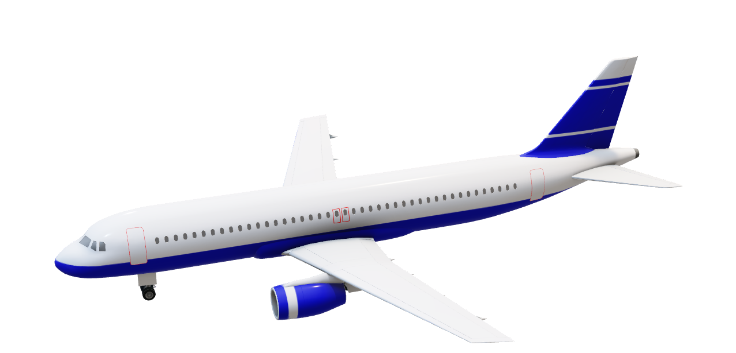
🗺️ Flights by Distance Group
Short-haul flights dominate the network—flights under 1500 miles make up over 88% of total trips, with the <500-mile segment alone accounting for more than 50%. These routes are ideal for increasing frequency, optimizing fleet deployment, and enhancing connectivity.

Slide 12
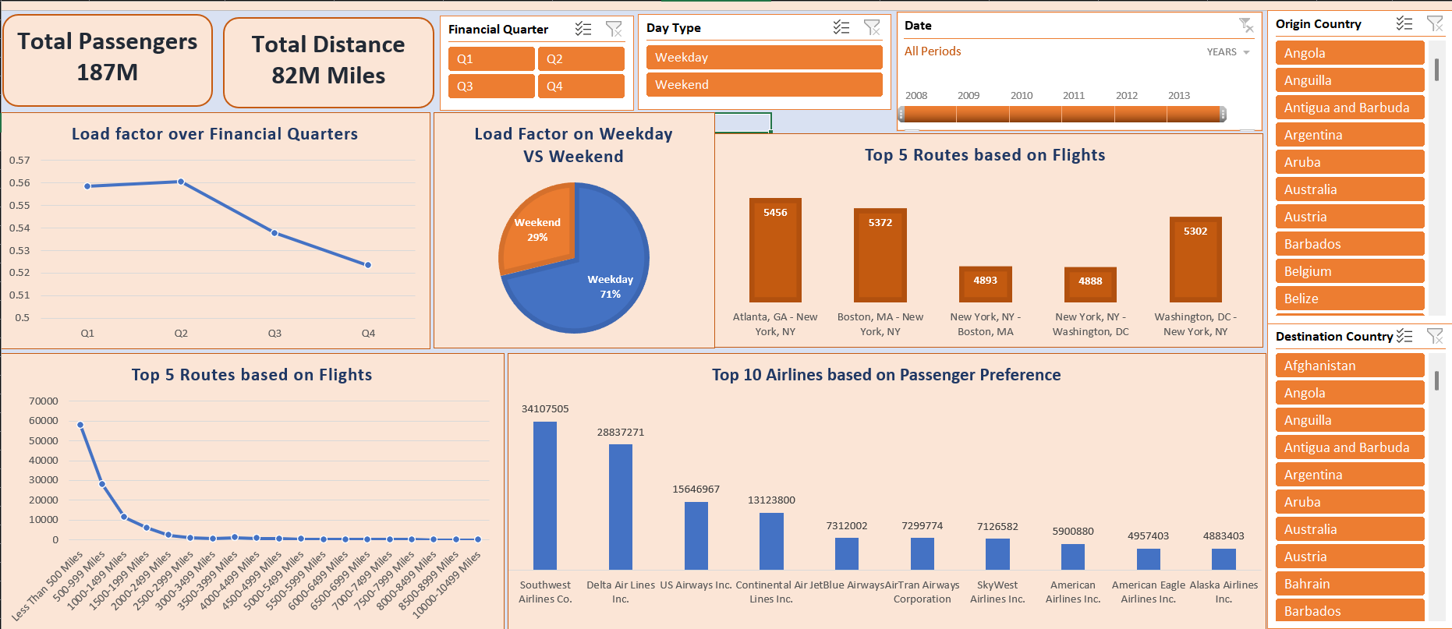
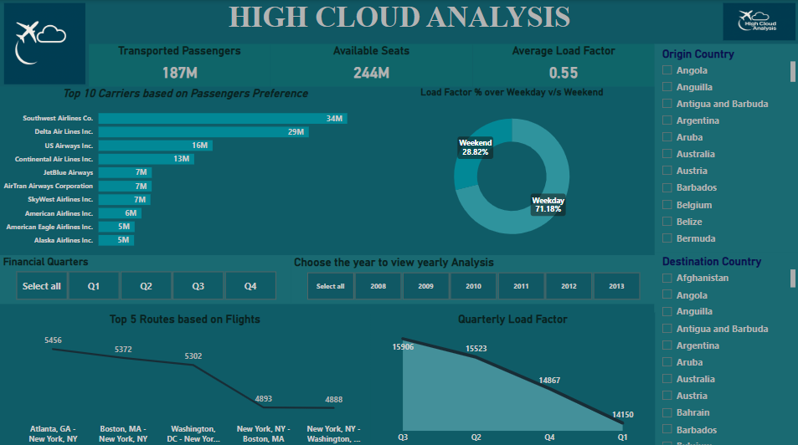
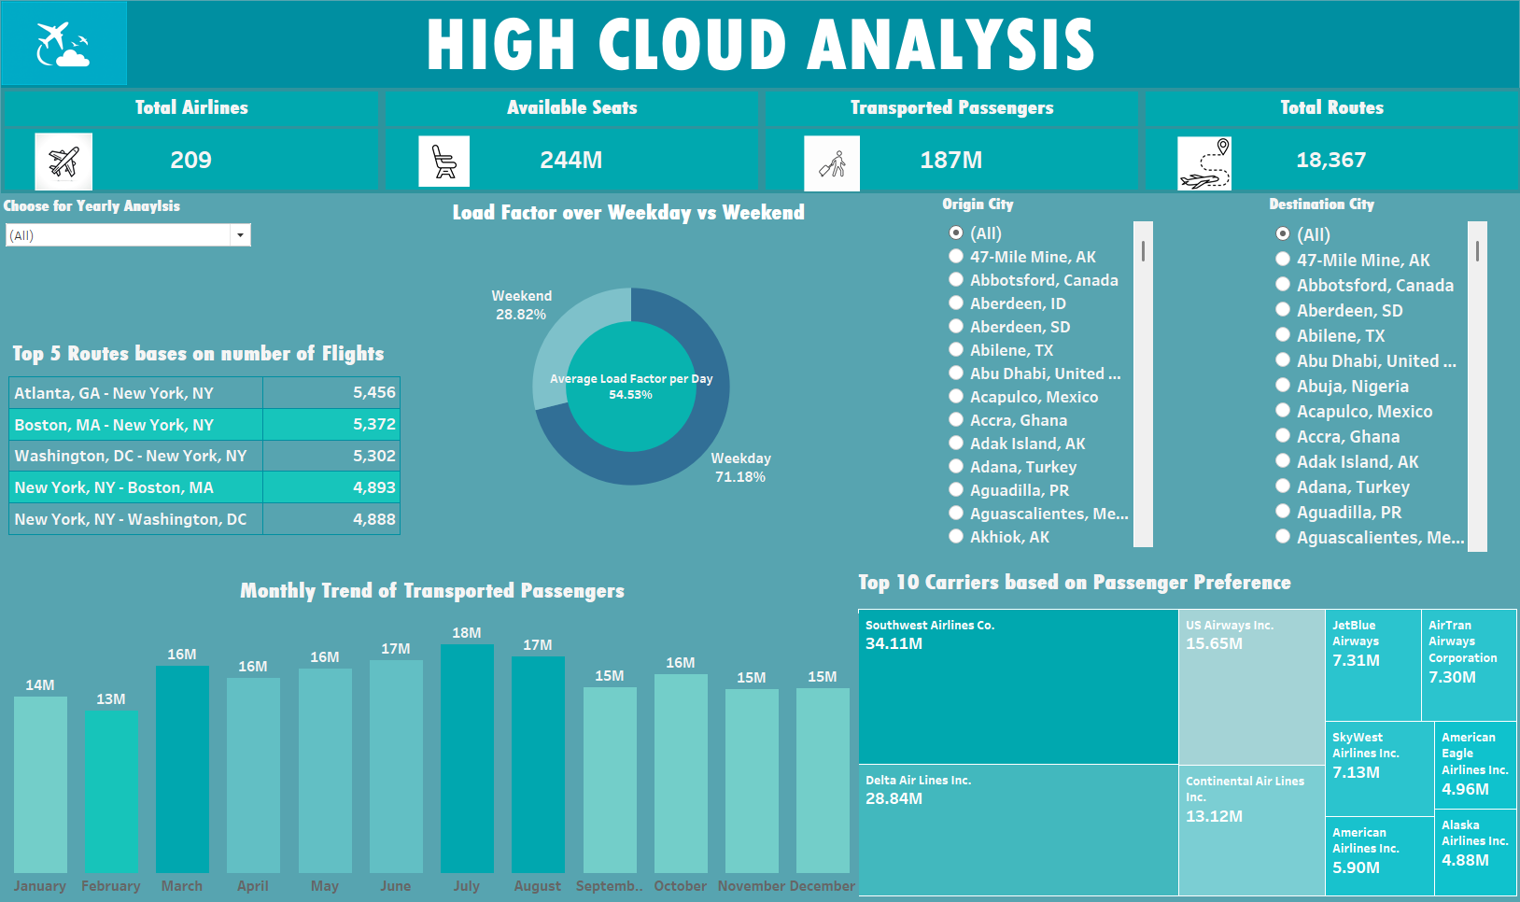
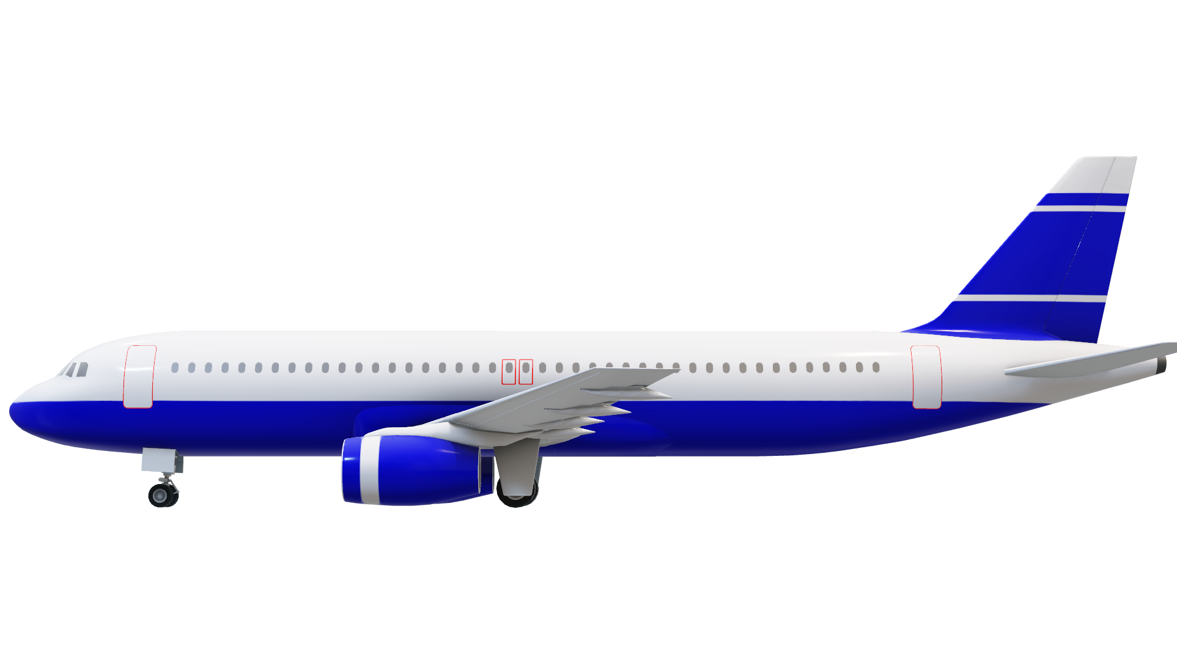
📊 Dashboard Summary Features
EXCEL
POWER BI
TABLEAU
We used the same airline dataset across Excel, Power BI, and Tableau to showcase tool versatility. Each dashboard delivers the same KPIs, proving powerful insights come from data, not just tools.

Slide 13

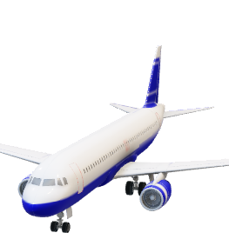
EXCEL
POWER BI
TABLEAU
Starting with Excel, we pulled the required KPIs using structured functions, derived time fields, and arranged visuals into a clear, digestible dashboard. Excel’s strength lies in its flexibility and familiarity, making it an excellent choice for quick, reliable analysis.

Slide 14

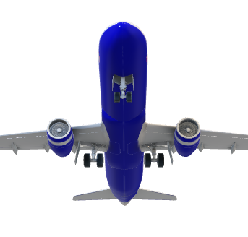
POWER BI
EXCEL
TABLEAU
In Power BI, we built dynamic visuals using DAX measures, slicers, and filters. This dashboard allows users to interact with the data in real-time, tailoring insights by year, carrier, and distance groups. It’s ideal for business users needing agile decision support.

Slide 15

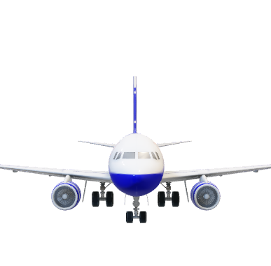
TABLEAU
EXCEL
POWER BI
Finally, in Tableau, we leveraged calculated fields and dynamic KPI cards to craft a visually compelling narrative. Tableau shines in its ability to highlight patterns and trends with design precision, great for stakeholder presentations and deep-dive analysis.

Slide 16

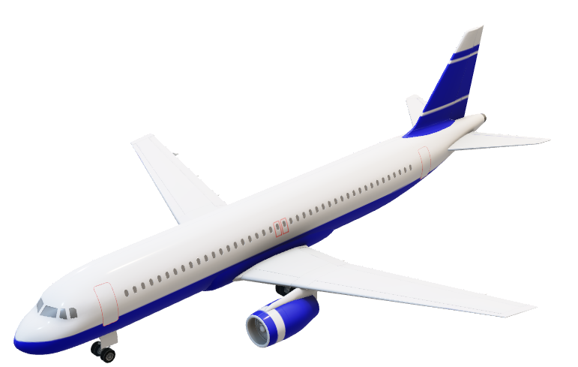
🔍 Final Insights
✈️Southwest Airlines Commands the Market: Southwest carried 34.1M passengers, the highest among all carriers, highlighting brand loyalty, vast route coverage, and a competitive edge in the U.S. airline industry.
📅Q3 Performance Peaks: Load Factor % peaks in Q3 (>85%) across all carriers, driven by seasonal demand and holidays. Indicates high operational utilization during these months.
📌Market Concentration: Top 5 carriers manage over 70% of passengers. High brand dominance and preference, ideal for loyalty program leverage. Use of Power BI and Tableau dashboards allows flexible filtering, ad-hoc analysis, and strategic review – critical for data-driven planning.

Slide 17


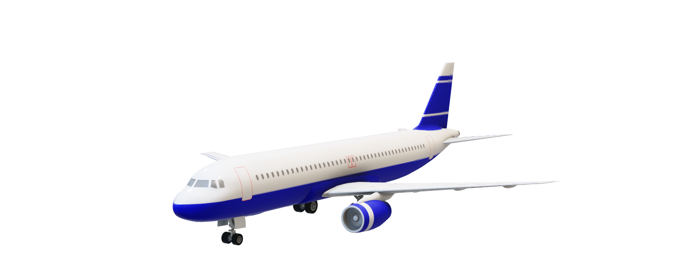
🔚Conclusion
The High Clouds Case Study provided a comprehensive view of airline performance through data. By leveraging tools like Excel, SQL, Power BI, and Tableau, we transformed raw flight records into actionable insights. Our deep-dive into KPIs revealed patterns in load efficiency, market dominance, and passenger behavior.
The findings empower stakeholders to:
Optimize carrier operations.
Improve route planning.
Strategically target underutilized time slots and days.
In a data-driven era, these insights are not just numbers—they’re levers for smarter, faster, and more informed decisions.

Slide 18

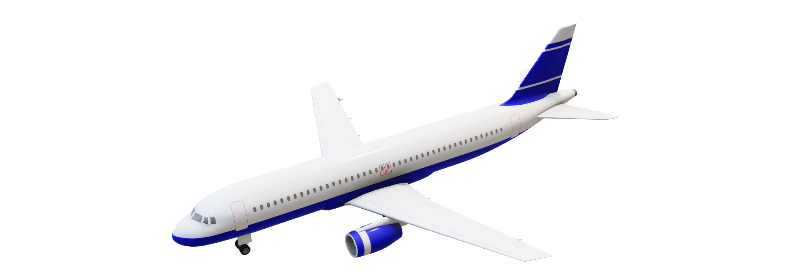
🙏Thank you
Open for questions and discussion

