Slide 1
S&D Terminals Monthly AOP Review for the Month August’26
Notes:
<number>

Slide 2




HSE KPI’s
iRCMS Compliance
0 Overdue
LWC FR – 0
DCMP
5 | 10 Completed
TRC FR – 0
Show Cause Notice
1
Tier 1 & 2 – 0
Fire – 1 & RWC - 1
Notes:
<number>

Slide 3




HSE AOP’s
Risk Management
4 Items
Assessment & Audits
5 items
Safety Management
1 item
03
Digital Initiative
8 Items
Capability Building
8 Items
Risk Reduction Initiative
3 items
Notes:
<number>

Slide 4
HSE AOP’s
AOP Review – September, 2020
S&D HSSE Performance (FY20-21)
01 Base line PHA for Tada
10%
One round of initial Discussion held with Depot Officer. Training planned on 3rd Week of Sept’26 to proceed.
June’26
Aug’26
Sept’26
Oct’26
Nov’26
1
2
3
4
5
Initiation & Planning
Data Collection & Preparation
Workshop Execution
Report Review
Close Out
All required data collected, review of data in progress, modelling will be planned shortly facing constrain in getting slot as we have only one license at group level.
02 QRA for 10 Mini Depots
10%
Aug’26
Sept’26
Oct’26
Dec’26
1
2
3
4
QRA Modelling
Risk Evaluation
Report & Review
Closeout
10%
RR review initiated, QRA input to RR session also completed, from QRA input scenario selection is in progress.
03 Risk Register Review & RNE
June’26
July’26
Aug’26
Sept’26
Oct’26
Nov’26
1
2
3
4
5
6
Team Formation
Location Review
Cross – Terminal Review
HO Review
DRR Updation
Approval – RNE & RR
Notes:
<number>

Slide 5
HSE AOP’s
AOP Review – September, 2020
S&D HSSE Performance (FY20-21)
Received quotes from 4 approved vendors; 2 were technically approved after S&OR evaluation, and Details shared with Projects for WO. Planned only for Rewari.
04 F&G Mapping Study
10%
June’26
Aug’26
Sept’26
Oct’26
Dec’26
Jan’27
1
2
3
4
5
6
Scope Finalization
Data Collection
PR/PO
Study Initiation
Coverage analysis & S&OR Review
Closeout
05 Cross Terminal LOD -1
10%
Schedule released, audit planned from Spet’26.
July’26
Aug’26
Nov’26
Mar’27
1
2
3
4
Schedule
Preparation
Audit
Recommendation Tracking
06 LOD-2 Barrier Verification
10%
Schedule released, planned from Oct’26.
July’26
Sept’26
Jan’27
Mar’27
1
2
3
4
Schedule
Preparation
Audit
Recommendation Tracking
Notes:
<number>

Slide 6
HSE AOP’s
AOP Review – September, 2020
S&D HSSE Performance (FY20-21)
07 LOD-3 Management Audit
60%
Completed for Chennai and Abhanpur planned on 10th & 11th Sept’26.
July’26
Aug’26
Sept’26
Mar’27
1
2
3
4
Schedule
Preparation
Audit
Recommendation Tracking
08 IMS Surveillance Audit
0%
Yet to initiate
Nov’26
Dec’26
Feb’27
Mar’27
1
2
3
4
Schedule
Preparation
Audit
Recommendation Tracking
09 ERDMP Certification - Bhopal
100%
Audit Completed, Received certificate.
May’26
July’26
Aug’26
Dec’26
1
2
3
4
PR/PO
Preparation
Audit
Certification
Notes:
<number>

Slide 7

HSE AOP’s
AOP Review – September, 2020
S&D HSSE Performance (FY20-21)
10 OMS Conformance
0%
Yet to initiate Gap Assessment.
Sept’26
Oct’26
Nov’26
Feb’27
1
2
3
4
5
Gap Assessment
HO Review
Gap Closure
LOMS Updation
IFGA & OPR
11 R&M IT Development
50%
Development of Phase -1 of ESS system ready in prod, rest development is in Progress.
Jun’26
Aug’26
Nov’26
Jan’27
1
2
3
4
Scope
BRD
Development
UAT & Roll Out
Planned for JCC, Mock Drill, MIIS Dashboard, HFOM, DRR for Depots & Risk Pulse.
Now Mock Drill Lined up, HFOM & MIIS on hold due to IP21 requirement.
12 MFG IT Development
20%
Jun’26
Aug’26
Nov’26
Jan’27
1
2
3
4
Scope
BRD
Development
UAT & Roll Out
Notes:
<number>

Slide 8
HSE AOP’s – Competency Development
AOP Review – September, 2020
S&D HSSE Performance (FY20-21)
13 Live Fire Fighting Training
2 – RIL Batch, 2- Contractor Batch
50%
1 Batch of Contractor & RIL Completed. Second batch of RIL planned on 16-17 Dec
100%
Completed in July First Week at Bhopal Terminal.
14 UICC Training
0%
1 Batch Completed, 2nd Batch yet to be planned.
15 Intensive Operation
16 Scaffolding Training
100%
Completed through 3rd party for 24 employees at Chennai Terminal.
17 Mass Training
100%
Completed for the identified Soft Skills.
18 Rescue Training
0%
PR / PO to be initiated. Target : Jan’27
19 Process Safety Workshop
0%
Plan discussed with Group S&OR, Date finalization is under discussion. Target : Sept’26.
20 Half Yearly Validation
0%
1st round planned in Sept’26
Notes:
<number>

Slide 9
HSE AOP’s – Risk Reduction Initiative
AOP Review – September, 2020
S&D HSSE Performance (FY20-21)
21 Fire Engine Safety PLC
20%
Basis and logic review completed, PO and execution In progress.
Technical Bid evaluation under progress at MEC end.
22 Fire water recirculation
20%
P&ID has been reviewed and all input given for Engg.
Under Procurement.
23 Gantry Water Spray
20%
P&ID has been reviewed, comments have been shared, and it is currently under detailed engg.
Notes:
<number>

Slide 10
AOP items for Individual functions with direct accountability
Sl. No | AOP Items | UoM | Plan | Status
1 | Filing of renewal applications as per statutory deadlines; 1a. Correctness of Volumes in application in line with Env Standards; 1b. Update volumes in line with changes in ground conditions | Nos | 100 % | SGWA renewal application for Rewari terminal submitted on 13th March 2026 SGWA renewal application for Kanpur terminal submitted on 25th May 2026 & New application to be submitted by Consultant again
2 | Obtain Consents / License before expiry of existing | Nos | 100 % | HWA granted to Haldia on 26/08/2026
3 | Environment conditions compliance and returns within statutory timelines | Nos | 99 % | There are total of 2047 conditions, out of which 2016 are complied and 26 conditions are under capex. 05 conditions are in progress
4 | Revalidation of Env. conditions applicability to initiate appropriate actions towards compliance | Nos | 100 % | Complied and ongoing
5 | Show cause notice or penalty from authorities or complaint from surrounding habitants | Nos | 01 | Nil
Notes:
<number>

Slide 11
AOP items for Individual functions with direct accountability
Sr. no. | Key Outcome | Milestone/Metric | Timeline | Status
1 | CTO/CTE/HZW/any other NOC renewal/expansion | a) Submission of application to Authority for renewal/ expansion/amendment b) Review of granted CTO/CTE/HZW renewal/ expansion conditions | Expansion and renewal whenever required. Status every monthly | SGWA application for Rewari terminal on 13th March 2026 Application to be submitted again
2 | Rainwater Harvesting at Terminal -05 Terminals | Proposal/Engineering Job execution/Construction Implementation / operation | Aug, 26 Nov, 26 Mar, 27 | PO placed to vendor
3 | Rooftop Solar System at Terminals - Bhopal & Haldia | Proposal / Engineering Job execution/Construction Implementation / operation | June, 26 Sept, 26 Dec, 26 | In progress
4 | Laying of separate OWS outlet line with pit and pump arrangement - 05 Terminals | Proposal Job execution/Construction Implementation / operation | Aug, 26 Dec, 26 Mar, 27 | In progress
5 | Replacement of Purimeter at all terminals | Release of PO Job execution Implementation | Nov, 26 Dec, 26 Mar, 27 | Vendor selection is in progress
6 | LDAR Survey and Implementation (Including Ethanol) | Survey and Monitoring Review and Reporting as per statutory requirement | Half yearly, 2026 Half yearly, 2026 | Reports received from Bhopal, Chennai, & Rewari
Notes:
<number>

Slide 12
AOP items for Individual functions with direct accountability
Sr. no. | Key Outcome | Milestone/Metric | Timeline | Status
7 | Development of sustainability culture at site and Sustainability Reporting as per GRI | Awareness on reporting framework/ uniform format for SR data collection Analysis of Data Capture Compilation of data Reporting as per GRI | Oct, 2026 Monthly Monthly Monthly | Ongoing
8 | Impact Aspect Register Review / Endorsement of Own Terminals | Field Review HO Review Endorsement | Oct ‘26 Nov ‘26 Dec ‘26 | Yet to start
Near Term Goals:
Sr. no. | Key Outcome | Milestone/Metric | Timeline | Status
1 | Dedicated Hazardous shed for Depots – 11 Depots (Except Rudrapur) | Proposal / Engineering Job execution/Construction Implementation / operation | July, 26 Dec, 26 Mar, 27 | Vendor selection in progress
2 | DG Stack for Depots as per norms - 8 Depot’s: Tada, Dobhi, Mandar, Tilbegumpur, Baharagora, Girisola, Abhanpur, & Hazurnagar | Proposal / Engineering Job execution/Construction Implementation / operation | Aug, 26 Dec, 26 Mar, 27 | Vendor selection in progress
3 | Water Management with Garland Drain – Bhopal & Chennai | Proposal / Engineering Job execution/Construction Implementation / operation | Aug, 26 Dec, 26 Mar, 27 | Vendor selection in progress
Notes:
<number>

Slide 13
AOP items for Individual functions with direct accountability
Sr. no. | Key Outcome | Milestone/Metric | Timeline | Status
4 | Provide Borewell structure as per CGWA - 07 Depot’s: Dobhi, Bharagoda, Patran, Pollachi, Abhanpur, Hazurnagar, & Betnoti | Proposal / Engineering Job execution/Construction Implementation / operation | July, 26 Dec, 26 Mar, 27 | Vendor selection in progress
5 | Rooftop Solar System at Terminals – Kanpur, Rewari & Chennai | Proposal / Engineering Job execution/Construction Implementation / operation | Dec, 2026 Mar,2027 Mar, 2027 | Site survey/visit in progress
6 | Waterless Urinal at Driver Amenity (DA) block | Proposal Job execution/Construction Implementation / operation | Nov, 26 Dec, 26 Mar, 27 | Yet to start
Long Term Goals:
Sr. no. | Key Outcome | Milestone/Metric | Timeline | Status
1 | Rooftop Solar System at Depots – All depots | PR/PO generation Job execution/Construction Implementation / operation | Dec, 2025 Mar,2026 Mar, 2026 | Site survey/visit in progress
Notes:
<number>

Slide 14
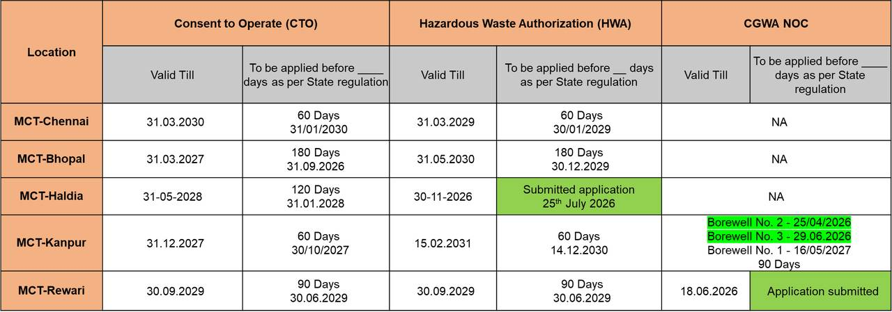
Legal License Status – Own Terminal
Legal License Status – Own Terminal
 | Upcoming
 | Applied
CTE Application :
Haldia – Granted on 17th July
Chennai – Yet to start
Notes:
<number>

Slide 15
Legal License Status – Depots
Location | Consent to Operate (CTO) |  | Hazardous Waste Authorization (HWA) |  | CGWA NOC
 | Valid Till | To be applied before ____ days as per State regulation | Valid Till | To be applied before ____ days as per State regulation | Valid Till | To be applied before ____ days as per State regulation
Abhanpur | 31.12.2028 | 90 days 31.09.2028 | 24/07/2028 | 60 days 24/05/2028 | 27/03/2027 | 60 Days 26/01/2027
Tada | 30.06.2027 | 90 days 31.03.2027 | 30.06.2027 | 90 days 31.03.2027 | NA | NA
Huzurnagar | 31.07.2031 | 90 Days 30.04.2031 | 31.07.2031 | 90 Days 30.04.2031 | DGWC obtained on 17.04.2018 | NA
Pollachi | 31.03.2027 | 90 days 31.12.2026 | 31.03.2029 | 90 Days 31.12.2028 | DGWC obtained in 22.06.2018 | Nil
Mandar | 31.05.2027 | 90 days 30.02.2027 | 31.05.2028 | 90 Days 23.02.2028 | NoC Surrendered
Patran | 30.09 2029 | 60 days 30.06.2029 | 30.09.2027 | 60 Days 30.06.2027 | PWRDA dated 11.06.2021 . | Exemption letter submitted to PWRDA dated 25/04/2024
Rudrapur | 31.03.2031 | 90 days 31.01.2031 | 31.03.2031 | 90 days 31.01.2031 | 17.03.2027 | 90 Days 17.12.2026
Tilbegumpur | 31.03.2029 | 60 Days 30.01.2029 | 08.03.2028 | 60 Days 07.01.2028 | 25-09-2027 | Surrendered the CGWA NOC on 26/06/2023
Dhobi | 02.11.2028 | 90 days 01.08.2028 | 19.01.2028 | 90 days 18.10.2027 | 31.10.2024 | Exemption letter submitted to CGWA on 28/06/2024 as per new notification dated 29.03.2023
Betnoti | 31.03.2027 | 90 Day 31.12.2026 | 31.03.2027 | 120 Days 04.01.2027 | 21.08.2026 | 90 days 20.05.2026
Baharagora | 30.11.2027 | 90 Day 30.08.2027 | 22.12.2028 | 90 days 21.09.2027 | 17-07-2023 | Application submitted for Exemption as per new notification dated 29.03.2023
Girisola | 31.03.2030 | 90 Day 30.12.2029 | 31.03.2030 | 120 Days 30.11.2029 | NA | NA
Nalagarh | 31.03.2031 | 120 Days 31/12/2030 | --- | Application submitted 27/01/2026 | Validity not mentioned
Notes:
<number>

Slide 16
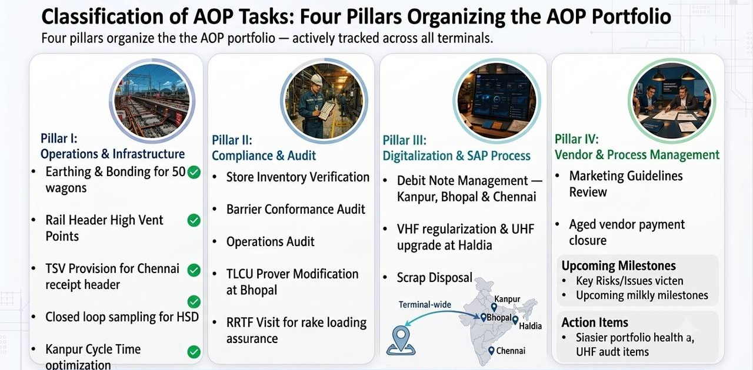
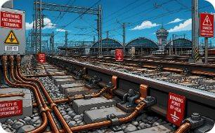



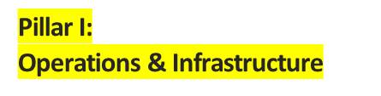
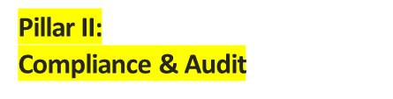

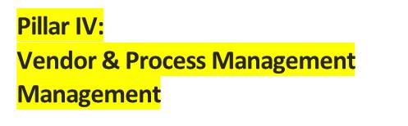

Classification of AOP Tasks
Four pillars organize the AOP portfolio — actively tracked across all terminals.
Earthing & Bonding for 50 wagons
Rail Header High Vent Points
TSV Provision for Chennai receipt header
Closed loop sampling for HSD
Kanpur Cycle Time optimization
Store Inventory Verification
Barrier Conformance Audit
Operations Audit
TLCU Prover Modification at Bhopal
RRTF Visit for rake loading assurance
Marketing Guidelines Review
Aged vendor payment closure
Debit Note Management — Kanpur, Bhopal & Chennai
VHF regularization & UHF upgrade at Haldia
Scrap Disposal
<number>
AOP Status Indicator: Portfolio actively tracked across all terminals.

Slide 17
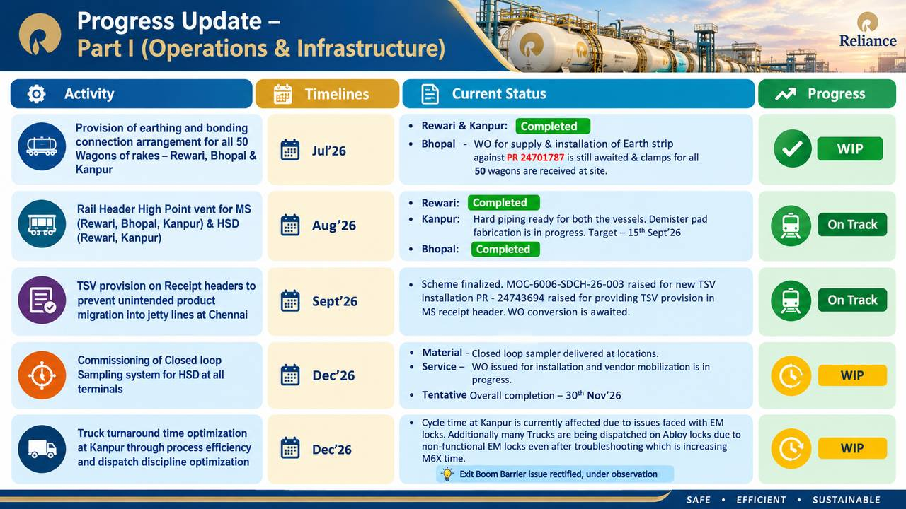
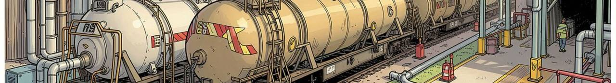
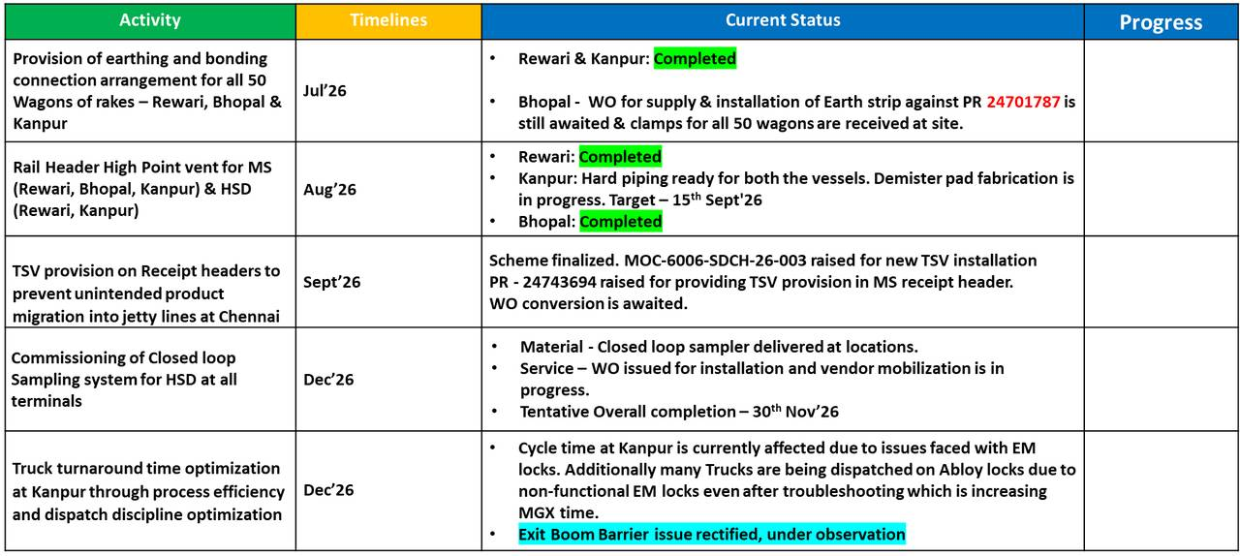
AOP Review – September, 2020
Progress Update — Part I (Operations & Infrastructure)
S&D HSSE Performance (FY20-21)
WIP
On Track
On Track
WIP
WIP
Notes:
<number>

Slide 18
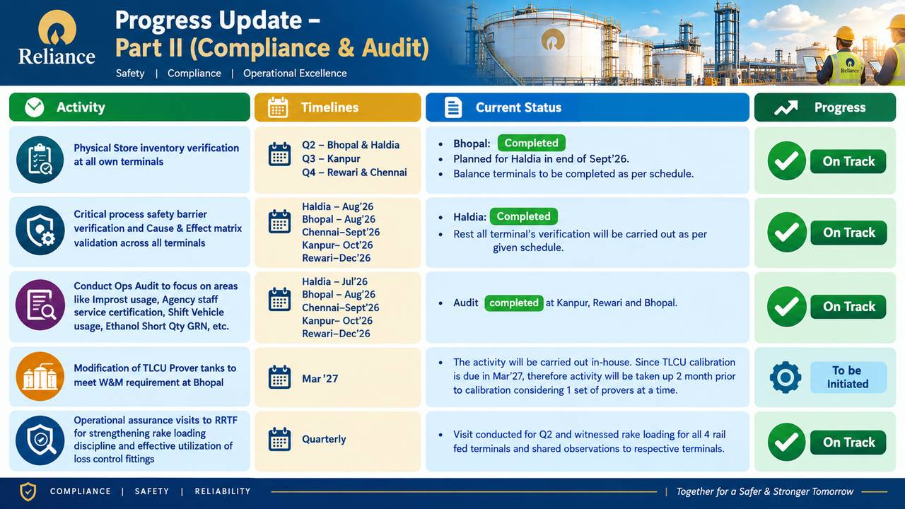

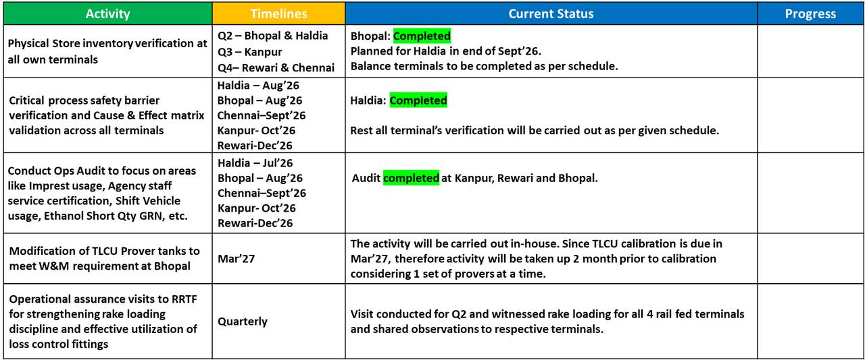
AOP Review – September, 2020
S&D HSSE Performance (FY20-21)
Progress Update — Part II (Compliance & Audit)
On Track
On Track
On Track
To be Initiated
On Track
Notes:
<number>

Slide 19
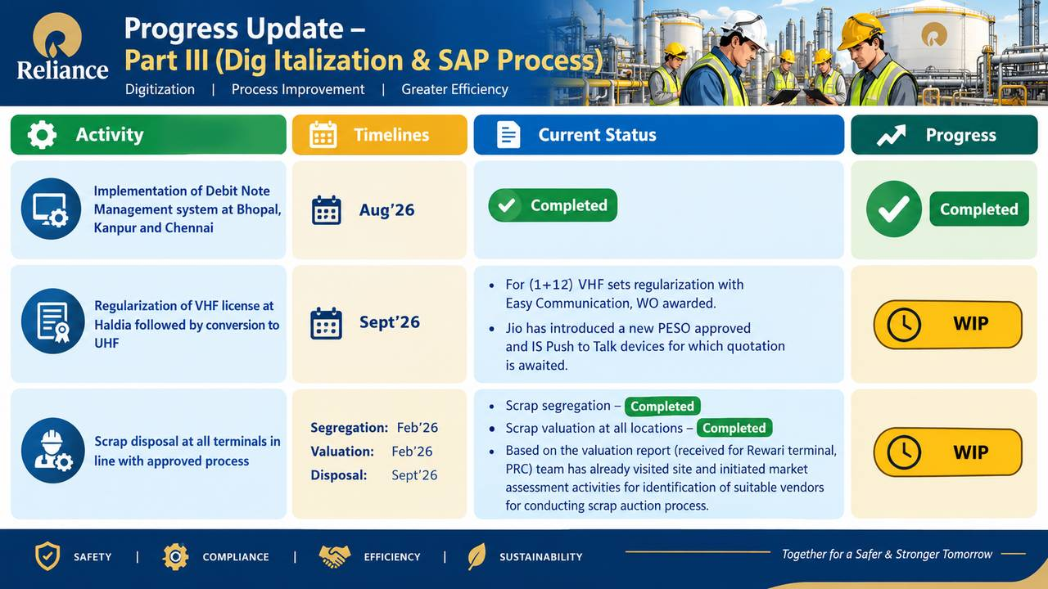

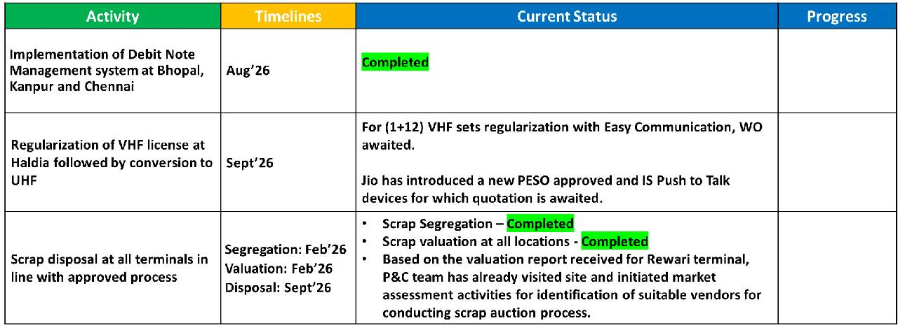
AOP Review – September, 2020
S&D HSSE Performance (FY20-21)
Progress Update — Part III (Digitalization & SAP Process)
Completed
WIP
WIP
Notes:
<number>

Slide 20
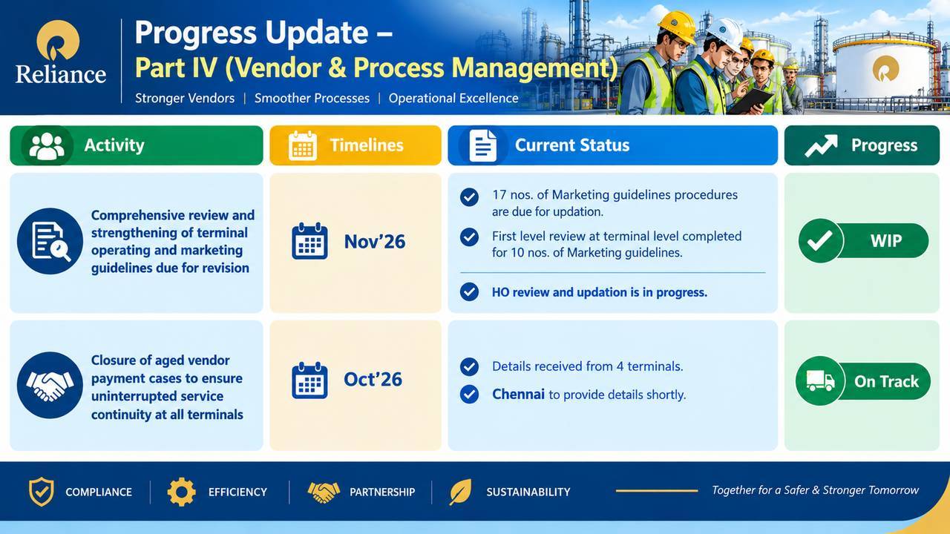
AOP Review – September, 2020
S&D HSSE Performance (FY20-21)
Progress Update — Part IV (Vendor & Process Management)
Activity | Timelines | Current Status | Progress
Comprehensive review and strengthening of terminal operating and marketing guidelines due for revision | Nov’26 | 17 nos. of Marketing guidelines procedures are due for updation. First level review at terminal level completed for 10 nos. of Marketing guidelines. HO review and updation is in progress.
Closure of aged vendor payment cases to ensure uninterrupted service continuity at all terminals | Octt’26 | Details received from 4 terminals. Chennai to provide details shortly.
WIP
On Track
Notes:
<number>

Slide 21

MAINTENANCE AOP ACTIVITY STATUS TRACKER
Electrical AOP
FY 2026-27 · AOP STATUS REVIEW
MILESTONES
TARGETS
STATUS
PROGRESS
COMPLETED - 1
ON TRACK - 6
IN PROGRESS - 5
DELAYED - 3
NOT STARTED
SN | MAINTENANCE AOP OUTCOME | MILESTONES | TARGETS | STATUS | PROGRESS
01 | Protection relay installation for New DGs at Bhopal, Kanpur & Rewari | Engineering Budgetary Quote Material Codifying Creating PR | 10-05-2026 20-05-2026 30-05-2026 15-06-2026 | a) Completed. b) Completed. c) Completed. d) PR pending for budget upload.
02 | Energy meter installation for 2 No's identified motors at all terminals | Carry Forwarded from Past AOP. WO/PO Awaiting | 31.12.2026 | PR released for Materials and Services, PO/WO awaited.
03 | Transformer Overhauling at Bhopal, Chennai, Haldia & Rewari | Carry Forwarded from Past AOP. WO/PO Awaiting | 31.12.2026 | PR released for Materials and Services, PO/WO awaited.
04 | RLA for Transformer at all terminals | Scope preparation and Creation of PR | 30.06.2026 | RLA Service code 3294246 made ready. Waiting for budget for uploading PR Preparation.
05 | Electrical Training videos for 3 Critical SMPs | a) Uploading revised SMPs b) Training module for 1st SMP c) Training module for 2nd SMP d) Training module for 3rd SMP | 31-05-2026 30-06-2026 31-07-2026 31-08-2026 | a) SMPs uploaded in portal. b) 1st Training Module delivered and validation completed. c) 2nd Training Module completed. d) 3rd Training Module is in Progress
Engineering
Budgetary Quote
Material Codifying
Creating PR
IN PROGRESS
31.12.2026
DELAYED
DELAYED
ON TRACK
ON TRACK
TOTAL: 15 ACTIVITIES

Slide 22
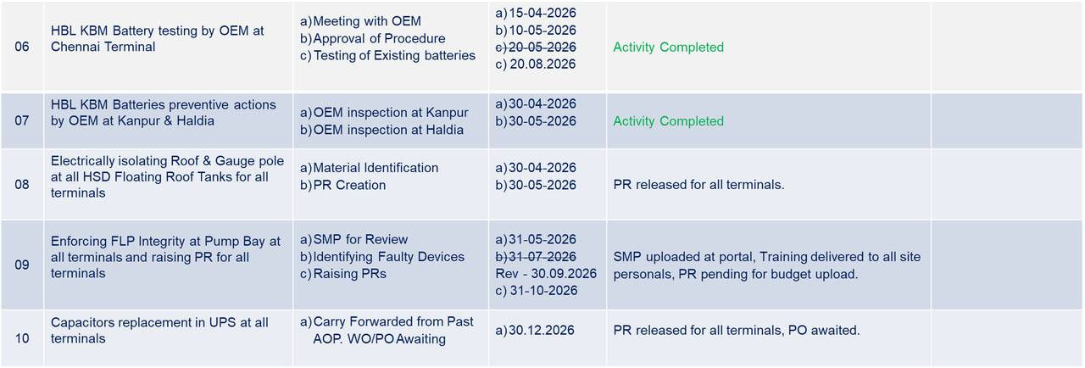
MAINTENANCE AOP ACTIVITY STATUS TRACKER
Electrical AOP
FY 2026-27 · AOP STATUS REVIEW
COMPLETED - 2
ON TRACK - 6
IN PROGRESS - 5
DELAYED - 3
NOT STARTED
SN | MAINTENANCE AOP OUTCOME | MILESTONES | TARGETS | STATUS | PROGRESS
COMPLETED
COMPLETED
ON TRACK
ON TRACK
DELAYED
TOTAL: 15 ACTIVITIES

Slide 23
MAINTENANCE AOP ACTIVITY STATUS TRACKER
Electrical AOP
FY 2026-27 · AOP STATUS REVIEW
COMPLETED - 1
ON TRACK - 6
IN PROGRESS - 5
DELAYED - 3
NOT STARTED
SN | MAINTENANCE AOP OUTCOME | MILESTONES | TARGETS | STATUS | PROGRESS
11 | Relay coordination study for all terminals | Technical Scope DEWA to MEC for allocation of Engineers Completing RCS. | 31-05-2026 30-06-2026 31-12-2026 | MEC declined to perform the engineering activities on 9th June 2026; however, they had already finalized the scope. Service code Created, PR created and under release.
12 | DCRM Testing on OLTC overhauling. | Material Identification PR Creation | 30-04-2026 15-06-2026 | a) Service code 3330214 created. b) PR pending for budget approval.
13 | Completing Commissioning of Solar Roof Tops at Bhopal | Receiving Material at site Installation Commissioning | 31-05-2026 31-06-2026 10-07-2026 | a) CEIG Approval received. b) On Track
14 | Completing Commissioning of Solar Roof Tops at Haldia | Receiving Material at site Installation Commissioning | 31-05-2026 31-07-2026 31-10-2026 | a) Completed. b) Completed. c) In progress.
15 | 12No's of locations budgetary offers for installation of Rooftop (3T,7D&2LPG) | Allocation of Team for individual site survey. Feasibility of Identified locations for installation of Rooftops at all 12 locations Budgetary offers for all 12 locations | 31-05-2026 31-08-2026 15-09-2026 | a) Completed Survey by solar team at 5 Locations and budgetary quote received at 5 locations. b) Remaining sites survey in progress, status will be updated by 10th Sep’2026.
ON TRACK
ON TRACK
IN PROGRESS
IN PROGRESS
IN PROGRESS
TOTAL: 15 ACTIVITIES

Slide 24

MAINTENANCE AOP ACTIVITY STATUS TRACKER
Instrumentation AOP
FY 2026-27 · AOP STATUS REVIEW
COMPLETED - 2
ON TRACK - 8
IN PROGRESS
DELAYED
NOT STARTED
SN | MAINTENANCE AOP OUTCOME | MILESTONES | TARGETS | STATUS | PROGRESS
1 | Establish Cyber Security Servers AMC for PDC, SDC, and ePO central servers across Chennai, Haldia, Kanpur, and RCP central servers with end-to-end support | Codification and PR PO Awarded Execution | 31.07.2026 31.12.2026 31.03.2027 | Budgetary quotation received from OEM; Service code created. PR created and under release.
2 | Establish TAS system AMC to ensure reliable, secure, and uninterrupted operations across depot locations—Mandar, Tilbegumpur, Tada, Girisola, Baharagora, and Dobhi | Technical Review Codification and PR PO Awarded Execution | 30.06.2026 31.08.2026 31.01.2027 31.03.2027 | Budgetary quotation received from OEM, Technical review completed, Service code created.
3 | Conduct a technical feasibility study for IP21 system implementation across Chennai, Haldia, and Kanpur terminals, including its use for real-time process data acquisition, monitoring, reporting, and integration with existing control systems, along with assessment of infrastructure readiness, network compatibility, and cost implications. | Technical Review Codification and PR PO Awarded Execution | 30.06.2026 31.08.2026 31.12.2026 31.03.2027 | Technical feasibility assessment in progress. Scope identified, Terminal central server allocated and handover GMS tech COE installation IP21 applications.
4 | Implement centralized CCTV remote access at RCP for real-time monitoring of depot locations (Girisola, Dobhi, Baharagora, Nalagarh, Tada, Tilbegumpur, and Mandar) via the Jio Secure platform, ensuring secure connectivity, user access control, and system reliability. | Technical Review Codification and PR PO Awarded Execution | 30.06.2026 31.08.2026 31.01.2027 31.02.2027 | Activity Completed.
ON TRACK
ON TRACK
ON TRACK
COMPLETED
TOTAL: 10 ACTIVITIES

Slide 25
MAINTENANCE AOP ACTIVITY STATUS TRACKER
Instrumentation AOP
FY 2026-27 · AOP STATUS REVIEW
COMPLETED - 2
ON TRACK - 8
IN PROGRESS
DELAYED
NOT STARTED
SN | MAINTENANCE AOP OUTCOME | MILESTONES | TARGETS | STATUS | PROGRESS
5 | Preparation of Instrument Index for all terminals, with corrective actions based on field vs. system range verification as per datasheets; signed documents to be uploaded to the R&M portal in line with GDP Summary 5.4-0001-A/3.a.3. | Corrective actions Document sign off | 30.06.2026 31.12.2026 | Document sources identified from shared folders, hard copies, and REIMS; instrument index preparation is in progress.
6 | Cause and effect verification on a sample basis for all terminals, carried out in coordination with the operations team. | Haldia Rewari Chennai Haldia Kanpur | 30.06.2026 30.07.2026 31.09.2026 31.10.2026 30.11.2026 | Haldia completed. Rewari delayed, planned in 2nd week of Sep’2026.
7 | DCS Pump Logic Gap Closure – All Terminals: Improved reliability through DCS logic modifications by preventing pump start-up via LCS during active interlock conditions. Service PO for the remaining four terminals is in progress. | Bhopal Rewari Chennai Haldia Kanpur | 30.06.2026 30.08.2026 31.10.2026 31.11.2026 30.01.2027 | Activity Completed.
ON TRACK
DELAYED
ON TRACK
TOTAL: 10 ACTIVITIES

Slide 26
MAINTENANCE AOP ACTIVITY STATUS TRACKER
Instrumentation AOP
FY 2026-27 · AOP STATUS REVIEW
COMPLETED - 2
ON TRACK - 8
IN PROGRESS
DELAYED
NOT STARTED
SN | MAINTENANCE AOP OUTCOME | MILESTONES | TARGETS | STATUS | PROGRESS
8 | TAS configuration for EBMS modified to enable dynamic multi-product selection and sub-product addition under a base product, implemented as a pilot at Rewari terminal. Service PO for the remaining four terminals is in progress. | Haldia Chennai Haldia Kanpur | 30.06.2026 30.07.2026 31.09.2026 31.10.2026 30.11.2026 | Activity Completed.
9 | Replacement of obsolete power supply units in DCS/ESD/F&G panels as per BMP at all terminals | Technical Review Codification and PR PO Awarded Execution | 30.06.2026 30.08.2026 31.12.2026 31.01.2027 | Bulk power supply replacement scope finalized as per COE recommendations; OEM budgetary quotation received, codification under progress.
10 | AI-Based Video Monitoring System for Safety Compliance and Operability Assessment at RIL Bhopal Terminal integration with Automation systems-DCS/ESD | Technical Review PO Procurement Implementation | 30.06.2026 30.08.2026 30.10.2026 31.12.2026 | M/s Algo Fusion: Technical documents have been received. Confirmation from the Security Technology Group is awaited regarding the additional CCTV makes and models. Other competing vendors: M/s Intozi, M/s Orvin, M/s Videonetics, and M/s AlgoVision have been provided with all use cases and existing CCTV details for technical review.
COMPLETED
ON TRACK
ON TRACK
TOTAL: 10 ACTIVITIES

Slide 27

MAINTENANCE AOP ACTIVITY STATUS TRACKER
Mechanical AOP
FY 2026-27 · AOP STATUS REVIEW
COMPLETED - 1
ON TRACK - 9
IN PROGRESS
DELAYED
NOT STARTED
SN | MAINTENANCE AOP OUTCOME | MILESTONES | TARGETS | STATUS | PROGRESS
1 | Marine Loading Arm (MLA) complete Inspection through the OEM at Haldia Terminal | PO Awarded Execution | 30.04.2026 31.12.2026 | Activity Completed.
2 | Replacement of old air eliminators in Ethanol and Bottom Loading Bays with new units to improve reliability | PO Awarded Execution | 30.04.2026 31.12.2026 | PO Released, EDD: 30.10.2026.
3 | Preparation of corrosion loop manual for Chennai Terminal for risk reduction, integrity assurance and compliance. | Define Scope Document preparation Final Review and publish | 30.06.2026 31.01.2026 31.03.2027 | a) Manual under preparation.
4 | Jetty pipeline dig verification to validate data from in-line inspection (ILI) tools and composite repair of pipeline. | PO Awarded Execution | 30.05.2026 31.03.2027 | Dig verification and Composite Repair – WO released. Material PO released. EDD: 16.12.2026
5 | Wind girder strengthening to be carried out at Chennai Terminal for 4 tanks | Technical Review & Scope preparation Codification and PR | 30.06.2026 31.08.2026 | Tank T008A - wind girder completed. WO released for Tank T008B, T002A and T002B. Tank T008B : Scaffolding erection completed and wind girder strengthening under progress.
COMPLETED
ON TRACK
ON TRACK
ON TRACK
ON TRACK
TOTAL: 10 ACTIVITIES

Slide 28
MAINTENANCE AOP ACTIVITY STATUS TRACKER
Mechanical AOP
FY 2026-27 · AOP STATUS REVIEW
COMPLETED - 1
ON TRACK - 9
IN PROGRESS
DELAYED
NOT STARTED
SN | MAINTENANCE AOP OUTCOME | MILESTONES | TARGETS | STATUS | PROGRESS
6 | Rail gantry unloading header blasting and painting at all land terminals for corrosion control | PO Awarded Execution | 31.05.2026 31.03.2027 | PR raised for all terminals, WO awaited.
7 | Piping inspection using ultrasonic testing to be conducted at all terminals to ensure system reliability and safety, as per OISD-130 guidelines | PO Awarded Execution | 31.05.2026 31.03.2027 | Rewari Terminal Piping inspection completed PR raised for all terminals, WO awaited.
8 | Tank Maintenance and Inspection to ensure system reliability and safety, as per OISD-129 | PO Awarded Execution | 31.09.2026 31.03.2027 | Tank M & I Completion Status: Kanpur – 2 oo 3 Bhopal – 2 oo 6 Chennai – 6 oo 10 Haldia – 1 oo 14 Rewari – 7 oo 9
9 | Installation of a new TSV on the receipt header to address thermal expansion issues | PO Awarded Execution | 31.09.2026 31.03.2027 | MOC-6006-SDCH-26-003 raise for new TSV installation.
10 | Tank 27 A and B, 12” outlet pipeline replacement to address localized metal loss, pitting, and potential leaks. | PO Awarded Execution | 31.07.2026 31.03.2027 | SOQ prepared. Service WO received, Material PO awaited.
ON TRACK
ON TRACK
ON TRACK
ON TRACK
ON TRACK
TOTAL: 10 ACTIVITIES

Slide 29

MAINTENANCE AOP ACTIVITY STATUS TRACKER
Planner AOP
FY 2026-27 · AOP STATUS REVIEW
COMPLETED
ON TRACK - 2
IN PROGRESS - 2
DELAYED
NOT STARTED
SN | MAINTENANCE AOP OUTCOME | MILESTONES | TARGETS | STATUS | PROGRESS
1 | To determine the VED classification for all Depot and LPG equipment’s through Asset critical Analysis | Scope Preparation VED analysis | a) 31.05.2026 b) 31.09.2026 | VED classification list prepared and sent to SME for review.
2 | BOM Updation of equipment where not updated as per site inputs. | List out all equipment's based on equipment details/BOM Updation/Non-required equipment's etc. Site inputs to be taken for listed equipment’s. SAP Updation as per site inputs. | a) 31.05.2026 b) 30.08.2026 c) 31.03.2027 | Equipment list prepared with BOM updation status and shared to site for inputs.
3 | Frequency review of all equipment at Own Terminals and LPG bottling plant and update as per revised procedures. | Change equipment frequency as per SME's recommendation. | 31.01.2027 | Rajkot and Sanand – Completed Own Terminals : Mechanical Part Completed. Own Terminals : Electrical Part under progress.
4 | To develop and update SAP based online concession deviation process for PM/CM orders of equipment | Authorization to be decided Follow -up with SAP team to proceed further. | a) 30.06.2026 b) 31.01.2027 | Under discussion.
ON TRACK
ON TRACK
IN PROGRESS
IN PROGRESS
TOTAL: 04 ACTIVITIES

Slide 30
DISPATCH PERFORMANCE | AOP vs ACTUAL | FY 27 | Aug’26
1,304
90%
+13%
-24%
TKL ACTUAL
AOP ACHIEVEMENT
HT VARIANCE
DU VARIANCE
AOP vs Actual — Segment View
SEGMENT
AOP (TKL)
ACTUAL (TKL)
VARIANCE
LEADERSHIP TAKEAWAYS
Mini Depot
806
681
▼ 15%
90%
Overall AOP achievement
Hired Terminal
Kanech, Mangalore, Cochin, Mumbai
350
396
▲ 13%
+13%
HT over-delivered vs AOP
Dispatch Units (13 Nos.)
298
226
▼ 24%
-15%
MD remains below plan
1,454
1,304
▼ 10%
-24%
DU is the largest gap
TOTAL
On Target
WIP
Not Started
Not Meeting
Source: AOP / Actual
AMS Locations in Scope – Hired Terminal-5, Depots-12, DUs-13.
Notes:
<number>

Slide 31
HT, Depot, DU - AOP Performance - FY 27 – Aug’26
S.N. | AOP Description | AOP Target upto August 2026 | Actual Achieved AOP upto August 2026 | Status
1 | Conversion of HSD UG Tanks (2 Nos) to MS Grade – Tilbegumpur | Statutory Prior Approval (PESO, CTE Factory) - Jun’26 PR Creation - Jul’26 PO Issuance - Sep’26 Execution - Nov’26 Statutory Post Approval - Dec’26 SAP Modification - Dec’26 | Prior Approval for PESO received, CTE application portal NIVESH MITRA under upgradation, application will be applied post portal update. Budget uploaded, PR created/released. PO - under release stage.
2 | Augmentation / Project Execution - Huzurnagar | T&P Approval (Initial) for Admin - Jun’26 Commencement of construction Admin Bldg - Aug’26 Completion of Project (in Total) - Feb’27 Statutory approval (Final) - Mar’27 | T&P approval received. KoM of meeting planned on 08/09/2026
3 | Addition of 70 KL HSD Tank - Hazurnagar | Statutory Prior Approval (PESO, CTE Factory) - Jun’26 Commencement of construction – UG tank - Aug’26 STO UG Tank - Sep’26 Statutory approval (Final) - Mar’27 Commission of UG Tank - Mar’27 | PESO prior approval obtained. CTE for UG tank to be applied. CA certificate awaited.
4 | Painting of Old Admin, Tanks and Gantry Structure (2 Depots – Abhanpur & Patran) | PR creation - Jul’26 PO issuance - Aug’26 Execution - Nov’26 Completion - Mar’27 | PR created PO awaited.
On Target
WIP
Not Started
Not Meeting
Locations in Scope – Hired Terminal-5, Depots-12, DUs-13.
<number>
Notes:
<number>

Slide 32
HT, Depot, DU - AOP Performance - FY 27 – Aug’26
S.N. | AOP Description | AOP Target upto August 2026 | Actual Achieved AOP upto August 2026 | Status
5 | Boundary wall extension / Internal Road Bitumination - Betnoti | RFQ floated - Jun’26 TBE & WO issue - Aug’26 Commencement of construction - Sep’26 Completion - Feb’27 | Completed Term sheet under approval.
6 | Internal Road Bitumination - Patran | RFQ floated - Jun’26 TBE & WO issue - Aug’26 Commencement of construction - Sep’26 Completion – Mar’27 | CBR samples report awaited.
7 | Boundary Wall construction as per MoHA - Rudrapur | Statutory Prior Approval (PESO) - Jul’26 RFQ - Aug’26 TBE & WO issue - Nov’26 Commencement of construction - Dec’26 Completion - Jun’27 | Discussion with RBML team to undertake in the project under their scope.
8 | MOC Execution 1 : Louvers of fire engine shed at 8 Depot (Tada, Dobhi, Mandar, Tilbegumpur, Baharagora, Girisola, Patran and Pollachi) | Engineering : Completion RFQ - Apr’26 Contractor Finalization - Jul’26 Commencement of construction - Sep’26 Completion – Feb’27 | NA RFQ floated. TBE completed. Contracted finalization, work started for Patran and Girisola.
On Target
WIP
Not Started
Not Meeting
Locations in Scope – Hired Terminal-5, Depots-12, DUs-13.
<number>
Notes:
<number>

Slide 33
HT, Depot, DU - AOP Performance - FY 27 – Aug’26
S.N. | AOP Description | AOP Target upto August 2026 | Actual Achieved AOP upto August 2026 | Status
9 | MOC Execution 2: Construction of hazardous waste shed 10 Depots (Tada, Dobhi, Mandar, Tilbegumpur, Baharagora, Girisola, Patran, Huzurnagar, Betnoti and Pollachi) | Engineering Completion Statutory Prior Approval - Jun’26 RFQ - Apr’26 Contractor Finalization - Jul’26 Commencement of construction - Sep’26 Completion - Feb’27 Statutory Final Approvals - Mar’27 | NA RFQ floated. TBE completed for all depot. Order released for Girisola and Patran. Completed for Rudrapur and WIP for Patran and Girisola.
10 | MoC Execution 3: DG stack height enhancement at 7 Depot (Tada, Dobhi, Mandar, Tilbegumpur, Baharagora, Girisola and Huzurnagar) | Engineering Completion Statutory Prior Approval - Jun’26 RFQ - Apr’26 Contractor Finalization - Jul’26 Commencement of construction - Sep’26 Completion - Feb’27 Statutory Final Approvals - Mar’27 | NA RFQ floated. TBE completed for all depot. Order released for Girisola and work started.
11 | MoC Execution 4: Bore well head protection at 6 Depots (Patran, Pollachi, Huzurnagar, Betnoti, Dobhi and Baharagora) | Engineering Completion Statutory Prior Approval - Jun’26 RFQ - Apr’26 Contractor Finalization - Jul’26 Commencement of construction - Sep’26 Completion - Feb’27 Statutory Final Approvals - Mar’27 | NA RFQ floated. TBE completed for all depot. Order released for Patran.
On Target
WIP
Not Started
Not Meeting
Locations in Scope – Hired Terminal-5, Depots-12, DUs-13.
<number>
Notes:
<number>

Slide 34
HT, Depot, DU - AOP Performance - FY 27 – Aug’26
S.N. | AOP Description | AOP Target upto August 2026 | Actual Achieved AOP upto August 2026 | Status
12 | Agreement sign-off – PIPAVAV Hired Terminal | Agreement Signoff - Jun’26 | Agreement Sign-off – 26th August 2026
13 | Commissioning of PIPAVA Hired Terminal. | Completion of Project work by HTO - Oct’26 RIL Manpower deployment - Sep’26 SAP System readiness - Oct’26 Commissiong of Facility - Dec’26 Commence to dispatches - Dec’26 | Boundary wall extension work in progress Gantry Pilling work completed
14 | Agreement with REPONO for UP-West HT for 15 Years | Management Approval Agreement Signoff - Jun’26 | Management Approval – 20th Jan 2026 Agreement Sign-off – 29th May 2026
15 | Hiring of Additional Tankage and Bay – Cochin (KCPL) | Hand-over of 8TKL tank - Jul’26 Commissiong of 8TKL tank - Jul’26 Grade change of 2 existing MS tanks to HSD - Aug’26 | a) Hand-over of 8TKL tank will done post commissioning of 7700 KL in Aug’26.
16 | Commissioning of New DUs | Facility readiness & Commissioning | Kasaragod expected to started in 2nd or 3rd week of Spe’26
On Target
WIP
Not Started
Not Meeting
Locations in Scope – Hired Terminal-5, Depots-12, DUs-13.
<number>
Notes:
<number>

Slide 35
HT, Depot, DU - AOP Performance - FY 27 – Aug’26
S.N. | AOP Description | AOP Target upto August 2026 | Actual Achieved AOP upto August 2026 | Status
17 | OWS construction Patran | RFQ floated - Jul’26 TBE & WO issue – Jul / Aug’26 Commencement of construction - Aug’26 Completion – Sep’26 | PO issued for the supply of OWS. Civil Terms Sheet under approval.
18 | VBS Patran | RFQ floated - Jul’26 TBE & WO issue - Aug’26 Commencement of construction - Aug’26 Completion – Sep’26 | PO issued for the supply of OWS. Civil Terms Sheet under approval.
On Target
WIP
Not Started
Not Meeting
Locations in Scope – Hired Terminal-5, Depots-12, DUs-13.
<number>
Notes:
<number>

Slide 36
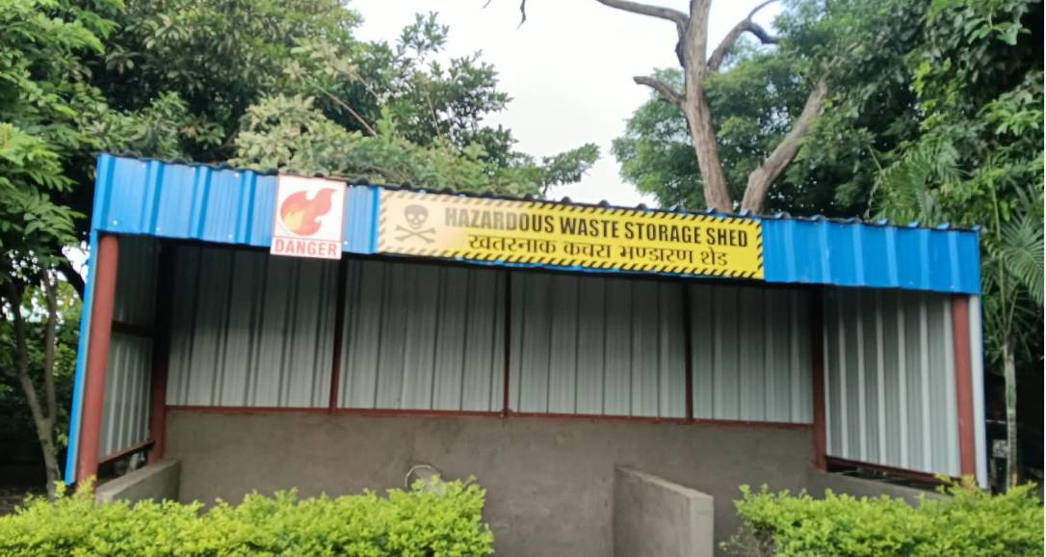
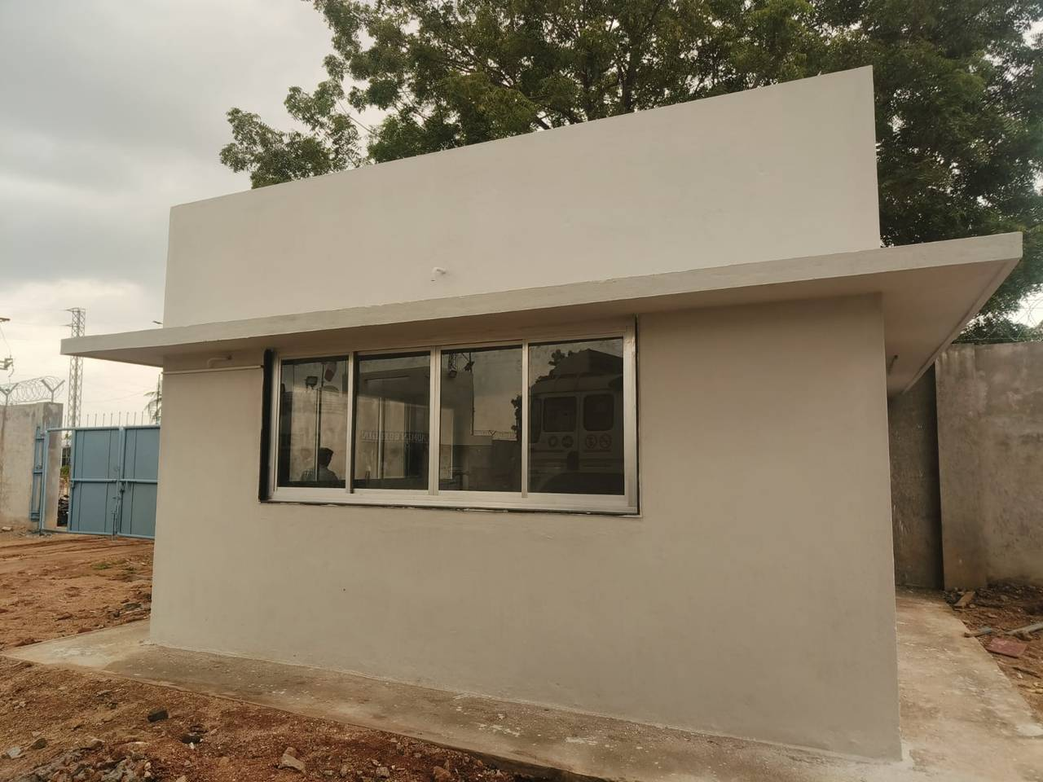
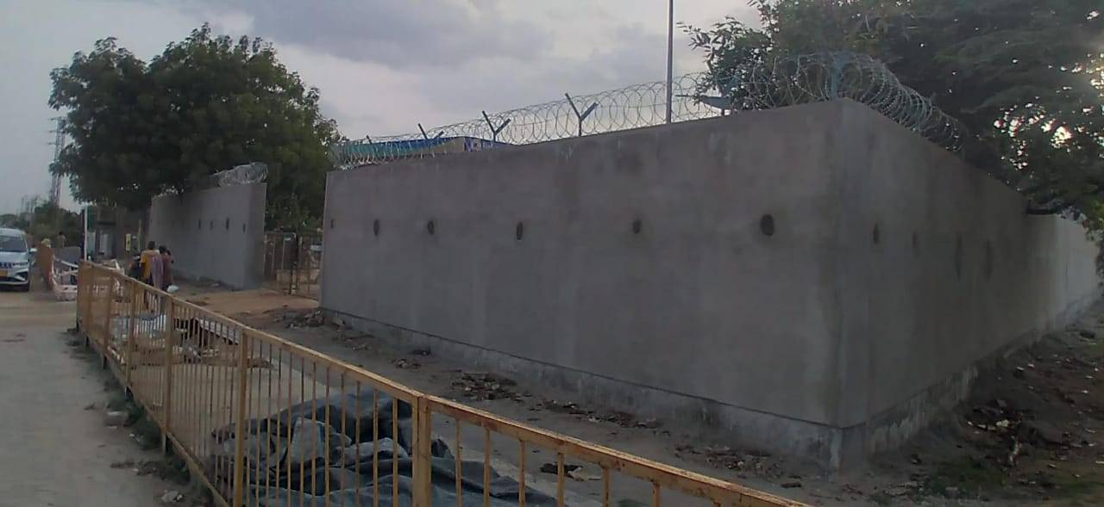
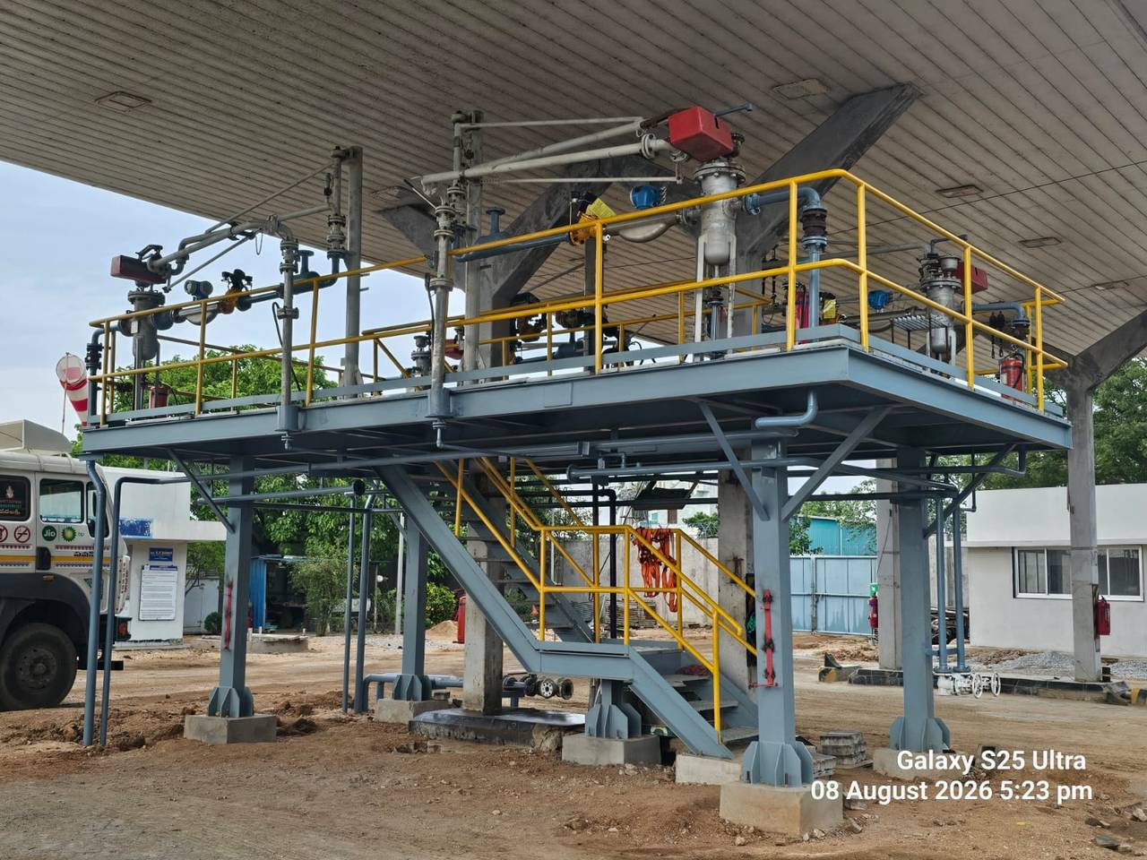
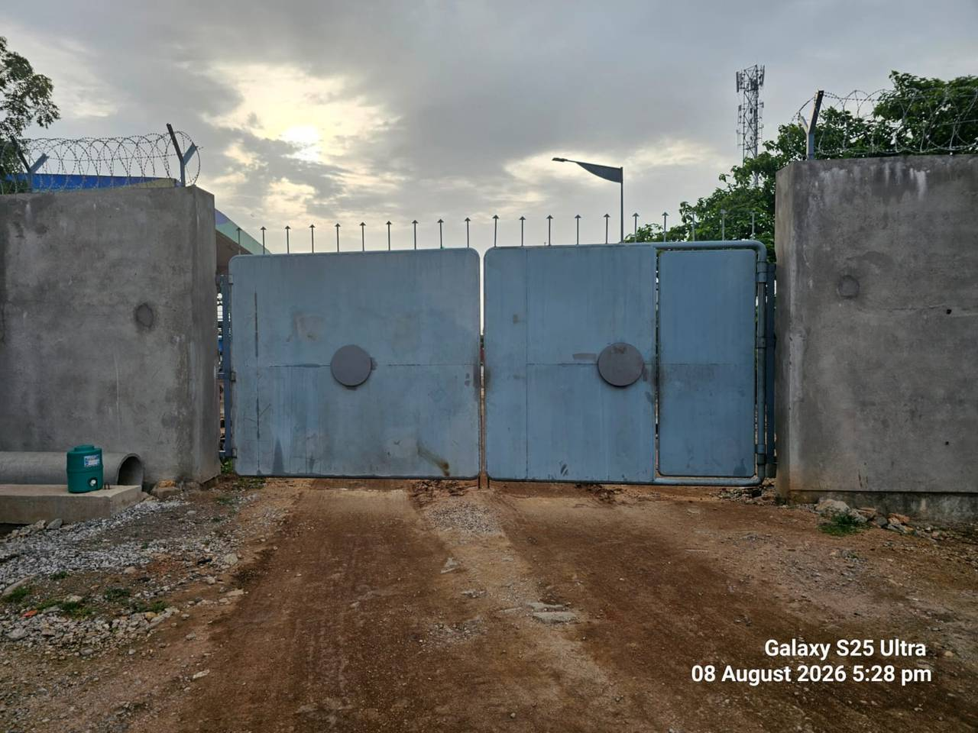
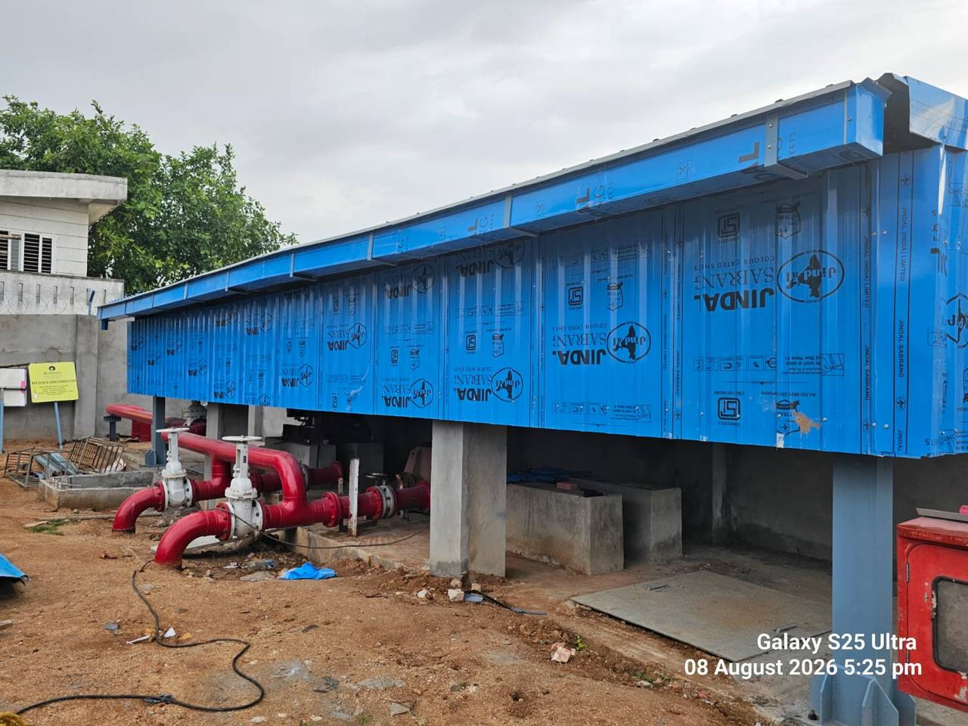

Slide 37
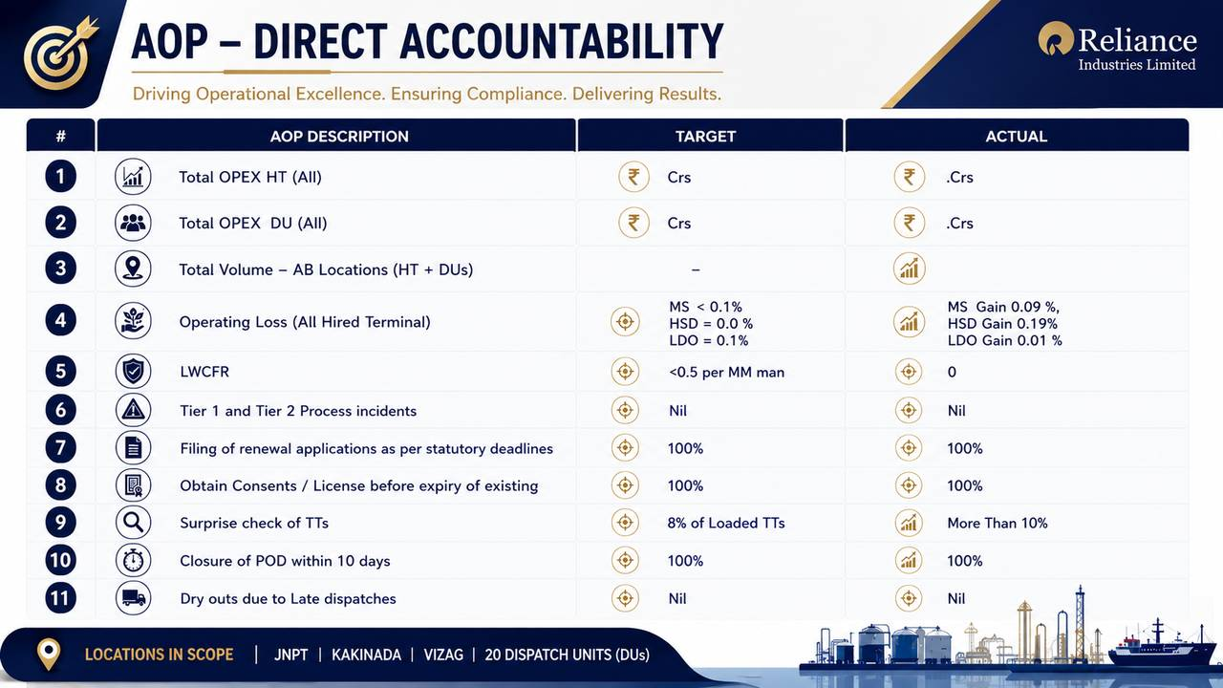
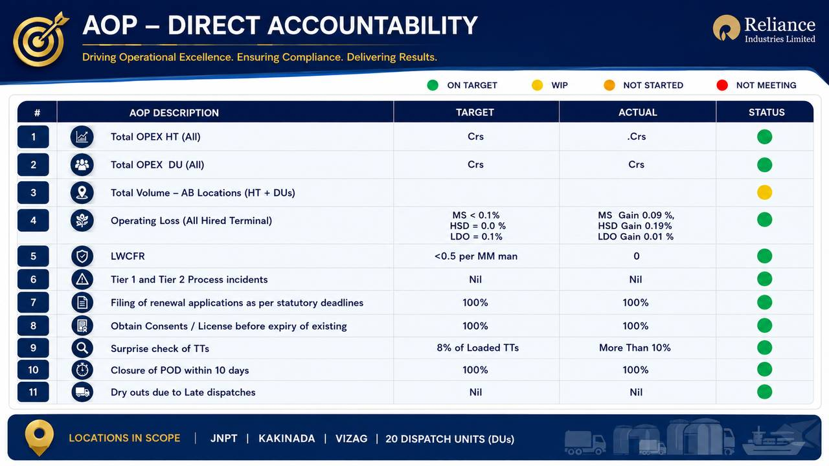
AOP - Direct Accountability
On Target
WIP
Not Started
Not Meeting
Sr. No. | AOP Description | Target | Actual | Status
1 | Total OPEX HT (All) | Crs | .Crs
2 | Total OPEX DU (All) | Crs | Crs
3 | Total Volume – AB Locations ( HT + DUs) | 389 TKL | 238 TKL
 |  | HT: 362 TKL LDO: 2TKL | HT: 215 TKL LDO: 0 TKL
 |  | DU: 25TKL | DU: 23 TKL
4 | Operating Loss (All Hired Terminal) | MS < 0.1%, HSD= 0.0 % LDO=0.1% | MS Gain 0.09 %, HSD Gain 0.19% LDO Gain 0.01 %
5 | LWCFR | <0.5 per MM man | 0
6 | Tier 1 and Tier 2 Process incidents | Nil | Nil
7 | Filing of renewal applications as per statutory deadlines | 100% | 100%
8 | Obtain Consents / License before expiry of existing | 100% | 100%
9 | Surprise check of TTs | 8% of Loaded TTs | More Than 10%
10 | Closure of POD within 10 days | 100% | 100%
11 | Dry outs due to Late dispatches | Nil | Nil
Locations in Scope : JNPT, Kakinada, Vizag and 20 DU’s
<number>
Notes:
<number>

Slide 38
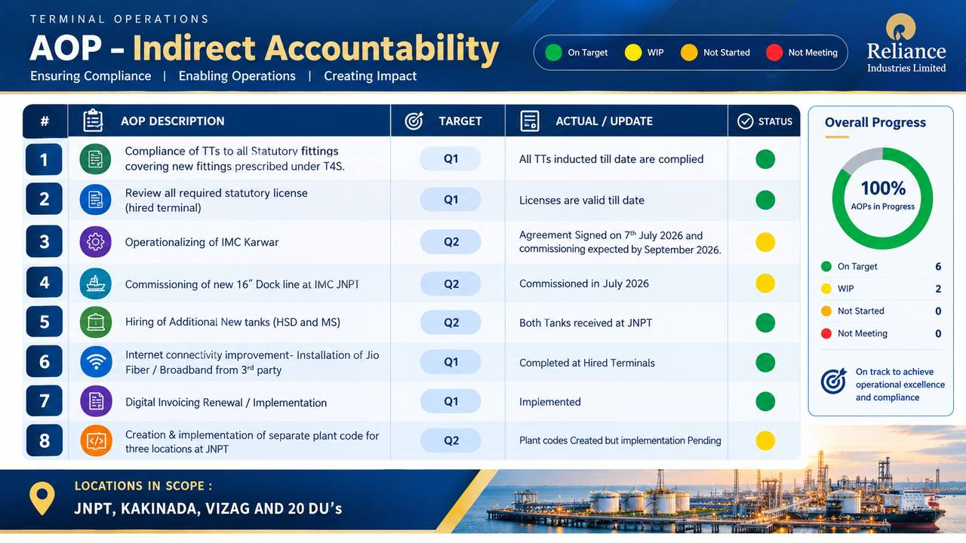
AOP - Indirect Accountability
On Target
WIP
Not Started
Not Meeting
Sr. No | AOP Description | Target | Actual | Status
1 | Compliance of TTs to all Statutory fittings covering new fittings prescribed under T4S. | Q1 | All TTs inducted till date are complied
2 | Review all required statutory license (hired terminal) | Q1 | Licenses are valid till date
3 | Operationalizing of IMC Karwar | Q2 | Agreement Signed on 7th July 2026 and commissioning expected by Aug month end.
4 | Commissioning of new 16” Dock line at IMC JNPT | Q2 | Commissioned in the 1st week of July
5 | Hiring of Additional New tanks (HSD and MS) | Q2 | 1 Tank Received in the 2nd week of July and another one expected by Aug 26 at JNPT
6 | Internet connectivity improvement- Installation of Jio Fiber / Broadband from 3rd party) | Q1 | Completed at Hired Terminals
7 | Digital Invoicing Renewal / Implementation | Q1 | Implemented
8 | Creation & implementation of separate plant code for three locations at JNPT | Q2 | Plant codes Created and UAT Pending as indents not received.
Locations in Scope : JNPT, Kakinada, Vizag and 20 DU’s
<number>
Notes:
<number>

Slide 39
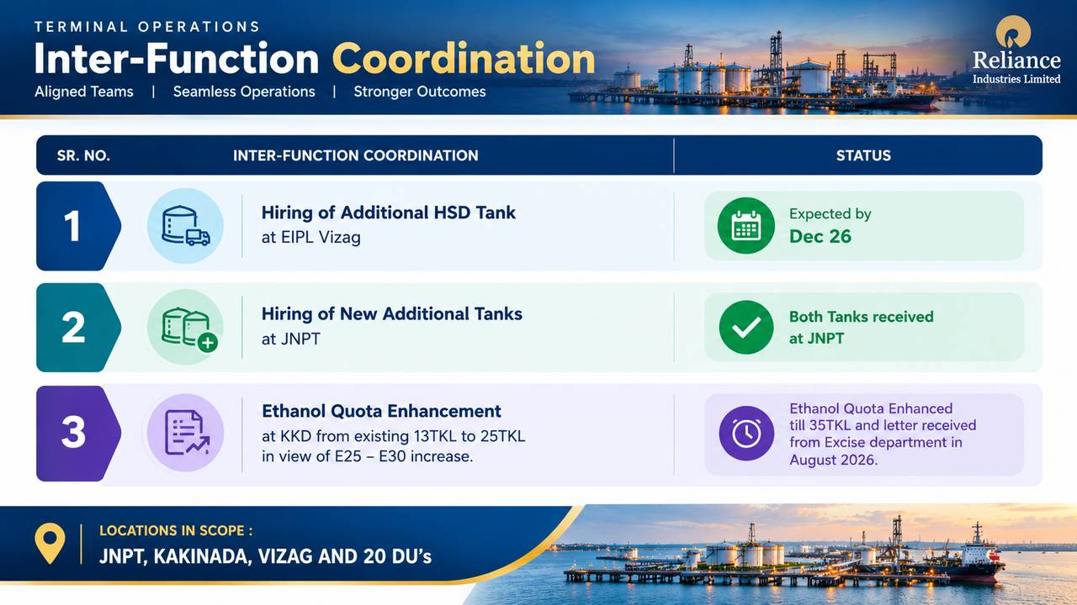
Inter-Function Coordination
Sr No | Inter-Function Coordination | Status
1 | Hiring of Additional HSD Tank at EIPL Vizag | Expected by Dec 26
2 | Hiring of New Additional Tanks at JNPT | 1 Tank received in the 2nd week of July and another one expected by Aug month.
3 | Ethanol Quota enhancement at KKD from existing 13TKL to 25TKL in view of E25 – E30 increase. | Enhancement expected by Oct 26
Locations in Scope : JNPT, Kakinada, Vizag and 20 DU’s
<number>
Notes:
<number>

Slide 40
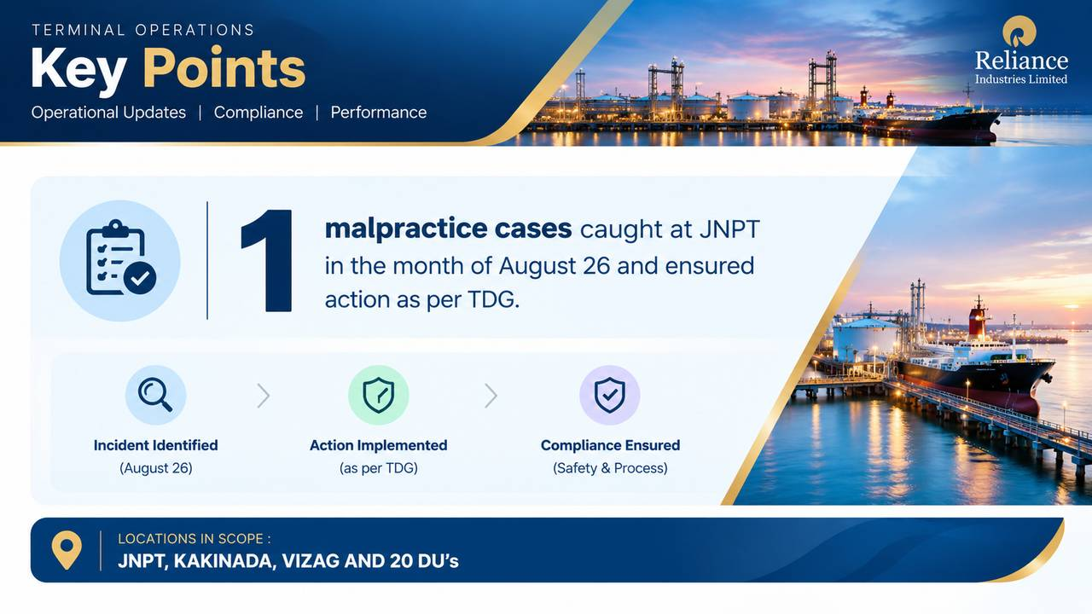
Key Points
2 malpractice cases caught at JNPT in the month of June and July 26 and ensured action as per TDG.
New Dispatch Unit BPCL Kanpur have been commissioned in the month of July 26.
Locations in Scope : JNPT, Kakinada, Vizag and 20 DU’s

Slide 41
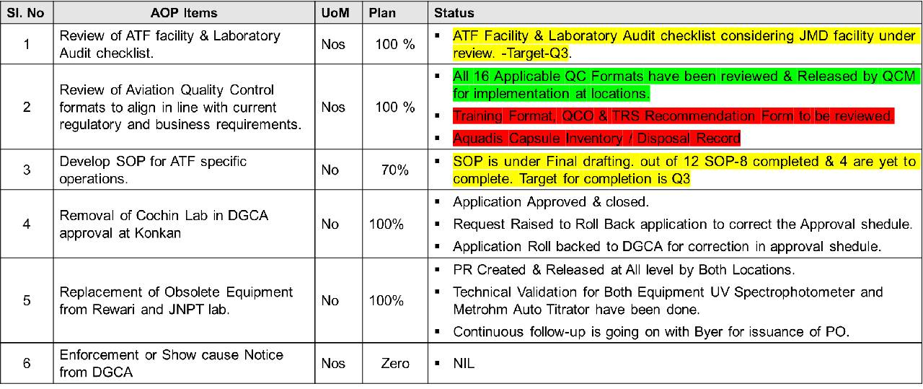
Aviation QA QC AOP items with direct accountability(August 26 )
Notes:
<number>

Slide 42
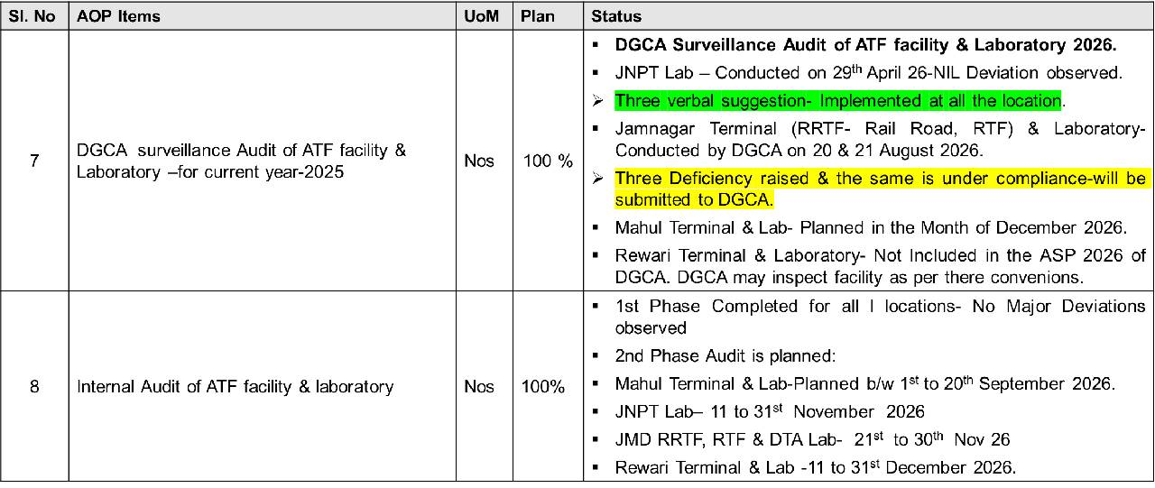
Aviation QA QC AOP items with direct accountability (August 26 )
Notes:
<number>

Slide 43
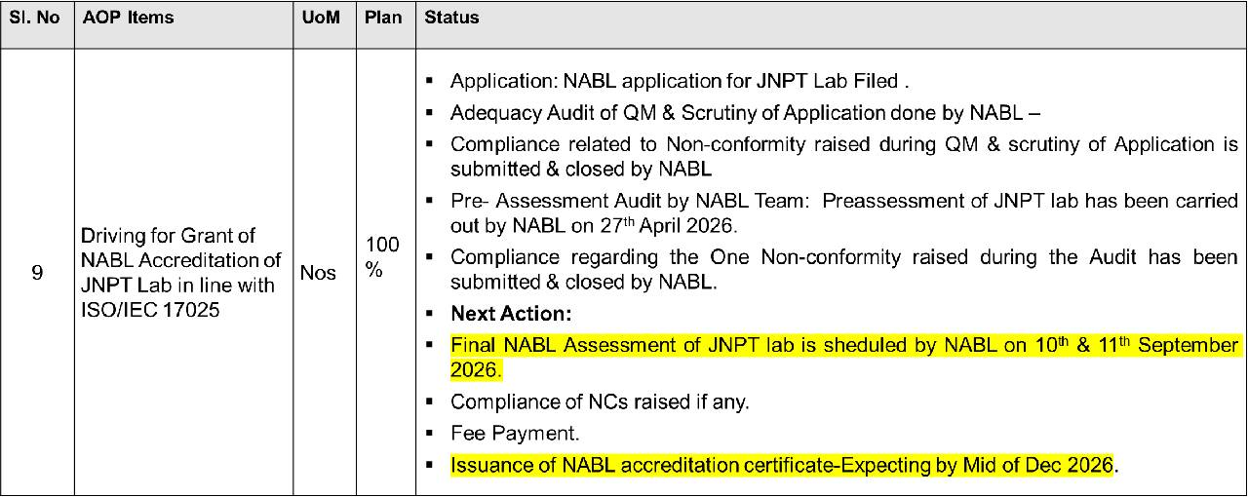
JNPT Lab NABL Accreditation
Notes:
<number>

Slide 44
Thank You

