Slide 1

DEPARTMENT OF ELECTRONICS AND COMMUNICATION ENGINEERING
PROJECT TITLE :
“ ENHANCED MEDICAL IMAGE FUSION IN THE NON-SUBSAMPLED
SHEARLET TRANSFORM DOMAIN USING EDPNT-NET AND
ADVANCED EDGE DETECTION “
PROJECT BATCH – C2
Supervisor -
Dr.S.FAHIMUDDIN ,M. Tech ,Phd
Associate professor
STUDENTS NAME -
K .Pavan Kalyan - 21701A04A8
B .Pavani - 21701A04B0
B .Sai Niranjan - 21701A04E1
P . Reddy Varshini - 21701A04D8

Slide 2
OBJECTIVES
Develop an advanced medical image fusion method within the NSST domain using an Enhanced Dual Pulse Neural Turing Network (EDPNT-Net) combined with edge detection techniques.
Employ a imporved dual-channel pulse-coupled neural network (IDPCNN) with Neural Turing Machines (NTM) for precise fusion of high-pass sub-images.
Use Canny edge detection and maximum regional energy (MRE) to optimize fusion of low-pass sub-images.

Slide 3
Literature review
FRAMEWORK | ADVANTAGE | DISADVANTAGES
Discrete Wavelet Transform (DWT) fusion | DWT fusion maintains sharp edges and important structural features in images, which is crucial for applications like medical imaging and remote sensing. | DWT-based fusion may introduce artifacts like ringing and blocking, especially near edges and high-contrast areas.
Nonsubsampled Contourlet Transform (NSCT) fusion | Due to its non-subsampled nature, it avoids frequency aliasing and reduces distortion artifacts common in other transforms. | NSCT involves a large number of decomposition levels and directional filters, leading to high computation time and memory usage
NSST-PAPCNN fusion | The method maintains the energy and contrast of the original images, resulting in fused images with high brightness and clarity. | The integration of NSST and PAPCNN can lead to increased computational demands, potentially resulting in longer processing times.

Slide 4
METHODOLOGY
DATA
Iterate through low pass sub bands
Iterate through high pass sub bands
Extract low pass and high pass sub bands
L
O
W
P
A
S
S
B
A
N
D
H
I
G
H
P
A
S
S
B
A
N
D
Compute absolute intensity for low pass band
Compute absolute intensity for high pass band
Generate canny edge detection and MRE fusion map for each low pass component
Generate canny edge detection and MRE fusion map for each high pass component
Create fused using low pass map
Reconstruct image using inverse NSST
Create fused high pass map
Output final fused image F

Slide 5
EXPLANATION OF BLOCKS INVOLVED
NSST (Non Subsampled Shearlet Transform) :
A method to break an image into different parts that show different levels of detail (like low and high-frequency features).
It helps capture important features in an image, such as edges and textures, which are needed for fusion.
MRE (Maximum Regional Energy):
A medical imaging technique that captures detailed images of soft tissues in the body.
It breaks the image into small regions and calculates how much detail each region has. The region with the most detail is called the Maximum Regional Energy.
IDPCNN (Improved Dual Channel Pulse Coupled Neural Network):
A neural network that helps decide which features (like edges or textures) to keep from each image.
It fuses the sharp details from both images, ensuring that important features from each are included in the final fused image.

Slide 6
Inverse NSST:
The reverse of NSST.
After fusing the image details, Inverse NSST rebuilds the final image with combined features from both input images.
Neural Turing Machines (NTM):
A type of advanced neural network that has memory and can "remember" information.
Though not used directly in this method, it could help with more complex decision-making in fusion by remembering key features from the images
Canny Edge Detection:
A method to find edges (boundaries) in images.
It detects important boundaries (like the edges of organs or structures) and helps preserve them when merging the images.

Slide 7
PSEUDO CODE
Medical_Fusion(Image_A, Image_B):
# Step 1: Apply NSST to decompose images into subbands
Decompose Image_A into Low_A and High_A subbands
Decompose Image_B into Low_B and High_B subbands
# Step 2: Fuse low-frequency subbands (smooth details)
Edge_Map_A = Detect_Edges(Low_A)
Edge_Map_B = Detect_Edges(Low_B)
Energy_A = Calculate_Energy(Low_A)
Energy_B = Calculate_Energy(Low_B)
Low_Fused = Fuse_Low_Frequency(Low_A, Low_B, Edge_Map_A, Edge_Map_B, Energy_A, Energy_B)

Slide 8
Continue….
# Step 3: Fuse high-frequency subbands (detailed textures)
FOR each high-frequency subband i:
Detail_A = Get_Detail(High_A[i])
Detail_B = Get_Detail(High_B[i])
Decision_Map = Neural_Network_Fusion(Detail_A, Detail_B)
High_Fused[i] = Apply_Decision_Map(Decision_Map, High_A[i], High_B[i])
# Step 4: Reconstruct final fused image
Fused_Image = NSST_Reconstruct(Low_Fused, High_Fused)
RETURN Fused_Image

Slide 9
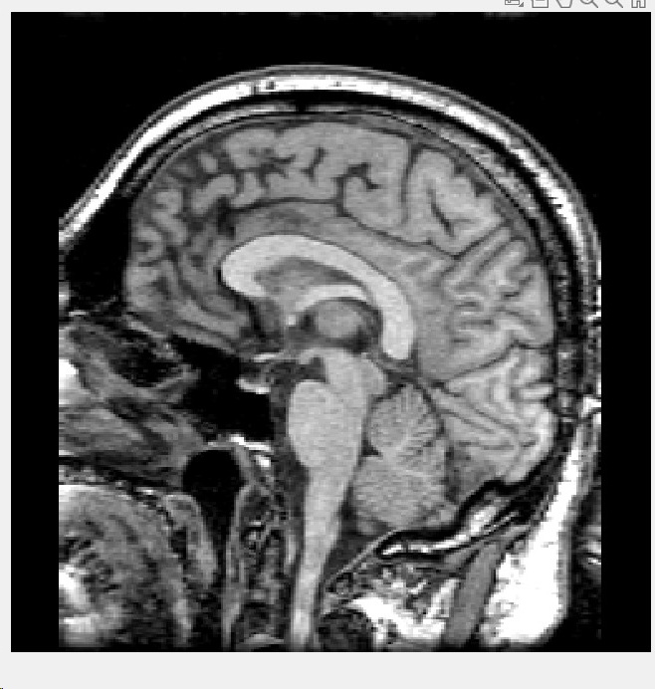
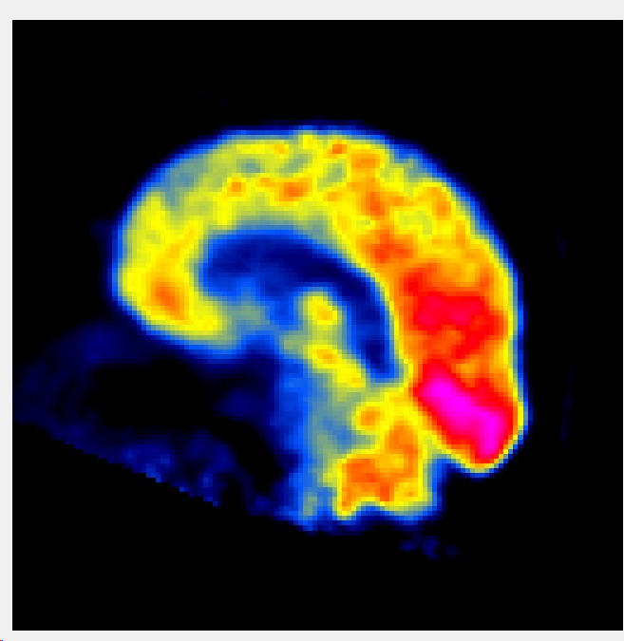
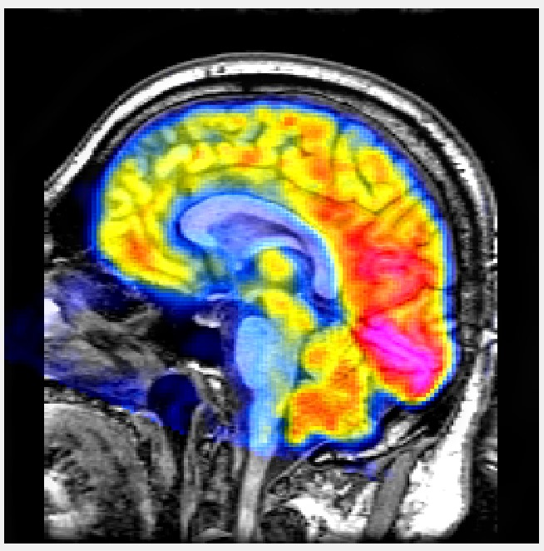
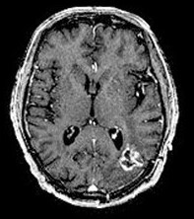
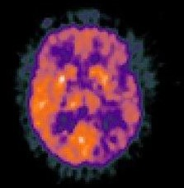
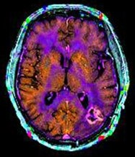
OUTPUTS
(INPUT IMAGE ) gray-scale image | (INPUT IMAGE) pseudo-color images | (OUTPUT IMAGE) Fused image

Slide 10
TOOLS AND DATASET
MATLAB R 2022b
Dataset : BraTS dataset

Slide 11
REFERENCES
1. "Image Fusion Algorithm Implementation Using Laplacian Pyramid," International Journal of Scientific Progress & Research - by Ravi
2., "Segmentation of 3D MRI Images of the Brain using a PCA Atlas," International Journal of Engineering Science & Research Technology - by Ravi, M. Praveen Kumar
3. "Survey on Image Segmentation Using Thresholding Methods," International Journal for Research and Development in Technology - by J. Ravi, K. Venkat Rao, N. Kishore Chandra Dev, K. Yugandhar
4. "Implementation of Image Encryption Using Elliptic Curve Cryptography," International Journal of Scientific Progress & Research – by Ravi, K. Venkat Rao, N. Kishore Chandra Dev,
5., "Image Segmentation Based on Background Recognition and Edge Detection," – by J. Ravi, P. Subba Rao, G. Soma Lakshmi, S. Mahesh Babu, N. Priyanka
6. "Implementation of Image Fusion using Matlab," International Journal of Science & Advance Research in Technology – by Ravi, M. Gowri Sri Durga, MD. Shabeena Begum, Y.D.R.C. Kartheek, T. Raju,

Slide 12
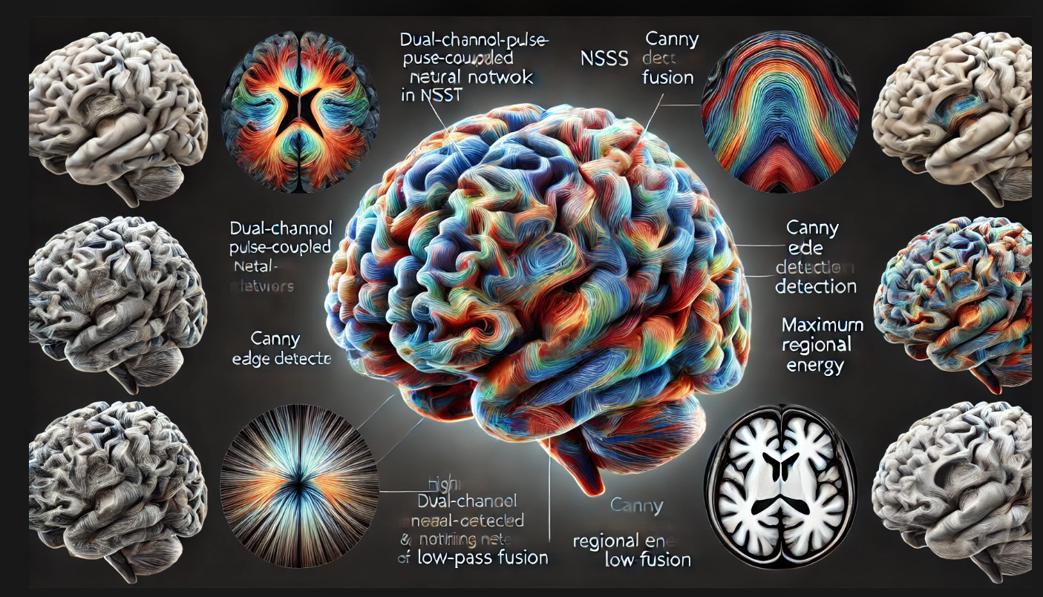

Slide 13


