Slide 1
MUTUAL FUND ANALYTICS PLATFORM
Bluestock Fintech Capstone Project
Submitted By: Pavan Kumar Katkuri
Bluestock Fintech Internship 2026

Slide 2
Problem Statement & Objectives
Problem Statement
Investors face challenges in:
Selecting suitable mutual funds.
Understanding risk and return.
Tracking SIP growth.
Comparing fund performance.
Objectives
Data Cleaning
Performance Analysis
Risk Analysis
Dashboard Development
Investor Analytics

Slide 3
Data Sources
Datasets Used
Fund Master Data
NAV History
AUM Data
SIP Inflows
Investor Transactions
Portfolio Holdings
Benchmark Indices
Total Datasets: 10
Period:
2022–2026

Slide 4
Project Architecture
Project Workflow
Data Collection
Data Cleaning
SQLite Database
EDA Analysis
Performance Analytics
Advanced Analytics
Power BI Dashboard
Final Reporting

Slide 5
Exploratory Data Analysis
EDA Highlights
NAV trend analysis
SIP inflow analysis
AUM growth analysis
Investor demographics
Category inflows
Geographic distribution
Charts Created:
15+ visualizations
Insert:
NAV chart
SIP chart

Slide 6
Key EDA Findings
Important Findings
SIP inflows increased significantly.
Equity funds generated higher returns.
Younger investors preferred SIP investments.
Large fund houses dominated AUM.
Investor behavior varied across states.
Insert:
Heatmap
AUM chart

Slide 7
Performance Analytics
Metrics Calculated
Annual Return
CAGR
Sharpe Ratio
Sortino Ratio
Alpha
Beta
Maximum Drawdown
Total Funds Analyzed:
40

Slide 8
Risk Analysis
Advanced Analytics
Value at Risk (VaR)
Conditional VaR
Rolling Sharpe Ratio
Sector Concentration
SIP Continuity Analysis
Risk Management Insights:
High-risk funds identified.
Downside risk measured.
Insert:
Rolling Sharpe chart
VaR chart

Slide 9
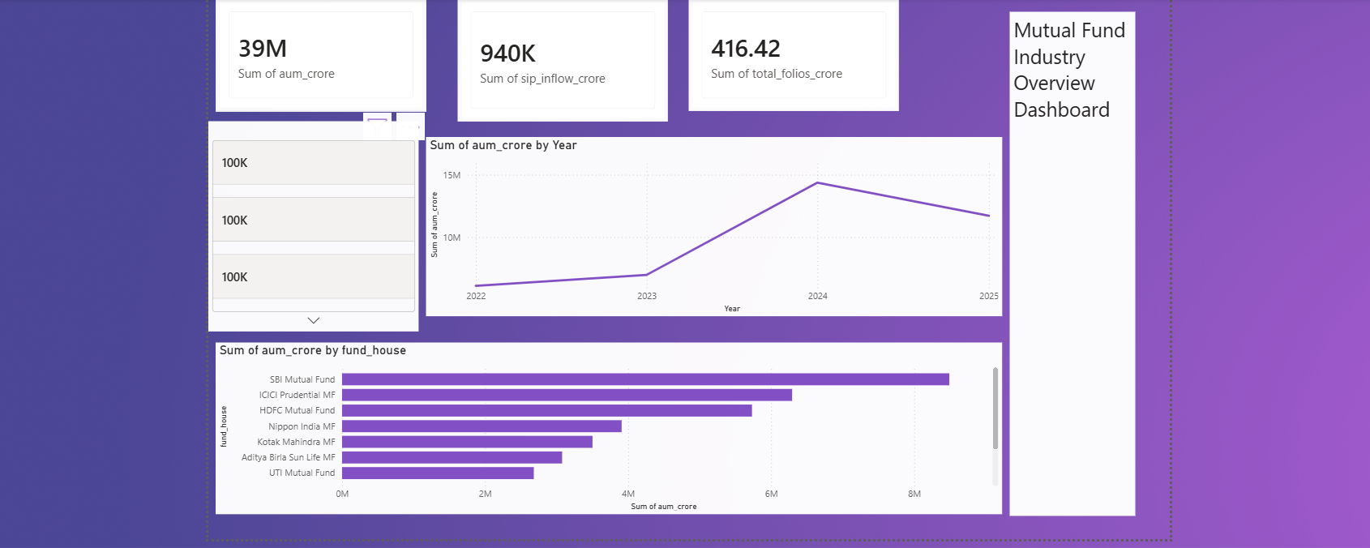
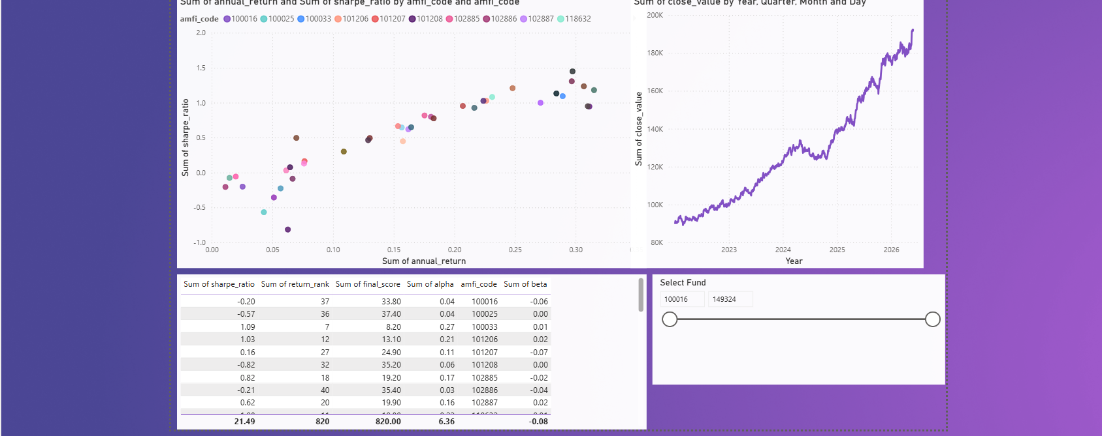
Dashboard – Industry Overview
Power BI Dashboard
Page 1:
Total AUM
SIP Inflows
Fund Houses
Industry Growth
Page 2:
Fund Performance
Risk vs Return
Fund Rankings

Slide 10
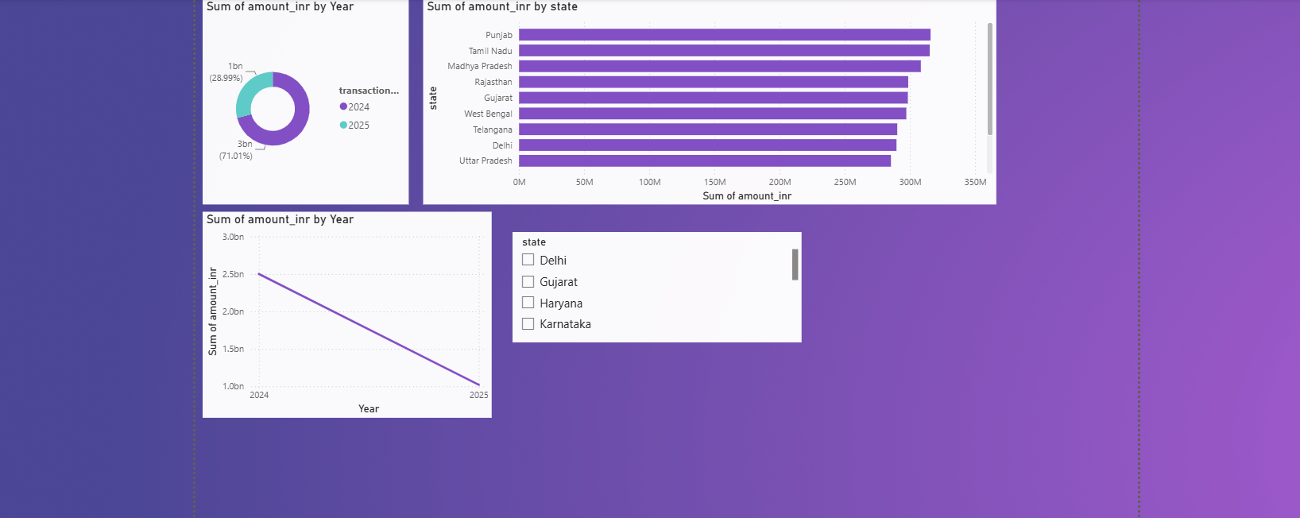

Dashboard – Investor Analytics
Dashboard Pages
Page 3:
Investor Analysis
Geographic Distribution
Transaction Analysis
Page 4:
SIP Trends
Market Analysis
Category Inflows

Slide 11
Key Findings & Learnings
Key Findings
SIP investments are increasing.
Risk-adjusted returns differ across funds.
Portfolio diversification reduces risk.
Market corrections impact fund performance.
Learnings
Python
Pandas
SQL
SQLite
Power BI
Git & GitHub

Slide 12
Thank You
Thank You
Pavan Kumar Katkuri Email:pavankumarkatkuri204@gmail.com
GitHub: github.com/Pavankumar-std

