Slide 1
DG Interns Hub – Week 2
Web Application Internship Task
Personal Professional Portfolio
Pavan Kumar Katkuri

Slide 2
1. Project Overview
Built a frontend portfolio using HTML, CSS and JavaScript.
Implemented Header, Hero, About, Services, Contact and Footer.
Focused on clean structure, styling, responsiveness and interaction.
Published the source code on GitHub.

Slide 3
2. HTML Structure
Semantic elements: header, nav, section and footer.
Added headings, paragraphs, lists, links and image content.
Created navigation links and a contact form.

Slide 4
3. CSS Styling
Applied colors, fonts, spacing and visual hierarchy.
Used Flexbox for layout.
Added hover effects to links, buttons and cards.
Added responsive CSS for smaller screens.

Slide 5
4. JavaScript Features
Button click alert for user interaction.
Basic contact-form validation.
Email format checking.
Success message and form reset.

Slide 6
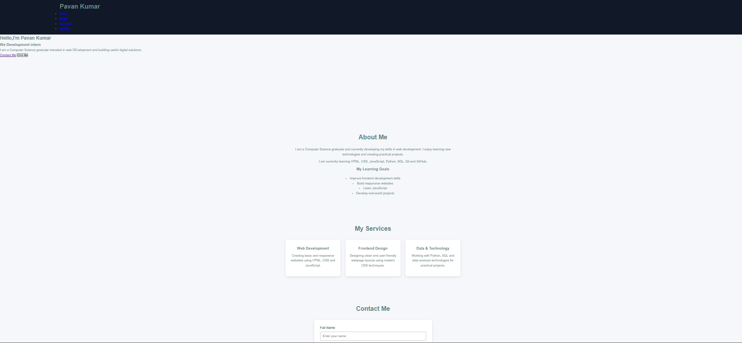
5. Project Screenshot

Slide 7
6. GitHub & Conclusion
Repository: https://github.com/Pavankumar-std/web-development-week-2
Project files: index.html, style.css, script.js and images.
The project strengthened my frontend development fundamentals.
Next: animations, mobile menu and GitHub Pages deployment.

