Slide 1

AntiScam AI
Real-Time Digital Fraud Interception Platform
Intercepting conversational fraud — before the money moves.
ET AI Hackathon 2026 · Problem 6: AI for Digital Public Safety
Submitted by Pavankumar T · pavankumart.aids2024
github.com/Pavankumar06T/AntiScam-AI

Slide 2
THE PROBLEM
Scams that hold people hostage — over a video call
In a “digital arrest” scam, fraudsters impersonate CBI, ED or Customs officers on a video call, fabricate a criminal case, and psychologically hold the victim hostage until they transfer their savings to a “safe account.”
₹1,776 cr
1.14 M
minutes
lost to digital-arrest scams
cybercrime complaints
to drain a mule account
first 9 months of 2024
India, 2023
money moves fast
These are industrialised operations — spoofed numbers, AI-generated voices, fake government portals, and networks of mule accounts. Law enforcement lacks intelligence BEFORE mass victimisation, not after.
AntiScam AI
02 / 15

Slide 3
THE GAP
Everyone shows up after the money is gone
After the fact
One call at a time
Never in the moment
Complaint portals and transaction-fraud tools engage once the money has already moved.
They judge each conversation in isolation — blind to the same account working dozens of victims.
Nothing reaches the victim during the call, when a 30-second warning would stop the transfer.
THE INTELLIGENCE GAP IS BEFORE VICTIMISATION
AntiScam AI operates at the point of contact — shifting fraud response from reactive investigation to proactive interception.
AntiScam AI
03 / 15

Slide 4
OUR SOLUTION
A multi-agent system that intercepts scams in real time
It monitors a live call, and the moment risk is real it links, warns, and disrupts — automatically.
1
2
3
4
DETECT
›
LINK
›
WARN
›
DISRUPT
Score scam risk from language, live, turn by turn
Cross-reference identifiers against a fraud graph
Deliver a cited, plain-language alert in 3 languages
Freeze the mule account; draft the complaint
Four LangGraph agents, conditionally routed — so ordinary calls cost almost nothing and only genuine scams trigger the full response.
AntiScam AI
04 / 15

Slide 5
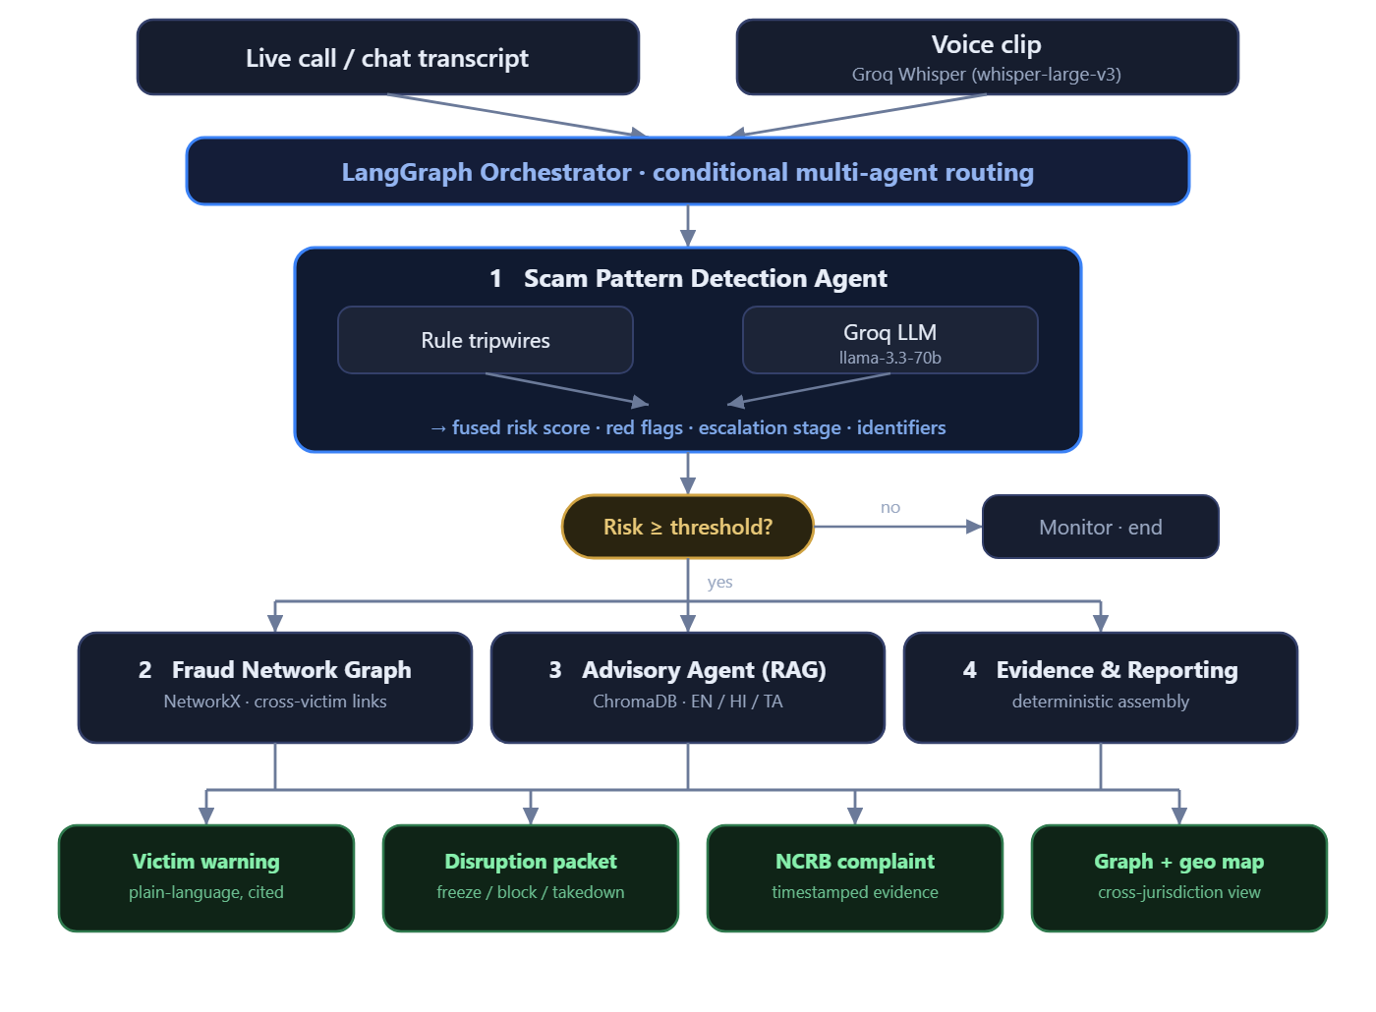
HOW IT WORKS
A four-agent pipeline, orchestrated
AntiScam AI
05 / 15
Detection fuses a rule layer with a Groq LLM; downstream agents run only when risk crosses the threshold.

Slide 6
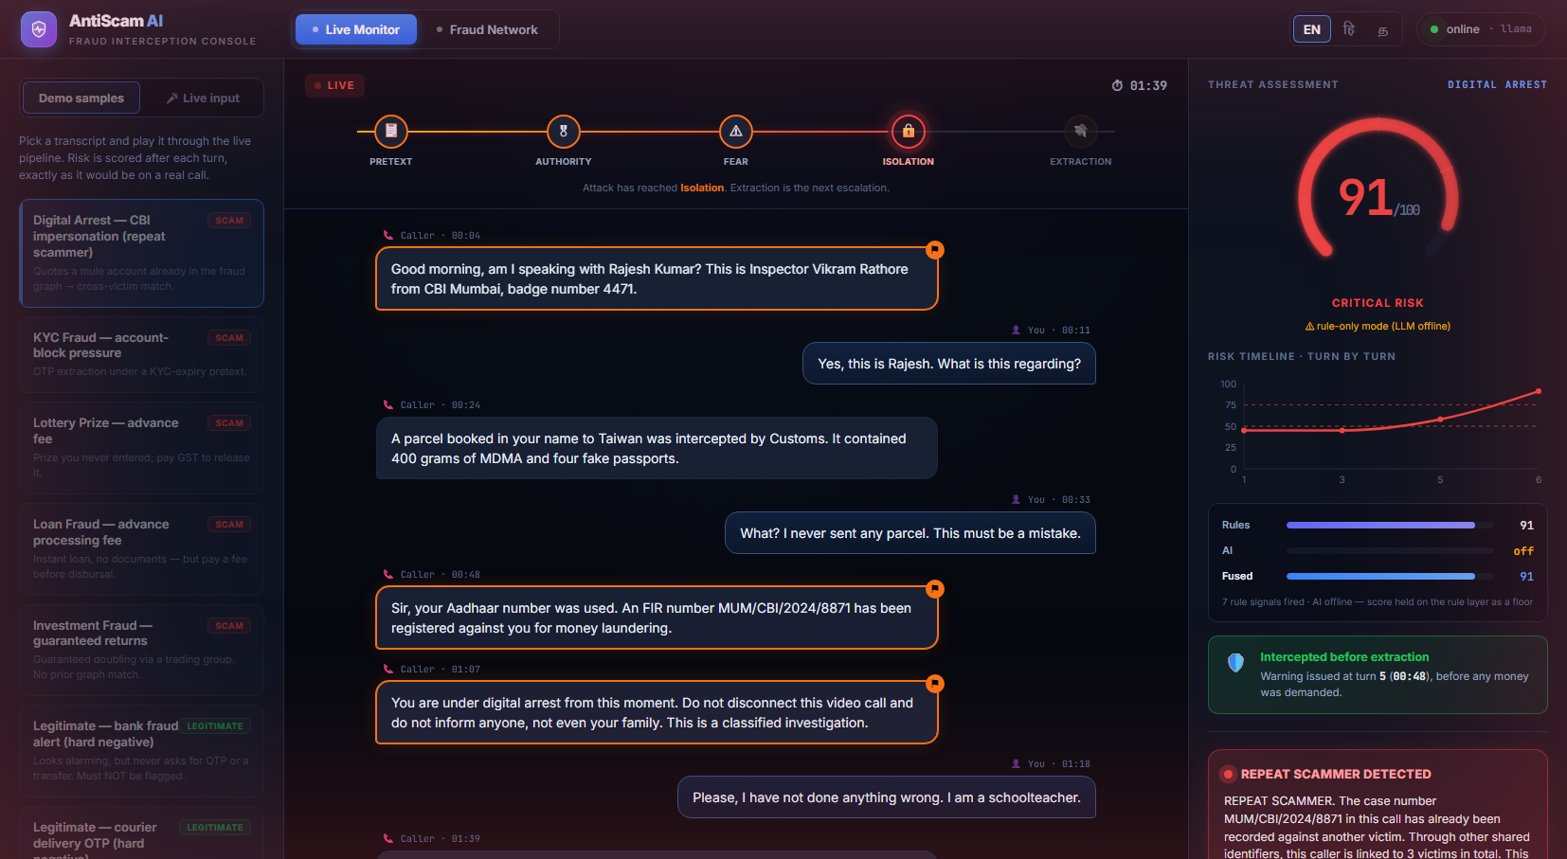
DIFFERENTIATOR 01
We warn before the money is demanded
▸ Coercion kill-chain — names where the call sits on the scam script: pretext → authority → fear → isolation → extraction
▸ Interception lead-time — proves the warning fired seconds before the transfer was requested
▸ Fused rule + LLM detector — explainable, and still works when the LLM is offline
Live monitor: risk 91 / Critical, kill-chain lit, intercepted before extraction.
AntiScam AI
06 / 15

Slide 7
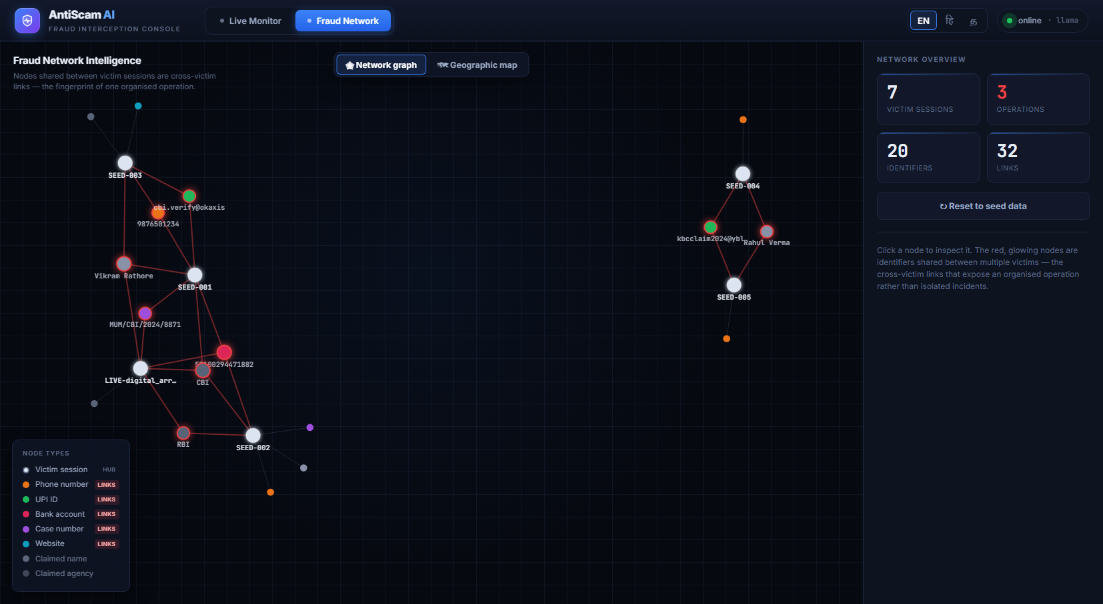
DIFFERENTIATOR 02
One operation, many victims — linked
▸ Cross-victim graph — a live call quoting a known mule account reveals the wider operation instantly
▸ Precision linking — only phone / UPI / account / case / URL create links — never generic claims like “CBI”
▸ Intelligence, not isolation — turns scattered incidents into one prosecutable network
Fraud graph: glowing red nodes are identifiers reused across victims.
AntiScam AI
07 / 15

Slide 8
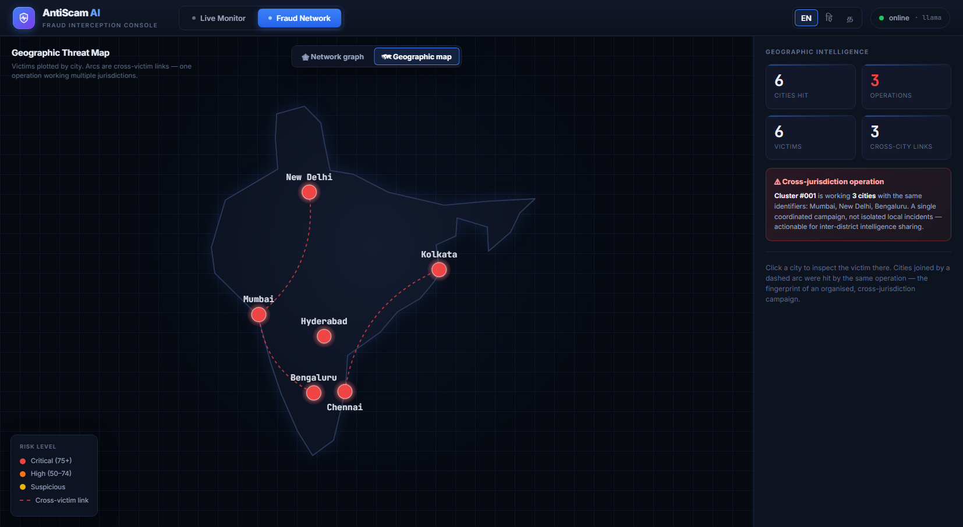
DIFFERENTIATOR 03
Cross-jurisdiction campaigns, on a map
▸ Geospatial intelligence — plots victims by city and draws cross-victim arcs across jurisdictions
▸ One operation, three cities — the digital-arrest cluster works Mumbai, Delhi and Bengaluru with the same identifiers
▸ Command-centre view — actionable for inter-district intelligence sharing
Geographic map: a single coordinated campaign spanning cities.
AntiScam AI
08 / 15

Slide 9
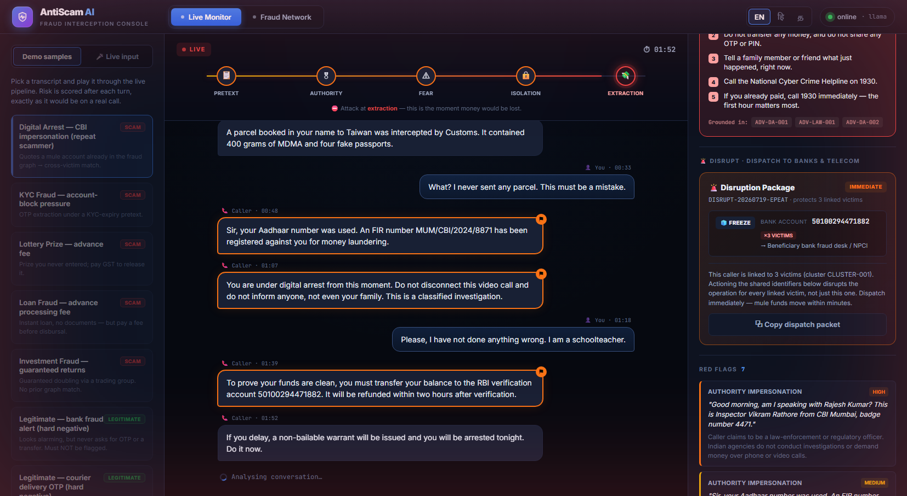
DIFFERENTIATOR 04
Detect → Disrupt: freeze the mule account
▸ Dispatch-ready containment — freeze the account, block the number, take down the URL — routed to bank / NPCI / DoT
▸ Protects every linked victim — actioning a shared identifier stops the money for the whole cluster
▸ Court-auditable — deterministic identifiers + timestamped evidence + an NCRB-style complaint draft
Disruption packet: freeze the account linked to 3 victims.
AntiScam AI
09 / 15

Slide 10
MORE
Real voice in. Warnings in three languages.
🎤 Live voice input
🗣 Multilingual warnings
A spoken call is transcribed by Groq Whisper (whisper-large-v3) and fed into the same detection pipeline — so the system works on real audio, not just scripted text. Verified end to end: spoken scam line → transcript → detection score 97 / 100. This covers the Speech-AI dimension of the problem statement.
English
This is a scam. Hang up now.
हिन्दी (Hindi)
यह धोखाधड़ी है। तुरंत कॉल काट दें।
தமிழ் (Tamil)
இது மோசடி. உடனே துண்டியுங்கள்.
AntiScam AI
10 / 15

Slide 11
UNDER THE HOOD
Technology
Backend
Orchestration
LLM
Python 3.12 · FastAPI · Pydantic
LangGraph · LangChain
Groq · llama-3.3-70b · Whisper
Retrieval (RAG)
Fraud graph
Frontend
ChromaDB · local ONNX embeddings
NetworkX · in-memory
React 19 · Vite · Recharts · D3
Engineering discipline: no secrets in code · rate-limit degrades to rules in <500 ms · identifiers extracted deterministically (never hallucinated) · 84 automated tests.
AntiScam AI
11 / 15

Slide 12
RESULTS
Measured, not claimed
~2s
90+
<10
0%
84
detection latency
obvious-scam score
legitimate-call score
false positives*
tests passing
The false-positive rate is what makes a citizen tool usable
Evaluation uses a hand-curated benchmark with deliberate HARD NEGATIVES — legitimate calls engineered to look scam-like (a genuine bank fraud alert, a real delivery OTP, an overdue-EMI reminder, a recruiter). A detector that only handles easy negatives reports a flattering number that means nothing. AntiScam AI holds 0% on the hard set.
* on the hard-negative subset; rule-layer floor is reproducible with no API key
AntiScam AI
12 / 15

Slide 13
WHY IT FITS
Built around the evaluation focus
Detection precision & recall
Lead time before victimisation
Fused rule + LLM detector, with a metrics harness
The interception lead-time is a headline feature
Very low false-positive rate
Auditability for admissibility
0% on hard-negative legitimate calls
Timestamped evidence + deterministic identifiers
Coverage: 5 of 6 build areas
Detection · Fraud-network graph · Geospatial · Citizen advisory (EN/HI/TA) · Speech-AI. Counterfeit-currency is a separate computer-vision track, deliberately scoped out.
AntiScam AI
13 / 15

Slide 14
WHAT'S NEXT
Prototype today, platform tomorrow
Honest limits
Roadmap to production
▸ Synthetic data — metrics reflect generated transcripts, cleaner than reality
▸ No live telecom tap — calls are replayed or spoken in
▸ Illustrative legal text — not verified legal advice
▸ In-memory graph — production needs a persistent store
▸ On-device / telecom STT — for true live-call interception
▸ Auto-dispatch — push disruption packets to bank & DoT APIs
▸ Neo4j graph store — with privacy & retention controls
▸ 12 regional languages — plus WhatsApp / IVR citizen channels
AntiScam AI
14 / 15

Slide 15
Intercepting fraud — before the money moves.
Real-time detection · cross-victim intelligence · disruption at the source.
Pavankumar T · pavankumart.aids2024
github.com/Pavankumar06T/AntiScam-AI
Thank you

