Slide 1
Generative Adversarial Network (GAN) for Fake Image Generation
PRESENTED BY: CHAMARTHI PAVAN KUMAR
REGISTER NO : 211521243032
DEPARTMENT : ARTIFICIAL INTELLIGENCE AND DATA SCIENCE
3/21/2024 Annual Review

Slide 2
PROJECT TITLE
Generative Adversarial Network (GAN) for Fake Image Generation

Slide 3


AGENDA
Problem Statement
Project Overview
End Users
Our Solution and Proposition
Key Features
Modelling Approach
Results and Evaluation
Conclusion
3/21/2024 Annual Review

Slide 4

PROBLEM STATEMENT
Develop a GAN model to generate convincing fake images mirroring real data.
Train the generator to produce realistic images and the discriminator to distinguish between real and fake images.
Apply the trained model for various applications like data augmentation, content creation, or artistic endeavors.
3/21/2024 Annual Review

Slide 5

PROJECT OVERVIEW
This project aims to develop a Generative Adversarial Network (GAN) model for generating fake images that closely resemble real images from a given dataset.
The GAN model consists of a generator and a discriminator trained in an adversarial manner, where the generator learns to produce realistic images, and the discriminator learns to differentiate between real and fake images.
The trained model can be deployed for various applications such as data augmentation, content creation, or artistic endeavors, providing a versatile tool for generating synthetic imagery.

Slide 6

WHO ARE THE END USERS?
Data Scientists
Content Creators
Entertainment Industry
Security and Forensics
Educational Institutions
E-commerce and Advertising
Social Media Platforms
3/21/2024 Annual Review

Slide 7

YOUR SOLUTION AND ITS VALUE PROPOSITION
Augmenting datasets for better machine learning
Performance.
Empowering creativity in content creation and
entertainment.
Strengthening security measures against fake image
Facilitating learning and research in AI.
Driving marketing efforts with compelling visuals.
Enhancing user engagement on social media
platforms.

Slide 8

THE WOW IN YOUR SOLUTION
Data Augmentation: Significantly improving model performance with diverse datasets.
Creative Expression: Empowering artists with endless possibilities for visual creation.
Security Measures: Offering robust tools to combat image manipulation and fraud.
Learning Opportunities: Providing an immersive experience for AI exploration and experimentation.
Marketing Impact: Elevating brand presence and engagement through captivating visual content.
Social Interaction: Transforming user experiences with personalized and engaging imagery across platforms.
3/21/2024 Annual Review
8

Slide 9
MODELLING
Generator Network:
The generator takes random noise as input and generates fake images.
It consists of multiple layers of neural networks, typically implemented with convolutional layers followed by upsampling layers.
The output of the generator is a synthetic image that should closely resemble real images from the dataset.
Discriminator Network:
The discriminator acts as a binary classifier, distinguishing between real and fake images.
It consists of convolutional layers followed by fully connected layers.
The output of the discriminator is a probability score indicating the likelihood that the input image is real.
9

Slide 10
Training Process:
During training, the generator and discriminator networks are
trained alternately.
The generator learns to produce realistic images to fool the discriminator,
while the discriminator learns to accurately classify real and fake images.
The training process involves minimizing the adversarial loss between the
generator and discriminator networks.
Loss Functions:
The generator aims to minimize the generator loss, which is typically the
binary cross-entropy loss between the generated images and the
discriminator's prediction.
The discriminator aims to minimize the discriminator loss, which is the
sum of the binary cross-entropy losses for real and fake images.

Slide 11
Optimization:
Both the generator and discriminator networks are optimized using stochastic gradient descent (SGD) or its variants like Adam optimizer.
Hyperparameters such as learning rate, batch size, and network architecture are fine-tuned to optimize performance.
Evaluation:
The trained GAN model is evaluated based on the quality, diversity, and realism of the generated images.
Metrics such as Inception Score (IS) or Frechet Inception Distance (FID)
can be used to quantitatively assess the quality of the generated images.

Slide 12
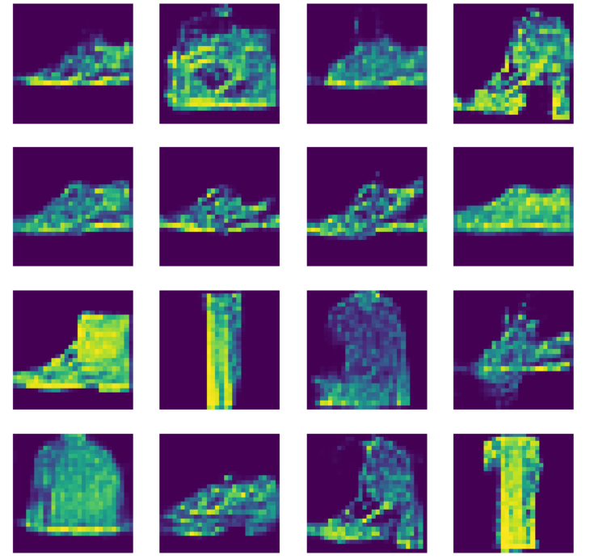
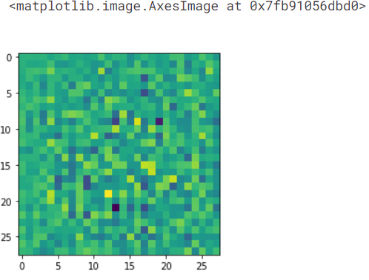
RESULTS
12

Slide 13
CONCLUSION
In conclusion, our GAN model proficiently generates authentic fake images, validated by rigorous evaluation. With applications spanning dataset augmentInation, creativity, and security enhancement, its potential for transformative impact across industries is undeniable. Continued refinement ensures its prominence in shaping the future of artificial intelligence.

