Slide 1
Excel final assesment

Slide 2
Case Study

Slide 3
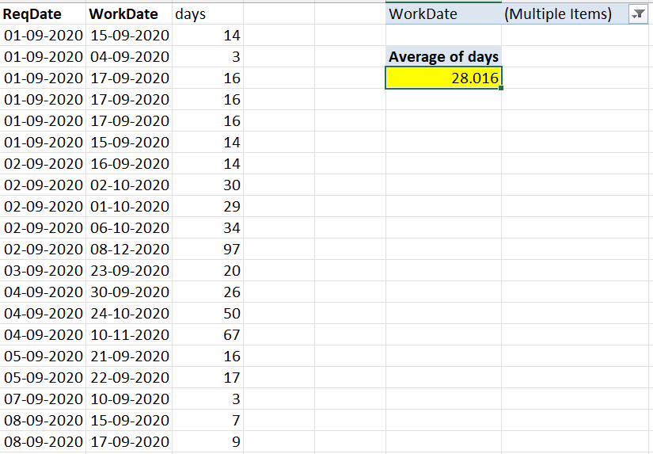
1.Lead time
Assumption: There are few places where workdate is not available they are considered as work not done. And so they are filtered out.
Insight: after filtering out the values with no workdate value, we get average number of days per completed work as 28.016 days

Slide 4
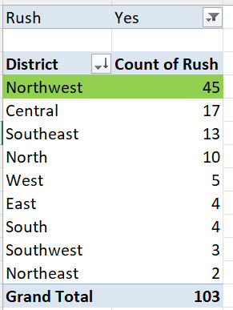
2. District with most rush jobs
Assumption: There are few places where Rush value is not available they are considered as no rush. And so they are filtered out. And value n/a is filled.
Insight:
Northwest district has the most rush jobs with 45 as count

Slide 5
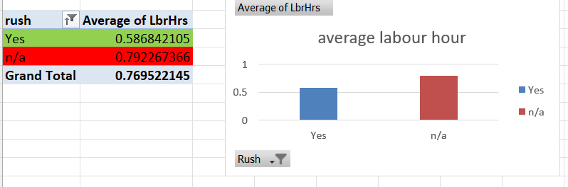
3.Labour hour for rush and non rush job
Assumption: Blanks in data are for those rush is false, and a value of n/a is given to represent it .
Insight: Rush works have much lesser labour hour signifying that the labour work with full focus to complete it soon.

Slide 6
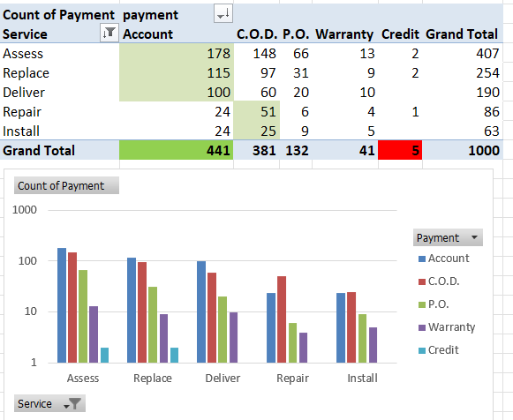
4. Distribution of payment type across different service
Axis scale: logrithimic scale is used for better visiualisation.
Insight: For assess, Replace and Deliver Account type of payments are maid the maximum.
For Repair and Install C.O.D is used more.
In general Account is most used and Credit is least used.

Slide 7
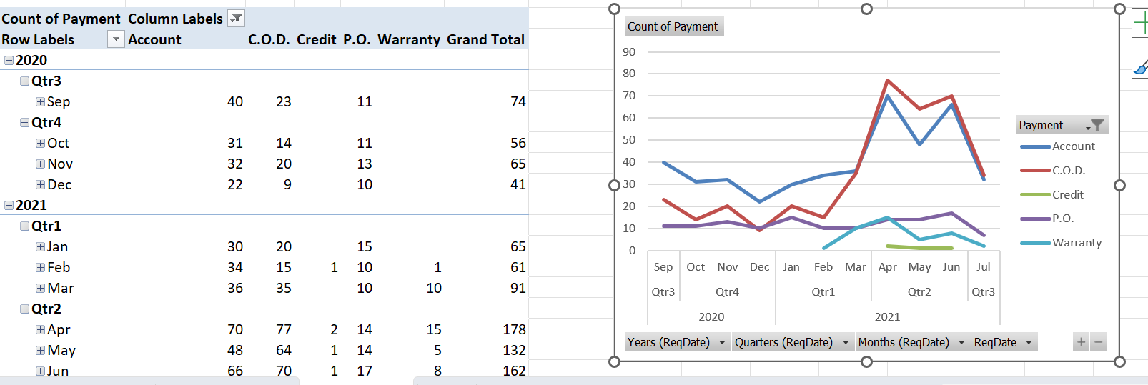
5. Trend in distribution of payment type
Insight:
Credit was only used in 2nd qtr of 2021 and in a very rare occasions.
Account was the predominant mode till march 2021 after which C.O.D. became more predominant.
There is a significant reduction in all payments from jun to July 2021.

Slide 8
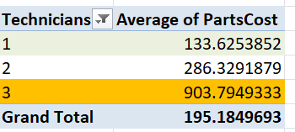
6.Relation between number of technicians and cost of part
The average cost of parts is considered to find the relation between parts cost and number of technicians.
Insight: More number of technicians work of jobs which involve costlier parts. This may be to ensure preventing loss due to damage of part.

Slide 9
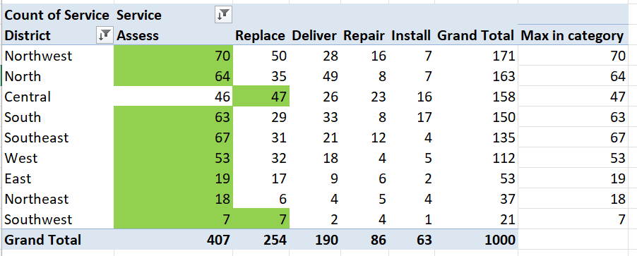
7.Most common service in each district
Insight:
In all the district except Central and southwest, Assess is the most common service.
In Central Replace is most common.
Southwest, has assess and replace as most common service

Slide 10
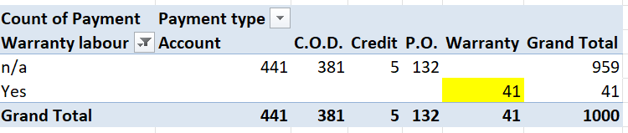
8.Payment type distribution for orders with warranty labour
Assumption: Blanks in data are for those warranty is false, and a value of n/a is given to represent it .
Insight:
All the payments for jobs with warranty labour are done through warranty.
On the other hand , for no warranty most of the payments are done though account and C.O.D.

Slide 11
Dashboard

Slide 12
