Slide 1
Excel Internal assessment 1

Slide 2
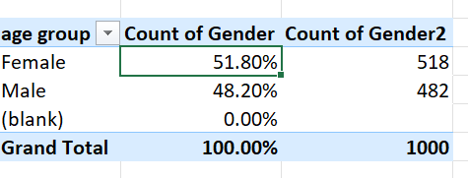
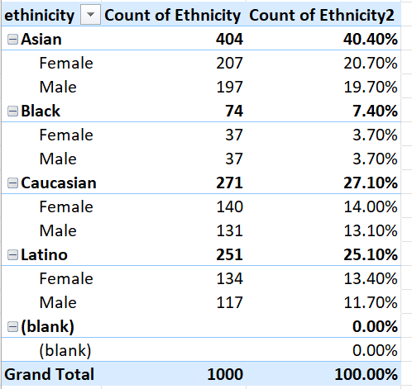
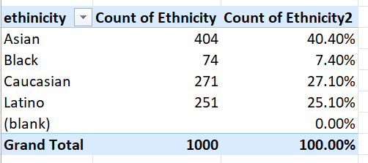
1. Gender and ethnic diversity

Slide 3
It is done in pivot table with ethinity and gender in rows and their count in value field
In the above pictures we can cleary see the company have clear diversity with 51.8% of women and
49.2 % of men, which says that the main equal gender balance and neutrality.
Based on ethnicity the company mostly has Asian employees with 40.4 % and followed by Caucasian and
Latino employees with 27.1 % and 25.1 % but very less black with 7.4 %.
Furthermore, within ethnicity there are no great difference between number of male and female employee.

Slide 4
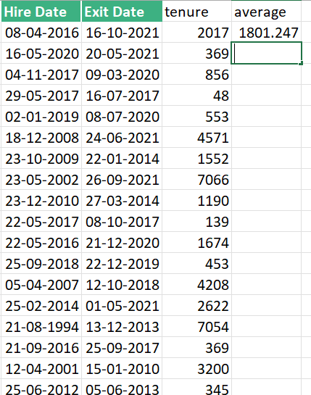
2.Average stay before leavinmg
Filetring the employee with exit and
using days to calculate tenure and then
Days and average function.
They stay an average for 1801 days.

Slide 5
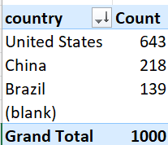
4.Country with highest employee
The question was to find the country with highest number of employee and to do to a pivot table was created and then using country column in rows and count value we get count of each country and then after sorting in descending order based on count, we found out the country with most employee is the US, with 643 employees.

Slide 6
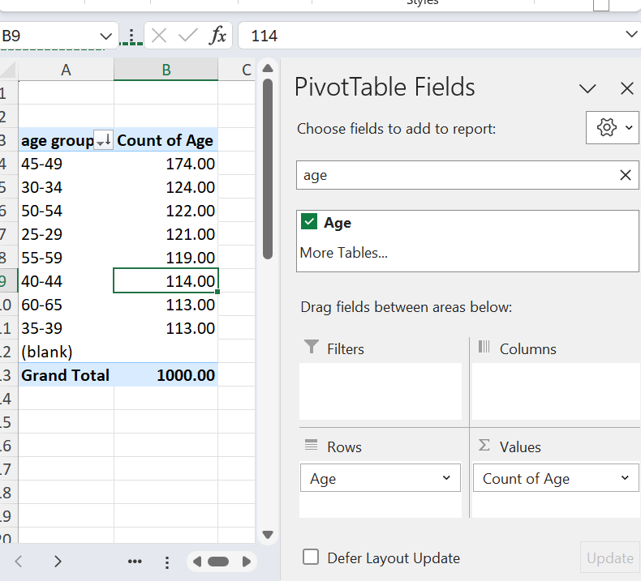
5. Common age group
The question was to find the age group title with occurs most, of employee data a pivot table was created and then assigning age column in value for rows, grouping with 5 years in a range and count of it in value we get count of employee in each age group and then after sorting in descending order based on count we found out the most common age group is 45 to 49 years with 174 employees.
This shows the company has more experienced people.

Slide 7
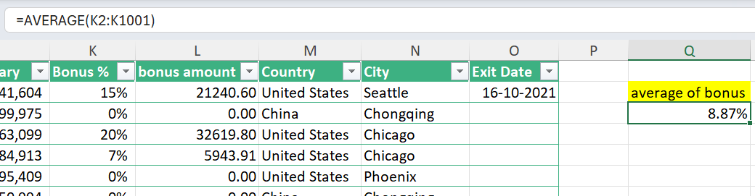
6. Average bonus percentage
The question was to find Average bonus percentage given to all employee, of employee data a cell is given with average formula with all the cells in bonus percentage as its arfument and we get average of bonus and it is 8.87%

Slide 8
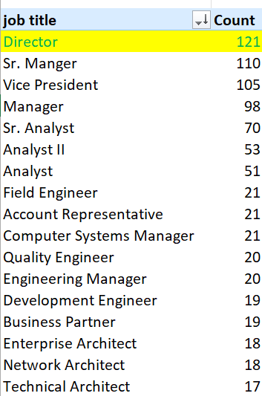
7. Most frequent job title
The question was to find the job title with occurs most frequently, of employee data a pivot table was created and then assigning job title column in value for rows and count of it in value we get count of each job and then after sorting in descending order based on count we found out the job title which occurs most frequently and it is director with 121 occurrences.

Slide 9
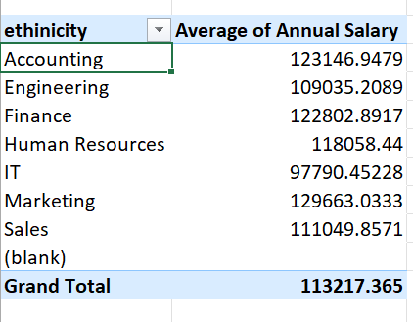
Difference in average salary
There is a difference

