Slide 1


Project Name: Online FIR(First Information Report) System
Project Member:
Rohit Ankalkhope 210543181080
Pavankumar Patil 210543181062
Rohan Pawar 210543181068
Tushar Shinde 210543181099

Slide 2
Introduction
“Online FIR System” is a web based application.
This software provides facility for reporting online crimes, complaints, missing persons, show most wanted person
The primary goal of an e-FIR site is to make City Police Station services online to reduce time and increase productivity
The system is implemented using a 3-tier approach, with a backend database, a middle tier of Spring Boot MVC, and web browser as the front end client.
These include multi-tiered architecture, server and client side scripting techniques, implementation technologies such as Spring boot uses all the modules of Spring-like Spring MVC, Spring Data JPA, Spring Security etc. Programming language (such as Core Java, Advance Java), relational databases (such as MySQL).
Each user first makes their login to sever to show their availability
Where the citizen will be given the power to know about his complaint and FIR status and would be able to review it.

Slide 3
3.1 Existing System
In the existing system only we can see the details of particular information about the police stations in our state, the existing system has more workload for the authorized person, but in the case of Proposed System, the user can registered in our site and send the crimereport and complaint about a particular city or person.
3.2 Drawbacks of Existing System
More man power.
Time consuming.
Consumes large volume of pare work.
Needs manual calculations.
No direct role for the higher officials.
To avoid all these limitations and make the working more accurately the system needs to be computerized.

Slide 4
Proposed System
The aim of proposed system is to develop a system of improved facilities. The proposed system can overcome all the limitations of the existing system. The system provides proper security and reduces the manual work. The existing system has several disadvantages and many more difficulties to work well. The proposed system tries to eliminate or reduce these difficulties up to some extent. The proposed system will help the user to reduce the workload and mental conflict. The proposed system helps the user to work user friendly and he can easily do his jobs without time lagging.
Advantages of Proposed System
Proper control of the higher officials.
Minimize manual data entry.
Minimum time needed for the various processing.
Greater efficiency.
Better service.
User friendliness and interactive.
Minimum time required.

Slide 5
Modules
Citizens:
Citizen will login to the portal
Citizen can click on the ‘file new complain’ button and reach the complaint details form page.
Citizen has to pick a crime types among the predefined Crime types and brief about the Crime with Occurrence location (address) and image of the Id Proof if any or Aadhar card number.
Citizen able to see his complaint Status After the complaint has been ‘Received’ or either ‘Resolved’ by the respective Police Officer and his/her got a mail when police officer update the Status update the status of complaint.

Slide 6
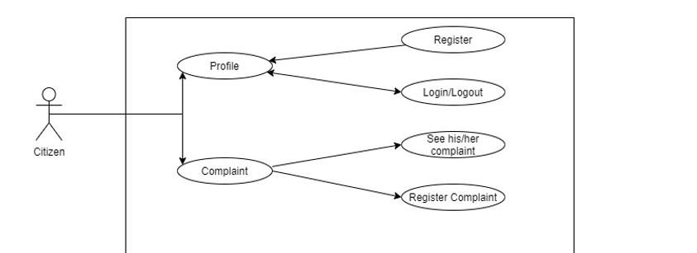

Slide 7
Police Inspector:
Police Inspector will login from the login page and will be able to see the Citizen Complaints filed by the Citizen of a particular City.
Police Inspector can Review the complaint and after verifying it Police Inspector will change the complaint status as submitted successfully and send mail to the citizen.
It is the job of Police Inspector to assign appropriate cases to the constables to resolve the case as soon as possible to Protect Citizen or solve the Complaints.
After conforming about the completion/resolving of the Complaint, Police Inspector will Update the status of the Complaint as ‘Resolved’ and send the mail to the citizen or complainer and head over to the next complaint if any.

Slide 8
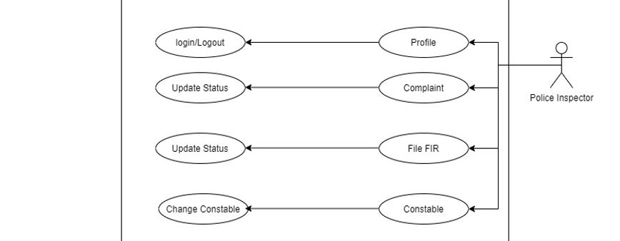

Slide 9
Senior Police Inspector:
Senior Police Inspector will login from the login page and will be able to see the Citizen Complaints filed by the Citizen of a particular City and previously added Police Inspectors, constables.
Senior Police Inspector can delete citizen complaints which status rejected. Senior Police Inspector can change the constables Assigned by police inspector and he can add Police Inspector also.

Slide 10
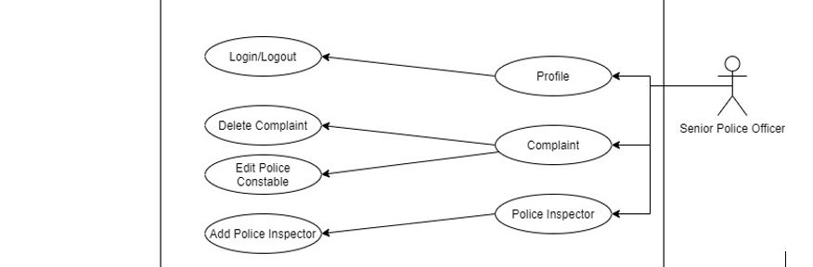

Slide 11
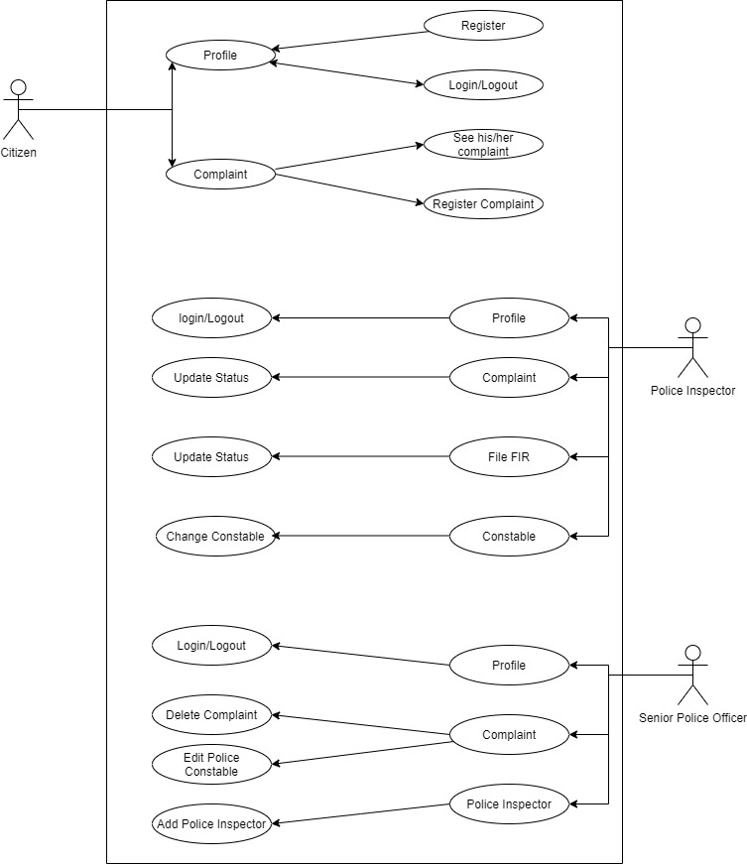
Use Case Diagram:
Figure : Use Case Diagram

Slide 12
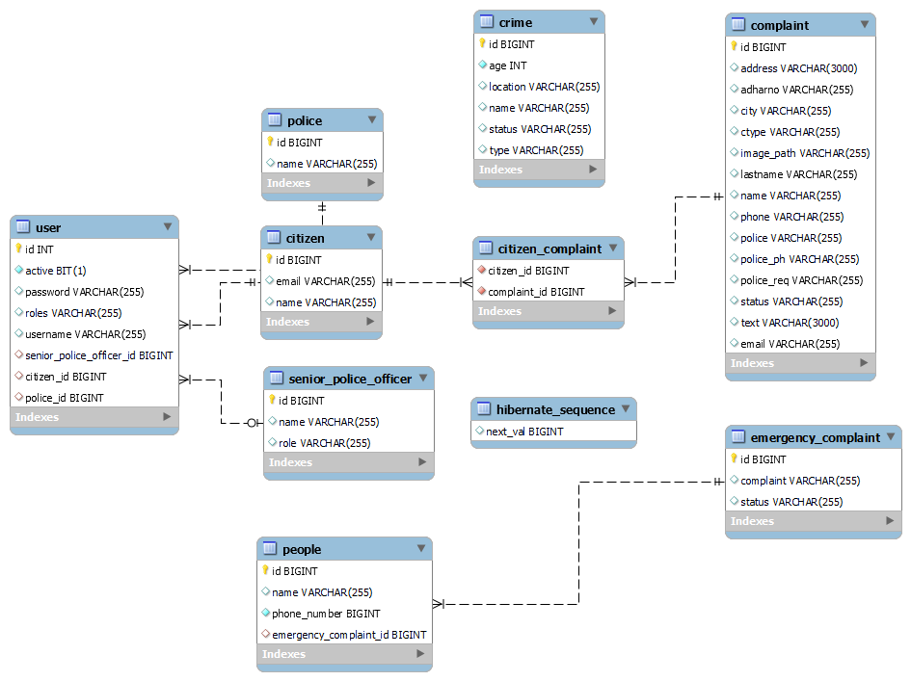
FIG: ERD diagram

Slide 13
Technologies Implemented:
1
2
3
Frontend
Backend
Databases
Languages- JSP(JavaScript)
Framework- Bootstrap, CSS
Languages- Core Java, Advance Java.
Framework- Spring Boot.
MYSQL

Slide 14


Thank You!

