Slide 1

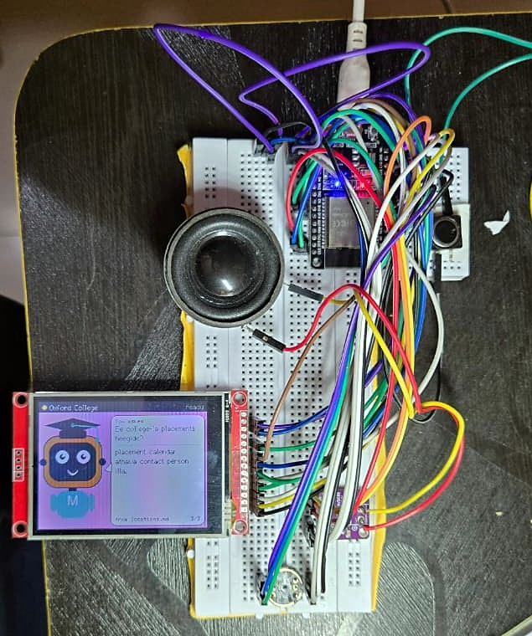

FIRSTHACK 2026 · SUBMISSION
CAMPUS
MITHRA
A voice kiosk, app, website and admin dashboard that answer visitors' and students' campus questions in English, Kannada or Hindi, and walk them to the right building.
TEAM
Team Spy
TRACK
Campus and Student Life
COLLEGE
The Oxford College of Engineering, Bengaluru
MEMBERS
Yadava HC · Pavan Kumar H · Lalitha K · Bhavani Patil
first-hack-team-spy-sigma.vercel.app
Notes:
Project: Campus Mithra. Mithra means friend. Your friend on campus, in your language.

Slide 2
THE PROBLEM
02
IMPACT & USEFULNESS · 20%
Admission day: families on a campus they have never seen, with questions nobody at the gate can answer in their language.
1
Lost on campus
2
Same questions, every year
3
Not in their language
Admission office, accounts, hostel, departments. Families walk around for twenty minutes looking for the right building.
Placements? CSE fee? Is there a hostel? A bus to my area? The college has every answer, in documents nobody at the gate can see.
Many parents are more at home in Kannada or Hindi. Many students speak Kanglish or Hinglish. An English notice board does not help.
WHO: first-time visitors on admission day — students and their parents — plus current students who need the hostel, a lab or today's notice.
HOW WE KNOW: Chidambara, a parent on admission day: "We asked three people where the accounts section was and got three different answers. Nothing at the gate was in Kannada."
Notes:
The college has the information: fees, placements, building plans. It is just not available at the moment, at the place and in the language the visitor needs it.

Slide 3
OUR SOLUTION
03
INNOVATION & ORIGINALITY · 30%
Campus Mithra lets a visitor ask the gate kiosk out loud, in their own language, and get a checked answer from the college's own records — with a QR code that walks them there on their phone.
WHAT MAKES IT DIFFERENT
WHAT IT DOES NOT DO
Real hardware at the gate: an ESP32 kiosk with a mic, speaker and a talking Mithra face — no phone or app needed to ask.
Code-mixed speech: asked in Kanglish or Hinglish, it answers in Kanglish or Hinglish; plain Kannada or Hindi gets plain replies.
Never makes things up: a grounding check rejects any sentence or number not in the college's records.
One live source: kiosk, website, Android app and admin dashboard share the same campus data and map.
Answer anything outside the college — it says "I don't know about that."
Run alone: the kiosk needs a PC beside it over USB.
Show Kannada or Hindi script on the kiosk screen — it shows Latin letters and speaks the language.
iOS: the app is Android only for now.
Notes:
Mithra means friend. Three places, one live data source: the kiosk at the Main Gate, the student app and website, and the admin dashboard.

Slide 4
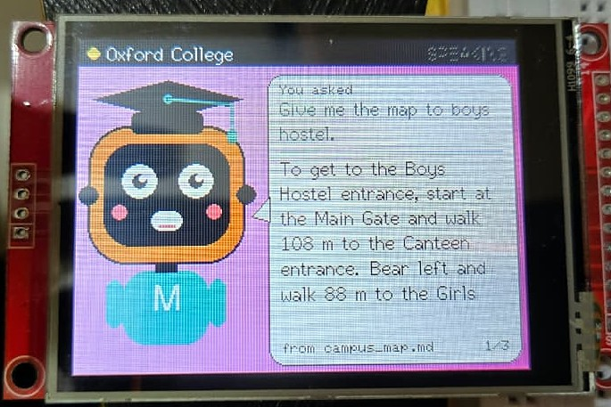
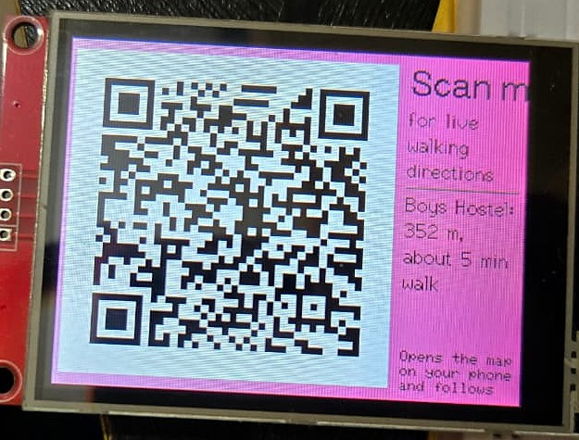
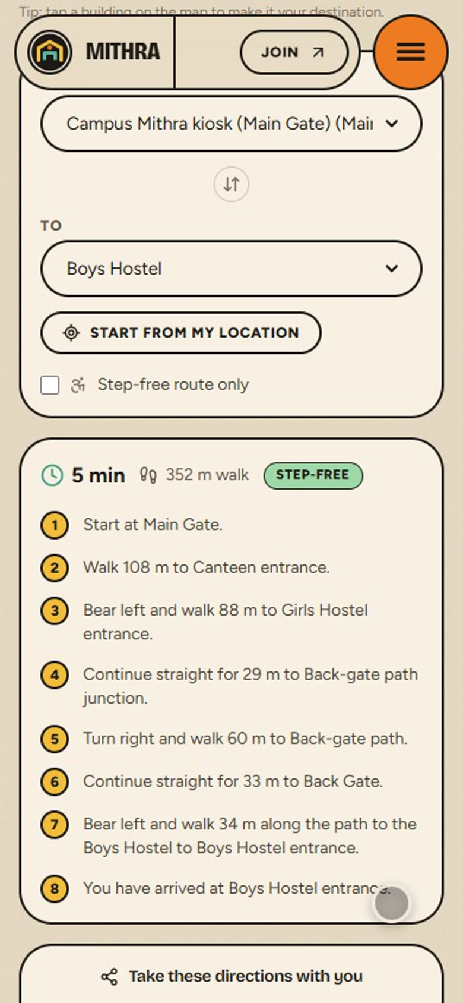
HOW IT WORKS
04
PRESENTATION & CLARITY · 20%
1
ASK
2
GET THE ANSWER
3
WALK THERE
Hold the kiosk button and ask out loud: "Boys hostel-ge hoguva map kodu."
Mithra says and shows the answer in the same language, names the source, and shows a QR code.
Scan it: the route opens on the phone with live GPS along the real campus paths.
5 min
352 m walk
Notes:
Live demo order: ask in English, then in Kanglish/Hinglish, then scan the QR and show the walking route on the phone.

Slide 5
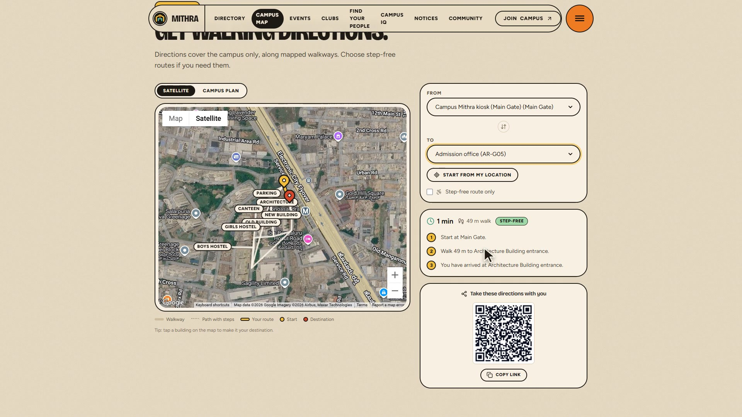
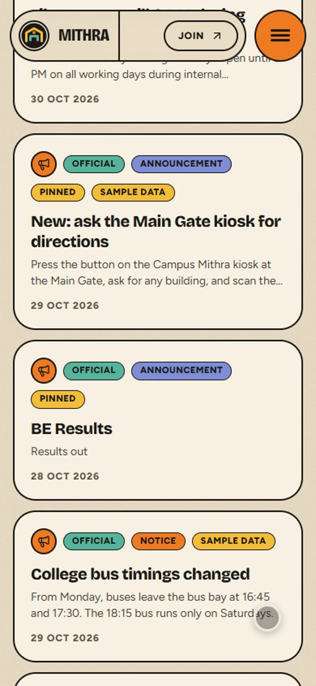
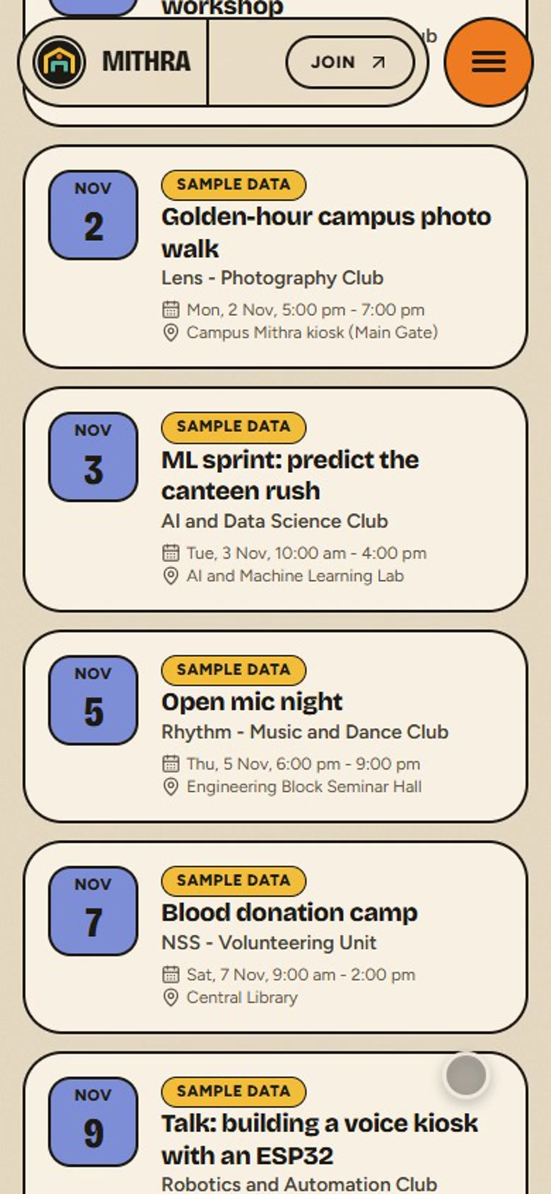
WEBSITE AND APP, LIVE
05
TECHNICAL EXECUTION · 30%
LIVE CAMPUS MAP
Real campus paths on the satellite view, shortest and step-free routes, and a QR to take them to the phone.
ANDROID APP · NOTICES · EVENTS
Notes:
All screens are captured from the live product: first-hack-team-spy-sigma.vercel.app and the Android app. Publishing a notice in the dashboard pushes it to every phone.

Slide 6
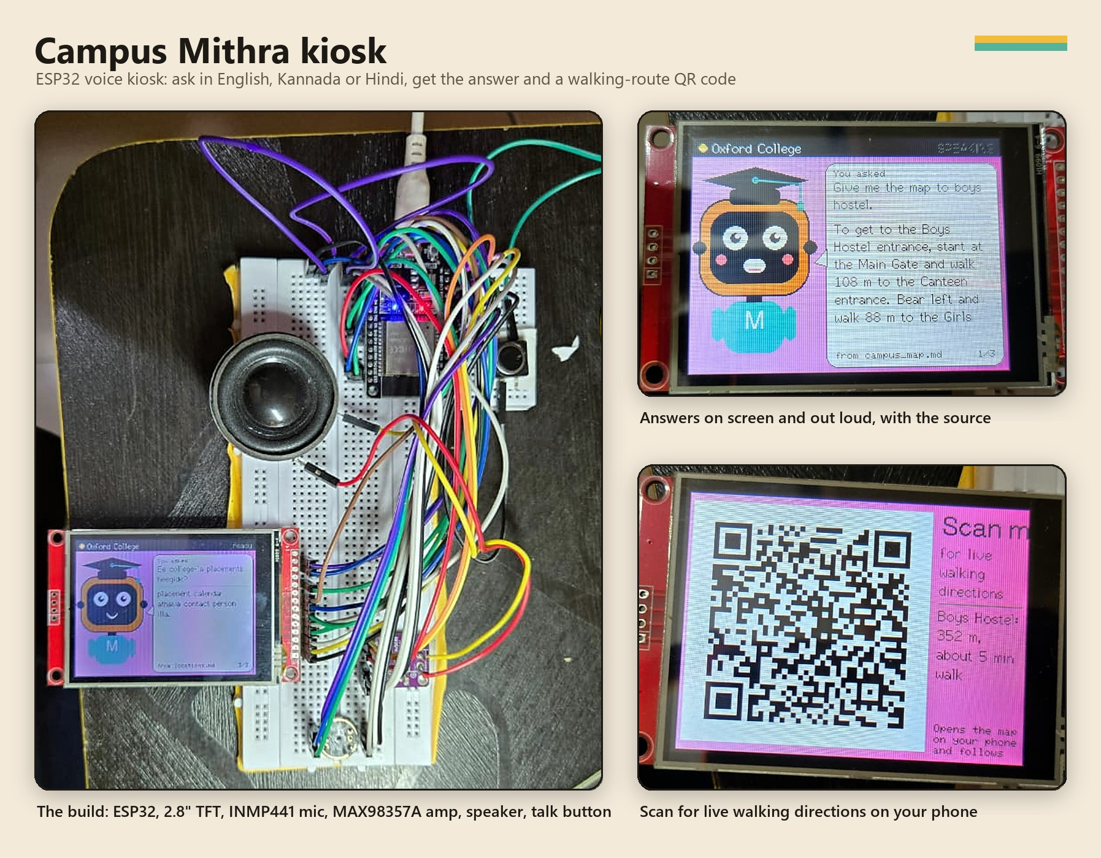
THE KIOSK HARDWARE
06
TECHNICAL EXECUTION · 30%
ESP32 DevKit runs the firmware (C++, PlatformIO)
2.8" ILI9341 TFT Mithra's face, answers and QR codes
INMP441 I2S mic records the question at 16 kHz
MAX98357A amp + speaker speaks the answer, lip-synced
Push button push-to-talk on GPIO27
₹1.5k
kiosk hardware build
USB
link to the PC — no Wi-Fi keys on the device
Less than one temporary helpdesk person for an admission season.
Notes:
The ESP32 listens, shows and speaks; the PC does the recognition and the thinking.

Slide 7
WHAT WE BUILT IT WITH
07
TECHNICAL EXECUTION · 30%
Speech
Sarvam saaras:v4
To English
Sarvam translate
Retrieval
embeddings + TF-IDF
Answer
Gemma 4
Check
grounding check
Back + speak
same language style
LANGUAGES & FRAMEWORKS
WHAT WAS HARDEST
WHAT WE USED FROM OTHERS
Kiosk: C++ on ESP32 (PlatformIO, TFT_eSPI, QRCode)
Server: Python, FastAPI, NumPy
Web + admin: Next.js 16, React, TypeScript, Tailwind, Google Maps
App: Flutter (Android)
Backend: Firebase Auth, Firestore, Storage, FCM
Answering in the style asked: Kanglish in, Kanglish out — translate to English for search and checking, then back with mayura:v1 for code-mixed or sarvam-translate for pure Kannada/Hindi.
Streaming speech to the ESP32 over USB serial without stutter: playback paced by credits from the kiosk.
Sarvam AI (speech, translation), Gemma 4 via Google AI Studio, edge-tts voices
Remotion for the animated characters
Open-source libraries listed in the repo
AI coding assistants helped write and review code
Notes:
Mithra answers only from the college's records: a retrieval gate, strict prompt rules, a grounding check on every sentence and number, and HMAC-signed campus context.

Slide 8
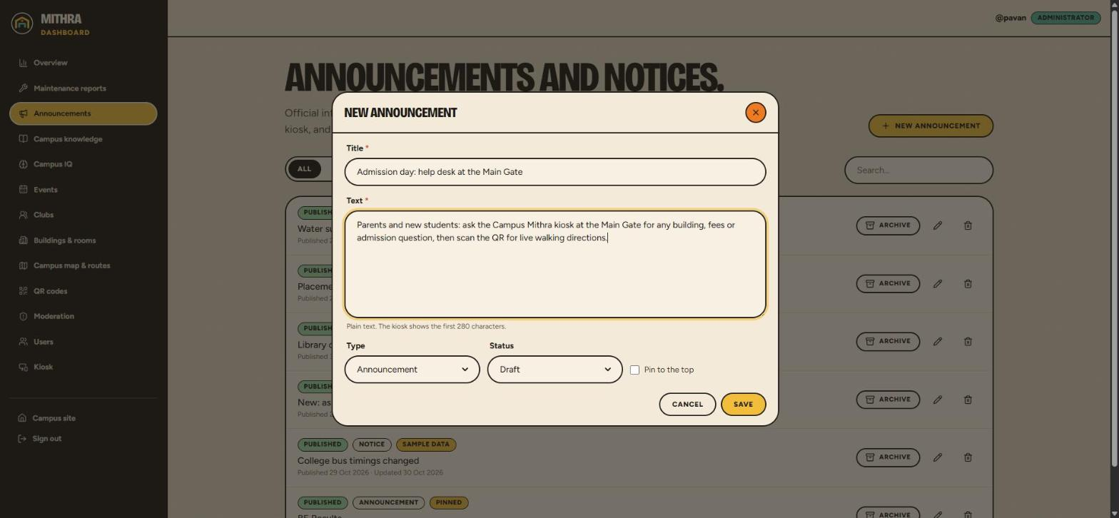
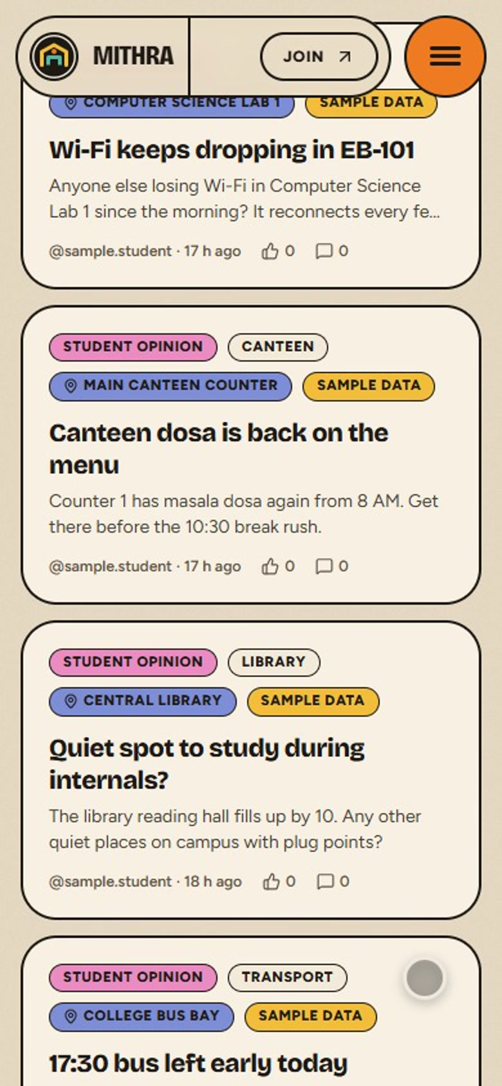
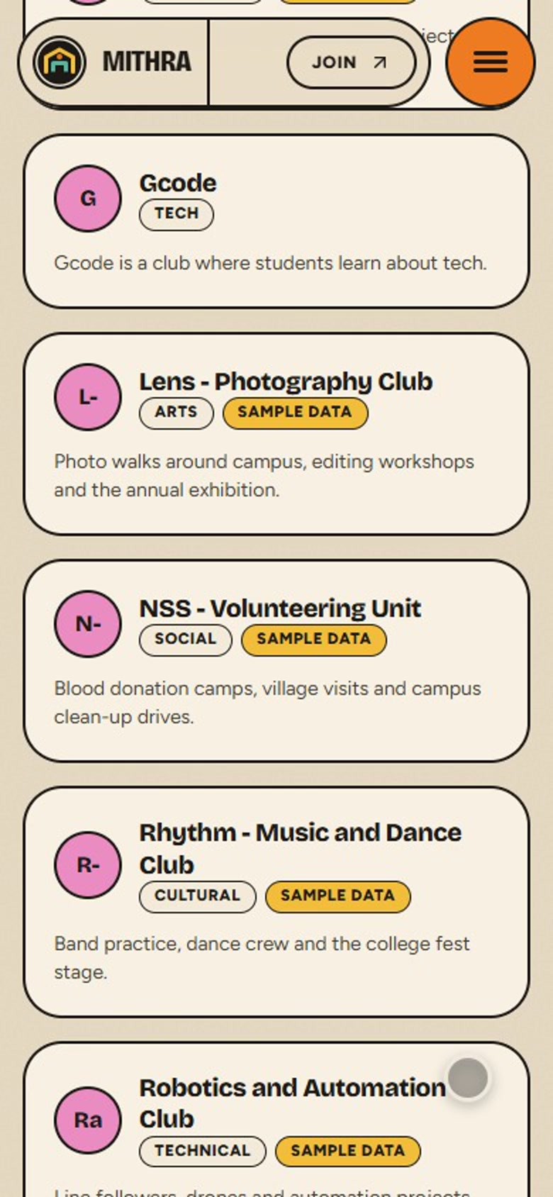
SEE IT RUNNING
08
TECHNICAL EXECUTION · 30%
CODE REPOSITORY
DEMO VIDEO
LIVE LINK
Public, with full commit history.
Real kiosk, website, app and dashboard.
Website, admin, and the Android APK at /app.
github.com/Pavankumarh0/first-hack-teamSPY
youtu.be/tY1Hf34JIiQ
first-hack-team-spy-sigma.vercel.app

Slide 9
WHAT WORKS, WHAT'S NEXT
09
WORKING TODAY
NOT BUILT YET
Kiosk answers spoken questions in English, Kannada, Hindi, Kanglish and Hinglish — on screen and out loud, with the source named
Walking-route QR codes that open live GPS directions on the phone
Live website and Android app: map, notices, events, clubs, issue reports, community, Campus IQ
Admin dashboard: map editor, content, QR codes, kiosk device keys, moderation
Push notifications when a notice is published
Stand-alone kiosk on Wi-Fi, no PC — one box at every gate
Kannada and Hindi script on the kiosk screen
An enclosure for the breadboard build
iOS app
Admissions insights for the college: what visitors asked, in which language
5
ways to ask: English, Kannada, Hindi, Kanglish, Hinglish
12
college documents in the knowledge base
1
live data source for kiosk, web, app and admin
0
answers allowed that are not in the records

Slide 10

HOW A COLLEGE ADOPTS IT
10
IMPACT & USEFULNESS · 20%
WEEK 1
WEEK 2
WEEK 3
ADMISSION DAY
Map the campus: paths, buildings, rooms
Load fees, placements, hostel, transport, events
Install kiosks, print QR codes for every door
Visitors ask, scan and walk
BUSINESS MODEL (PROPOSED)
WHERE WE GROW
Software subscription: ₹3,000 – ₹4,000 a year per campus
Kiosk hardware kit: about ₹1,500 to build; sold or rented for the admission season
Anywhere people get lost and ask the same questions: hospitals, government offices, malls, exhibitions and events.
Setup service: we map the campus and load the content
Admissions insights: premium add-on

Slide 11
THE TEAM
11
YH
PK
LK
BP
Yadava HC
Pavan Kumar H
Lalitha K
Bhavani Patil
4TH YEAR · ISE
4TH YEAR · ISE
4TH YEAR · ISE
4TH YEAR · ISE
TEAM SPY · THE OXFORD COLLEGE OF ENGINEERING, BENGALURU

Slide 12
CAMPUS MITHRA · TEAM SPY
THANK YOU
Your friend on campus, in your language.
Press a button, ask in your own language, get a true answer from the college itself, and walk straight there.
first-hack-team-spy-sigma.vercel.app
github.com/Pavankumarh0/first-hack-teamSPY
Yadava HC · Pavan Kumar H · Lalitha K · Bhavani Patil
The Oxford College of Engineering, Bengaluru

