Slide 1
Lead Score Case Study

Slide 2
Problem Statement
An education company named X Education sells online courses to industry professionals. On any given day, many professionals who are interested in the courses land on their website and browse for courses.
Now, although X Education gets a lot of leads, its lead conversion rate is very poor. For example, if, say, they acquire 100 leads in a day, only about 30 of them are converted. To make this process more efficient, the company wishes to identify the most potential leads, also known as ‘Hot Leads’. If they successfully identify this set of leads, the lead conversion rate should go up as the sales team will now be focusing more on communicating with the potential leads rather than making calls to everyone.
Business Goal:
X Education needs help is selecting the most promising leads, i.e. the leads that are most likely to convert into paying customers. The company requires a model wherein it needs to assign a lead score to each of the leads such that the customers with a higher lead score have a higher conversion chance and the customers with a lower lead score have a lower conversion chance.
The CEO, in particular, has given a ballpark of the target lead conversion rate to be around 80%.

Slide 3
Strategy
Data cleaning – removing and imputing the missing values wherever necessary.
Data preparation – grouping the data and creating dummy variables on categorical data .
EDA – using visualization tools to get insights on data.
Model Building – used both automatic and manual feature selection based on P and VIF values.
Prediction on train data – using the model to predict the outcome.
Calculating metrics – used to determine the predictive power of the model.
Prediction on test data – once satisfied with metrics, used the model to predict the test data.

Slide 4
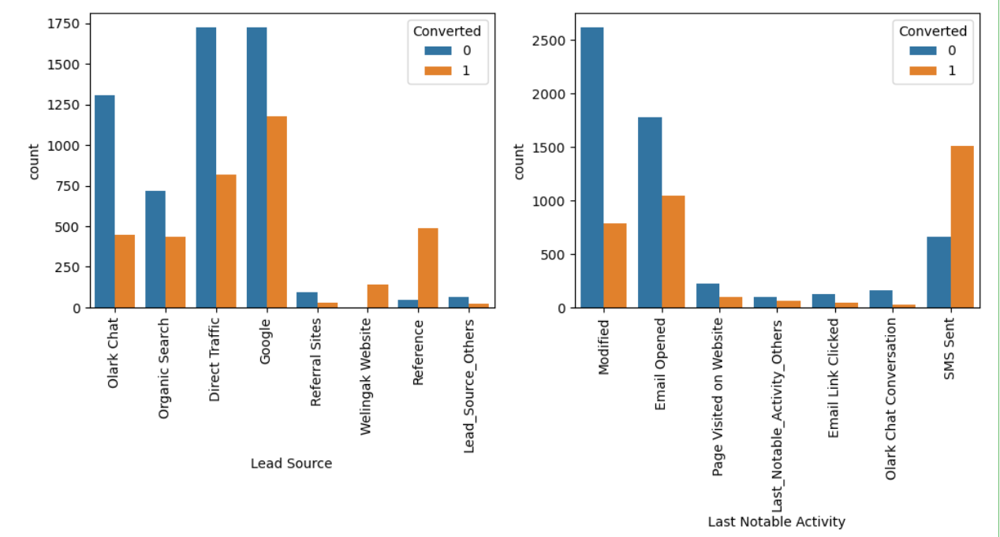
EDA – analysis of the categorical columns
Lead Score and Last Notable Activity
Observation:
In Lead Source, Direct traffic and Google has highest weightage, But reference has the highest conversions rate
SMS Sent has the good conversion rate, while modified and email opened has higher count value
Lead Import has very less count as well as conversion rate and hence can be ignored

Slide 5
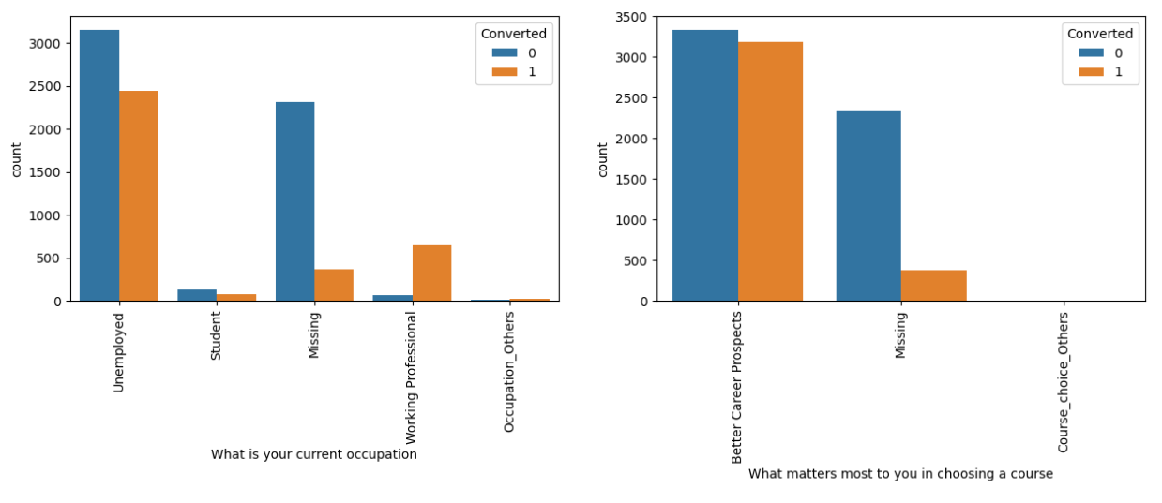
What is your current occupation
EDA – analysis of the categorical columns
Observations:
Unemployed candidates have highest count, while working professionals have the highest conversion rate
Better career prospects have both higher weightage ~50% conversion rate
Mumbai has higher count and Thane and outskirts has better conversion rate

Slide 6
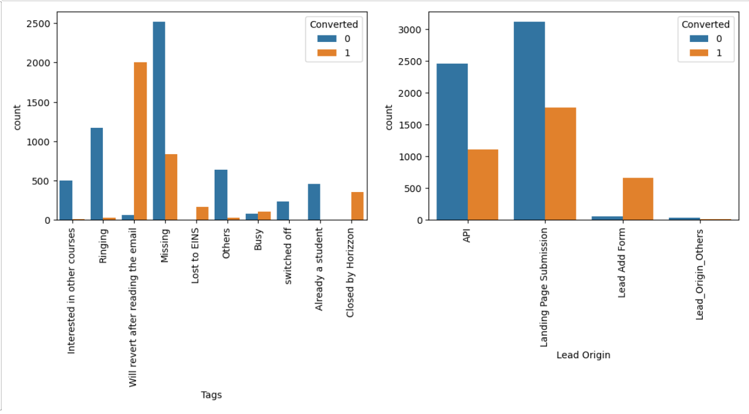
Tags and Lead Origin
EDA – analysis of the categorical columns
Observation:
1) revert after reading the email has extremely high conversion rate
2) In Lead Origin, API and Landing Page Submission has highest weightage in terms of counts, Lead Add Form has the highest conversion rate

Slide 7
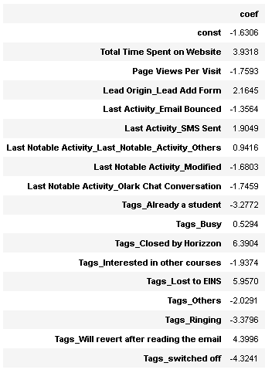
Feature scaling :
Using the Recursive Feature Elimination we went ahead and selected the 20 top important features. Using the statistics generated, we recursively tried looking at the P-value and VIF value in order to select the most significant values that should be present and dropped the insignificant variables.
we choose these values as cutoff and removed the variables/features one by one, Cutoff Value for P=0.05 and Cutoff Value for VIF = 5.
Final variables list :

Slide 8
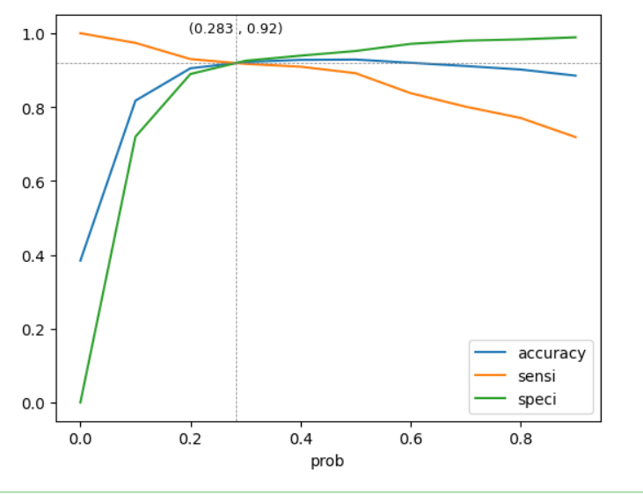
Model evaluation
[[3679 305] [ 204 2280
Specificity and sensitivity:
Accuracy - 92%
Sensitivity - 91%
Specificity - 92 %

Slide 9
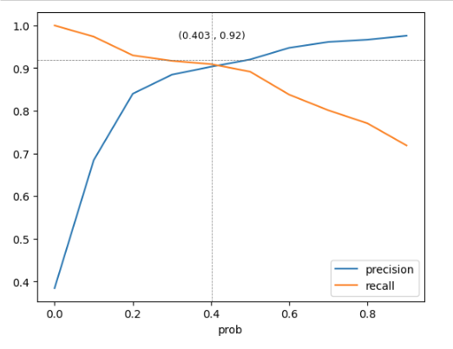
Model evaluation
Precision and Recall:
Accuracy - 92%
Precision - 90%
Recall - 90 %
For the given problem statement sensitivity/Recall are important, hence we choose 0.283 cut off, since that's the maximum sensitivity/recall.

Slide 10
Test data Specificity and sensitivity
Following are the metrics obtained on test data :
Sensitivity/Recall : 0.9239
Specificity : 0.9192
precision : 0.879
False-Positive-Rate : 0.0808
We observed that there are no much deviations between train metrics and test metrics , this model can be accepted for prediction .

Slide 11
Conclusion
1. we have chosen Specificity and sensitivity over precision and precall
2. Also the lead score calculator shows the conversion rate on the final prediction model of test data is 92%.
3.We have top 3 variables for the X company to focus on:
Tags
Last notable activity
Total time spent on the website

