Slide 1
Game Based Learning
By Pavan Ram, Tanmay , Andrew, Harsha and Balaji

Slide 2
Agenda of this Project.
Introduction About Game Based Learning.
Learning Via Minecraft.
(i)What is Minecraft
(ii)Why Minecraft.
(iii)How Minecraft.(practical)
Talks about Minecraft Education.
Conclusion.

Slide 3
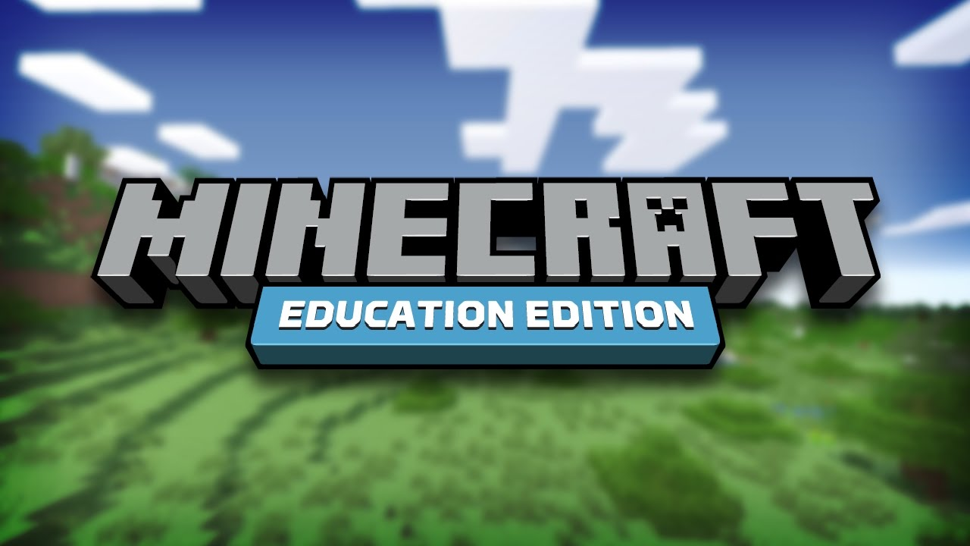
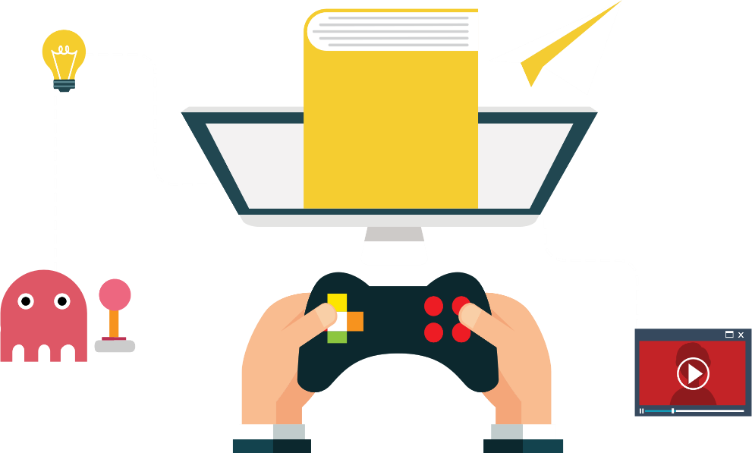
Introduction About Game Based Learning
Game based learning describes an approach to teaching, where students explore relevant aspect of games in a learning context designed by teachers. Teachers and students collaborate in order to add depth and perspective to the experience of playing the game.

Slide 4
Learning Via Minecraft
(i) What is Minecraft education edition?
It is a game-based learning platform that promotes creativity, collaboration, and problem-solving in an immersive digital environment.
Minecraft education edition’s features –
(i) Immersive STEM (Science Technology Engineering Mathematics) learning.
(ii) Creativity and innovation.

Slide 5
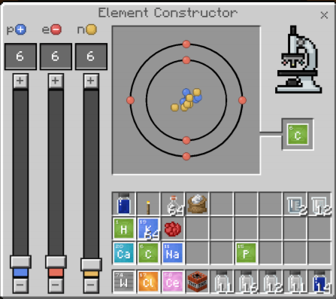
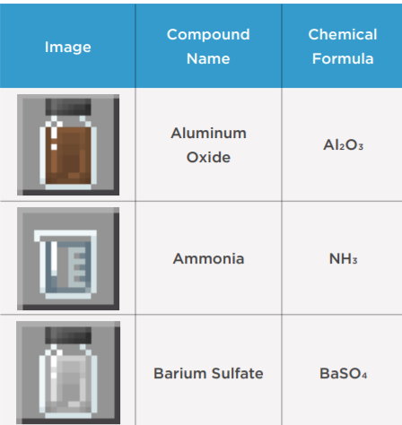
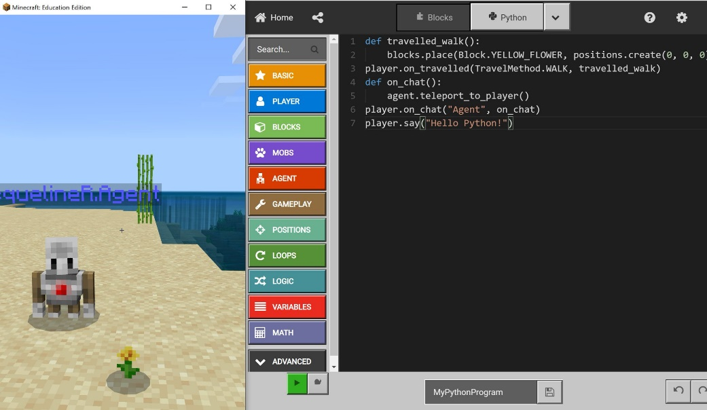
Why Minecraft
It follows guidelines for teaching.
Gives an environment for exploring learning.
Minecraft Education Edition provides endless opportunities for exploration, storytelling and digital learning.
it is used for teaching concepts like chemistry and use of elements, coding, coordinates in Minecraft etc.

Slide 6
How Minecraft
Now we will show some practical things In Minecraft.
First –
Elements in Periodic table.
Detailed Exploration about chemistry lab journal.
Class 1 concepts.
Class 5 concepts.
Class 10 concepts.

