Slide 1
DATA 5322 01 STATISTICAL MACHINE LEARNING - 2
Exploring Youth Substance Use with Ensembling Models
A Data-Driven Perspective using NSDUH 2023 Survey Data
By: Pavan Sai
Professor: Dr. Mendible

Slide 2
ABSTRACT
This project investigates patterns in youth substance use behavior using decision tree-based models on the NSDUH 2023 dataset. We focus on three core tasks predicting school attendance, classifying marijuana usage frequency, and estimating alcohol consumption.
We applied models including Decision Trees, Random Forests, Bagging, and Gradient Boosting. After evaluating with accuracy and error metrics like MSE, MAE, and RMSE, we observed:
• Substance use features like marijuana frequency and alcohol onset age were highly predictive.
• Peer and parental influences played a notable role in multi-class classification outcomes.
• Gradient Boosting performed best in regression, reducing MSE to 2.56 and MAE to 1.14.
This analysis offers interpretable insights into how environmental and behavioral factors shape youth outcomes, supporting targeted interventions in health and education.

Slide 3
Questions Chose:
Binary Classification : Can we predict whether a youth skipped school in the past month based on their substance use behavior?
Multi-Class Classification : Can we classify the frequency of marijuana use among youth into None, Occasional, and Frequent groups based on their home environment and peer influence?
Regression : Can we predict how many days a youth drank alcohol in the past year based on their demographics and parental involvement?

Slide 4
Dataset
National Survey on Drug Use and Health (NSDUH 2023).
Youth subset (ages under 18), preprocessed version: youth_data.RData.
Feature Categories Used:
• Substance Use Behaviors: Usage frequency and age of first use (alcohol, marijuana, cigarettes).
• Parental Involvement Indicators: Homework check-ins, setting rules, emotional support.
• Peer Influence Indicators: Friends’ behavior around substance use.
• Demographics: Gender, race, income, education level.
Preprocessing Steps:
• Dropped NA and special codes .
• Re-bucketed marijuana use into 3 categories: None, Occasional, Frequent.
• Downsampled to address class imbalance where needed.

Slide 5
Theoretical Background
Decision Tree
Overview :
A non-parametric supervised learning method used for classification and regression. Splits the data recursively based on feature values to create homogeneous subgroups.
How It Works :
At each node the best split is chosen by minimizing an impurity criterion: Gini index or Entropy (for classification) Variance reduction (for regression) The process continues until a stopping criterion is met (e.g., min samples, depth).
Key Concepts :
Overfitting is common without pruning Pruned trees reduce complexity using cross-validation and cost-complexity
Why We Used It :
Baseline model across all tasks Easy to interpret and visualize
Bagging
Overview:
An ensemble method that trains multiple models on bootstrapped samples of the data. The final prediction is the average (for regression) or majority vote (for classification). How It Works:
Reduces variance by combining multiple deep, unpruned trees Each tree sees a different random subset of the data Key Properties:
Each model sees a slightly different dataset Final model is more stable and robust to noise
Why We Used It:
Strong baseline for the binary classification task Helps mitigate variance from single-tree models

Slide 6
Theoretical Background
Random Forest
Overview:
An extension of bagging that introduces feature-level randomness at each split. This helps decorrelate trees, improving generalization.
How It Works:
Trains many trees on bootstrapped data.At each node, selects a random subset of features to split .Final prediction is based on average (regression) or majority vote (classification) .
Key Concepts:
Reduces overfitting compared to standard decision trees Allows interpretation of variable importance .
Why We Used It:
Balances performance and interpretability.Performed consistently well across all tasks
Gradient Boosting
Overview:
A sequential ensemble method where each tree attempts to correct the errors of the previous tree. Boosting gradually improves model performance.
How It Works:
Each tree is fit to the residuals of the previous model Uses gradient descent to minimize a loss function .Shrinkage (learning rate) slows down learning to prevent overfitting .
Key Concepts:
Very high accuracy when tuned properly.Sensitive to hyperparameters like learning rate, number of trees, and depth .
Why We Used It:
Performed best in multiclass classification.Captures complex patterns with well-controlled bias-variance tradeoff.

Slide 7
Methodology - Binary Classification :
Title: Binary Classification – Skipped School Prediction
Target Variable:
SKIPPED_SCHOOL (0 = No, 1 = Yes)
Derived from EDUSKPCOM (days skipped school)
Features Used:
Substance use: IRALCFM, IRMJFM, IRCIGFM
First use age: IRALCAGE, IRMJAGE, IRCIGAGE
Flags: ALCFLAG, MRJFLAG, TOBFLAG
youth_experience_cols, demographic_cols
Preprocessing:
Re-coded 991s as NA
Converted target & flags to factors
Dropped rows with missing values
No downsampling (class balance was acceptable)
Models Applied:
tree() with pruning (cv.tree())
randomForest() for Bagging (full mtry) & Forest (mtry = 4)
gbm() with Bernoulli loss, CV-tuned
Tuning And Evaluation:
Threshold tuned to 0.4 for GBM, RF, Bagging
Evaluated via F1, confusion matrices, barplots

Slide 8
Methodology - Multiclass Classification :
Title: Multiclass Classification – Marijuana Use Frequency
Target Variable:
SKIP_LEVEL: Frequent / Occasional / None
Created from MRJMDAYS via custom bucketing
Features Used:
Peer/parent influence: PARCHKHW, PARHLPHW, PRPROUD2, PRTALK3, PRPKCIG2, PRBSOLV2, PREVIOL2
Marijuana exposure: FRDMJMON, PRMJEVR2, YFLMJMO, YFLTMRJ2
Preprocessing:
Dropped NA rows
Applied slice_sample() or sample_n() to balance class sizes
Re-coded factor levels and ensured label consistency
Models Applied:
tree() for interpretable baseline
randomForest() (ntree = 200, mtry = 4)
gbm() with multinomial loss, CV tuned
Evaluation:
Per-class and Macro F1 using custom get_f1()
Heatmaps and barplots to visualize performance

Slide 9
Methodology - Regression:
Title: Regression – Predicting Alcohol Consumption Days
Target Variable:
ALCYDAYS = number of days alcohol consumed in past year.
Features Used:
Demographics: IRSEX, NEWRACE2, INCOME, EDUSCHGRD2
Parenting & peer influence: PARCHKHW, PARHLPHW, PRPROUD2, PRTALK3, PRLMTTV2
Behavior: FRDADLY2, PREVIOL2, YTHACT2
Preprocessing:
Different feature subsets used for tree, RF, GBM
Cleaned NAs, maintained consistency with set.seed(19)
Models Applied:
tree() with custom controls
randomForest() (ntree = 350, mtry = 3)
gbm() with Gaussian loss, 5-fold CV
Tuning And Evaluation:
MSE, RMSE, MAE
Visuals: Actual vs Predicted scatter plots
Comparison barplot of all models
Tuning And Evaluation:
MSE, RMSE, MAE
Visuals: Actual vs Predicted scatter plots
Comparison barplot of all models

Slide 10
Binary Classification
Can we predict whether a youth skipped school recently based on their substance use behavior?
Target Variable:
SKIPPED_SCHOOL
• 1 = Skipped school (1–30 days)
• 0 = Did not skip school (0 days)
MODEL | ACCURACY
Decision Tree | 55.6%
Random Forest | 62.2%
Gradient Boosting | 57%
Bagging | 66%

Slide 11
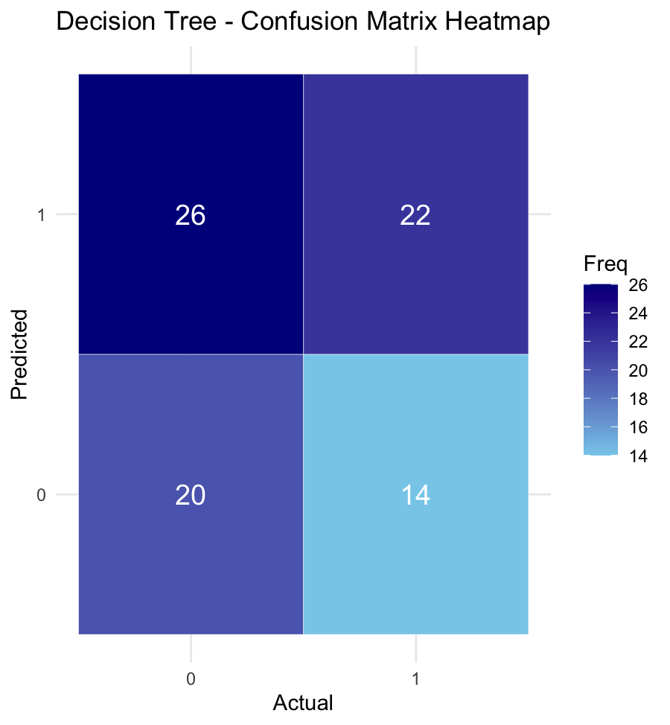
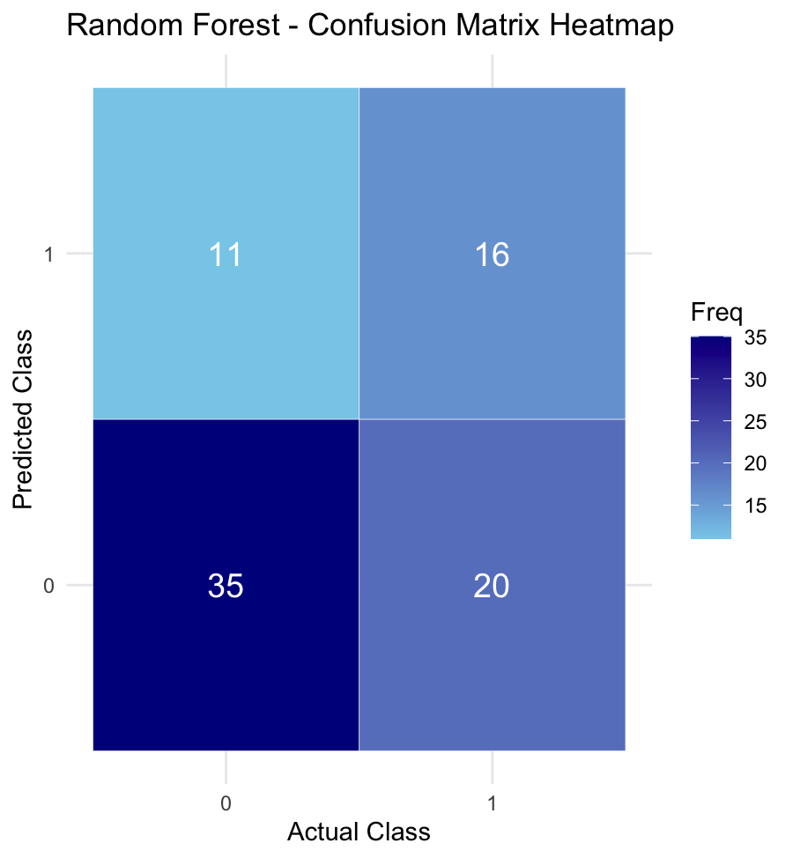
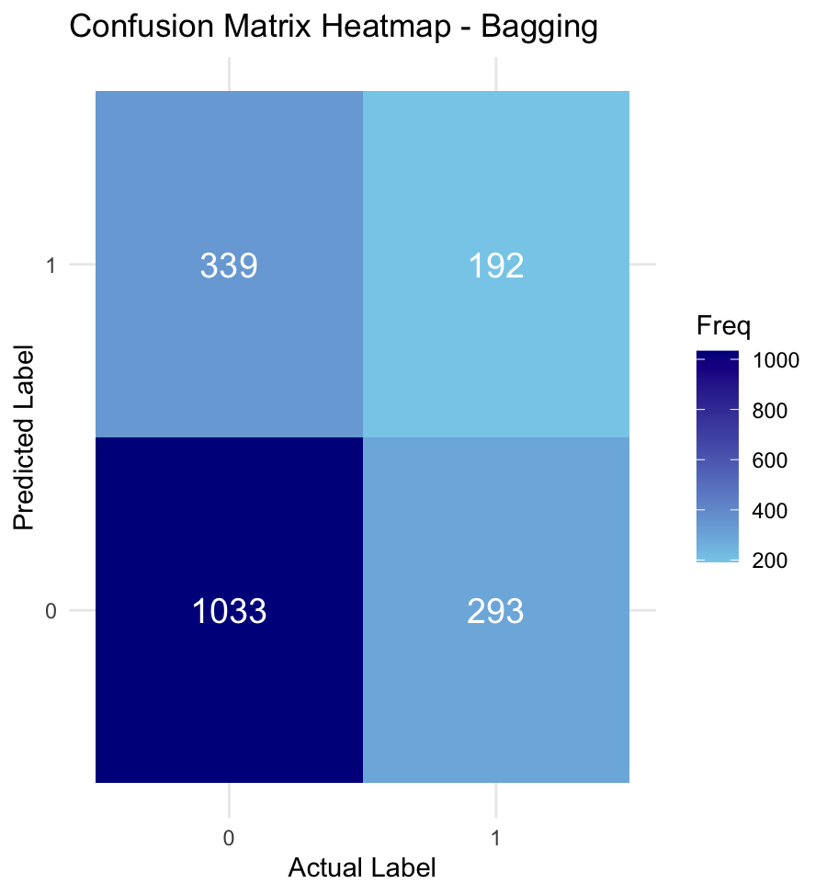
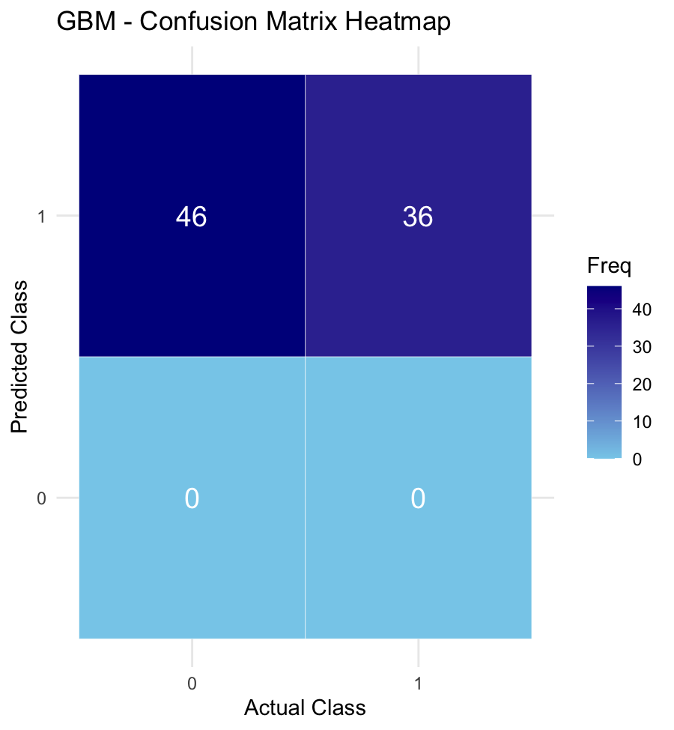
Binary Classification
Model Comparisons Using Confusion Matrix Heatmap

Slide 12
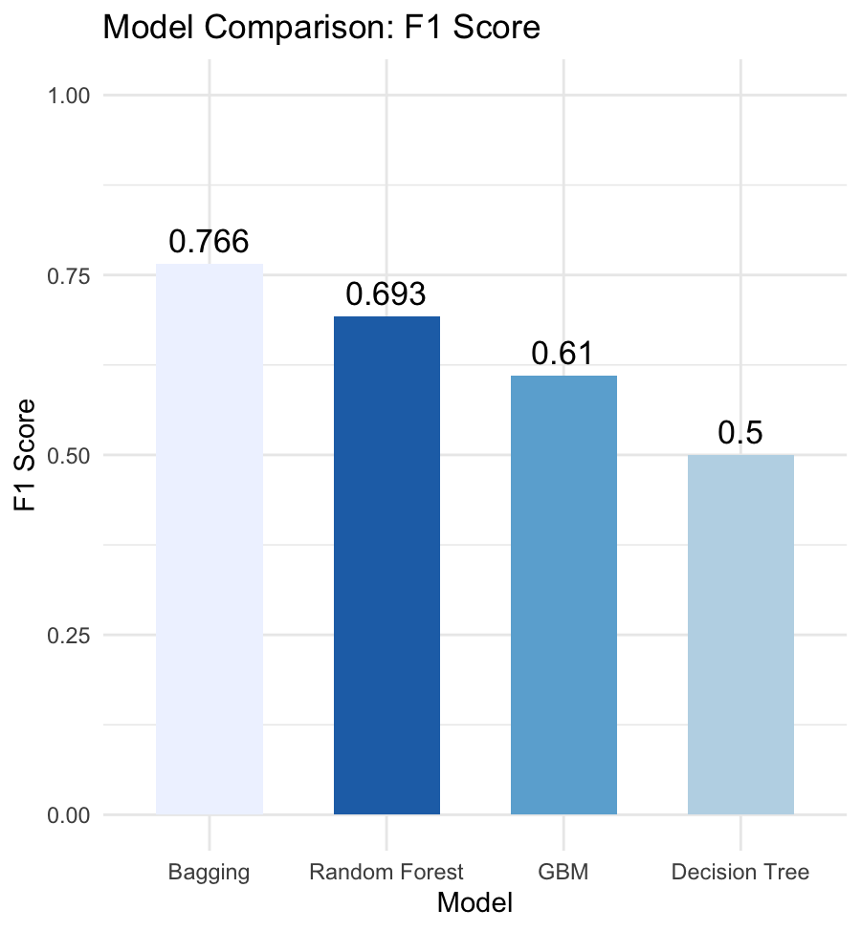
Binary Classification
Model Comparisons Using F1-Scores
Bagging (F1 = 0.766) → Bagging performed best by reducing variance across high-variance base learners decision trees. Its ensemble of unpruned trees on bootstrapped data helped generalize well without overfitting.
Random Forest (F1 = 0.693) → Performed slightly lower than bagging. While it also uses bootstrapped trees. it offered a strong balance of precision and recall.
GBM (F1 = 0.610) → Though GBM typically offers high accuracy, its sequential training can overfit on smaller, noisy data. Our use of 5-fold CV and shrinkage controlled that, but its sensitivity to imbalanced data and reliance on thresholding likely impacted its F1.
Decision Tree (F1 = 0.500) → The pruned tree served as a simple, interpretable baseline but underperformed due to its inability to capture complex patterns or interactions.

Slide 13
Multi-Class Classification
Can we classify the frequency of marijuana use among youth into None, Occasional, and Frequent groups based on their home environment and peer influence?
Target Variable:
MRJMDAYS rebucketed into SKIP_LEVEL
• None: No use in past month (MRJMDAYS = 5)
• Occasional: 3–10 days (MRJMDAYS = 3 or 4)
• Frequent: 1–2 days (MRJMDAYS = 1 or 2)
MODEL | ACCURACY
Decision Tree | 55.6%
Random Forest | 62.8%
Gradient Boosting | 58.1%

Slide 14
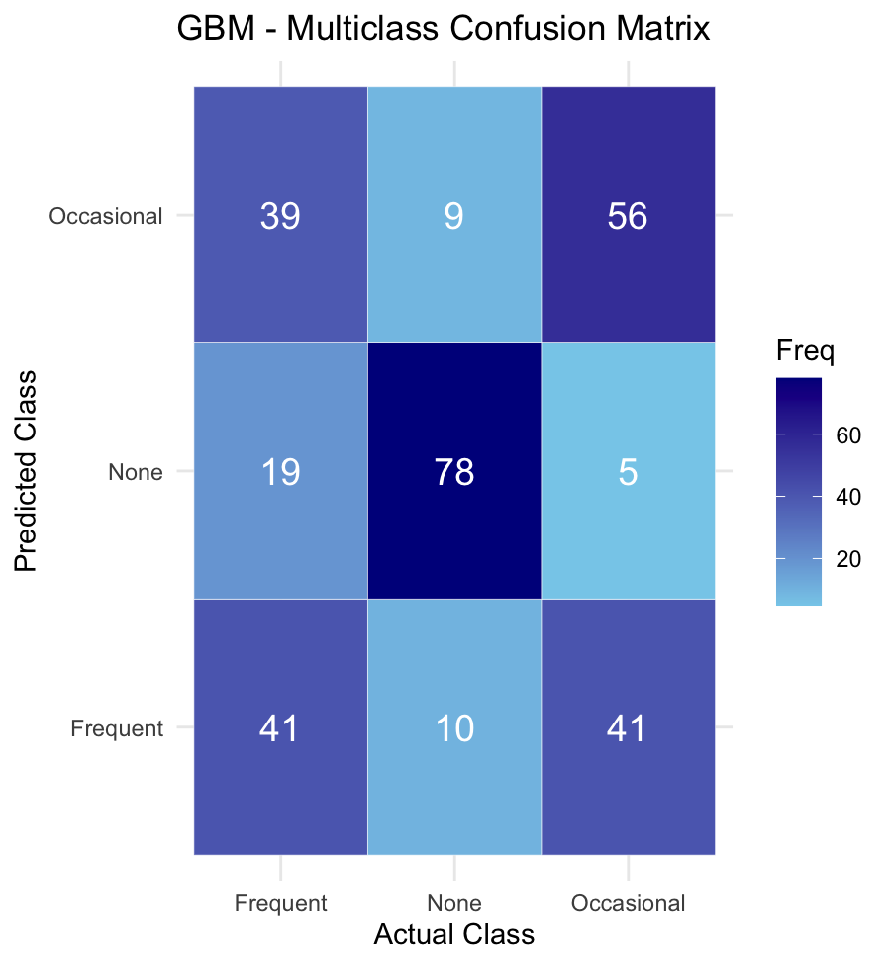
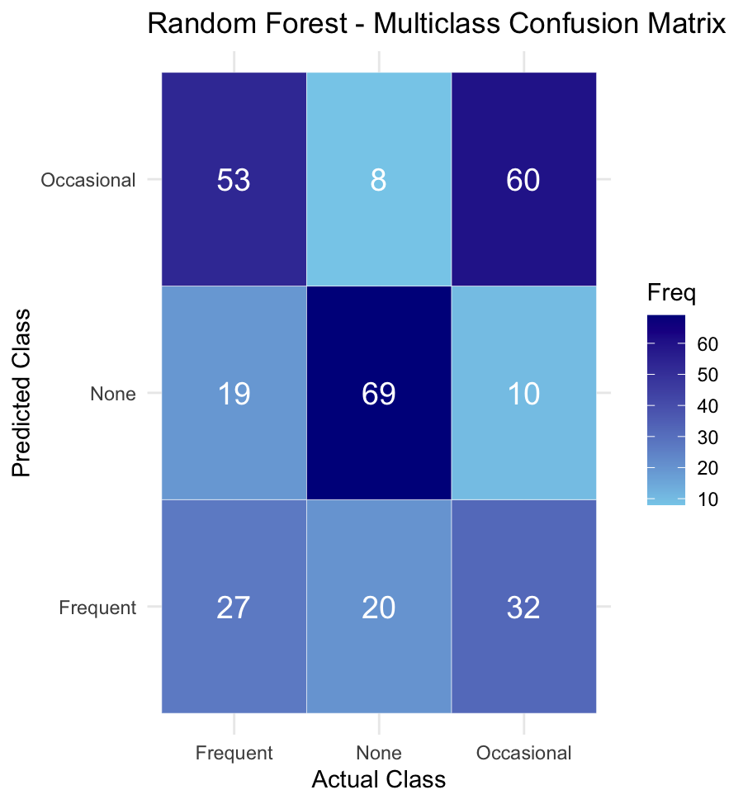
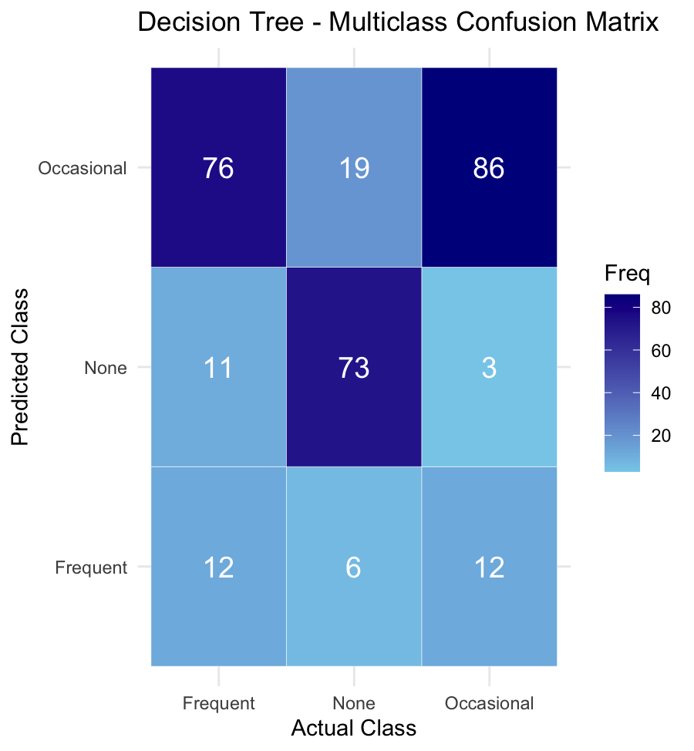
Multi-Class Classification
Model Comparisons Using Confusion Matrix Heatmap

Slide 15
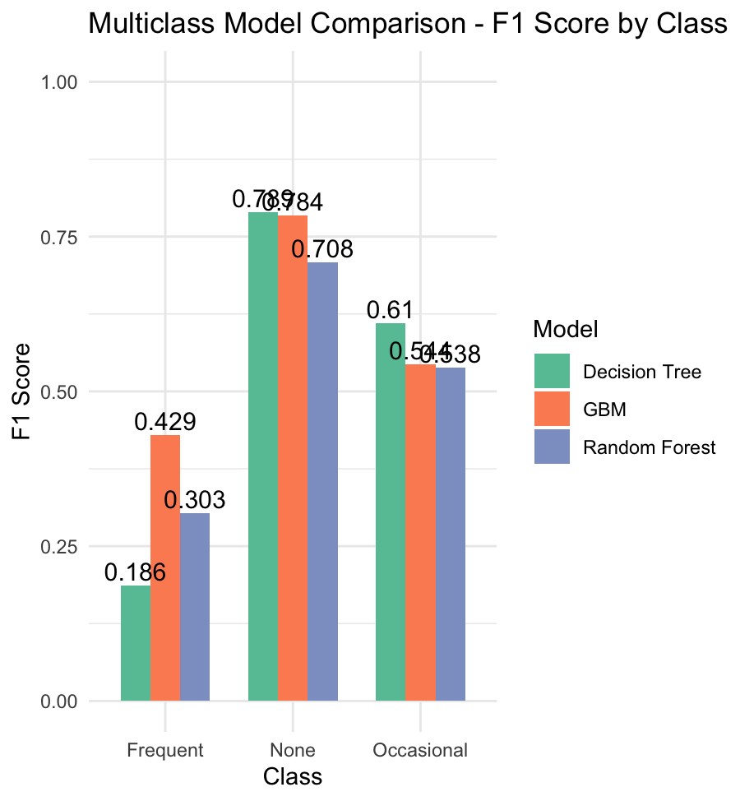
Multi-Class Classification
Model Comparisons Using F-1 Scores
None (Highest across all models) → All three models performed best on the ‘None’ class (F1 ≈ 0.70–0.78) because this group had the clearest patterns and largest support in training data. → GBM achieved the highest F1 (0.784).
Occasional (Moderate performance) → This class was harder to distinguish due to overlapping behavioral patterns with both ‘None’ and ‘Frequent’. → Decision Tree led with an F1 of 0.61 by possibly overfitting to this group’s structure. GBM and RF were slightly lower (~0.54).
Frequent (Lowest performing class) → All models struggled here due to class imbalance and limited support in training. → GBM outperformed others (F1 = 0.429), but even this score reflects weak recall.

Slide 16
Regression
Can we predict how many days a youth drank alcohol in the past year using their demographics and parental involvement?
Target Variable:
ALCYDAYS – Number of days alcohol was consumed in the past year
Model | MSE | MSA | RMSE
Decision Tree | 2.88 | 1.17 | 1.70
Random Forest | 2.88 | 1.17 | 1.70
Gradient Boosting | 2.56 | 1.14 | 1.60

Slide 17
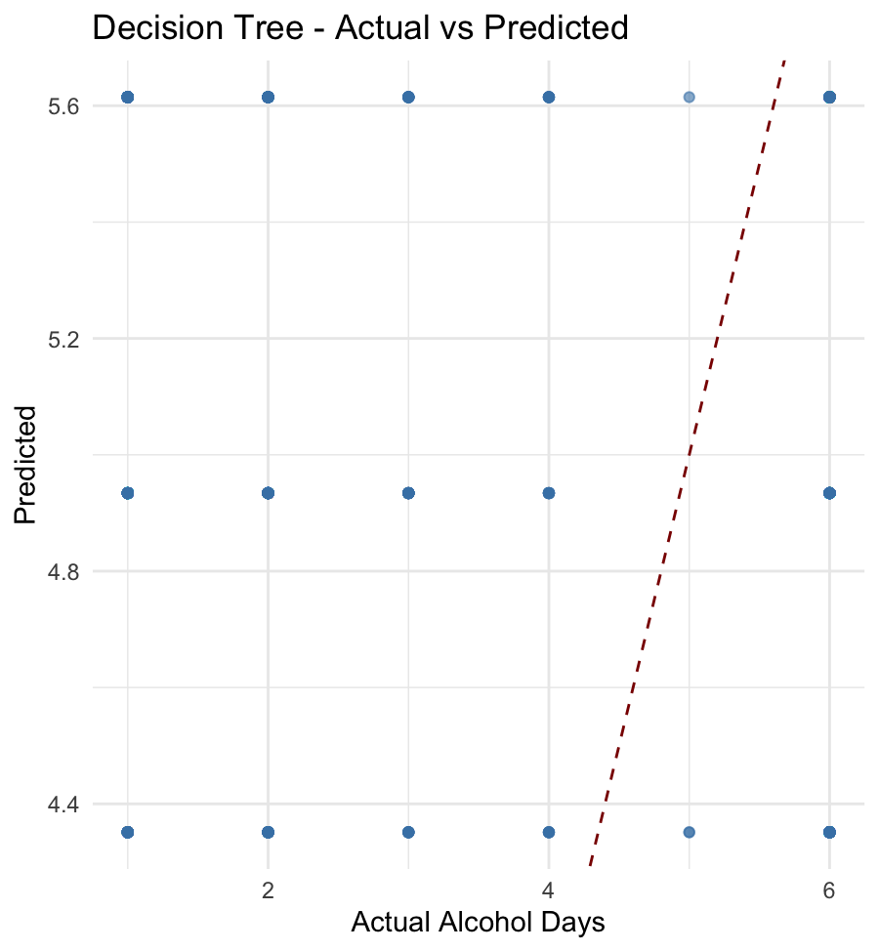
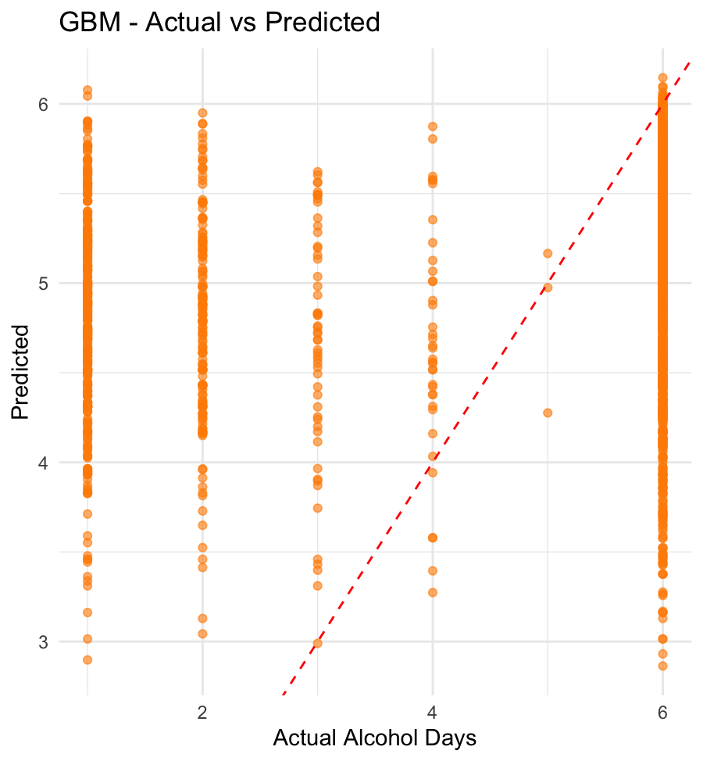
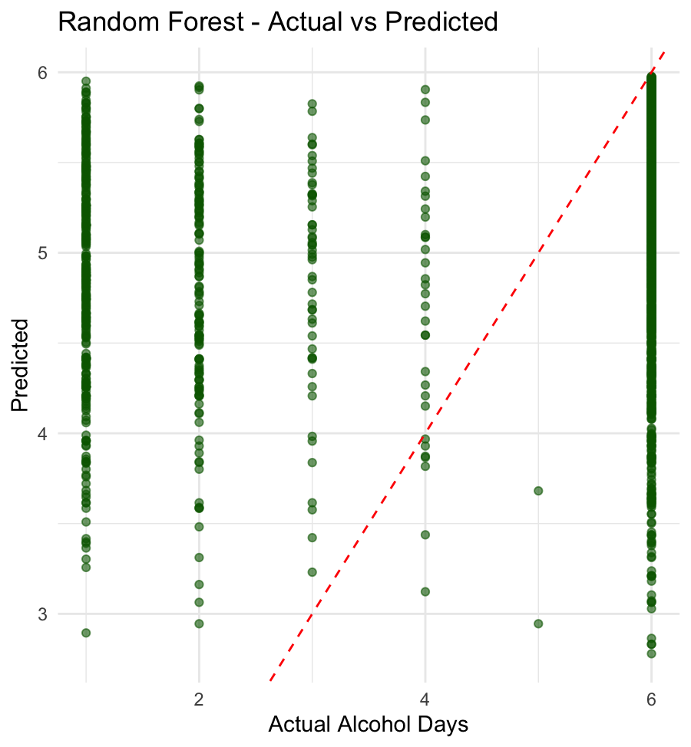
Regression
Model Comparisons

Slide 18
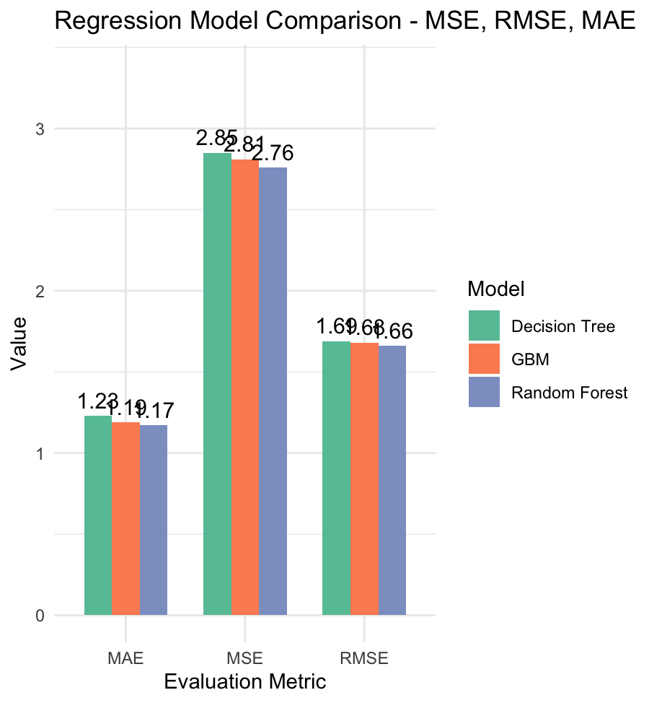
Regression
Model Comparisons Using F-1 Scores
Random Forest (Best Performer Overall) → Achieved the lowest error across all three metrics: MAE = 1.17, MSE = 2.76, RMSE = 1.66 → The ensemble of trees captured complex non-linear patterns while reducing overfitting through bootstrapping and feature randomness.
GBM (Close Second) → MAE = 1.19, RMSE = 1.68 — very close to RF → Slightly higher MSE (2.81).
Decision Tree (Most Interpretable, Least Accurate) → MAE = 1.23, MSE = 2.85, RMSE = 1. → Still useful for understanding basic splits and dominant predictors

Slide 19
Discussion
Early Issues: Data Leakage
Initial models included variables like EDUSKPCOM directly as predictors, which leaked information from the target
This resulted in inflated accuracy scores (e.g., ~95%) during early decision tree trials
After fixing, pruned tree accuracy dropped to ~51%, reflecting real-world performance
Reinforced why careful feature selection is critical for fair evaluation
Confusion Matrix Insights
Visual inspection showed models often misclassified ‘Frequent’ users as ‘None’ or ‘Occasional’ → Especially in multiclass task before downsampling
Binary task confusion matrices showed that models had strong precision, but recall was improved significantly only after threshold tuning (0.4)
Takeaways
Interpretability vs. Performance trade-off: Decision Trees are easy to explain but lacked depth; RF and GBM captured complexity better
Downsampling made multiclass classification more balanced, improving macro F1 from ~0.52 to ~0.586 using GBM
Visual diagnostics (heatmaps, barplots) helped debug bias toward dominant classes

Slide 20
Challenges
Data Leakage
• Accidentally used variables like MRJMDAYS as predictors while predicting derived versions of them.
• This led to unrealistically high accuracy. We resolved it by carefully excluding leakage-prone variables.
Class Imbalance
• Some categories, especially in the multi-class classification, were highly underrepresented.
• We used downsampling to balance classes before training.
Misleading Accuracy
• Early models showed high accuracy, but confusion matrices revealed poor class-wise performance.
• Confusion matrix analysis helped us tune thresholds and validate results properly.
Model Complexity vs Interpretability
• Ensemble models performed better but were less interpretable.
• We ensured clear feature importance plots and decision paths for explanation.

Slide 21
Conclusion
Decision trees and ensemble methods provide powerful tools for understanding youth behavior through survey data.
For binary classification, Random Forest and GBM performed well, revealing strong links between substance use and school attendance.
In multi-class classification, we predicted marijuana use levels using home and peer environment factors, with Random Forest giving the most balanced results after handling class imbalance and leakage.
In the regression task, predicting alcohol consumption days, GBM outperformed other models with the lowest error, while linear regression gave interpretable but less accurate results.
We learned that thoughtful feature selection, avoiding data leakage, and balancing performance with interpretability are critical in real-world modeling.
These insights can aid in early identification and targeted interventions for at-risk youth.

Slide 22
THANK YOU..!!

