Slide 1
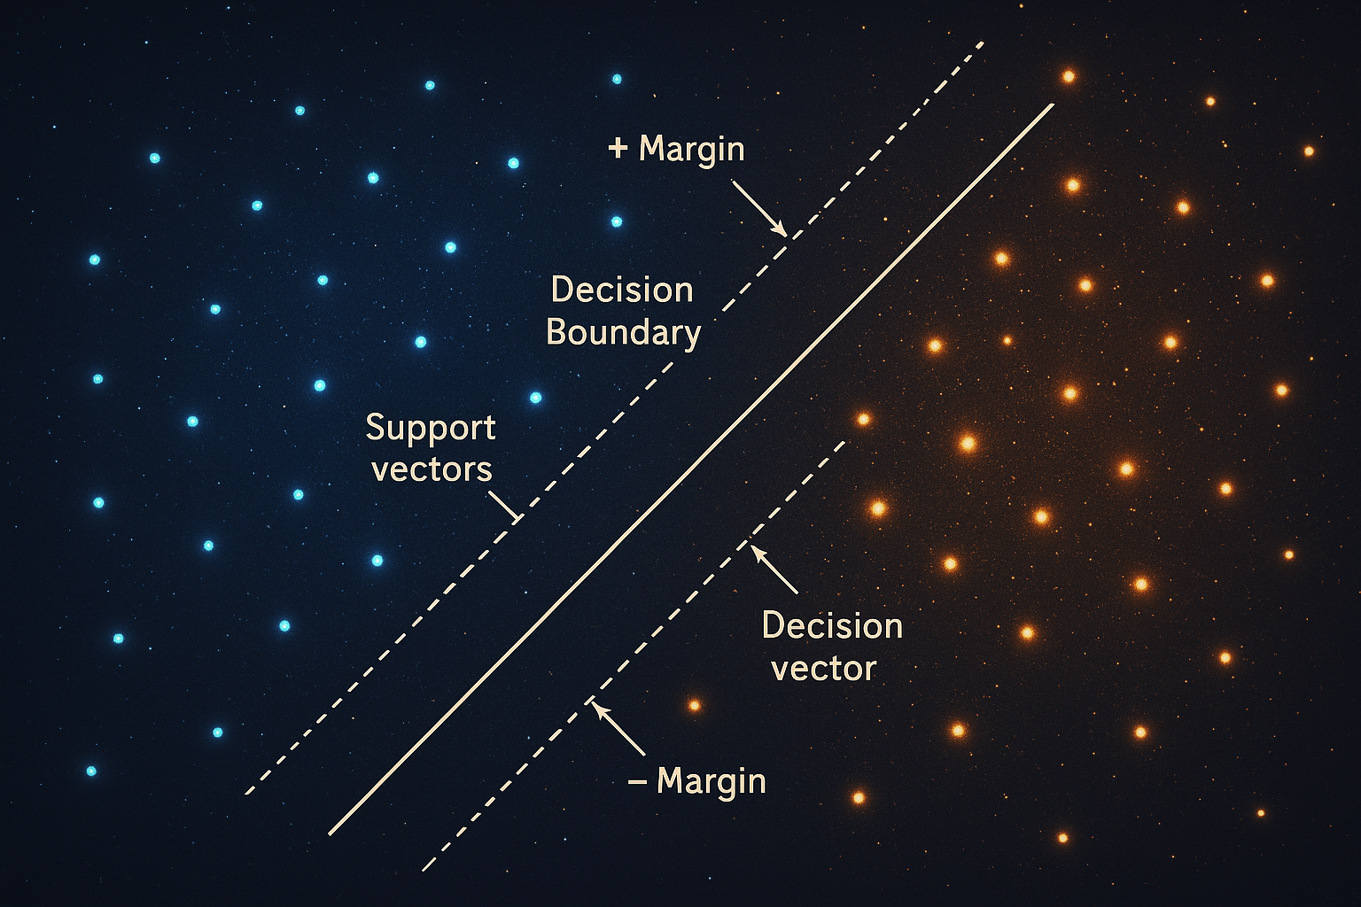
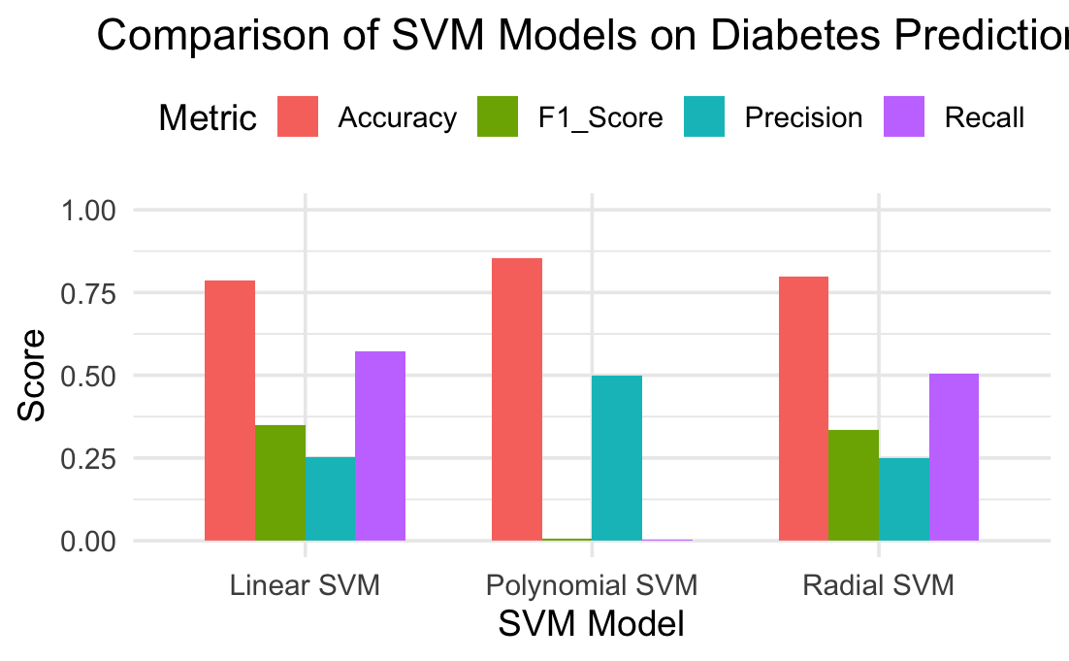
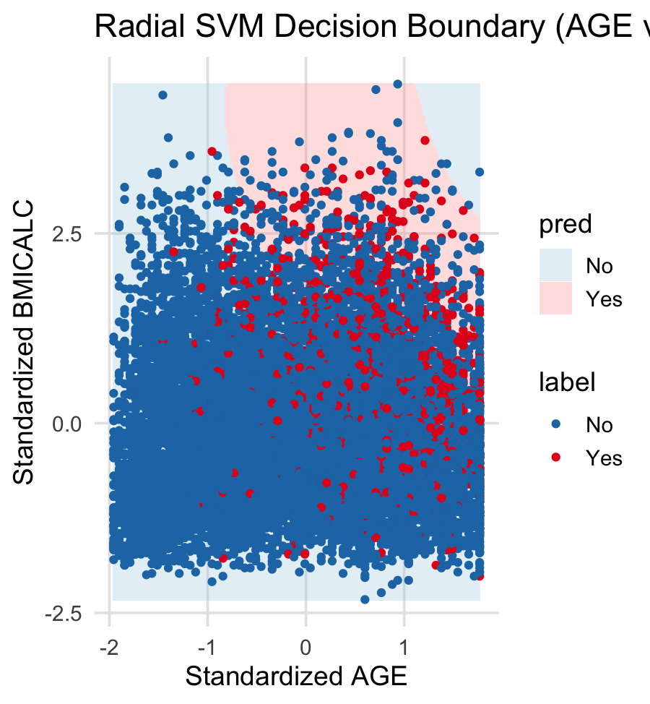
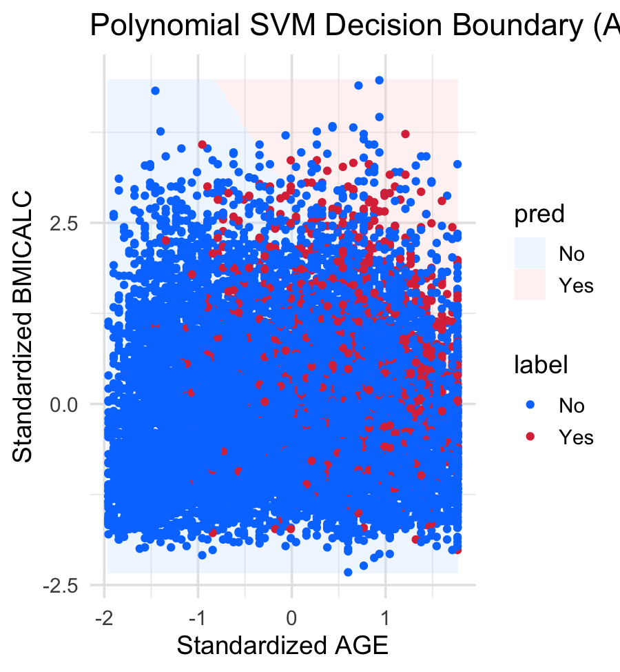
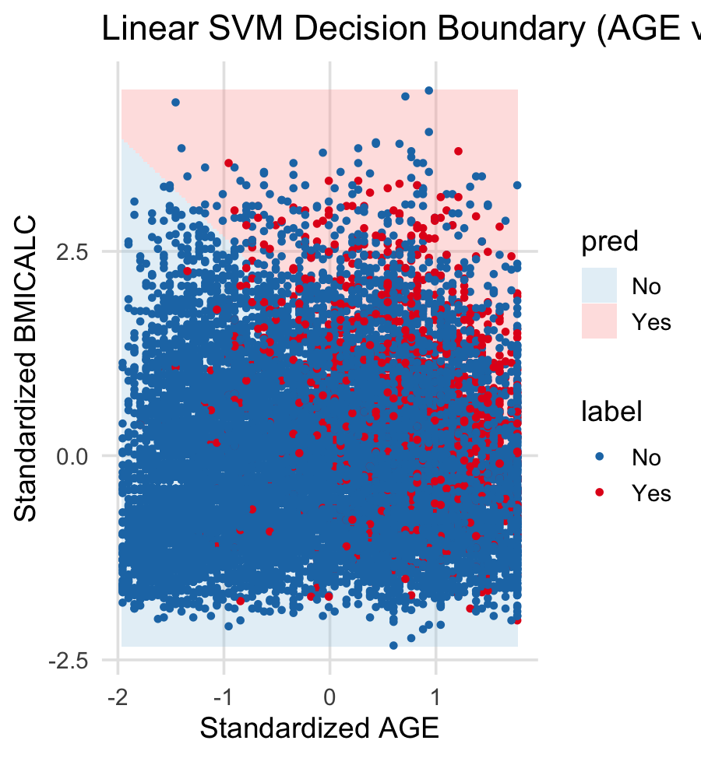
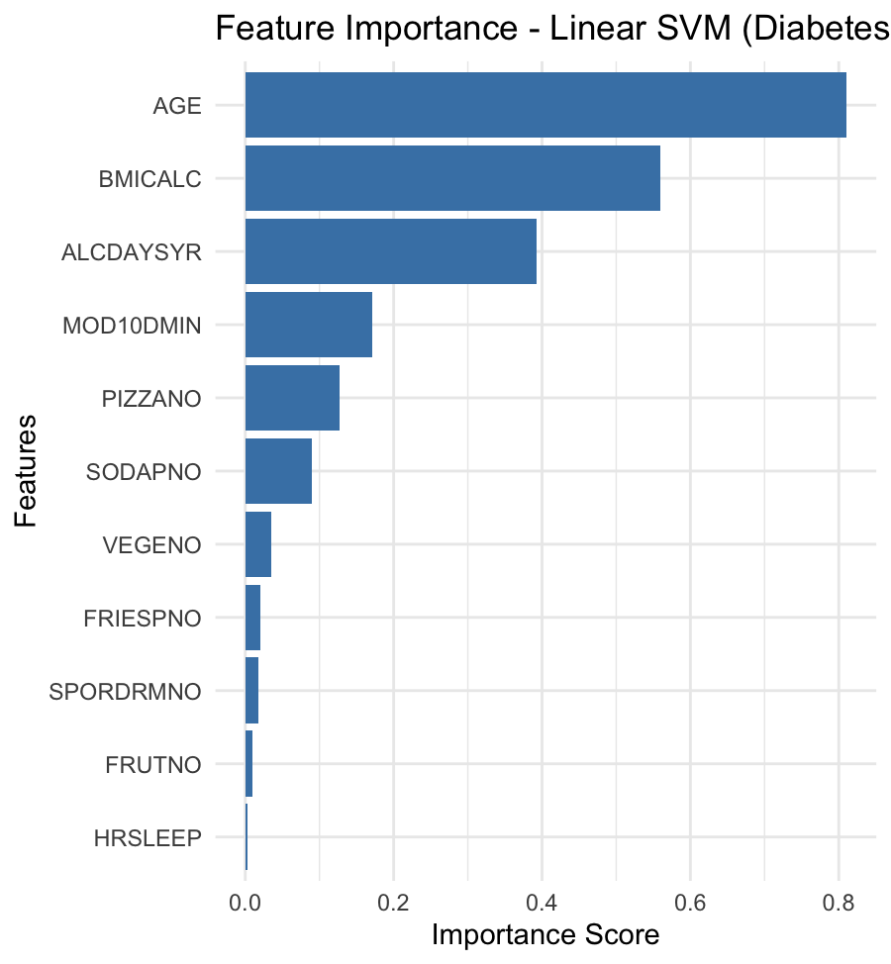
Predicting Diabetes Using Support Vector Machines (SVM)
Pavan Sai | Data Science Practical Homework 2
SEATTLE UNIVERSITY
Introduction
Goal: Predict likelihood of diabetes based on lifestyle and health factors.
Data: NHIS 2022 Adult dataset (~35,000+ records). Focus: Variables related to health (BMI, exercise, diet) and demographics (age).
Model: Support Vector Machine (Linear, Radial, Polynomial kernels).
Results
Model | Accuracy | Precision | Recall | F1 Score
Linear SVM | 0.79 | 0.25 | 0.57 | 0.35
Radial SVM | 0.80 | 0.26 | 0.50 | 0.35
Polynomial SVM | 0.85 | 0.50 | 0.003 | 0.006
Theoretical Background
What is SVM?
A supervised learning method that finds an optimal separating hyperplane.
Important Equations: Objective: (1/2) * ||w||² subject to yᵢ (wᵀ xᵢ + b) ≥ 1
Key Concepts: Hyperplane, margin maximization. Support vectors define the decision boundary. Tuning Parameters: Cost (C): Controls margin violation. Gamma (γ): For Radial Kernel. Degree: For Polynomial Kernel.
Plots
Methodology
Preprocessing:
Removed special codes (996–999).
Standardized all predictors.
Selected top predictors based on feature importance.
Model Building:
Trained Linear, Radial, and Polynomial SVMs.
Applied class weights to handle class imbalance (Diabetes Yes/No).
Tuned hyperparameters (Cost, Gamma, Degree).
Validation:
70% train / 30% test split.
Metrics: Accuracy, Precision, Recall, F1 Score.
Discussion & Conclusion
Age, BMI, and alcohol consumption were the most important predictors of diabetes. Class-weighted SVMs improved recall and F1-score, highlighting the need to handle class imbalance in health data. Nonlinear models like radial SVM better captured complex relationships, but all models agreed on core predictors.
This suggests public health efforts should focus on early screening and lifestyle support for older adults with higher BMI and alcohol intake. Even simple models, if properly tuned, can support impactful health interventions.
References
ChatGPT (2025). Background image created using OpenAI’s DALL-E.
U.S. National Health Interview Survey (NHIS) 2022. Dataset Access.
James, G., Witten, D., Hastie, T., & Tibshirani, R. (2021). An Introduction to Statistical Learning (2nd ed.). Springer.
Cortes, C., & Vapnik, V. (1995). Support-vector networks. Machine Learning, 20(3), 273–297.
American Diabetes Association. (2022). Standards of Medical Care in Diabetes—2022. Diabetes Care, 45(Supplement_1), S1–S264.

