Slide 1

Enhancing IoT Security Through Anomaly Detection and Intrusion Prevention in Cyber-Physical System
Under the Supervision of
Mrs. N. Madhuri, Asst. Prof.
Dept. CSE(AIML & CS)
Presented By: Batch No: 05
20551A4636 – Pavansai Nadella
20551A4615 – Madhavi Devarapu
20551A4627 – Katta Sri Manikanta Karthik
20551A4626 – Katari Venkata Naga Kiran
Project Presentation:Review
Branch: CSE-CSC|IV B.Tech I Sem

Slide 2
CONTENTS:
Abstract
Objectives
Introduction
Existing System
Proposed System
Modules And Methods
References

Slide 3
ABSTRACT:
A computer network may be impacted by malicious software, computer viruses, and other hostile attacks. A crucial element of network security is intrusion detection, which is an active defensive system. Traditional intrusion detection systems suffer from problems including poor accuracy, poor detection, a high rate of false positives, and an inability to handle novel forms of intrusions. The proposed method uses advanced deep learning techniques to enhance the detection of cybersecurity threats in computer networks. Unlike traditional systems, this approach overcomes issues like poor accuracy and false positives. By employing a generative adversarial network in IoT-driven networks, the method significantly improves accuracy, reliability, and efficiency in identifying various cyber-attacks such as Brute Force, DoS attacks, etc., across different datasets. Moreover, it ensures the security of sensitive user and system information throughout the training and testing processes.

Slide 4
OBJECTIVE:
This research aims to enhance computer network security by developing a novel deep learning-based intrusion detection method for cyber-physical systems. By contrasting unsupervised and deep learning discriminative approaches and employing a generative adversarial network, we seek to improve the accuracy, reliability, and efficiency of detecting various cyber threats within IoT-driven Industrial Internet of Cyber-Physical Systems (IICs) networks. Our objective is to achieve superior performance in terms of true rate and detection rate while safeguarding sensitive information integrity throughout the process.

Slide 5
INTRODUCTION:
A system called an intrusion detection system (IDS) observes network traffic for malicious transactions and sends immediate alerts when it is observed. It is software that checks a network or system for malicious activities or policy violations. Intrusion detection systems (IDS) are part of a system’s subsequent protection line.Employing a variety of benign traffic/ normal flow patterns and precise attack-specific rules, IDS can distinguish between harmful and non-malicious activity. Businesses are growing increasingly worried about securing critical infrastructure (CI), especially Internet Industrial Control Systems (IICs), as the number of devices used in IIoT based setups is continuously rising. In the literature, several intrusion detection systems (IDS) have been developed to identify online attacks on IICSs networks. However, there are some significant flaws in the methodologies and evaluation metrics of the majority of the current IDSs. To address the issues of poor detection rate and high false positive rates (FPR), we provides an effective IDS for IIoT-powered IICs utilizing deep-autoencoder-based LSTM model/method.

Slide 6
EXISTING SYSTEM:
In old models they introduced a deep neural network (DNN), a type of deep learning model, is explored to develop a flexible and effective IDS to detect and classify unforeseen and unpredictable cyberattacks. The continuous change in network behavior and rapid evolution of attacks makes it necessary to evaluate various datasets which are generated over the years through static and dynamic approaches. This type of study facilitates to identify the best algorithm which can effectively work in detecting future cyberattacks.

Slide 7
DISADVANTAGES OF EXISTING SYSTEM:
The existing work focuses on detecting and classifying unforeseen and unpredictable cyberattacks in general cyber environments.
While the existing work explores the use of a deep neural network (DNN) along with classical machine learning classifiers. Which may leads to decrease in performance in cyber attack detection.
The existing work, on the other hand, focuses on publicly available benchmark malware datasets, which may not fully capture the complexities of modern cyber-physical systems.

Slide 8
PROPOSED SYSTEM:
We propose a deep learning-based novel method to detect cybersecurity vulnerabilities and breaches in cyber-physical systems. The proposed framework contrasts the unsupervised and deep learning-based (RNN, CNN, and DNN) discriminative approaches. We presents a generative adversarial network(RBN, DBN, DBM., and DA) to detect cyber threats in IoT-driven IICs networks. Tests the performance of the proposed efficient IDS framework on IIoT IICs and exterior networks on the NSLKDD, KDDCup99, and UNSW-NB15 datasets.

Slide 9
ADVANTAGES OF PROPOSED SYSTEM:
We specifically targets cybersecurity vulnerabilities and breaches in cyber-physical systems, which may allow for a more specialized and tailored approach to threat detection.
We introduces a more diverse range of deep learning techniquesand various generative adversarial network (GAN) architectures (RBN, DBN, DBM, and DA). This broader range of approaches might lead to improved detection performance and adaptability.
We evaluates our proposed IDS framework on datasets such as NSL-KDD, KDDCup99, and UNSW-NB15. These datasets are widely recognized benchmarks in the field of intrusion detection research.
We introduces generative adversarial networks (GANs) for detecting cyber threats. GANs have shown promise in various domains for their ability to generate and discriminate data, potentially enhancing the detection capabilities in cyber-physical systems.

Slide 10
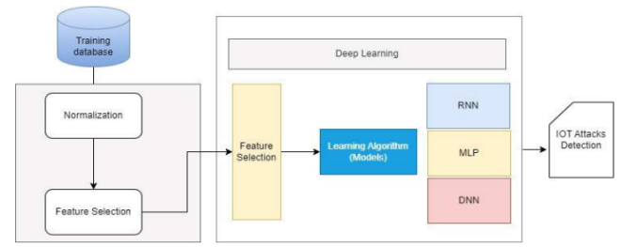
THE SYSTEM ARCHITECTURE

Slide 11
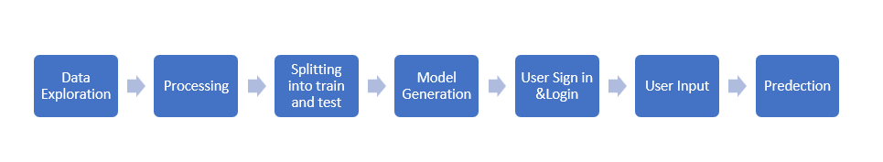
MODULES:
Data exploration: using this module we will load data into system
Processing: Using the module we will read data for processing
Splitting data into train & test: using this module data will be divided into train & test
Model generation: Model building
User signup & login: Using this module will get registration and login
User input: Using this module will give input for prediction
Prediction: final predicted displayed

Slide 12
Algorithms:
CNN: A convolutional neural network (CNN) is a specific type of artificial neural network that uses perceptrons, a machine learning unit algorithm, for supervised learning, to analyze data. CNNs apply to image processing, natural language processing and other kinds of cognitive tasks.
RNN – LSTM: Recurrent Neural Network with Long Short-Term Memory (RNN-LSTM) is a deep learning algorithm designed for sequential data analysis. It overcomes the limitations of traditional RNNs by incorporating LSTM units, which can capture long-range dependencies in data. LSTM units are equipped with memory cells and gates to control the flow of information, preventing the vanishing gradient problem. RNN-LSTM is particularly effective in tasks involving sequential data, such as natural language processing, speech recognition, and time-series forecasting, where it excels at capturing intricate temporal patterns and dependencies.
DNN: Deep neural networks (DNN) is a class of machine learning algorithms similar to the artificial neural network and aims to mimic the information processing of the brain. DNN shave more than one hidden layer (l) situated between the input and out put layers.

Slide 13
Algorithms:
RBM (CNN + BILGRU): RBM (CNN + BILGRU) is a hybrid deep learning algorithm that combines Convolutional Neural Networks (CNN) and Bidirectional Gated Recurrent Units (BILGRU). It's used for tasks like image and text processing. CNN extracts spatial features from data, while BILGRU captures temporal information bidirectionally. This fusion enhances the model's ability to handle complex patterns in both spatial and sequential data.
CNN + LSTM: A CNN processes sequence data by applying sliding convolutional filters to the input. A CNN can learn features from both spatial and time dimensions. An LSTM network processes sequence data by looping over time steps and learning long-term dependencies between time steps.

Slide 14
CONCLUSION:
Our Model discusses the involving challenges and limitations in previous studies, which have been investigating how to use deep learning in the early detection and eradication of cyber threats. We employs deep learning techniques for cyber-attack malware detection, such as identification and discriminative. However, we summarized the seven approaches, i.e., deep learning (RNN, CNN, and DNN) and generative models/methods (RBN, DBN, DBM., and DA). In addition, our investigation focuses on accuracy and provided dictionaries in the research field. The experimentation of our work demonstrates IDS and Cybersecurity attacks, which are detected successfully using a collaborative technological environment. Also, we have investigated to find which DL techniques performed better among the others. According to this analysis, the use of deep learning methods increases the investigational rate of classification intrusion while providing a robust performance of state-of-the-art supervised systems. In this scenario, a part of future work, this study extended to include advanced deep learning methods and transfer learning approaches. Moreover, the robustness of the supervised system is validated using IDS training. Thus, when designing a newfangled Intrusion Detection System (IDS), the properties can be used in the real-time system to detect internal and external intruders and their malicious behaviors.

Slide 15
Thank You

