Slide 1
RAILWAY RESERVATION SYSTEM
GROUP MEMBERS:
Utkarsh ( Reg no.210968082)
Pavan Tej ( Reg no.210968176)
Prashanth (Reg no.210968053)
Aarush (Reg no.210968066)
Kanishk ( Reg no.210968216)

Slide 2
PROJECT DESCRIPTION
We will be implementing the ability to reserve and modify railway tickets.
We will use
Linked List Operations
Searching Algorithm
Sorting Algorithms
To modify and print the data according to user’s needs. This project is simple to use and very user-friendly. It has minimal hardware and software requirements, and no training is needed for using it.

Slide 3
Project Scope
The scope of this project is to help a user reserve and modify their tickets without any hassle. This program will allow a user to reserve a ticket, edit their personal details, ask for a refund or cancel booking and view the reserved ticket. An Admin Panel will allow admins to View all the booked tickets, Add or Remove scheduled trains and Modify/Cancel a Ticket on User Request.
We have 2 modules in this scenario, where a user or the passenger, has their own options while admin has to login separately before having their own options. It works from the entering of user details, to payment, to printing of tickets and other operations are available as well.

Slide 4
Modules in Project
This program has 2 Modules:
User Module: This module is for user or the passenger to book their ticket, make payments for ticket directly, modify their ticket, ask for a refund, and print/generate their ticket.
Admin Module: This module allows admins to View all the booked tickets, Add or Remove Trains and Modify a ticket or remove it on a passenger’s request.

Slide 5
DATA STRUCTURES USED
Linked List Operations are used as they have no fixed size and values can be added constantly and data can be collected or called without affecting earlier or later values.We have mainly used linked list as insertion(reserving a ticket) and deletion (cancelling a tickets) are more is efficient.
Searching algorithm is used to search a train and its corresponding values
Sorting Algorithm to used to sort the data about train and tickets

Slide 6
METHODS USED:
Admin() – for accessing and using Admin Portal
Payment()-Regarding payment of tickets
Trainsort()-Sorting Train According to time
SeatChoose()-Choosing of seat while reserving
iniTrain()-Available Trains
trainFill()-For adding new train
trainPrice()-For creating different class type tickets(economy, first class, business class)
Reserveticket()-For reservation of ticket
Viewticket()-For viewing Booked tickets
Display()-For displaying all info
Editdetails()-Editing info
addTrains()-Adding new trains in admin portal

Slide 7
Project Features:
User Module:
Reserve a Ticket: Allows user to Reserve Tickets for available trains on desirable dates. We will be using linked list operations to insert ticket details. –
Choose Payment Methods & Pay: Allows user to pay for the ticket using Credit Card Details. We will use simply hard-coded Input/output for this feature as there is no other way to check Credit Card details i.e. No Databases used.
Cancel/Refund Booked Tickets: Allows user to Cancel and Refund your tickets. - We will be using linked list to delete ticket details. We will use searching algorithms to search and delete.
Edit Booked Tickets Personal Details: Allows user to Edit Personal Details from your Booked Ticket. We will use searching algorithms to search and edit. We will be using linked list operations to edit ticket details.
Print the Tickets: Prints on screen your ticket details for viewing and printing. - We will be using linked list operations to display ticket details. We will use searching algorithms to search and print
Admin Module:
View All Booked Tickets: Allows Admin to View All Booked Tickets saved. We will be using linked list operations to display all tickets details.
Add or Remove Trains: Add or Remove Available Trains from Database. We will be using linked list operations to display all trains details.
Modify Booked Tickets (based on User Requests): Tickets booked can be modified. We will be using linked list operations to edit ticket details.

Slide 8
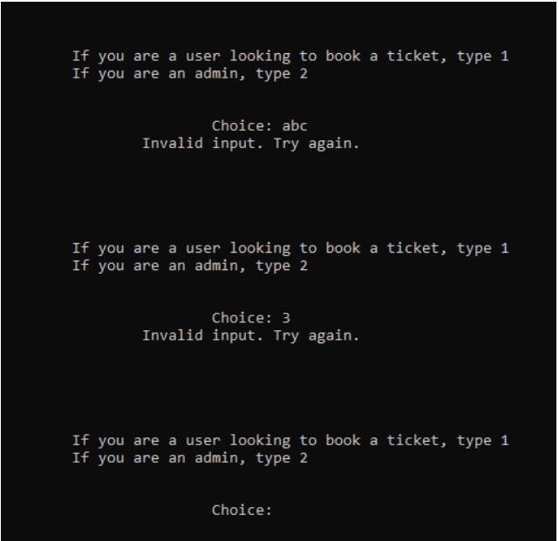
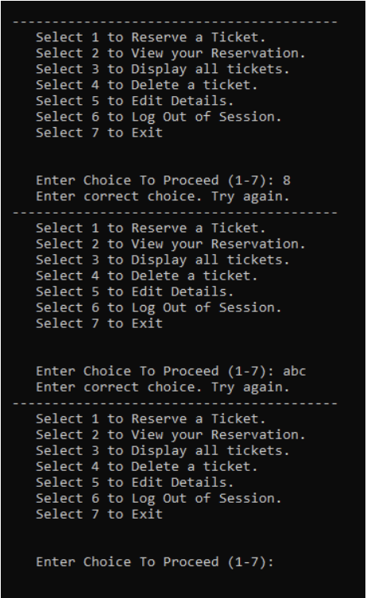
SCREENSHOT FOR INVALID INPUT CHECKING:

Slide 9
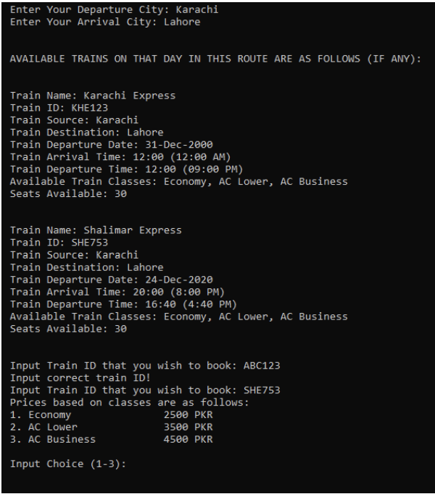
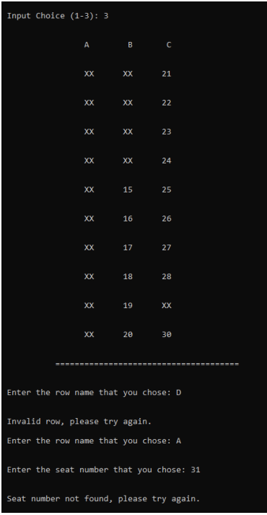
SCREENSHOT FOR INPUT CHECKING:

Slide 10
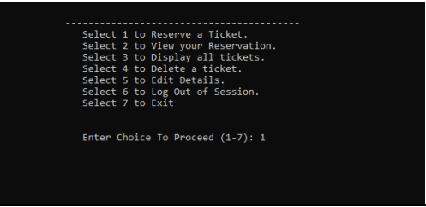
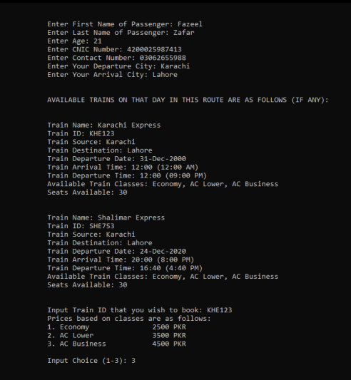
SAMPLE SCREEN SHOTS OF SYSTEM: USER PANEL: RESERVE TICKET:

Slide 11
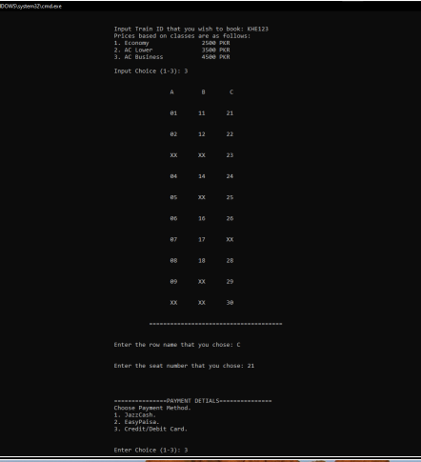
.
.
.

Slide 12
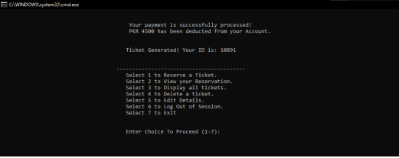
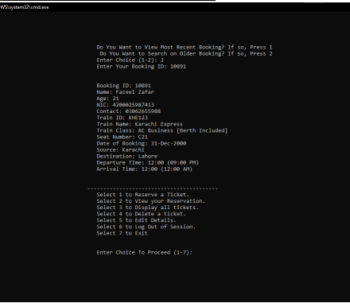
.
TICKET GENERATED
VIEW TICKET THROUGH SEARCHING

Slide 13
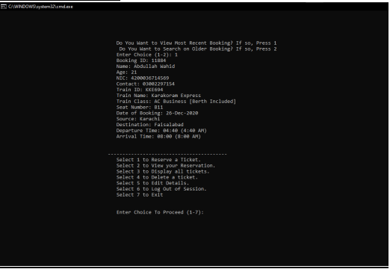
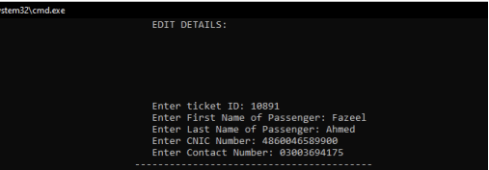
.
VIEW RECENT TICKET
EDIT DETAILS

Slide 14
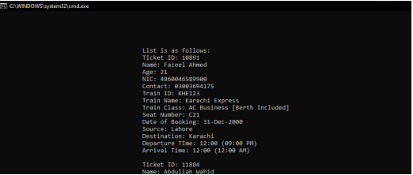
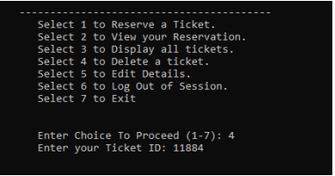
SEARCH AFTER EDITING
DELETION

Slide 15
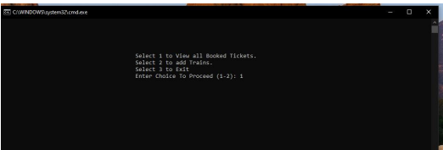
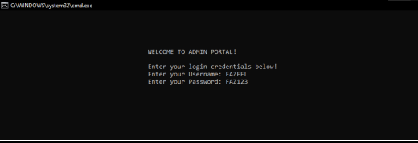
ADMIN:

Slide 16
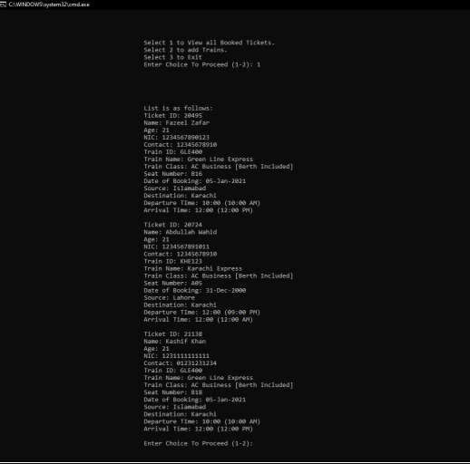
VIEWING TICKETS AS ADMIN

Slide 17
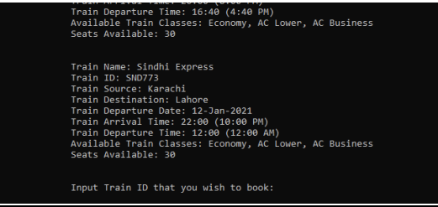
AFTER ADDING THAT TRAIN:

Slide 18
CONTRIBUTION AND SOURCES
UTKARSH-Cancelling and editing ticket details
PAVAN TEJ-Admin modules and implementation of methods
PRASHANTH- Admin module and errors ,PPT Presentation
AARUSH-Payment Methods ( Implementation of Methods),PPT Presentation
KANISHK-Compilation Errors and Ticket Reservation
SOURCES-
STACK OVERFLOW
GEEKSForGEEKS
Coursera
Youtube Videos

