Slide 1



STUDENT MANAGEMENT SYSTEM IN C USING LINKEDLIST

Slide 2

Hello!
NAME: Sk Mabud Alam
USN: 1NH20CS188
SEM: III
SECTION: 3D
Department: CSE
College: New Horizon College of Engineering

Slide 3
1. Objective Of Project
This is a simple project made in c using Linkedlist.It’s based on the concept of managing student’s record. This mini project contains limited features, but the essential one. This project is helpful for managing student information by adding, updating, removing, viewing and searching for details.
Create student record – the user can create a student record attendance.
Modify student record – the user can modify a student record information.
Delete student record – the user can delete a student record information.
Search student record – the user can search a student record information.
Display student record – the user can display a student record information.
Exit – For the exit, the user can also exit in the system.

Slide 4
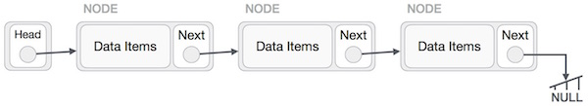
2. Data Structure
In this Project ,LinkedList is used to manipulate all data operations.
Linked List is a sequence of links which contains items. Each link contains a connection to another link.

Slide 5
2. Type of Data Stored
Integer Type data for Roll Number
Float type data for Percentage
Character type data for Name
Character type data for Phone Number

Slide 6


4. Modules
Add Data ()
Search Data()
Update Data()
Delete Data()
Display Data()

Slide 7
4A. Modules Details
Add Data ()
I created a function Add Data(), which will add a new node to the linked list. This function accepts student details as an argument. Then it creates a new node with the student details passed to the function and then inserts the new node at the beginning of the linked list.
Search Data()
The search function searches the record based on the roll number. It receives one argument roll number. This function traverse through LinkedList.
Update Data()
The update function first searches for the node with the required roll number. If the node is found, the program asks the user to enter new updated values.

Slide 8
4B. Modules Details
Delete Data()
Delete Data() function searches the record on the roll number.
It receives one argument roll number. This function traverse through LinkedList. When it finds the node then it deletes it from LinkedList.
Display Data()
Display function traverse the linked list and print all the details of each node of the linked list.

Slide 9
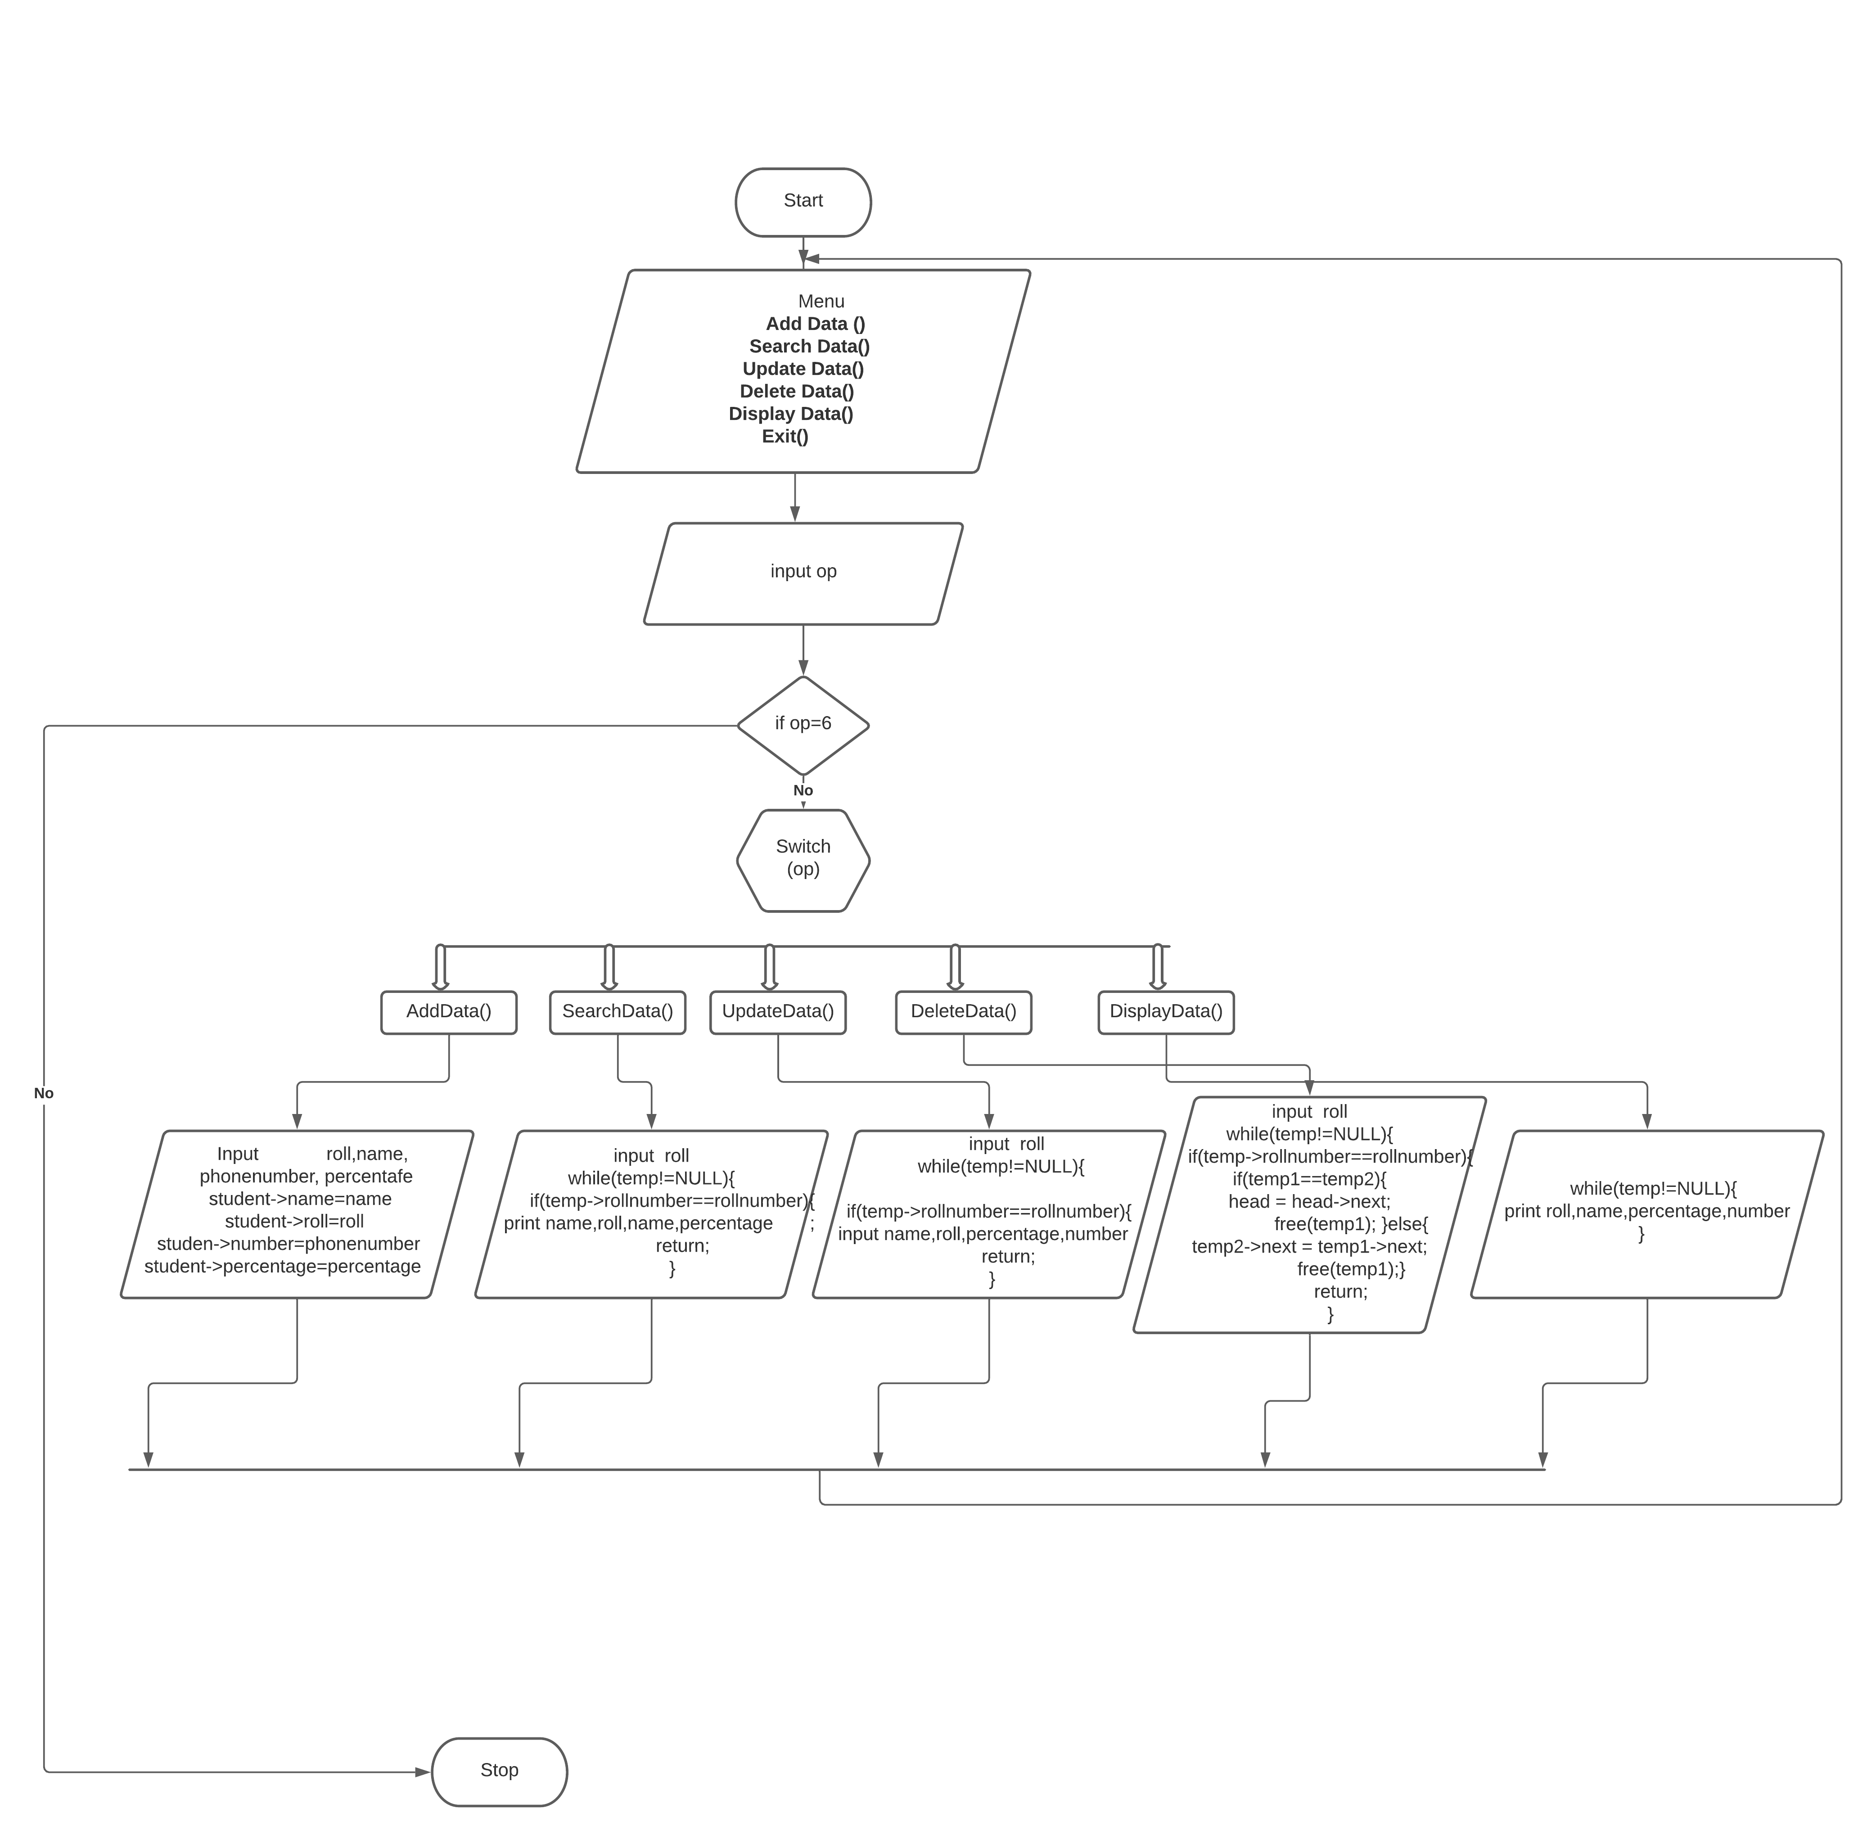
5. Flow chart

Slide 10
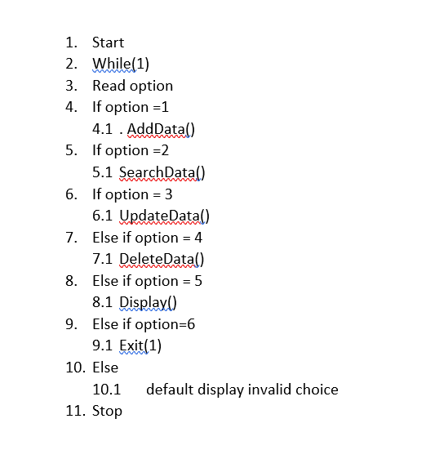


6. Algorithm

Slide 11
Thanks!

