Slide 1
Bot-IoT Dataset Graph Representation using NetworkX
Aliyev Abdulla
Taghizade Rahman
Shamsudinov Nail
Kuznetsov Pavel

Slide 2
INTRODUCTION
Python modules:
Pandas - data manipulation
Matplotlib - visualization
NetworkX - graph-based analysis

Slide 3




TABLE OF CONTENTS
01
02
03
DATASET DESCRIPTION
GRAPH VISUALIZATION
PATH FINDING ALGORITHM
04
05
COLOR
REPRESENTATION
NETWORK
ATTRIBUTES

Slide 4
01
DATASET DESCRIPTION

Slide 5
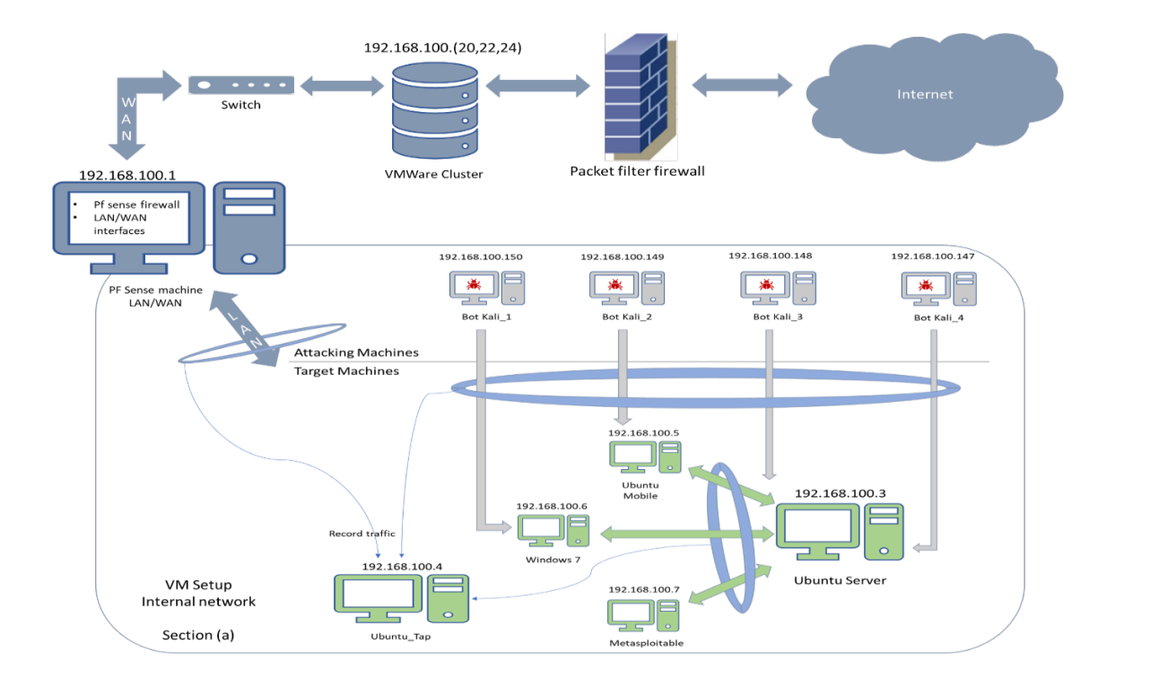

Slide 6
Network Structure
The Topology
4 Kali machines (192.168.100.147-150)
Regular machines (192.168.100.5-7)
Ubuntu Tap (192.168.100.4)
Ubuntu Server (192.168.100.3)
IoT Services (local and cloud)
Weather station
Smart fridge
Motion-activated light
Garage door
Smart thermostat.

Slide 7
Total Dataset Size
}
72’000’000 total
1’000’000 per file
150’000 selected
300 for graphs
requests

Slide 8
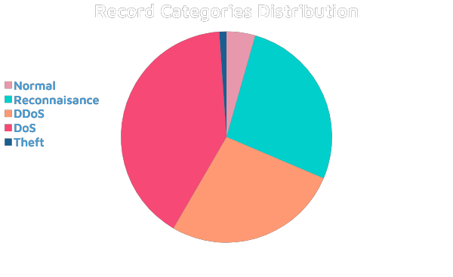
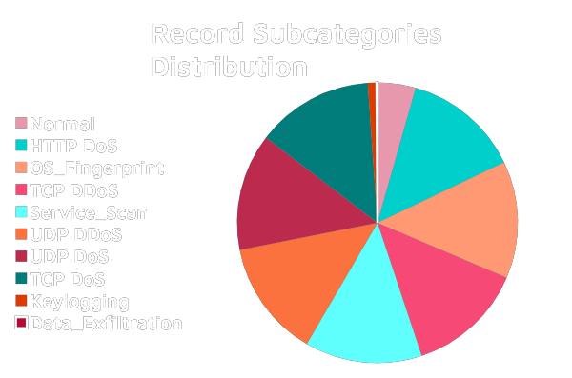
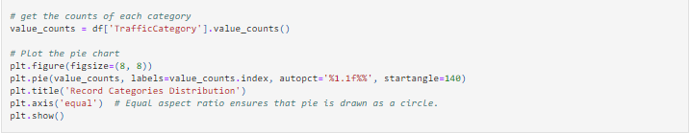
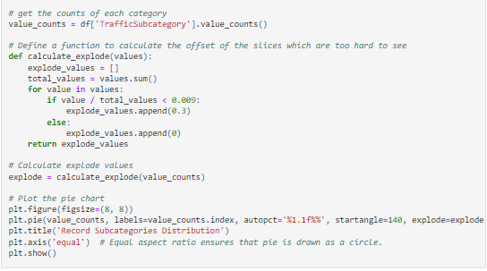
Attack Categories

Slide 9
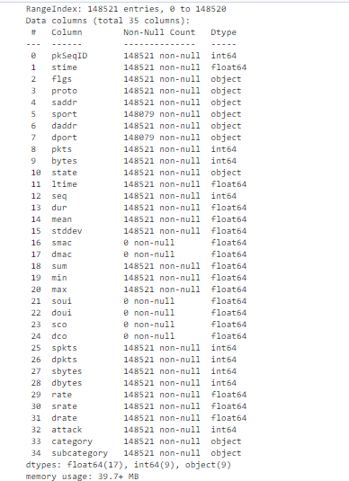
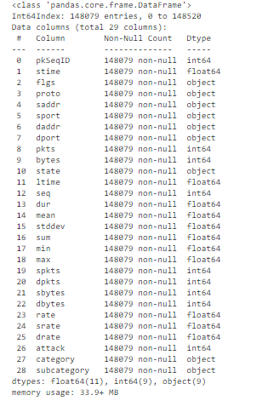
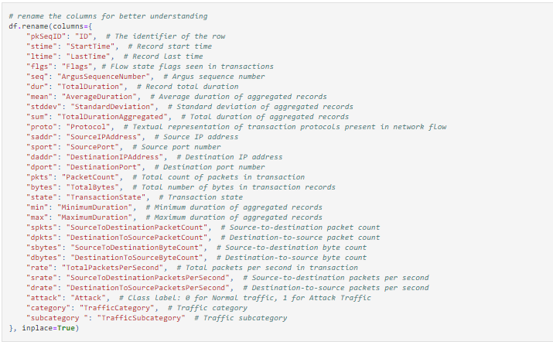
Removing Null values
Renaming the columns

Slide 10
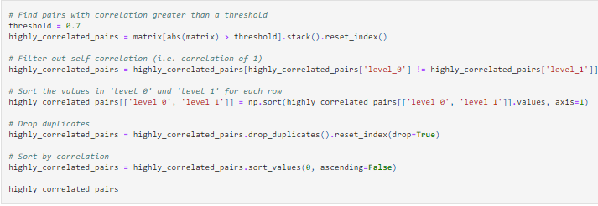
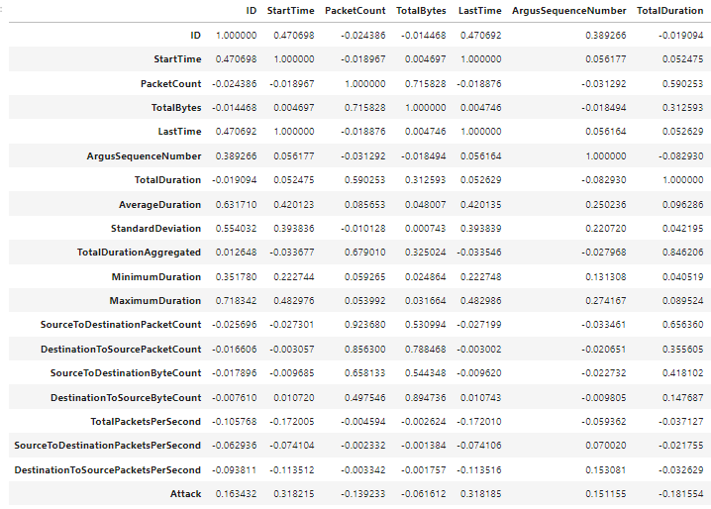
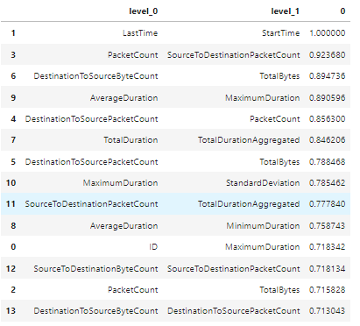
Correlation Matrix

Slide 11
02
GRAPH VISUALIZATION

Slide 12
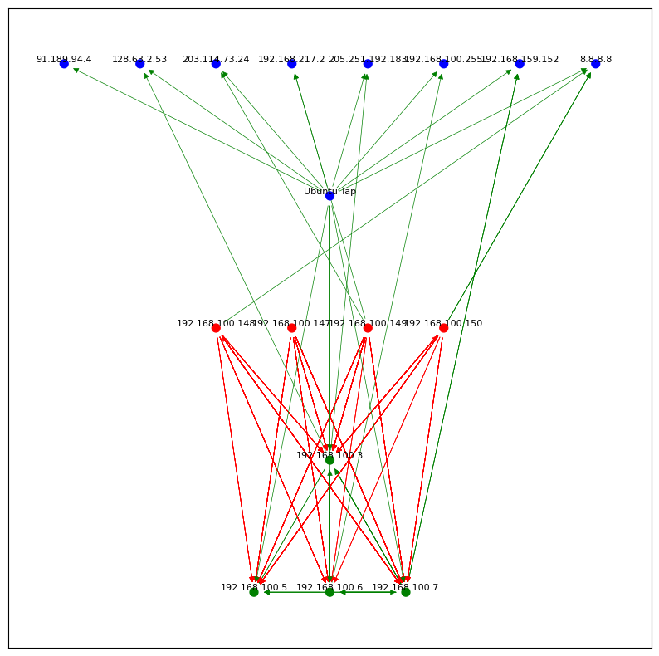

The graph consists of 5 layers:
The attacked devices
The attacking Kali machines
Ubuntu Tap
Cloud IoT devices

Slide 13
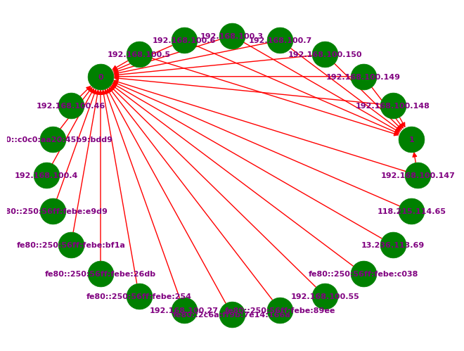
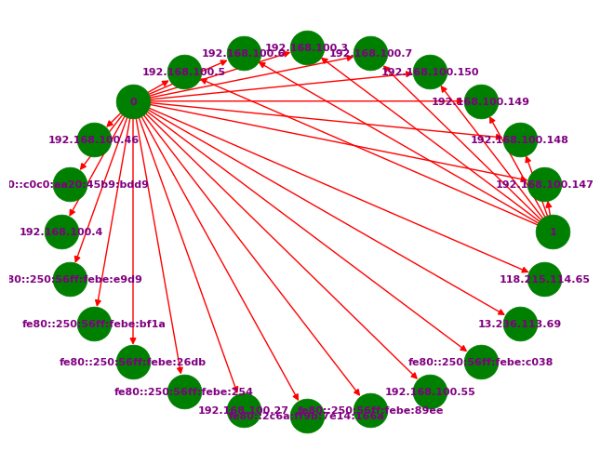
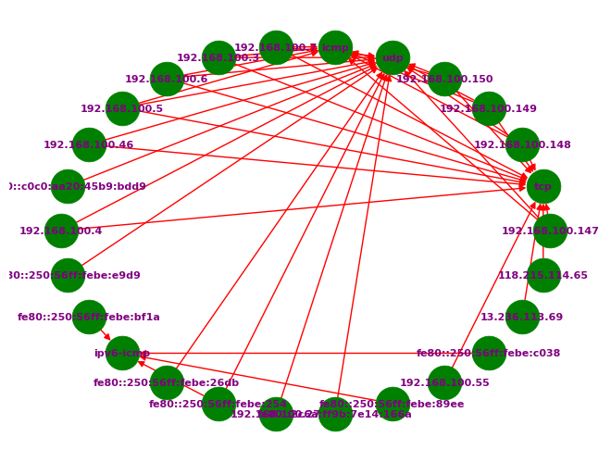



First representation uses “IP” as a node and an event as edges.
Second representation uses event (row) as a node.
Third representation uses any attribute that you decide as a node.

Slide 14
03
PATH FINDING ALGORITHM

Slide 15
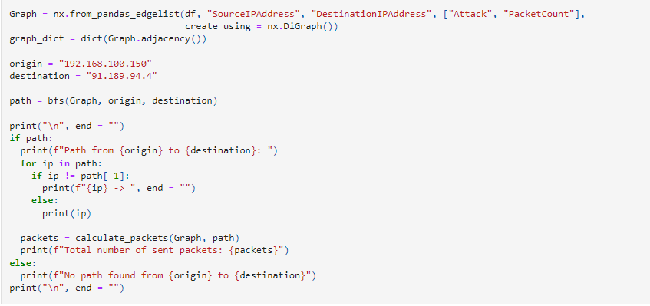

The Breadth First Search Algorithm
Packet count as weights

Slide 16
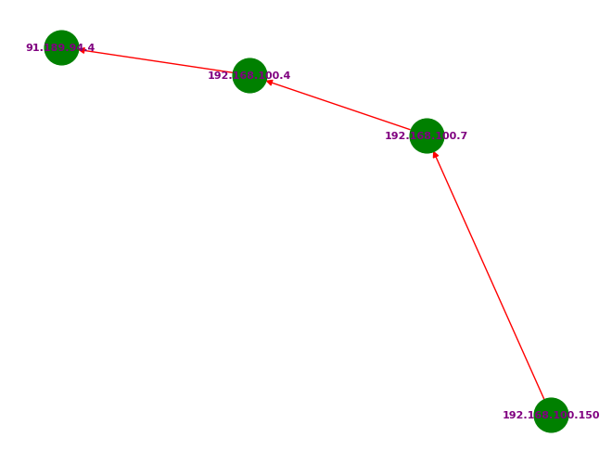
The Breadth First Search algorithm visualization

Slide 17
04
COLOR REPRESENTATION

Slide 18
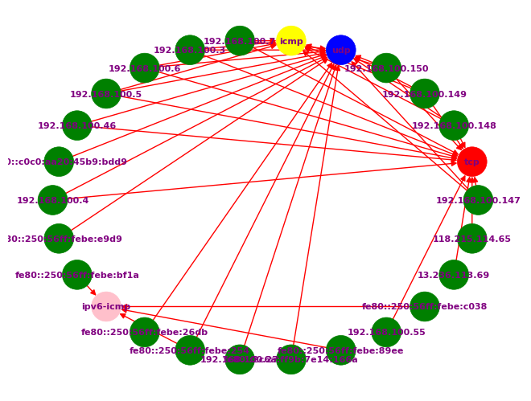
Protocol
Difference

Slide 19
05
NETWORK ATRIBUTES

Slide 20
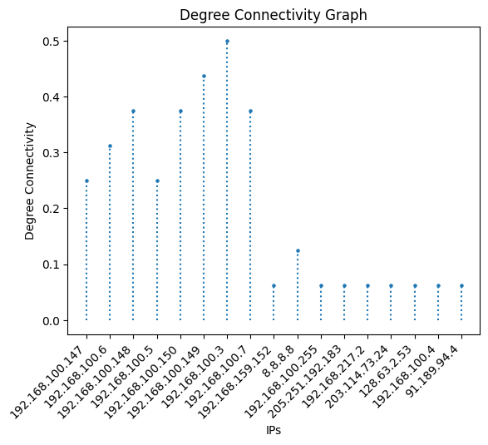
Degree connectivity
Ubuntu Server
Kali Linuxes
Defending devices
Cloud Services

Slide 21
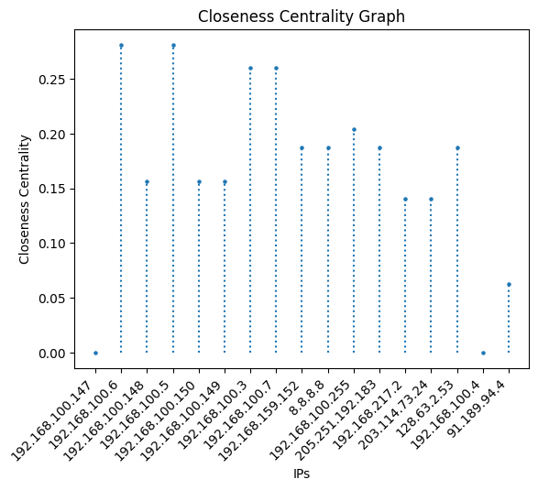
Closeness Centrality
Ubuntu Server
Defending devices
Attacking devices
Cloud Services

Slide 22
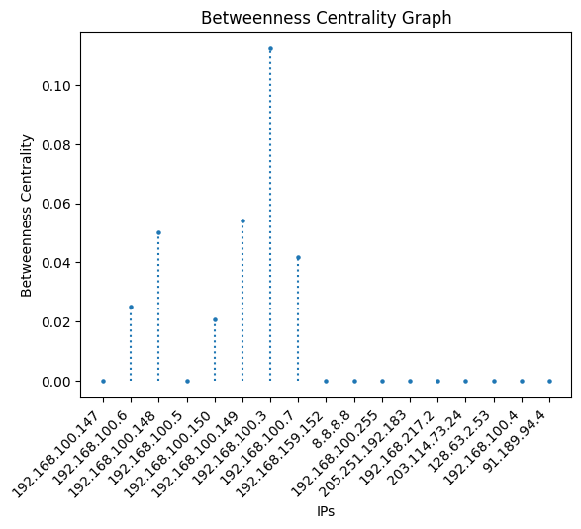
Betweenness Centrality
Ubuntu Server
Attacking Devices

Slide 23
NETWORK DENSITY | 0.10294117647058823 | Network density is the ratio of the number of edges in the network to the number of possible edges in the network.
NETWORK DIAMETER | 3 | Network diameter is the longest shortest path between any two nodes in the network.
NETWORK AVERAGE PATH LENGTH | 1.7 | Network average path length is the average shortest path length between any two nodes in the network.

Slide 24

Metrics Summary
The Ubuntu Server (192.168.100.3) has the highest degree connectivity, closeness centrality and betweenness centrality, as it is the most central node in the network.

Slide 25
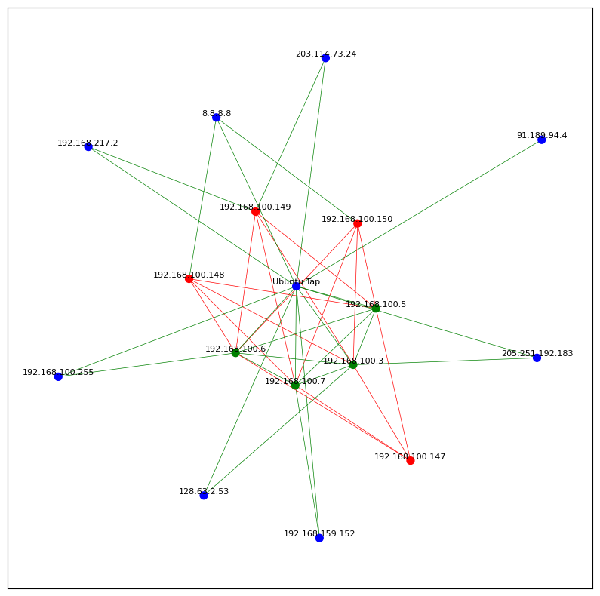
Other Representations
Spring Layout

Slide 26
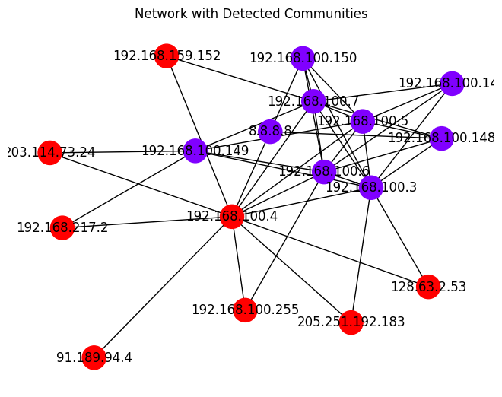
Graph Analysis
Layers:
WAN
LAN

