Slide 1
prefetch
Get Data from NCBI
vdb-validate
Validate data
Bismark
Mapping
wgbs2bed
Get coordinates
CG ± flank
parallel-fastq-dump
Extract FASTQ
samtools sort
Sorting
bedtools getfasta
Get sequences
FastQC
Quality Control
deduplicate_bismark
Remove PCR
duplicates
computeFlanks
Compute
flanking sequences
Trim Galore
Adapter/Quality
Trimming
bismark_methylation
extractor
Methylation call
analyseFlanks
Downstream
analysis
FastQC
Quality Control

Slide 2
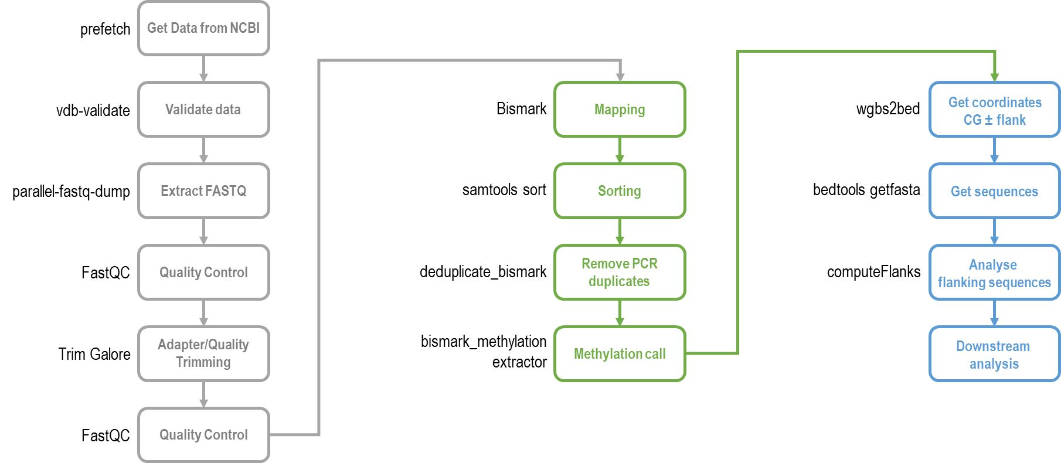

Slide 3


