Slide 1
DATA & AI · RISK MODELING
Predicting High-Risk
Insurance Customers
An explainable risk model — and a self-serve app the whole underwriting team can use.
AUROC 0.7803 · 60,000 customers · Explainable + GenAI-assisted
Submitted by Pavel Daulat Bodle
Senior AI Engineer
🔗 linkedin.com/in/pavelbodle 🐙 github.com/pavelbodle 📧 paveliitb@gmail.com
Notes:
WHAT TO SAY: Open with the thesis in one line — "I built an explainable model that flags high-risk customers, and wrapped it in a self-serve app so underwriters, not just data scientists, can use it." Give the headline number: AUROC 0.78, and the surprise — the SIMPLEST model won. Tell them the agenda: the data and stats, the model choice, the business call on the threshold, and a live demo of the app plus a GenAI assistant. Keep it to ~30 seconds and move on.

Slide 2
THE BUSINESS PROBLEM
Every mis-priced high-risk customer hurts the loss ratio
Insurers win or lose on one number: the loss ratio (claims paid ÷ premiums earned). If high-risk customers are approved at standard prices, claims rise and margins erode. The goal: flag high-risk applicants early — accurately, and in a way underwriters can trust and explain.
THE LEVER
Loss Ratio
Claims paid
Accuracy Rank customers by true risk so pricing matches exposure.
Premiums earned
Explainability Regulators and customers require a transparent reason for each decision.
A single missed high-risk customer can cost 10× an over-cautious flag. The model is how we manage that asymmetry.
Usability Underwriters — not only data scientists — must be able to use it day to day.
High-Risk Customer Prediction · Pavel Bodle
2
Notes:
WHAT TO SAY: Frame the stakes in business language before any statistics. Define the loss ratio in one sentence — claims divided by premiums — and say the model exists to price risk correctly so that ratio stays healthy. Name the three goals: accuracy, explainability, usability. Plant the key asymmetry now — a missed high-risk customer costs roughly 10× an over-flag — because it pays off on the threshold slide.

Slide 3
THE DATASET
The data at a glance
60,000
45.68%
5%
100
Customers (rows)
Are high-risk
Income values missing
Impossible ages fixed
nearly balanced
imputed w/ median
age = 200 → capped
8 predictors
age
health_score
has_chronic_disease
bmi
annual_income
past_claims_amount
policy_type
First read: the target is close to a 46 / 54 split — not the extreme imbalance these problems usually assume. That honesty shapes every downstream choice (see the metrics discussion). Only two features carry real signal.
High-Risk Customer Prediction · Pavel Bodle
3
Notes:
WHAT TO SAY: Walk the four big numbers left to right. Then raise the two nuances that show senior judgment: income is symmetric so mean ≈ median (a rule that does not actually apply here), and the target is ~46% positive — near balanced, not extreme imbalance. Finally, mention you caught 100 impossible age = 200 values and capped them; profiling before modeling is basic hygiene that protects a production model.

Slide 4
APPROACH
A disciplined, reproducible pipeline
1
2
3
4
5
Explore & clean
›
Test hypotheses
›
Model bake-off
›
Business insight
›
Productise
Profile, fix age outliers, median-impute income
t-test, Chi-square, correlation & VIF
LogReg vs Random Forest vs Gradient Boosting
Drivers, odds ratios, threshold economics
Streamlit app + GenAI assistant
Everything is scripted in analysis.py — one command reproduces every number and chart in this deck.
High-Risk Customer Prediction · Pavel Bodle
4
Notes:
WHAT TO SAY: Five steps, one script. The message here is rigor and reproducibility — a single command regenerates every number and chart, so the deck, the written answers and the app can never disagree. Emphasize that clean → test → model → insight → product is a repeatable workflow, not a one-off notebook.

Slide 5
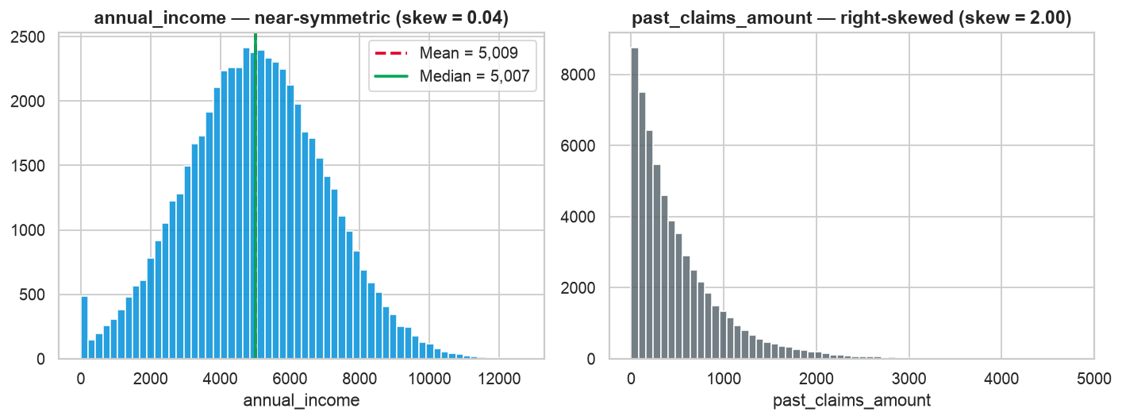
Q1 · PREPROCESSING
Mean or median? Measure first, then decide
Skew ≈ 0.04 annual_income is near-symmetric, so mean ≈ median (5009 vs 5007).
Use the median Robust to outliers and never harmful — the safe default even when skew is mild.
The real skew past_claims_amount is genuinely right-skewed (skew 2.002).
Figure: annual_income is symmetric; past_claims_amount is the skewed one.
Senior read: the "median-because-skew" rule is not actually load-bearing here — proving it with the number is the point.
High-Risk Customer Prediction · Pavel Bodle
5
Notes:
WHAT TO SAY: The answer is the median, but the real point is method — I measured the skew instead of assuming it. It is 0.04, essentially symmetric, so mean and median are basically identical here and the choice barely matters. The genuinely skewed column is past_claims_amount. Showing you do not apply textbook rules blindly is the takeaway.

Slide 6
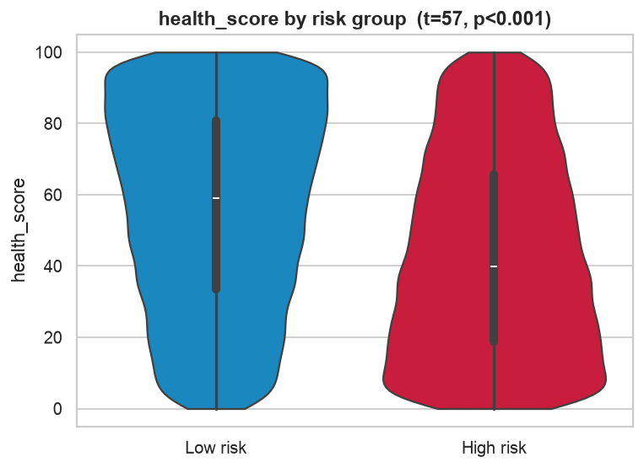
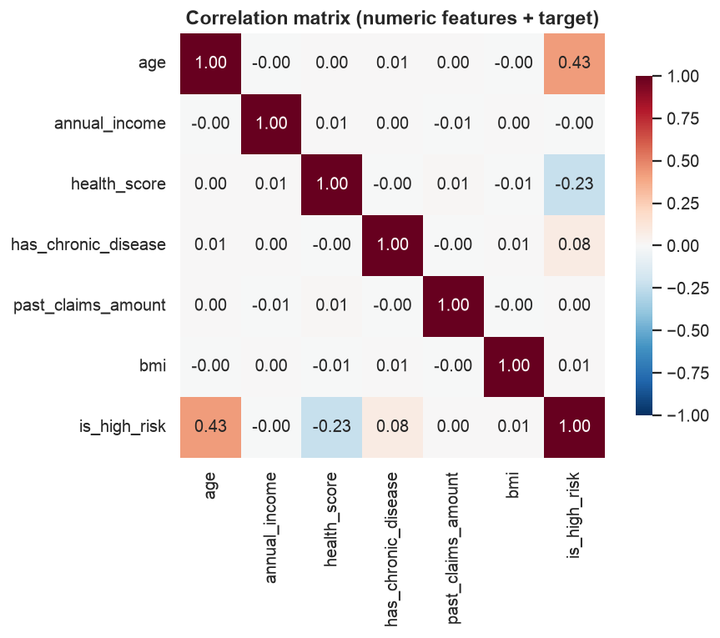
THE CORE INSIGHT
Two features tell almost the whole story: age & health
WHAT DRIVES RISK
Age +0.428 risk climbs 21% → 67% with age Health -0.227 protective; strongly significant Income · BMI · claims ≈ 0 essentially noise
Left: health_score cleanly separates the two groups. Right: only age & health_score correlate with the target.
High-Risk Customer Prediction · Pavel Bodle
6
Notes:
WHAT TO SAY: This is the slide to linger on — it is the core finding. Two features drive risk: age pushes it up, health score pulls it down, and everything else is essentially noise. The business translation is concrete: focus underwriting scrutiny on age and health; do not let income or BMI sway decisions on this data. If asked, note this pattern strongly suggests a synthetic dataset built mainly from age and health.

Slide 7
Q2 · STATISTICAL VALIDATION
We tested every claim before trusting it
WELCH'S T-TEST
CHI-SQUARE
VIF
t = 57
χ² = 431
≈ 1.0
health_score vs risk
chronic disease vs risk
multicollinearity check
p < 0.001. Mean 43.14 (high-risk) vs 56.27 (low). Highly significant.
p < 0.001 → significant. policy_type is NOT (χ²=1.12, p=0.57).
All predictors mutually uncorrelated (VIF≈1; >5 is a problem). No features dropped; L2 regularization as safeguard.
High-Risk Customer Prediction · Pavel Bodle
7
Notes:
WHAT TO SAY: Show you pick the right test for each data type — Welch t-test for a continuous feature vs a binary target (Welch because variances are not assumed equal), Chi-square for categoricals, VIF for multicollinearity. The honest findings matter: policy_type has NO relationship with risk (p = 0.57), and there is no multicollinearity to fix (all VIFs ≈ 1). I still used L2 regularization as a safeguard.

Slide 8
Q3 · MODEL SELECTION
The simplest model wins — and it is the most explainable
Model | AUROC | F1 | Acc
Logistic Reg. ✓ | 0.7803 | 0.6739 | 0.7108
Gradient Boost | 0.7796 | 0.669 | 0.706
Random Forest | 0.7624 | 0.6657 | 0.7015
Why F1 / AUROC over Accuracy?
• Errors are not equally costly — a miss hurts the loss ratio far more. • AUROC is threshold-free, so we can pick the operating point by business cost.
Explainability: each coefficient is an odds ratio an underwriter can read — auditable for regulators.
High-Risk Customer Prediction · Pavel Bodle
8
Notes:
WHAT TO SAY: The punchline — Logistic Regression ties Gradient Boosting on AUROC and beats Random Forest, while being far more explainable, so complexity is not justified. Explain the metric choice: because errors are asymmetric and AUROC is threshold-free, I lead with AUROC and F1, not accuracy. And every coefficient is an odds ratio an underwriter or regulator can read — that is the explainability insurance requires.

Slide 9
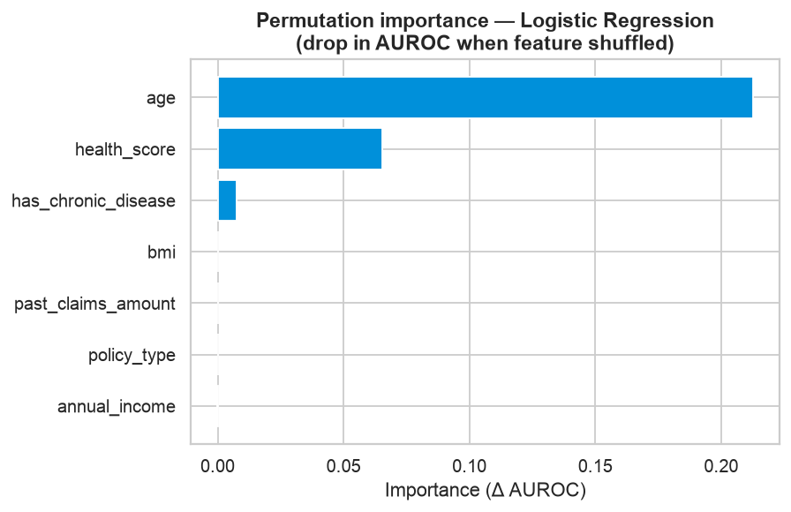
Q4 · BUSINESS INSIGHT
What moves the prediction — in plain odds
×2.905
age per +1 SD, odds of high-risk ~triple
×0.552
health_score protective — higher score lowers risk
×1.241
has_chronic_disease a smaller upward push
Odds ratios come straight from the model coefficients — this is the explainability underwriters and regulators need.
High-Risk Customer Prediction · Pavel Bodle
9
Notes:
WHAT TO SAY: Translate the model into business language. Per one standard deviation of age, the odds of high-risk roughly triple; health score is protective (odds ×0.55); chronic disease adds a smaller push. These numbers come straight from the coefficients — no black box. Permutation importance (the chart) confirms the same ranking.

Slide 10
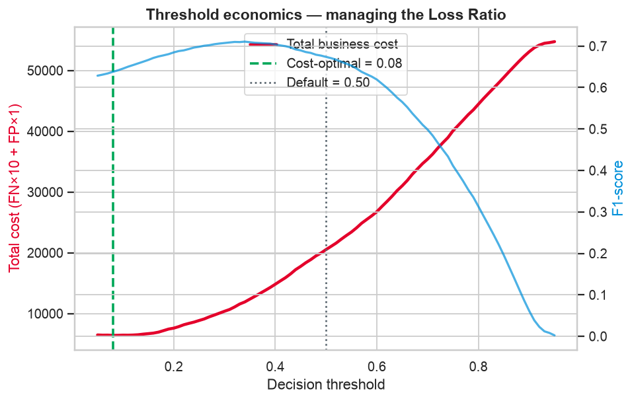
Q4 · THE BUSINESS LEVER
Should we raise or lower the threshold? Lower it.
A miss ≫ an over-flag Approving a truly high-risk customer at standard price inflates future claims.
Lower the threshold Cast a wider net so fewer risky customers slip through to standard pricing.
Cost-driven optimum At a 10:1 miss-to-over-flag cost, the loss-minimising threshold falls to ≈ 0.08.
In the app, managers set the cost ratio with a slider and watch the optimal threshold move in real time.
High-Risk Customer Prediction · Pavel Bodle
10
Notes:
WHAT TO SAY: This is the business decision. Lower the threshold below 0.50, because a missed high-risk customer hurts the loss ratio far more than an over-flag. The optimum is cost-driven; at a 10:1 cost ratio it lands around 0.08. Be honest that 0.08 is aggressive and illustrative — in production you calibrate the ratio to real claim costs. That is exactly why the app makes the threshold a live business dial, not a fixed statistic.

Slide 11
FROM MODEL TO PRODUCT
A self-serve app for non-technical underwriters
Predict a customer Move sliders → instant risk score, gauge, and plain-English reason.
🎯
WHY IT MATTERS
The model leaves the notebook
Portfolio explorer Filter 60k customers by age & health band; see high-risk rates live.
📊
✓ Deployable free on Streamlit Cloud ✓ Dynamic sliders — no code to explore ✓ Every score comes with a reason ✓ Owned by the whole team, not just DS
Threshold economics Set miss/over-flag costs; find the loss-minimising threshold.
💰
The data story The EDA charts with one-line takeaways for any audience.
📈
AI assistant Ask questions in natural language — answers grounded in real numbers.
🤖
High-Risk Customer Prediction · Pavel Bodle
11
Notes:
WHAT TO SAY: This answers the "usable by non-technical people" requirement directly. Five tabs take the model out of the notebook and into an underwriter's hands. If you can, switch to the live app right here and demo — predict a customer, open the SHAP view, load a random real customer, then flip to the threshold and portfolio tabs.

Slide 12
THE OPTIMIZATION: GENAI
ML score + LLM = trusted, conversational underwriting
① Decision narrator
② Underwriting chatbot
Turns the risk score + drivers into a plain-English explanation an underwriter can trust: "High-risk (72%), driven mainly by age 78 and a low health score of 41…"
Managers ask in natural language — "high-risk rate for customers over 60?" — and get an instant answer. Numbers are computed in Python first, then phrased by the LLM.
Directly reinforces the explainability theme.
No hallucinated statistics — a responsible-AI pattern.
Grounded by design: the LLM only verbalizes numbers the model and data produce. Free to run (Groq), and it degrades gracefully to exact template text if the AI is offline — so a live demo never breaks.
High-Risk Customer Prediction · Pavel Bodle
12
Notes:
WHAT TO SAY: This is the GenAI optimization. The one idea to land is GROUNDING — the LLM never computes a number; pandas computes it and the LLM only phrases it, so there are zero hallucinated statistics. That makes GenAI safe in a regulated setting. It runs free on Groq (Llama 3.3 70B) and falls back to exact template text offline, so the demo cannot break. Frame it as responsible AI, not a gimmick.

Slide 13
RECOMMENDATIONS
What we recommend next
Adopt
Ship the explainable Logistic Regression as the production scorer; keep gradient boosting as a challenger.
Tune
Operate below a 0.50 threshold, calibrated to the current loss-ratio target; review quarterly.
Focus
Direct underwriting scrutiny to older / lower-health segments; de-emphasise income & BMI (no signal).
Enable
Roll out the app + GenAI assistant to underwriting teams as day-to-day decision support.
High-Risk Customer Prediction · Pavel Bodle
13
Notes:
WHAT TO SAY: Close the analysis with four concrete actions in business language: adopt the explainable model, tune the threshold to the loss-ratio target, focus scrutiny on age/health segments, and roll the app out to teams. Add the responsible-use caveat: this is a screening aid with a human in the loop, not an automatic decline engine.

Slide 14
Thank you
Accurate where it counts · explainable by design · usable by everyone.
AUROC 0.7803 · Streamlit app + GenAI assistant · fully reproducible
Submitted by Pavel Daulat Bodle
Senior AI Engineer
🔗 linkedin.com/in/pavelbodle 🐙 github.com/pavelbodle 📧 paveliitb@gmail.com
See the appendix for all links (app, repo, documents).
Notes:
WHAT TO SAY: Recap the three pillars in one breath — accurate where it counts, explainable by design, usable by everyone — then open for questions. Point them to the appendix for the app, repo and document links. If time allows, end on the live app rather than this slide.

Slide 15
APPENDIX
Links & deliverables
🚀
Live app (Streamlit Cloud)
‹ paste your deployed app URL here ›
💻
GitHub repository
github.com/PavelBodle/metlife-high-risk-app
📄
Answers document (Q1–Q4)
‹ link or attached file ›
🖥️
Insights deck (this file)
‹ link or attached file ›
📚
Technical / interview guide
‹ link or attached file ›
🔗
LinkedIn
linkedin.com/in/pavelbodle
📧
Email
paveliitb@gmail.com
Replace the placeholders above with your live links before presenting.
Notes:
WHAT TO SAY: Keep this slide up during Q&A so reviewers can find everything. Before the interview, fill in the deployed Streamlit app URL and confirm the GitHub link, and attach or link the answers document, this deck and the technical guide. This is your one-stop reference slide.

