Slide 1



XAML Controls
Doncho Minkov
Technical Trainer
http://minkov.it
Telerik Software Academy
http://academy.telerik.com

Slide 2
Table of Contents
XAML Controls
Text controls
Buttons
List controls
GroupBox and Expander
Menus
Toolbars

Slide 3

Table of Contents
XAML Controls
Text controls
Buttons
List controls
GroupBox and Expander
Menus
Toolbars

Slide 4

Table of Contents
Other controls
Slider and Scroll controls
ProgressBar
ToolTip
Custom User Controls

Slide 5

XAML Controls

Slide 6
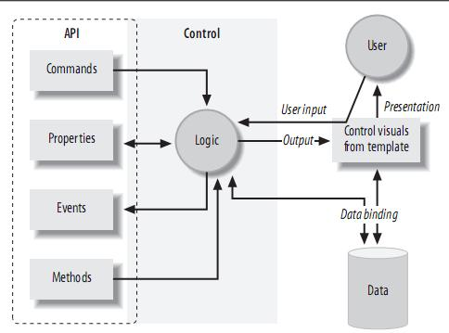
XAML Control
XAML Controls are typically not directly responsible for their own appearance
XAML Controls are all about behavior
They defer to templates to provide their visuals

Slide 7
XAML Controls (2)
Controls may use commands to represent supported operations
Controls offer properties to provide a means of modifying either behavior
Controls raise events when something important happens
XAML provides a range of built-in controls
Most of these correspond to standard Windows control types

Slide 8

Text Controls

Slide 9
Label
The purpose of the Label control is to provide a place to put a caption with an access key
How does the Label know to which control it should redirect its access key?
Target property, indicating the intended target of the access key
In the absence of this property, the Label control does nothing useful
Only available in WPF

Slide 10

Label
Live Demo

Slide 11

TextBox

Slide 12
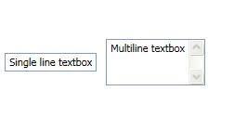
TextBox
TextBox is control for editing and displaying text
By setting AcceptsReturn to true, it can edit multiple lines
<TextBox Margin="5" VerticalAlignment="Center"
Text="Single line textbox" />
<TextBox AcceptsReturn="True" Margin="5" Height="50
VerticalScrollBarVisibility="Visible"
VerticalAlignment="Center" Text="Multiline textbox" />
<!--The result is-->

Slide 13
RichTextBox
RichTextBox supports all of the commands defined by the EditingCommands class
Recognize the RTF format
Paste formatted text from Internet Explorer and Word
Both TextBox and RichTextBox offer built-in spellchecking
SpellCheck.IsEnabled attached property

Slide 14
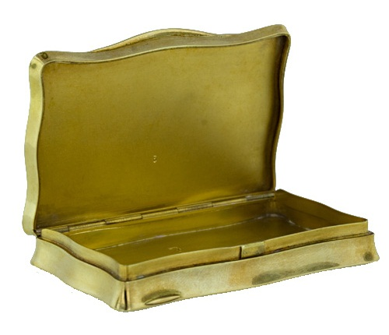
RichTextBox
Live Demo

Slide 15

Buttons

Slide 16
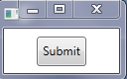
Buttons
Buttons are controls that a user can click
An XML attribute specifies the handler for the Click event
Buttons derive from the common ButtonBase base class
ButtonsWindow.xaml
<Button Click="ButtonClicked">Click</Button>
ButtonsWindow.xaml.cs
void ButtonClicked(object sender, RoutedEventArgs e)
{
MessageBox.Show("Button was clicked");
}

Slide 17

ToggleButton
Holds its state when it is clicked
IsChecked property
IsThreeState property
Gives IsChecked three possible values true, false, or null
ToggleButton defines a separate event for each value of IsChecked
Checked for true
Unchecked for false
Indeterminate for null

Slide 18

ToggleButton
Live Demo

Slide 19

CheckButton and RadioButton
They derive from ButtonBase indirectly via the ToggleButton class
IsChecked property, indicating whether the user has checked the button
CheckBox is nothing more than a ToggleButton with a different appearance
Radio buttons are normally used in groups in which only one button may be selected at a time

Slide 20
RadioButton - Example
Grouping radio buttons by name
<StackPanel>
<RadioButton GroupName="Fuel"
Margin="3">Petrol</RadioButton>
<RadioButton GroupName="Fuel"
Margin="3">Diesel</RadioButton>
<RadioButton GroupName="Induction"
Margin="3">Unforced</RadioButton>
<RadioButton GroupName="Induction"
Margin="3">Mechanical supercharger</RadioButton>
<RadioButton GroupName="Induction"
Margin="3">Turbocharger</RadioButton>
</StackPanel>

Slide 21

RadioButton
Live Demo

Slide 22

List Controls

Slide 23

ComboBox
Enables users to select one item from a list
ComboBox defines two events
DropDownOpened
DropDownClosed
ComboBox can contain complex items

Slide 24
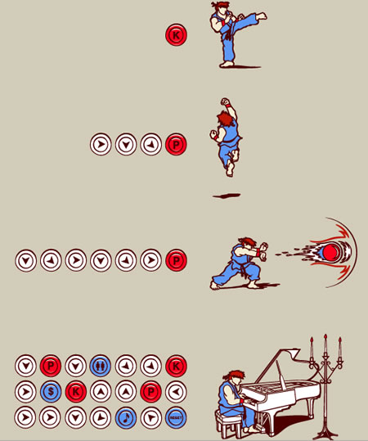
ComboBox
Live Demo

Slide 25
ListView
The ListView control derives from ListBox
It uses the Extended SelectionMode by default
View property
Enable customize the view in a richer way
The View property is of type ViewBase, an abstract class

Slide 26
GridView
GridView class
Has a Columns content property
GridViewColumn objects, as well as other properties to control the behavior of the column headers
Columns can be reordered by dragging and dropping them in the built application
Columns can be resized
Columns can automatically resize to "just fit"

Slide 27

ListView and GridView
Live Demo

Slide 28

TreeView

Slide 29
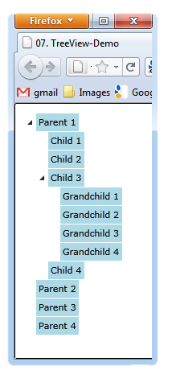
TreeView
Presents a hierarchical view
Data with nodes that can be expanded and collapsed
Important events:
Expanded
Collapsed
Selected
Unselected

Slide 30

TreeView
Live Demo

Slide 31

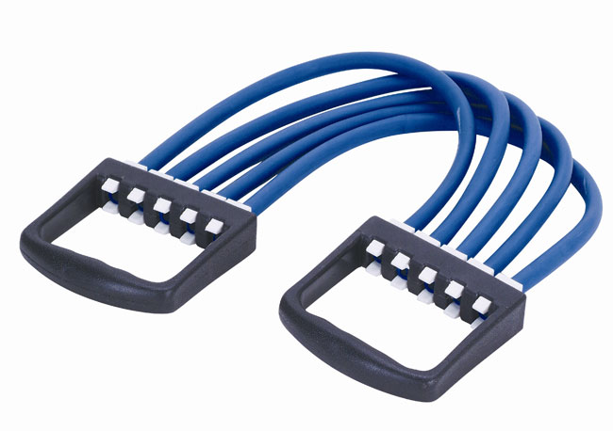
GroupBox and Expander

Slide 32

GroupBox and Expander
Both provide a container for arbitrary content and a place for a header on top
Expander can be expanded and collapsed
GroupBox always shows its content
Both controls derive from HeaderedContentControl
We can place whatever content we like directly inside the control

Slide 33

GroupBox and Expander
Live Demo

Slide 34

Menus

Slide 35
Menu
Menu simply stacks its items horizontally
<Menu Height="23" VerticalAlignment="Top" >
<MenuItem Header="_File">
<MenuItem Header="_New..."/>
<MenuItem Header="_Open..."/>
<Separator/>
<MenuItem Header="Sen_d To">
<MenuItem Header="Mail Recipient"/>
<MenuItem Header="My Documents"/>
</MenuItem>
</MenuItem>
<!--(the example continues)-->

Slide 36
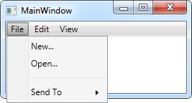
Menu (2)
<MenuItem Header="_Edit">
…
</MenuItem>
<MenuItem Header="_View">
…
</MenuItem>
</Menu>
<!-- The result is -->

Slide 37
MenuItem
MenuItem is a headered items control
The Header is actually the main object
MenuItem contains many properties for customizing
Icon
IsCheckable
InputGestureText
Can handle events or assign a command to MenuItem’s Command property

Slide 38

Menus
Live Demo

Slide 39
ContextMenu
Works just like Menu
It’s a simple container designed to hold MenuItems and Separators
Must attach it to a control via ContextMenu property
When a user right-clicks on the control the context menu is displayed
<ListBox>
<ListBox.ContextMenu>
<ContextMenu> … </ContextMenu>
</ListBox.ContextMenu> …
</ListBox>

Slide 40

Toolbars

Slide 41


Toolbars
Toolbars provide faster access for frequently used operations
WPF supports toolbars through the ToolBarTray and ToolBar controls
StatusBar behaves just like Menu
It’s typically used along the bottom of a Window

Slide 42

Toolbars
Live Demo

Slide 43

Other Controls

Slide 44
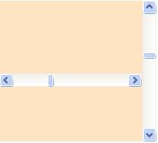
Slider and Scroll Controls
Allow a value to be selected from a range
They show a track, indicating the range and a draggable "thumb"
The ScrollBar control is commonly used in conjunction with some scrolling viewable area
Control the size of a scroll bar’s thumb with the ViewportSize property

Slide 45

Slider and Scroll Controls (2)
Slider control is used to adjust values
Slider and ScrollBar have an Orientation property
They both derive from a common base class, RangeBase
Provides Minimum and Maximum, SmallChange and LargeChange properties

Slide 46

ProgressBar
Helps user realize that progress is indeed being made
ProgressBar has a default Minimum of 0 and a default Maximum of 100
IsIndeterminate property
True - ProgressBar shows a generic animation
Orientation property
Horizontal by default

Slide 47


ToolTip
Allows a floating label to be displayed above some part of the user interface
To associate a ToolTip with its target element set it as the ToolTip property of its target
<TextBox Width="147" Height="25">
<TextBox.ToolTip>
<ToolTip Content="Type something here" />
</TextBox.ToolTip> <!--The result is-->
</TextBox>

Slide 48

XAML Controls
Questions?

Slide 49
Exercises
Write a program that show the simple window with one TextBox. Add text to the TextBox. If you select some text in the TextBox – display the current selection information.
Write a program with a Button and a Label. The label should show the number of clicks on the button.
Write a program that visualize which one of the items collection are checked.
Write a program that shows a ComboBox with various elements added to its Items. For example – add text, ellipse and picture.

Slide 50
Exercises (2)
Write a program that shows ListView with columns that contain controls such as checkboxes and text boxes. The name of the columns are ID, Enabled, Value.
Write a text editing user control that is like simple WordPad. It should have at least a TextWrap property, Scrollbar, Buttons for Save and Load, ComboBoxes for choosing FontFamily and FontSize.

Slide 51
Exercises (3)
Implement a specialized editor of text document libraries. A library is a number of text documents, organized as a tree in folders. In a folder there can be documents and other folders (as in Windows). Every document is some text with formatting. The editor must be able to create libraries, to open/save libraries, to read/write libraries from/to XML files. When a library is open the editor can edit the documents inside (changing the text and the formatting) and can create/delete/rename folders and documents. Use a TreeView for the folder tree and RichTextBox for the active document.

Slide 52
Exercises (4)
The editor should have a main menu, 2 context menus (for the folder tree and for the active document area), 3 tool bars (to open/save a library, to facilitate working with the folder tree and one for the active document), a status bar and appropriate shortcuts for the most frequently used

