Slide 1


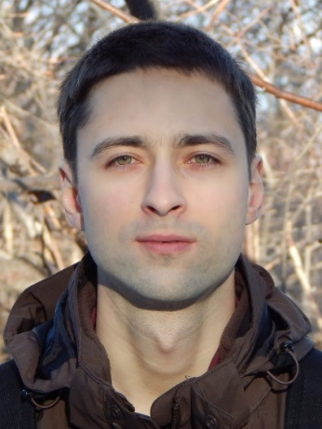
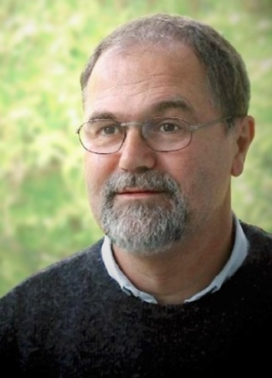
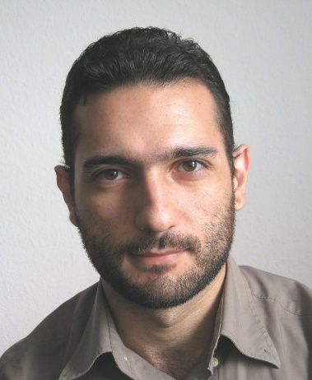



Two Results On Slime Mold Computations
R. Becker, A. Karrenbauer, P. Kolev, K. Mehlhorn (MPI-INF)
V. Bonifaci (IASI-CNR)
September 06, 2017

Slide 2
Talk Outline
Physarum Polycephalum
Definition and Mathematical Models
Our Results:
Continuous Undirected Model
Discretized Directed Model
Summary

Slide 3
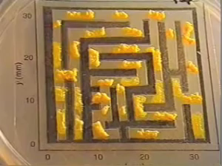
Physarum Polycephalum
A slime mold that solves
Shortest Path problems
NYT’00 experiment
allocate pieces of the Physarum in a maze
wait until the Physarum spreads uniformly
insert two food sources
after some time the Physarum retracts to the shortest path
NYT’00 - Nakagaki, Yamada, Toth - Nature’00
Notes:
Nakagaki Yamada Toth
Nature’00

Slide 4
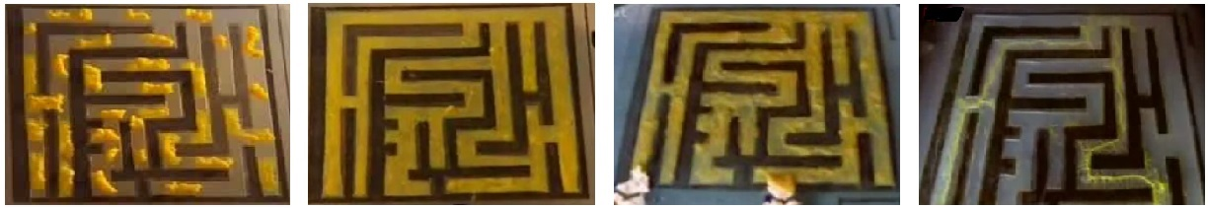
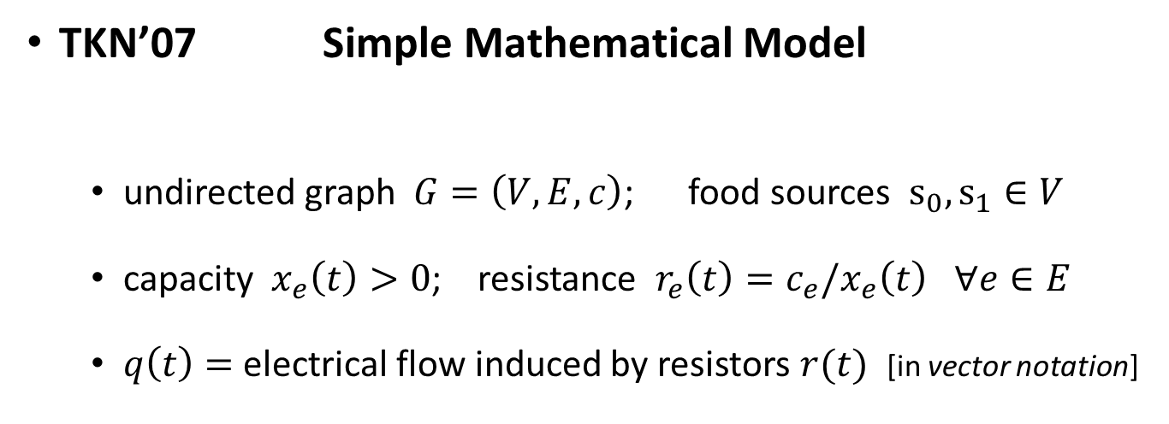
Physarum Polycephalum
TKN’07 Simple Mathematical Model
undirected graph $G=\left(V,E,c\right)$; food sources $s_{0},s_{1}∈V$
capacity $x_{e}\left(t\right)>0$; resistance $r_{e}\left(t\right)=c_{e}/x_{e}\left(t\right)$ $∀e∈E$
$q\left(t\right)=$electrical flow induced by resistors $r(t)$ [in vector notation]
Physarum is an electrical network with time varying resistors.
TKN’07 - Tero, Kobayashi, Nakagaki - Journal of Theoretical Biology’07
Notes:
Tero Kobayashi Nakagaki
Journal of Theoretical Biology’07

Slide 5


Physarum Polycephalum
TKN’07 Simple Mathematical Model
undirected graph $G=\left(V,E,c\right)$; food sources $s_{0},s_{1}∈V$
capacity $x_{e}\left(t\right)>0$; resistance $r_{e}\left(t\right)=c_{e}/x_{e}\left(t\right)$ $∀e∈E$
$q\left(t\right)=$electrical flow induced by resistors $r(t)$ [in vector notation]
Physarum is an electrical network with time varying resistors.
ODE: $\dot{x}=\left|q\right|−x$
$x^{⋆}=1_{P^{⋆}}$
TKN’07 - Tero, Kobayashi, Nakagaki - Journal of Theoretical Biology’07
Notes:
Tero Kobayashi Nakagaki
Journal of Theoretical Biology’07

Slide 6
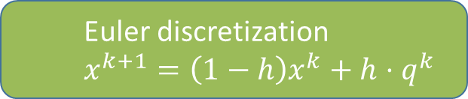
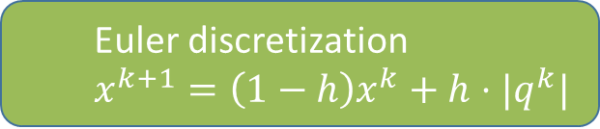
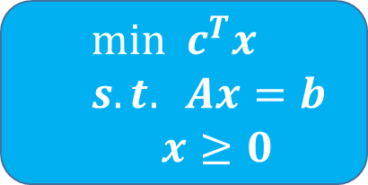

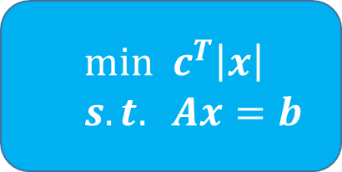


Mathematical Models
Biologically Grounded
Biologically Inspired
$$\dot{x}=\left|q\right|−x$$
$$\dot{x}=q−x$$
Euler discretization
$$x^{k+1}=\left(1−h\right)x^{k}+h⋅|q^{k}|$$
Euler discretization
$$x^{k+1}=\left(1−h\right)x^{k}+h⋅q^{k}$$
positive Linear Programs (posLP)
i.e. $c>0$ and $A$ has full row rank
$$min c^{T}\left|x\right|$$
$$s.t. Ax=b$$
$$min c^{T}x$$
$$s.t. Ax=b$$
$x≥0$

Slide 7
Mathematical Models
Biologically Grounded
Biologically Inspired
$$\dot{x}=\left|q\right|−x$$
$$\dot{x}=q−x$$
Two New Results
Euler discretization
$$x^{k+1}=\left(1−h\right)x^{k}+h⋅|q^{k}|$$
Euler discretization
$$x^{k+1}=\left(1−h\right)x^{k}+h⋅q^{k}$$
positive Linear Programs (posLP)
i.e. $c>0$ and $A$ has full row rank
$$min c^{T}\left|x\right|$$
$$s.t. Ax=b$$
$$min c^{T}x$$
$$s.t. Ax=b$$
$x≥0$

Slide 8
Mathematical Models
Biologically Grounded
Biologically Inspired
$$\dot{x}=\left|q\right|−x$$
$$\dot{x}=q−x$$
1. Bio Grounded
Euler discretization
$$x^{k+1}=\left(1−h\right)x^{k}+h⋅|q^{k}|$$
Euler discretization
$$x^{k+1}=\left(1−h\right)x^{k}+h⋅q^{k}$$
positive Linear Programs (posLP)
i.e. $c>0$ and $A$ has full row rank
$$min c^{T}\left|x\right|$$
$$s.t. Ax=b$$
$$min c^{T}x$$
$$s.t. Ax=b$$
$x≥0$

Slide 9

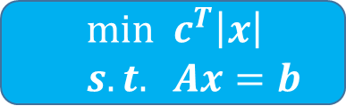

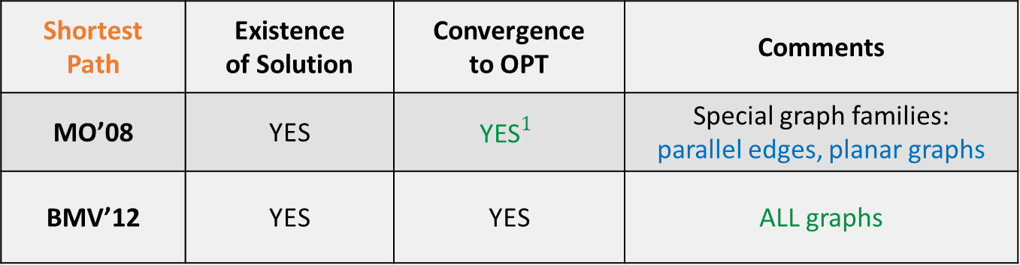
Prior Work
$$min c^{T}\left|x\right|$$
$$s.t. Ax=b$$
$$\dot{x}=\left|q\right|−x$$
Problem: Shortest Path (SP)
$c>0$, $A$ vertex-edge incidence matrix, $b=1_{s_{1}}−1_{s_{0}}$
Shortest Path | Existence of Solution | Convergence to OPT | Comments
MO’08 | YES | $${\text{YES}}^{1}$$ | Special graph families: parallel edges, planar graphs
BMV’12 | YES | YES | ALL graphs
MO’08 - Miyaji, Ohnishi - International Journal of Pure and Applied Mathematics 2008
BMV’12 - Bonifaci, Mehlhorn, Varma - Journal of Theoretical Biology 2012
Notes:
Miyaji Ohnishi
International Journal of Pure and Applied Mathematics 2008
Bonifaci Mehlhorn Varma
Journal of Theoretical Biology 2012

Slide 10

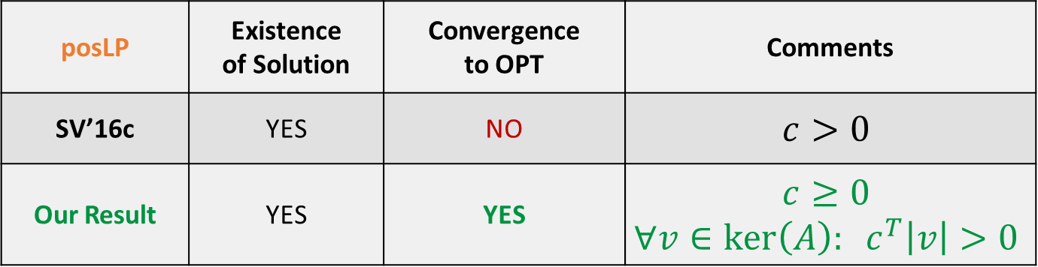
Prior Work
$$min c^{T}\left|x\right|$$
$$s.t. Ax=b$$
$$\dot{x}=\left|q\right|−x$$
Problem: positive Linear Program (posLP)
$c>0$, $A$ full row rank, any $b$
posLP | Existence of Solution | Convergence to OPT | Comments
SV’16c | YES | NO | $$c>0$$
Our Result | YES | YES | $$c≥0$$ $$∀v∈ker\left(A\right): c^{T}\left|v\right|>0$$
Example: For the SP, the graph $G$ has no zero-cost cycle.
SV’16c - Straszak, Vishnoi - IRLS and Slime Mold: Equivalence and Convergence – arXiv 2016
Notes:
Straszak Vishnoi
IRLS and Slime Mold: Equivalence and Convergence
arXiv 2016

Slide 11
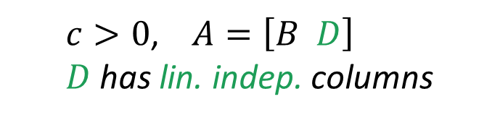

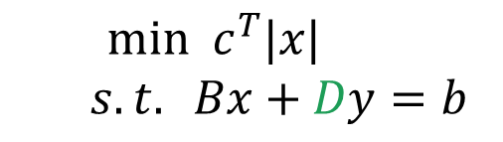
Prior Work
$$min c^{T}\left|x\right|$$
$$s.t. Ax=b$$
$$\dot{x}=\left|q\right|−x$$
Problem: positive Linear Program (posLP)
$c>0$, $A$ full row rank, any $b$
Generalization: non-negative Linear Program
posLP | Existence of Solution | Convergence to OPT | Comments
SV’16c | YES | NO | $$c>0$$
Our Result | YES | YES | $$c≥0$$ $$∀v∈ker\left(A\right): c^{T}\left|v\right|>0$$
$$min c^{T}|x|$$
$$s.t. Bx+Dy=b$$
$c>0$, $A=\left[B D\right]$
$D$ has lin. indep. columns
SV’16c - Straszak, Vishnoi - IRLS and Slime Mold: Equivalence and Convergence – arXiv 2016
Notes:
Straszak Vishnoi
IRLS and Slime Mold: Equivalence and Convergence
arXiv 2016

Slide 12
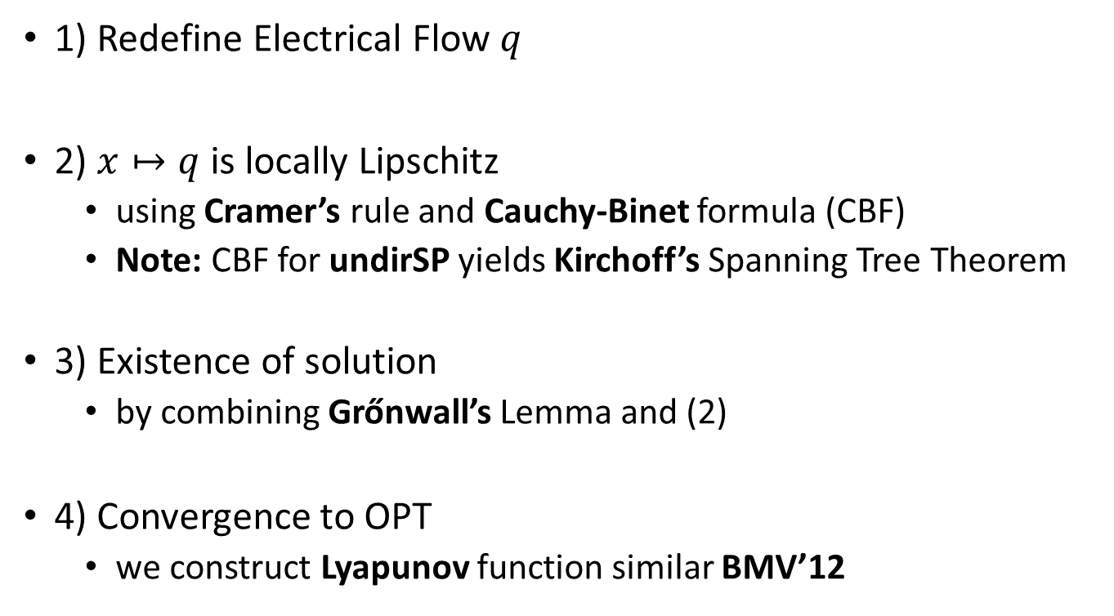
Proof Idea
$$min c^{T}\left|x\right|$$
$$s.t. Ax=b$$
$$\dot{x}=\left|q\right|−x$$
1) Redefine Electrical Flow $q$
2) $x↦q$ is locally Lipschitz
using Cramer’s rule and Cauchy-Binet formula (CBF)
Note: CBF for undirSP yields Kirchoff’s Spanning Tree Theorem
3) Existence of solution
by combining Grőnwall’s Lemma and (2)
4) Convergence to OPT
we construct Lyapunov function similar BMV’12
BMV’12 - Bonifaci, Mehlhorn, Varma - Journal of Theoretical Biology 2012
Notes:
Bonifaci Mehlhorn Varma
Physarum can compute shortest paths
Journal of Theoretical Biology 2012

Slide 13

Mathematical Models
Biologically Grounded
Biologically Inspired
$$\dot{x}=\left|q\right|−x$$
2. Bio Inspired
$$\dot{x}=q−x$$
Euler discretization
$$x^{k+1}=\left(1−h\right)x^{k}+h⋅|q^{k}|$$
Euler discretization
$$x^{k+1}=\left(1−h\right)x^{k}+h⋅q^{k}$$
positive Linear Programs (posLP)
i.e. $c>0$ and $A$ has full row rank
$$c>0$$
$$min c^{T}\left|x\right|$$
$$s.t. Ax=b$$
$$min c^{T}x$$
$$s.t. Ax=b$$
$x≥0$

Slide 14
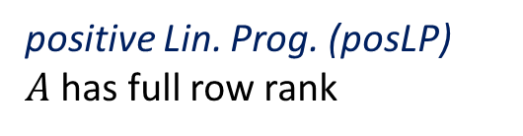
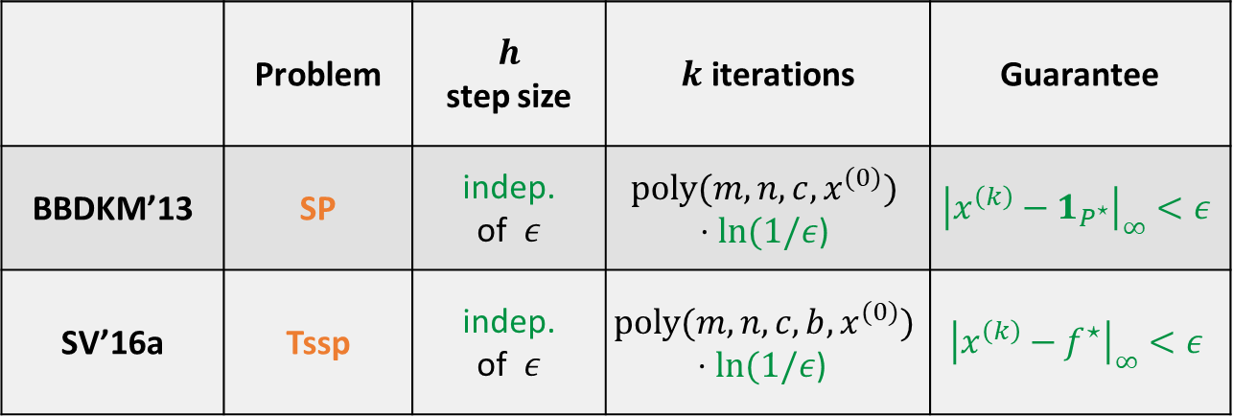

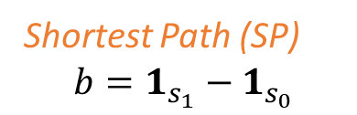


Prior Work
$$min c^{T}x$$
$$Ax=b, x≥0$$
$$x^{(k+1)}=\left(1−h\right)x^{(k)}+h⋅q^{(k)}$$
Shortest Path (SP)
$$b=1_{s_{1}}−1_{s_{0}}$$
Transshipment (Tssp)
$$1^{T}b=0$$
positive Lin. Prog. (posLP)
$A$ has full row rank
 | Problem | $h$ step size | $k$ iterations | Guarantee
BBDKM’13 | SP | indep. of $ε$ | $$poly(m,n,c,x^{(0)})$$ $$⋅ln(1/ε\text{)}$$ | $${\left|x^{\left(k\right)}−1_{P^{⋆}}\right|}_{∞}<ε$$
SV’16a | Tssp | indep. of $ε$ | $$poly(m,n,c,b,x^{(0)})$$ $$⋅ln(1/ε\text{)}$$ | $${\left|x^{\left(k\right)}−f^{⋆}\right|}_{∞}<ε$$
BBDKM’13 - Becchetti, Bonifaci, Dirnberger, Karrenbauer, Mehlhorn - ICALP 2013
SV’16a - Straszak, Vishnoi - Natural algorithms for flow problems - SODA 2016
Notes:
Becchetti Bonifaci Dirnberger Karrenbauer Mehlhorn
Physarum can compute shortest paths: Convergence proofs and complexity bounds
ICALP 2013
Straszak Vishnoi
Natural algorithms for flow problems
SODA 2016

Slide 15

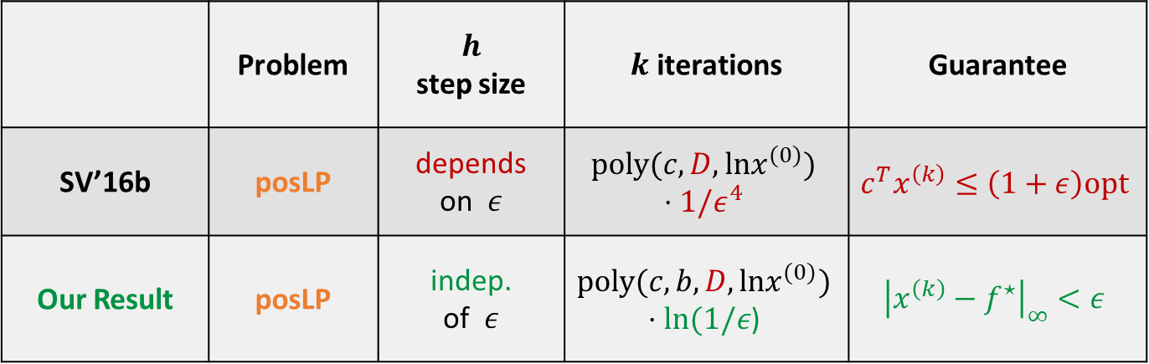
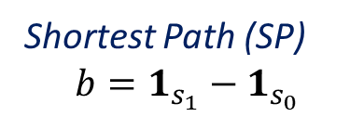
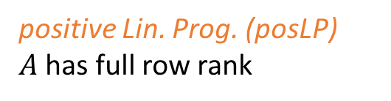
Prior Work
$$min c^{T}x$$
$$Ax=b, x≥0$$
$$x^{(k+1)}=\left(1−h\right)x^{(k)}+h⋅q^{(k)}$$
Shortest Path (SP)
$$b=1_{s_{1}}−1_{s_{0}}$$
Transshipment (Tssp)
$$1^{T}b=0$$
positive Lin. Prog. (posLP)
$A$ has full row rank
 | Problem | $h$ step size | $k$ iterations | Guarantee
SV’16b | posLP | depends on $ε$ | $$poly(c,D,lnx^{(0)})$$ $$⋅1/ε^{4}$$ | $$c^{T}x^{\left(k\right)}≤\left(1+ε\right)opt$$
Our Result | posLP | indep. of $ε$ | $$poly(c,b,D,lnx^{(0)})$$ $$⋅ln(1/ε\text{)}$$ | $${\left|x^{\left(k\right)}−f^{⋆}\right|}_{∞}<ε$$
$$D=max \left\{ \left| det\left(A^{′}\right) \right| : is a square submatrix of A \right\}.$$
SV’16b - Straszak, Vishnoi - On a natural dynamics for linear programming - ITCS 2016
Notes:
Straszak Vishnoi
On a natural dynamics for linear programming
ITCS 2016

Slide 16
Proof Idea
$$min c^{T}x$$
$$Ax=b, x≥0$$
$$x^{(k+1)}=\left(1−h\right)x^{(k)}+h⋅q^{(k)}$$
Issue: The SV’16b analysis relies on a proof technique
developed in BBDKM’12 for undirected discrete Physarum.
1) We extend the analysis for the directed discrete case in
BBDKM’12 (Shortest Path) and
SV’16a (Transshipment)
to the setting of positive Linear Programs.
2) Then, we combine the analysis in SV’16b with (1).
Our Approach:
BBDKM’13 - Becchetti, Bonifaci, Dirnberger, Karrenbauer, Mehlhorn - ICALP 2013
SV’16a - Straszak, Vishnoi - Natural algorithms for flow problems - SODA 2016
SV’16b - Straszak, Vishnoi - On a natural dynamics for linear programming - ITCS 2016
Notes:
SV’16a - Straszak Vishnoi
Natural algorithms for flow problems
SODA 2016
SV’16b - Straszak Vishnoi
On a natural dynamics for linear programming
ITCS 2016
BBDKM’12 - Becchetti Bonifaci Dirnberger Karrenbauer Mehlhorn
Physarum can compute shortest paths: Convergence proofs and complexity bounds
ICALP 2012

Slide 17


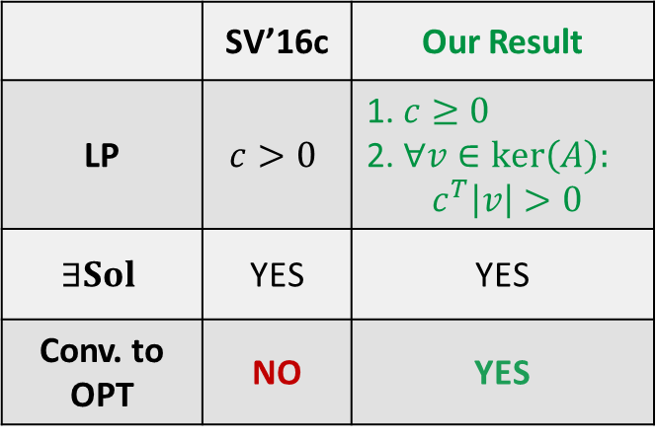
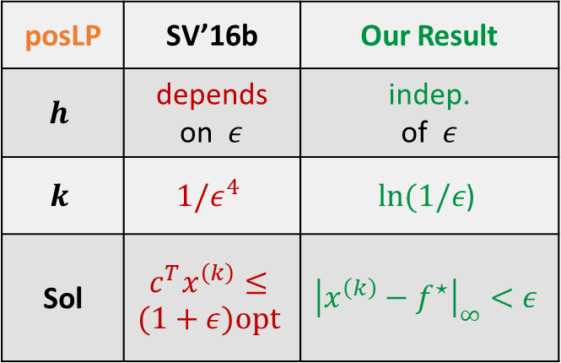
Summary
Biologically Grounded Model
Biologically Inspired Model
$$\dot{x}=\left|q\right|−x$$
Euler discretization
$$x^{k+1}=\left(1−h\right)x^{k}+h⋅q^{k}$$
 | SV’16c | Our Result
LP | $$c>0$$ | 1. $c≥0$ 2. $∀v∈ker\left(A\right):$ $$c^{T}\left|v\right|>0$$
$$∃Sol$$ | YES | YES
Conv. to OPT | NO | YES
posLP | SV’16b | Our Result
$$h$$ | depends on $ε$ | indep. of $ε$
$$k$$ | $$1/ε^{4}$$ | $$ln(1/ε\text{)}$$
Sol | $$c^{T}x^{\left(k\right)}≤$$ $$(1+ε)opt$$ | $${\left|x^{\left(k\right)}−f^{⋆}\right|}_{∞}<ε$$
SV’16b - Straszak, Vishnoi - On a natural dynamics for linear programming - ITCS 2016
SV’16c - Straszak, Vishnoi - IRLS and Slime Mold: Equivalence and Convergence – arXiv 2016

Slide 18
Thank you!

