Slide 1
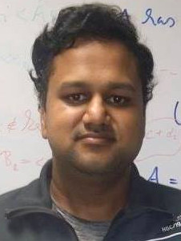
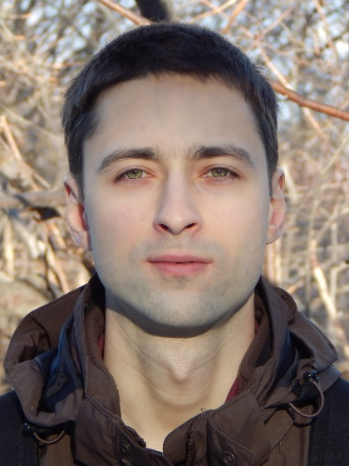



Density Independent Algorithms for Sparsifying $k$-Step Random Walks
Gorav Jindal, Pavel Kolev (MPI-INF)
Richard Peng, Saurabh Sawlani (Georgia Tech)
August 18, 2017

Slide 2
Talk Outline
Definitions
Sparsification
Random walk graphs
Our result
Sparsification by Resistances
Walk sampling algorithm

Slide 3
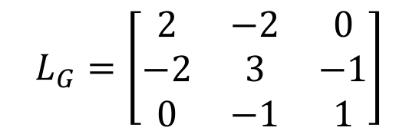
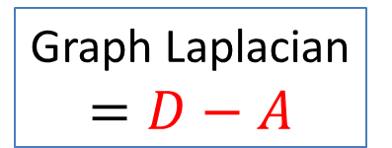
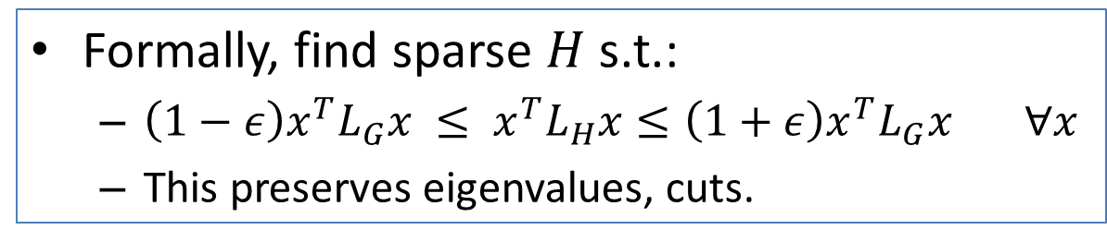

Spectral Sparsification
Sparsification: Removing (many) edges from a graph while approximating some property
Spectral properties of the graph Laplacian!
Graph Laplacian
$$=D−A$$
$$L_{G}=\left[\begin{matrix}2 & −2 & 0 \\ −2 & 3 & −1 \\ 0 & −1 & 1\end{matrix}\right]$$
e.g.:
$$G=$$
2
1
Formally, find sparse $H$ s.t.:
$\left(1−ε\right)x^{T}L_{G}x ≤ x^{T}L_{H}x≤\left(1+ε\right)x^{T}L_{G}x ∀x$
This preserves eigenvalues, cuts.

Slide 4
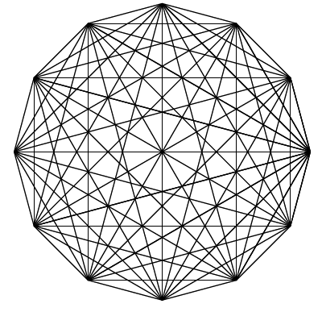
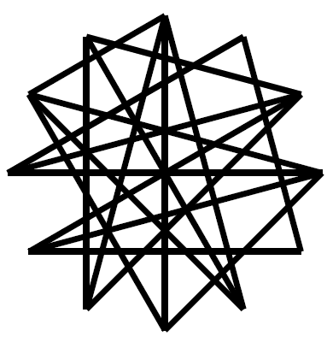
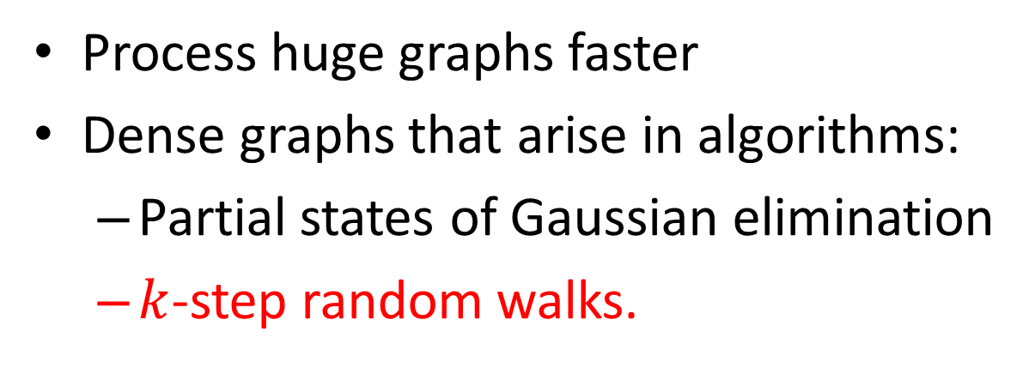
Applications of Sparsification
Process huge graphs faster
Dense graphs that arise in algorithms:
Partial states of Gaussian elimination
$k$-step random walks.

Slide 5
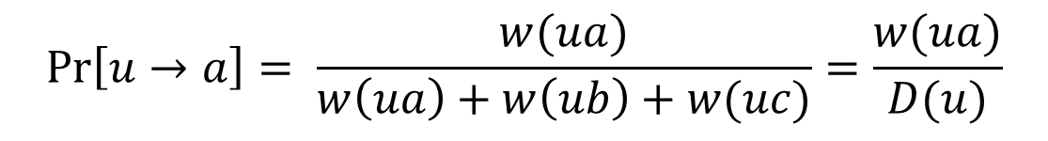
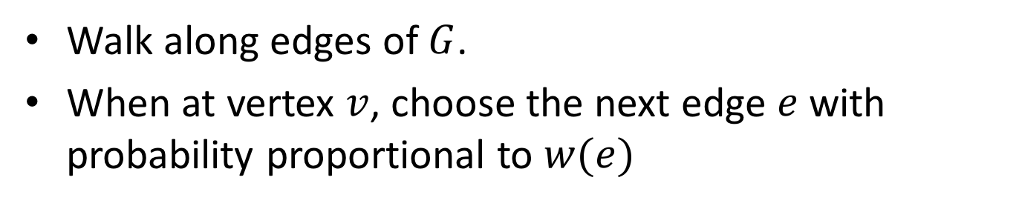
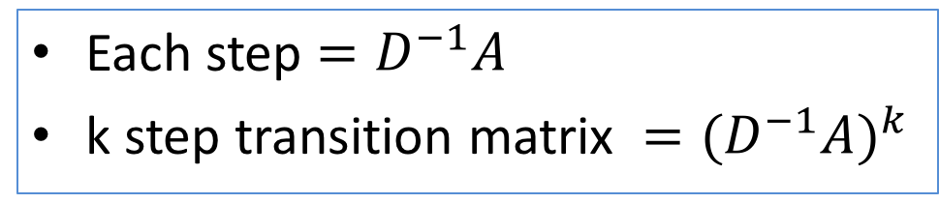
Random Walk Graphs
Walk along edges of $G$.
When at vertex $v$, choose the next edge $e$ with probability proportional to $w(e)$
a
u
$$\operatorname{Pr}\left[u→a\right]= \frac{w(ua)}{w\left(ua\right)+w\left(ub\right)+w(uc)}=\frac{w(ua)}{D(u)}$$
b
c
Each step $=D^{−1}A$
k step transition matrix $={(D^{−1}A)}^{k}$

Slide 6
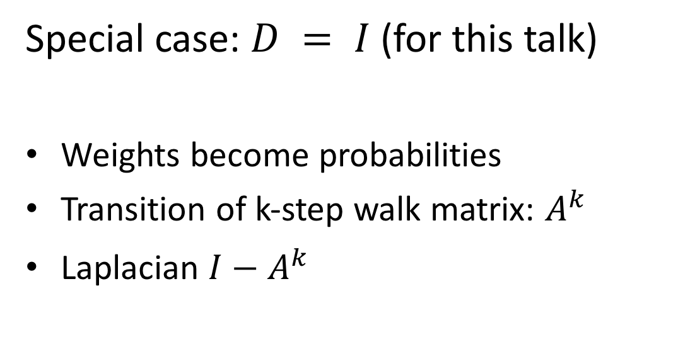
Random Walk Graphs
Special case: $D = I$ (for this talk)
Weights become probabilities
Transition of k-step walk matrix: $A^{k}$
Laplacian $I−A^{k}$

Slide 7


Random Walk Graphs
Example:
.68
.68
.2
.8
a
a
b
b
.32
$$G=$$
$$G^{2}=$$
.32
.68
.8
.2
c
c
.68
Notes:
Make numbers bigger

Slide 8
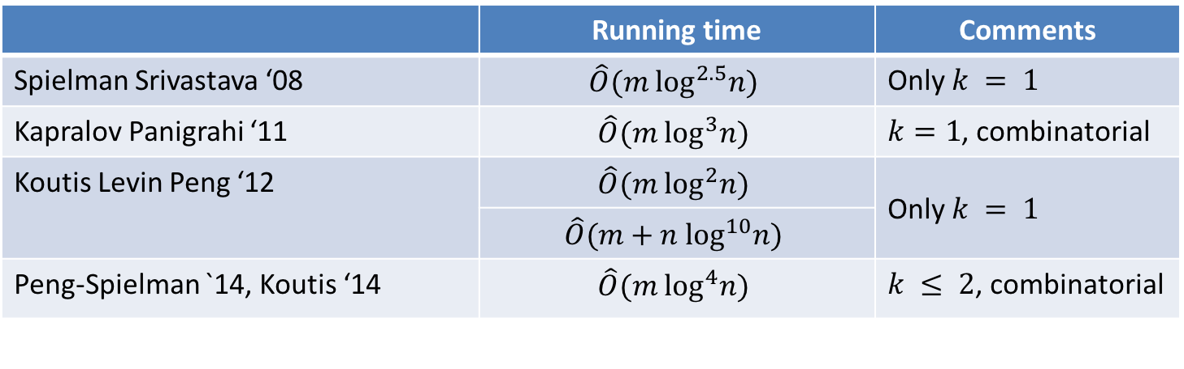
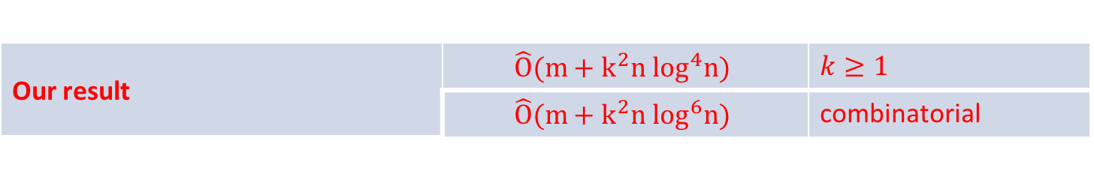
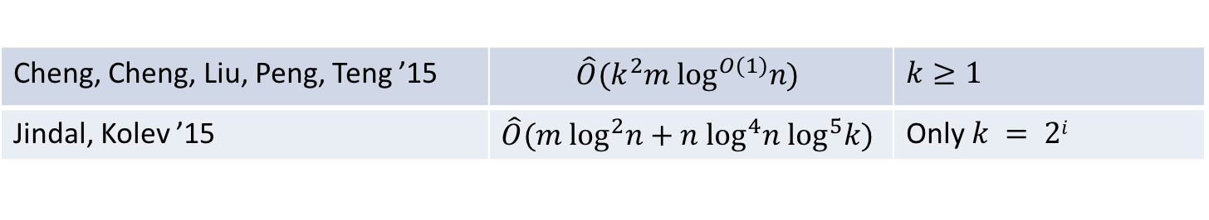
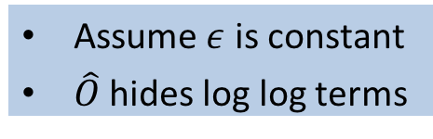
Our Result
Assume $ε$ is constant
$\hat{O}$ hides log log terms
 | Running time | Comments
Spielman Srivastava ‘08 | $$\hat{O}(m \log^{2.5}n)$$ | Only $k = 1$
Kapralov Panigrahi ‘11 | $$\hat{O}(m \log^{3}n)$$ | $k=1$, combinatorial
Koutis Levin Peng ‘12 | $$\hat{O}(m \log^{2}n)$$ | Only $k = 1$
 | $$\hat{O}(m+n \log^{10}n)$$
Peng-Spielman `14, Koutis ‘14 | $$\hat{O}(m \log^{4}n)$$ | $k ≤ 2$, combinatorial
Cheng, Cheng, Liu, Peng, Teng ’15 | $$\hat{O}(k^{2}m \log^{O(1)}n)$$ | $$k≥1$$
Jindal, Kolev ’15 | $$\hat{O}(m \log^{2}n+n \log^{4}n \log^{5}k)$$ | Only $k = 2i$
Our result | $$\hat{O}(m+k^{2}n \log^{4}n)$$ | $$k≥1$$
 | $$\hat{O}(m+k^{2}n \log^{6}n)$$ | combinatorial
Notes:
Highlight density independent ones

Slide 9

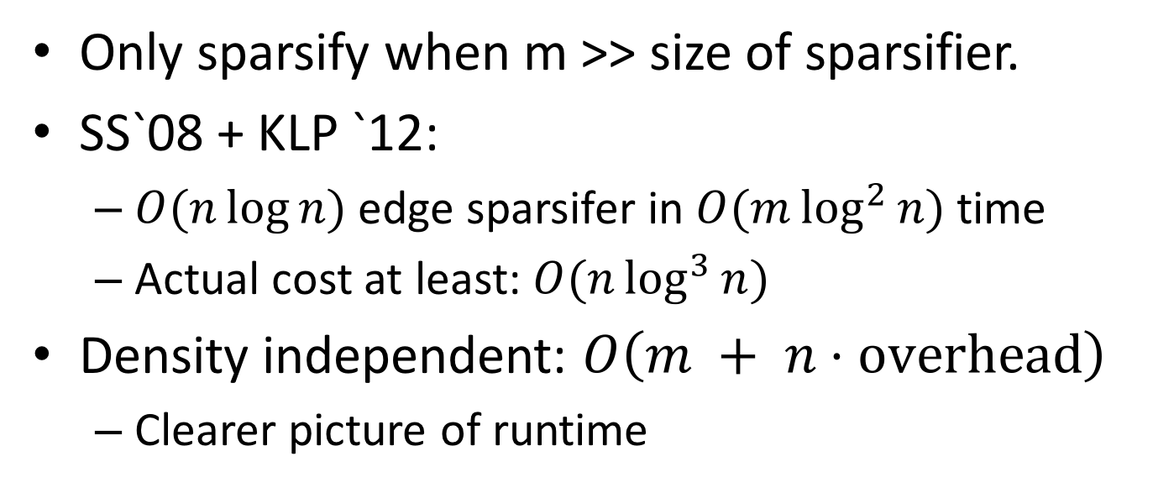
Density Independence
$$\hat{O}(m+k^{2}n \log^{4}n)$$
Only sparsify when m >> size of sparsifier.
SS`08 + KLP `12:
$O(n\log{n})$edge sparsifer in $O(m\log^{2}{n})$ time
Actual cost at least: $O(n\log^{3}{n})$
Density independent: $O\left(m + n⋅\text{overhead}\right)$
Clearer picture of runtime

Slide 10
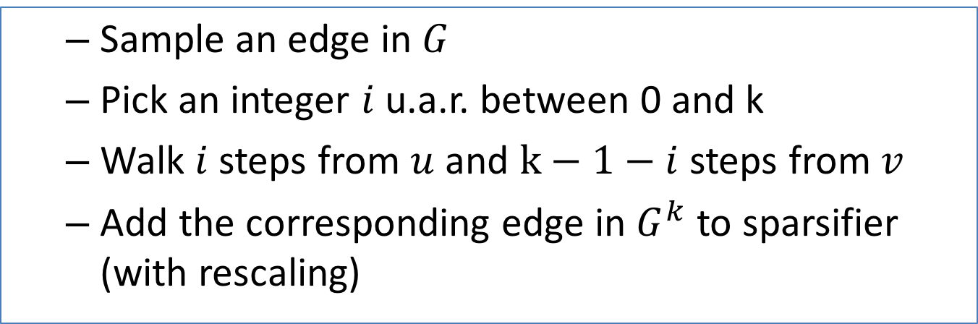
Algorithm
Sample an edge in $G$
Pick an integer $i$ u.a.r. between 0 and k
Walk $i$ steps from $u$ and $k−1−i$ steps from $v$
Add the corresponding edge in $G^{k}$ to sparsifier (with rescaling)
Walk sampling has analogs in:
Personalized page rank algorithms
Triangle counting / sampling

Slide 11
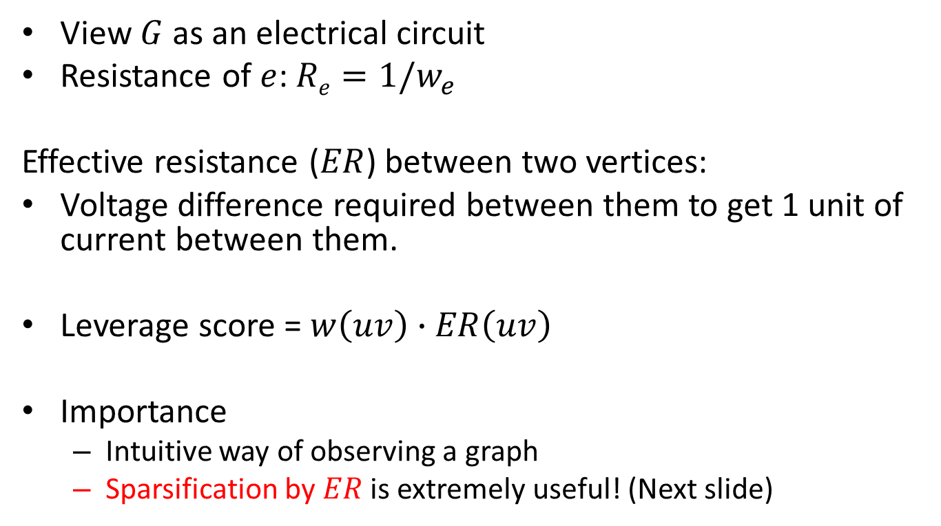
Effective Resistances
View $G$ as an electrical circuit
Resistance of $e$: $Re=1/w_{e}$
Effective resistance ($ER$) between two vertices:
Voltage difference required between them to get 1 unit of current between them.
Leverage score = $w\left(uv\right)∙ER\left(uv\right)$
Importance
Intuitive way of observing a graph
Sparsification by $ER$ is extremely useful! (Next slide)

Slide 12
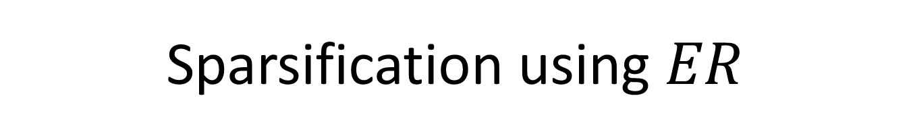
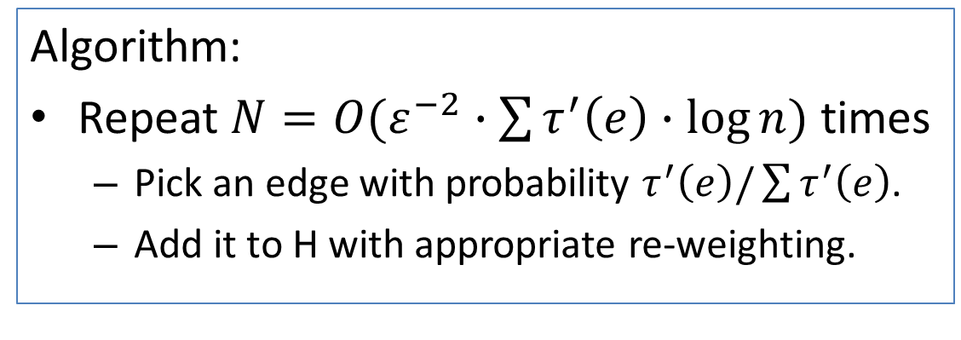
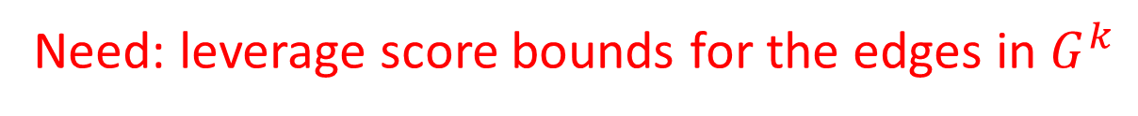
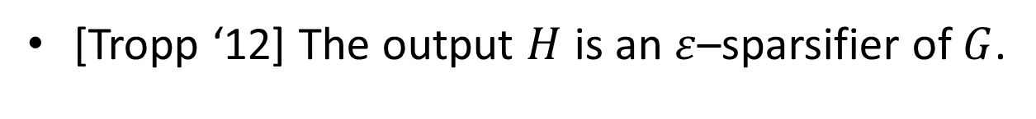
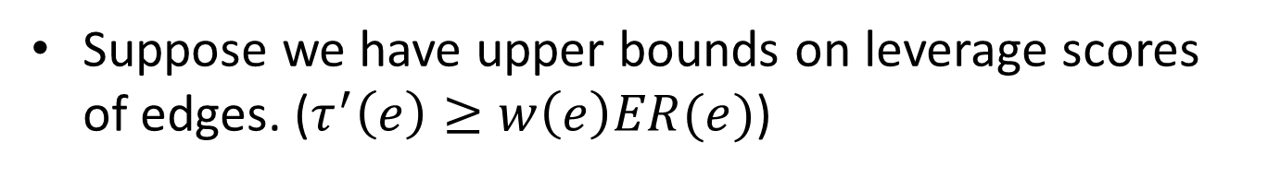
Sparsification using $ER$
Suppose we have upper bounds on leverage scores of edges. ($τ^{′}\left(e\right)≥w\left(e\right)ER(e)$)
Algorithm:
Repeat $N=O(ε^{−2}∙\sum{τ^{′}\left(e\right)}∙\log{n})$ times
Pick an edge with probability $τ^{′}\left(e\right)/\sum{τ^{′}\left(e\right)}$.
Add it to H with appropriate re-weighting.
[Tropp ‘12] The output $H$ is an $ε$–sparsifier of $G$.
Need: leverage score bounds for the edges in $G^{k}$
Notes:
Was this first used in SS08?

Slide 13
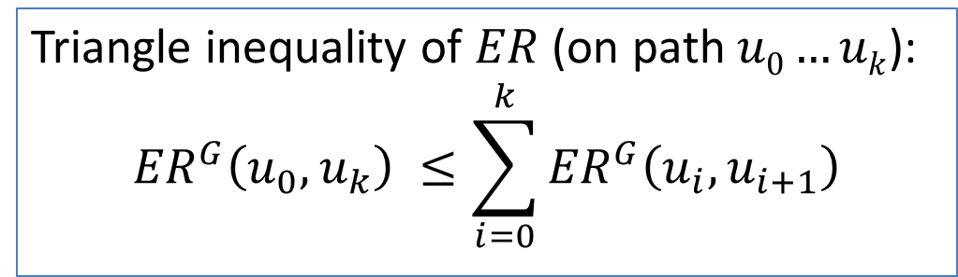
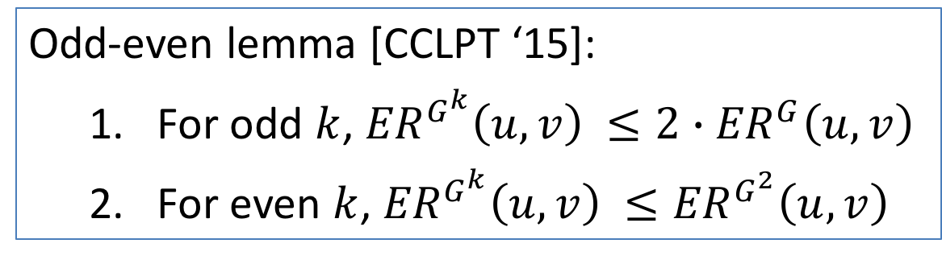
Tools for Bounding Leverage Scores
Odd-even lemma [CCLPT ‘15]:
For odd $k$, ${ER}^{G^{k}}\left(u,v\right) ≤2∙{ER}^{G}\left(u,v\right)$
For even $k$, ${ER}^{G^{k}}\left(u,v\right) ≤{ER}^{G^{2}}\left(u,v\right)$
Triangle inequality of $ER$ (on path $u0…uk$):
$${ER}^{G}\left(u_{0},u_{k}\right) ≤\sum_{i=0}^{k}{{ER}^{G}\left(u_{i},u_{i+1}\right)}$$
We will use these to implicitly select edges by leverage score

Slide 14
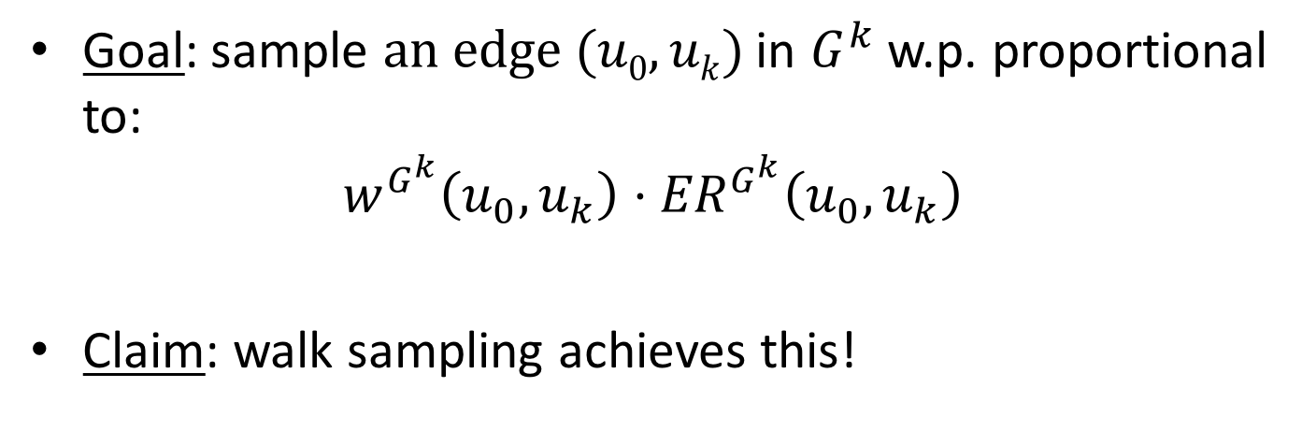
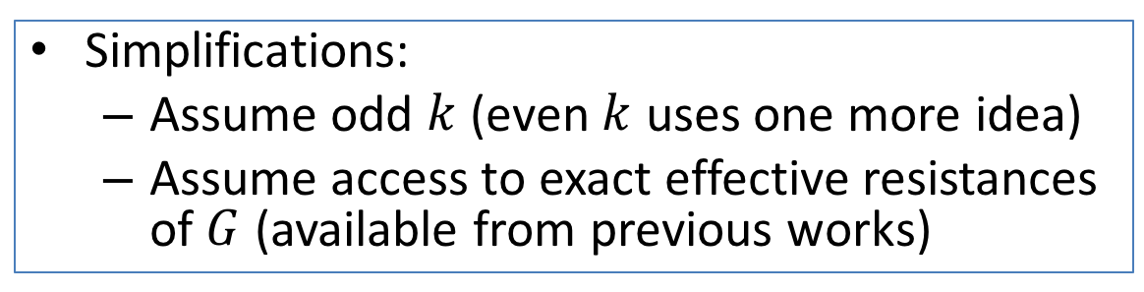
Analysis:
Simplifications:
Assume odd $k$ (even $k$ uses one more idea)
Assume access to exact effective resistances of $G$ (available from previous works)
Goal: sample $an edge (u0,uk)$ in $G^{k}$ w.p. proportional to:
$$w^{G^{k}}\left(u_{0}, u_{k}\right)⋅{ER}^{G^{k}}\left(u_{0}, u_{k}\right)$$
Claim: walk sampling achieves this!

Slide 15
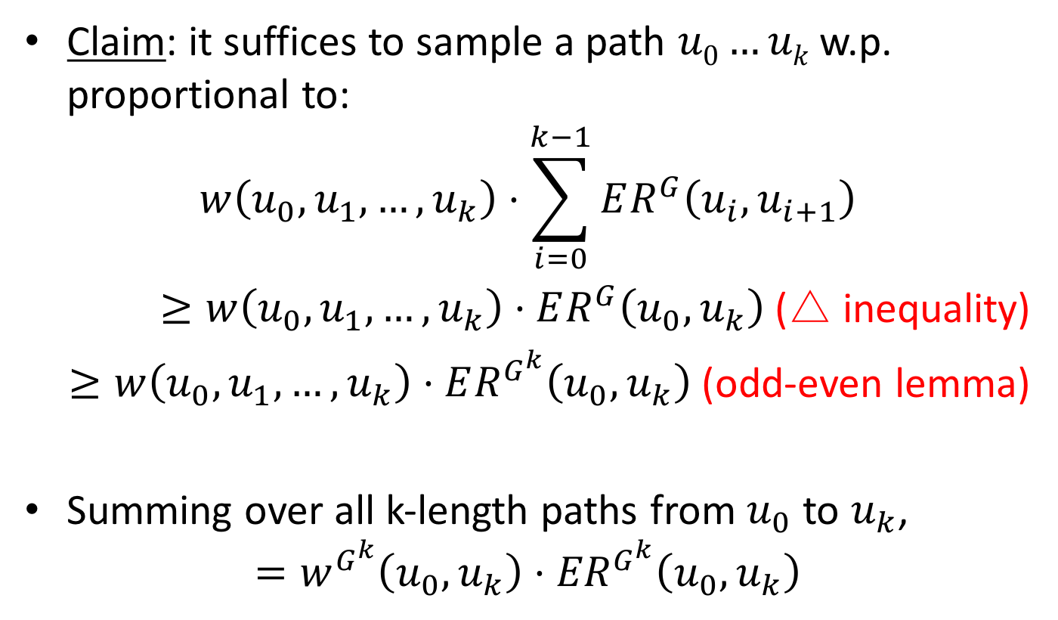
Analysis:
Claim: it suffices to sample a path $u0…uk$w.p. proportional to:
$$w\left(u_{0},u_{1},…,u_{k}\right)⋅\sum_{i=0}^{k−1}{ER^{G}\left(u_{i},u_{i+1}\right)}$$
$≥w\left(u_{0},u_{1},…,u_{k}\right)⋅ER^{G}\left(u_{0},u_{k}\right)$ (△ inequality)
$≥w\left(u_{0},u_{1},…,u_{k}\right)⋅ER^{G^{k}}\left(u_{0},u_{k}\right)$ (odd-even lemma)
Summing over all k-length paths from $u_{0}$ to $u_{k}$,
$$=w^{G^{k}}\left(u_{0}, u_{k}\right)⋅{ER}^{G^{k}}\left(u_{0}, u_{k}\right)$$

Slide 16
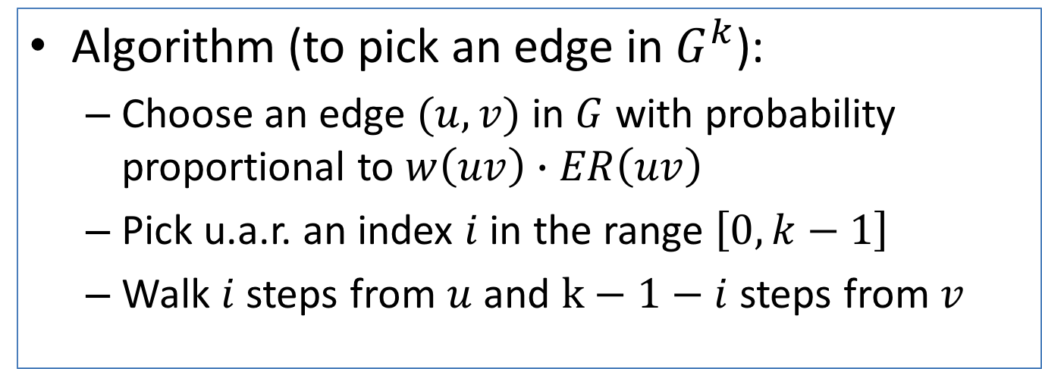
Walk Sampling Algorithm
Algorithm (to pick an edge in $G^{k}$):
Choose an edge $(u,v)$ in $G$ with probability proportional to $w\left(uv\right)∙ER\left(uv\right)$
Pick u.a.r. an index $i$ in the range $\left[0, k−1\right]$
Walk $i$ steps from $u$ and $k−1−i$ steps from $v$

Slide 17
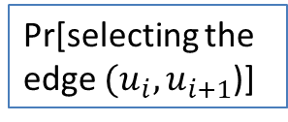

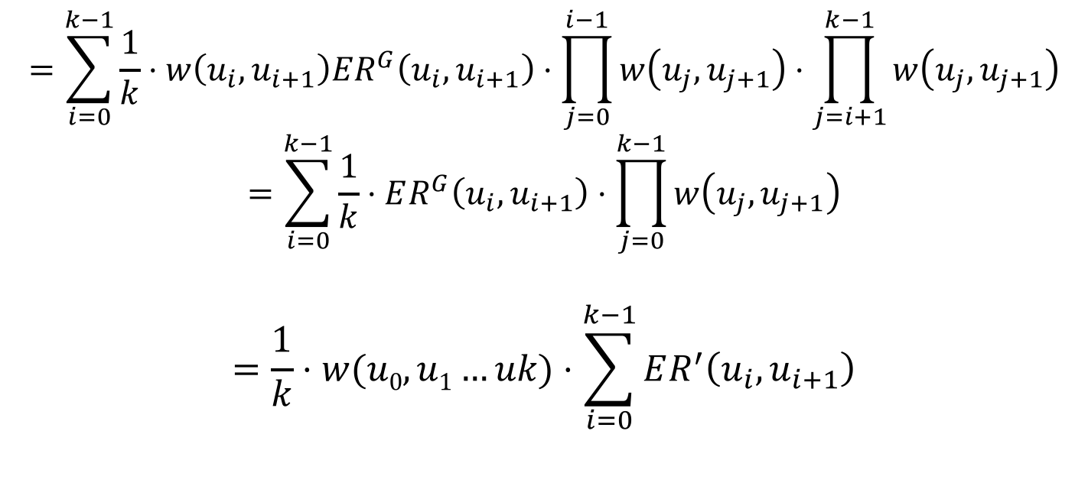

Analysis of Walk Sampling
Probability of sampling the walk $(u_{0},u_{1},⋯,u_{k})∝$
x
Pr[selecting the edge $(u_{i},u_{i+1}$)]
x
Pr[Walk from $u_{i}$ to $u_{0}$]
x
Pr[index=i]
Pr[Walk from $u_{i+1}$ to $u_{k}$]
$$=\sum_{i=0}^{k−1}{\frac{1}{k}⋅w\left(u_{i},u_{i+1}\right)ER^{G}\left(u_{i},u_{i+1}\right)⋅\prod_{j=0}^{i−1}{w\left(u_{j},u_{j+1}\right)}⋅\prod_{j=i+1}^{k−1}{w\left(u_{j},u_{j+1}\right)}}$$
$$=\sum_{i=0}^{k−1}{\frac{1}{k}⋅ER^{G}\left(u_{i},u_{i+1}\right)⋅\prod_{j=0}^{k−1}{w\left(u_{j},u_{j+1}\right)}}$$
$$=\frac{1}{k}⋅w(u0,u1…uk)⋅\sum_{i=0}^{k−1}{ER^{′}\left(u_{i},u_{i+1}\right)}$$

Slide 18


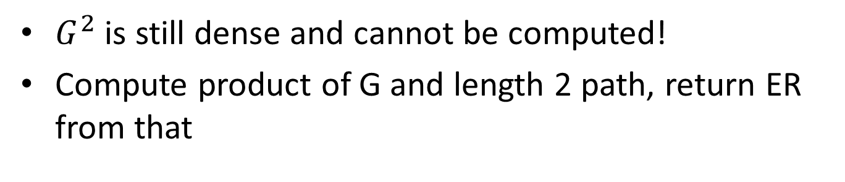


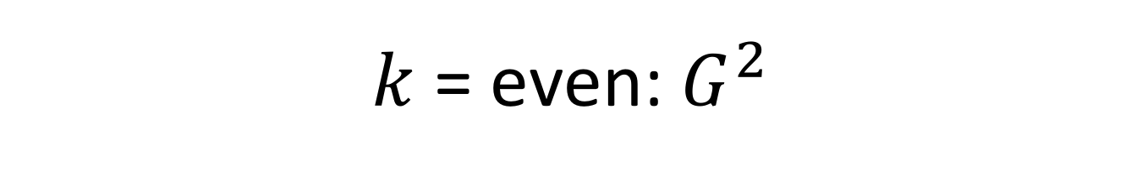



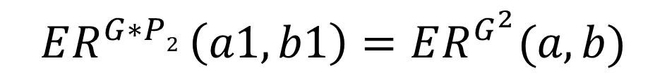




$k$ = even: $G^{2}$
$G^{2}$ is still dense and cannot be computed!
Compute product of G and length 2 path, return ER from that
.68
.68
d
a
b
.2
.8
$$a1$$
$$a2$$
a
.32
b
$$b1$$
$$b2$$
.68
.32
.8
.2
$$c1$$
$$c2$$
c
c
$$d1$$
$$d2$$
.68
$$G$$
$$G×P2$$
$$G^{2}$$
$$ER^{G∗P2 }\left(a1,b1\right)=ER^{G^{2}}(a,b)$$

Slide 19
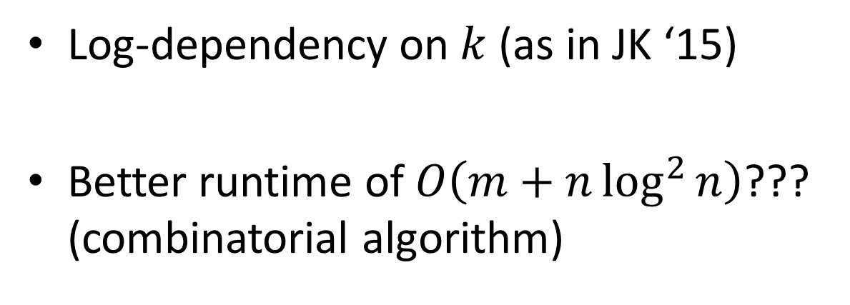

Future Work
This result: $O\left(m+k^{2}n\log^{4}{n}\right)$ time.
Log-dependency on $k$ (as in JK ‘15)
Better runtime of $O\left(m+n\log^{2}{n}\right)$??? (combinatorial algorithm)

Slide 20
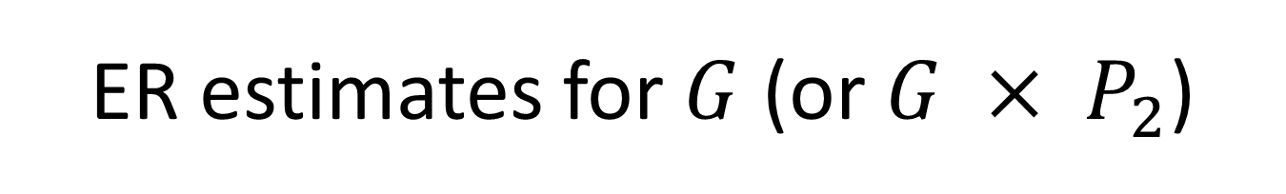
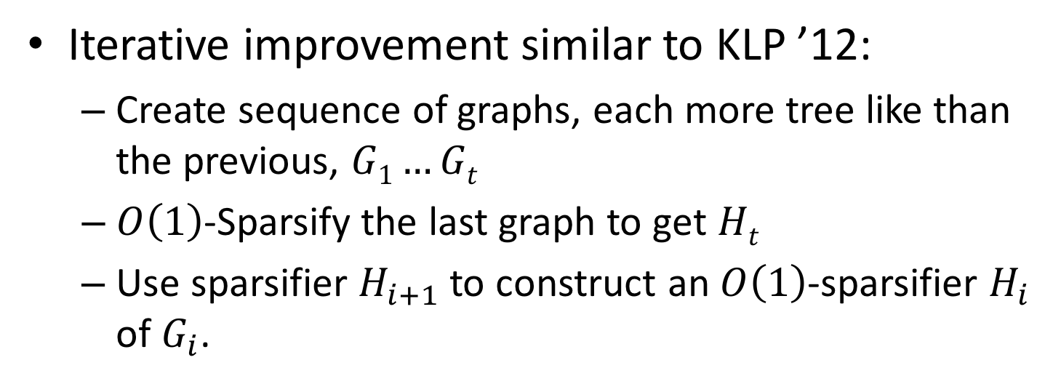
ER estimates for $G$ (or $G × P_{2}$)
Iterative improvement similar to KLP ’12:
Create sequence of graphs, each more tree like than the previous, $G1…Gt$
$O\left(1\right)$-Sparsify the last graph to get $Ht$
Use sparsifier $H_{i+1}$ to construct an $O\left(1\right)$-sparsifier $H_{i}$ of $G_{i}$.

