Slide 1
Parking space reservation chatbot

Slide 2
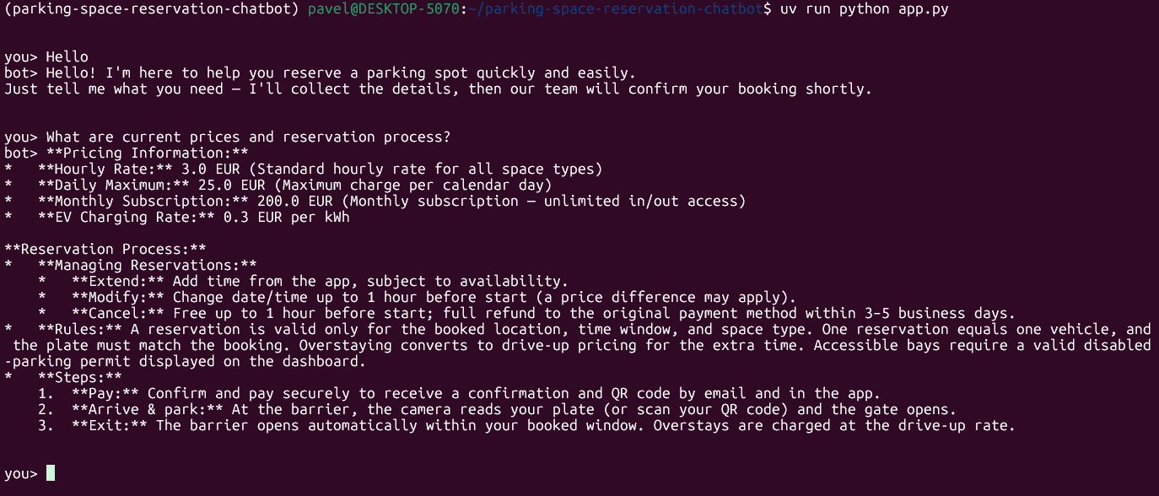
General information retrieval

Slide 3
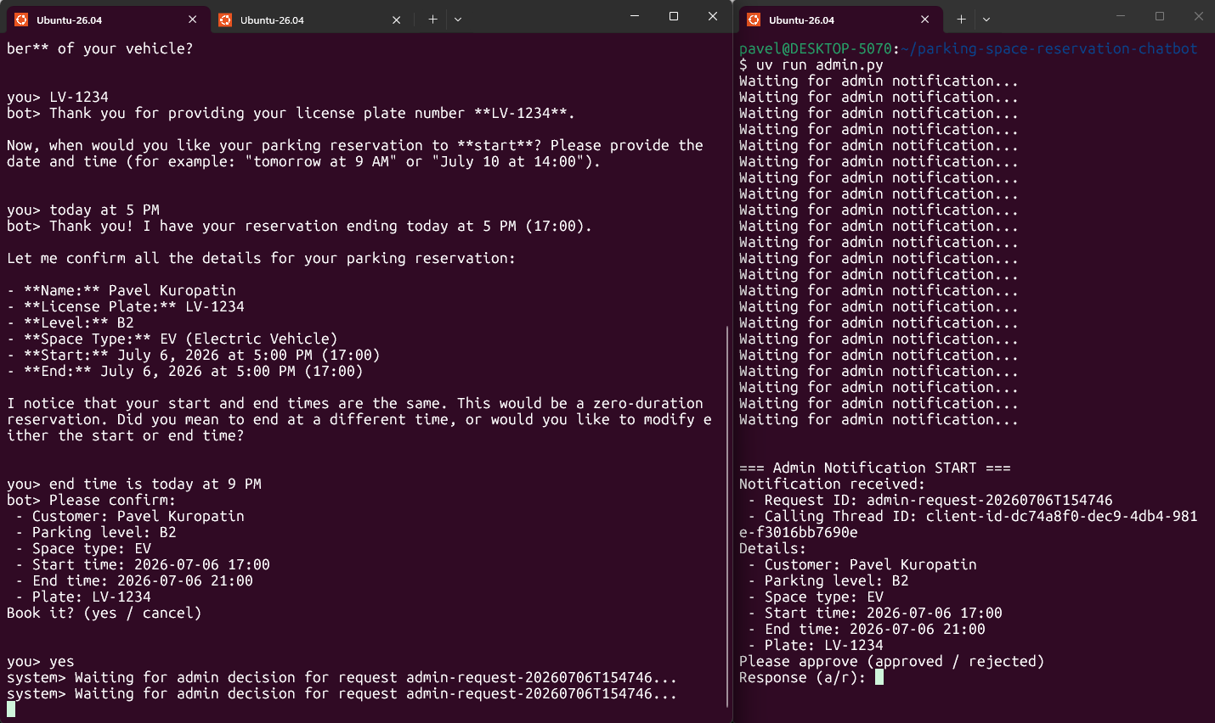
Reservation process (part 1.1)
Updated with admin approval
Success scenario
Single session
* submitted request

Slide 4
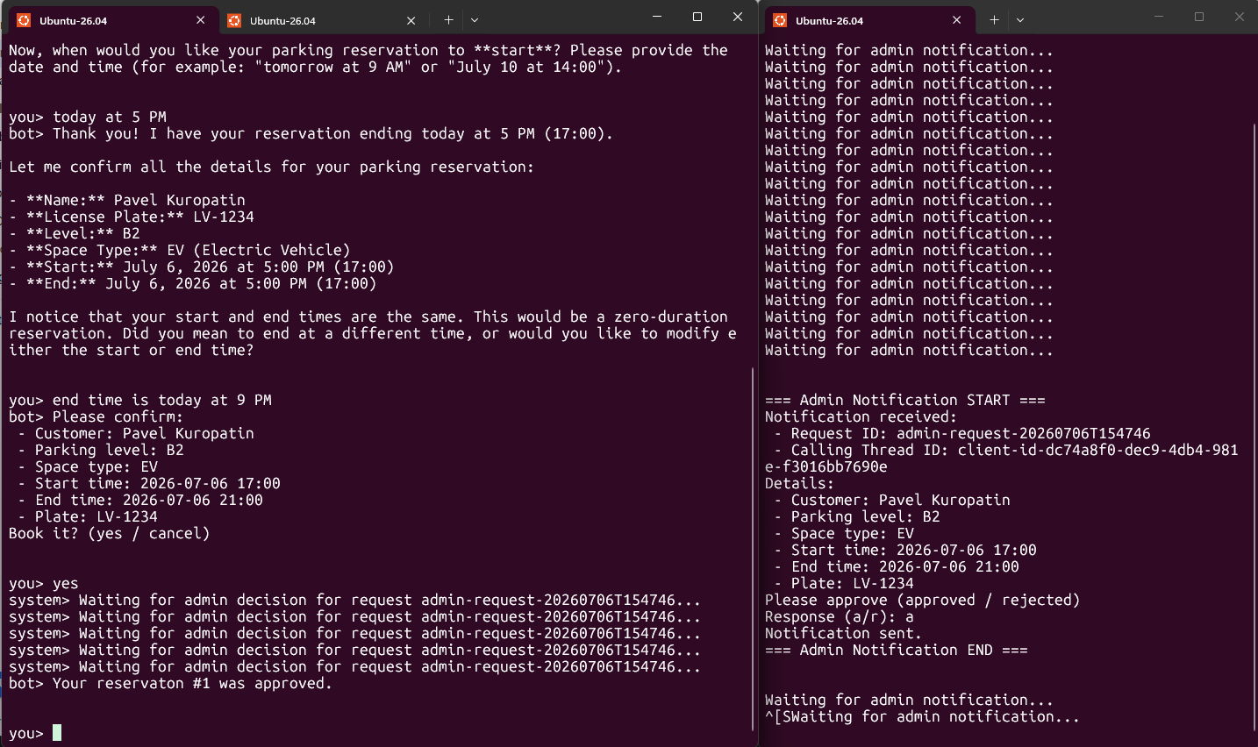
Reservation process (part 1.2)
Updated with admin approval
Success scenario
Single session
* submit request and wait for approval

Slide 5
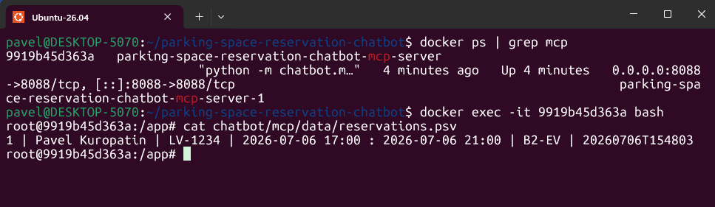
Reservation process (part 1.3)
Updated with admin approval
Success scenario
Single session
* mcp server text file

Slide 6
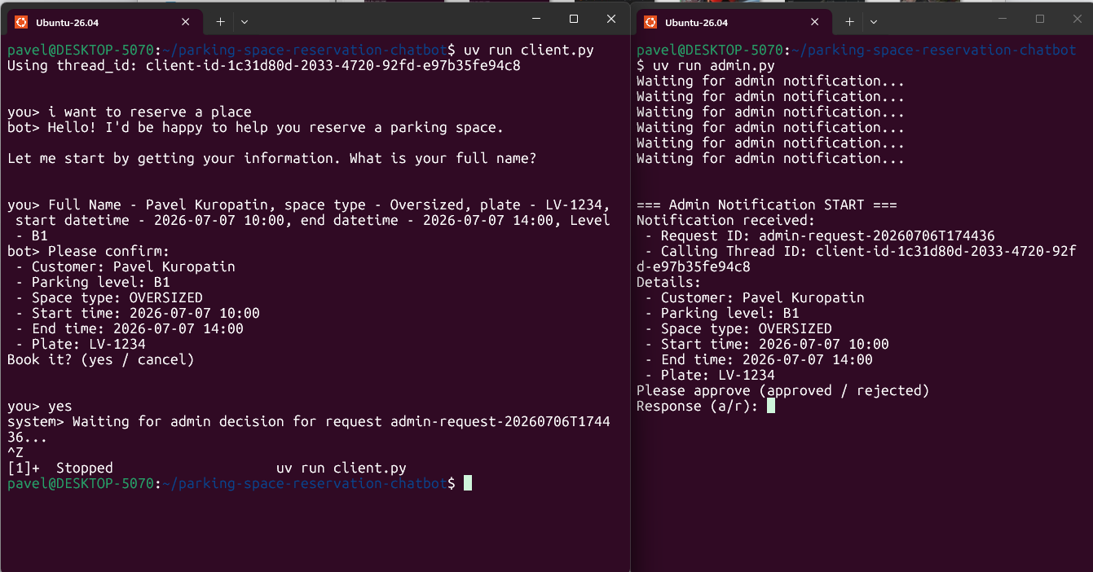
Reservation process (part 2.1)
Updated with admin approval
Failed scenario
Resumed session
* submit request and exit from chatbot

Slide 7
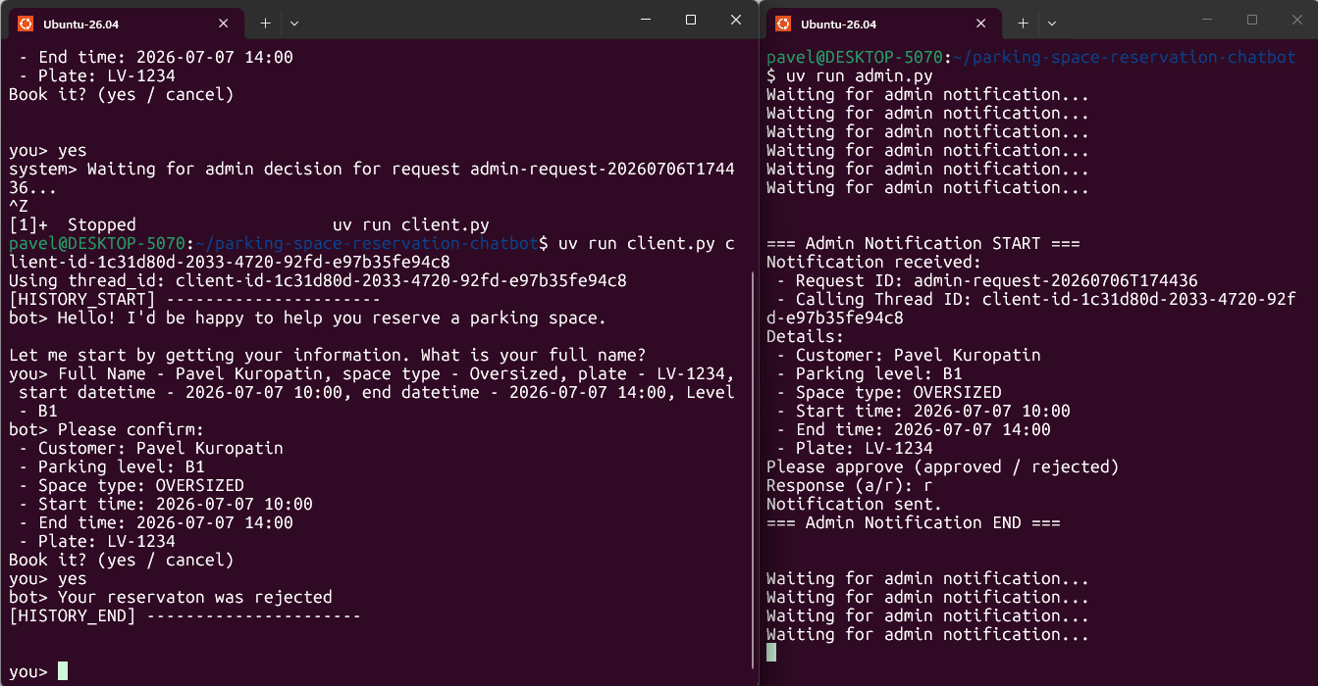
Reservation process (part 2.2)
Updated with admin approval
Failed scenario
Resumed session
* receive rejection from history

Slide 8
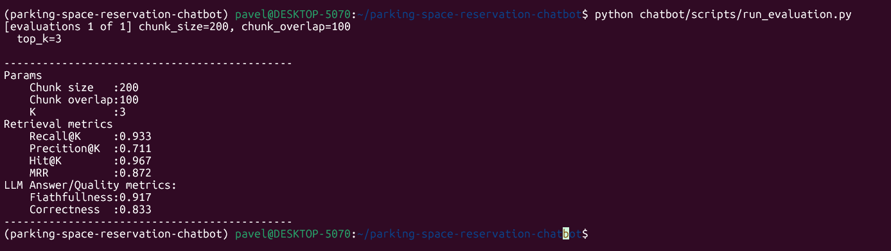
Evaluation

