Slide 1

Start Learning Query
Writing

Slide 2
Why
To become a master of MongoDB
Enable us to write deep query
To manage relational data
To learn database related problem solving
To migrate SQL Database into MongoDB
Master

Slide 3

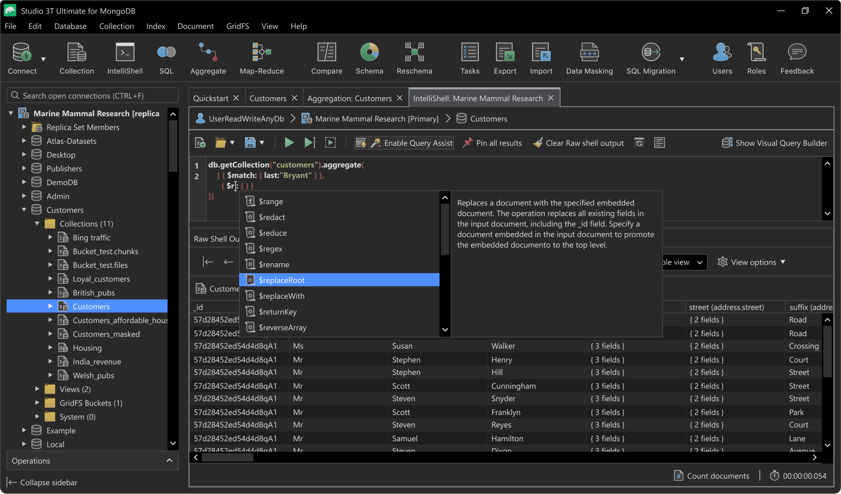
TOOLS
Master

Slide 4
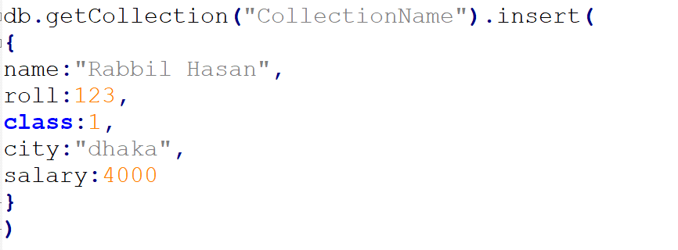
Insert One
Master

Slide 5
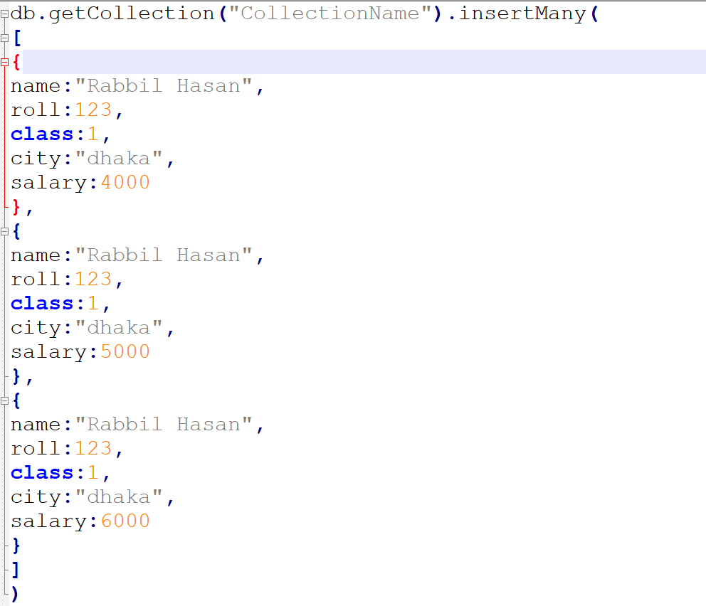
Insert Many
Master

Slide 6
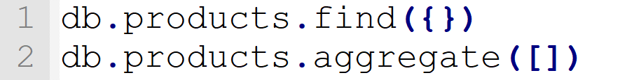
Select All Data
Master

Slide 7
Row Count
Master

Slide 8
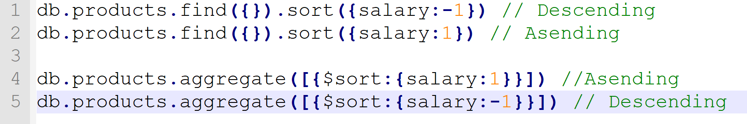
Sorting
Master

Slide 9
Limiting
Master

Slide 10
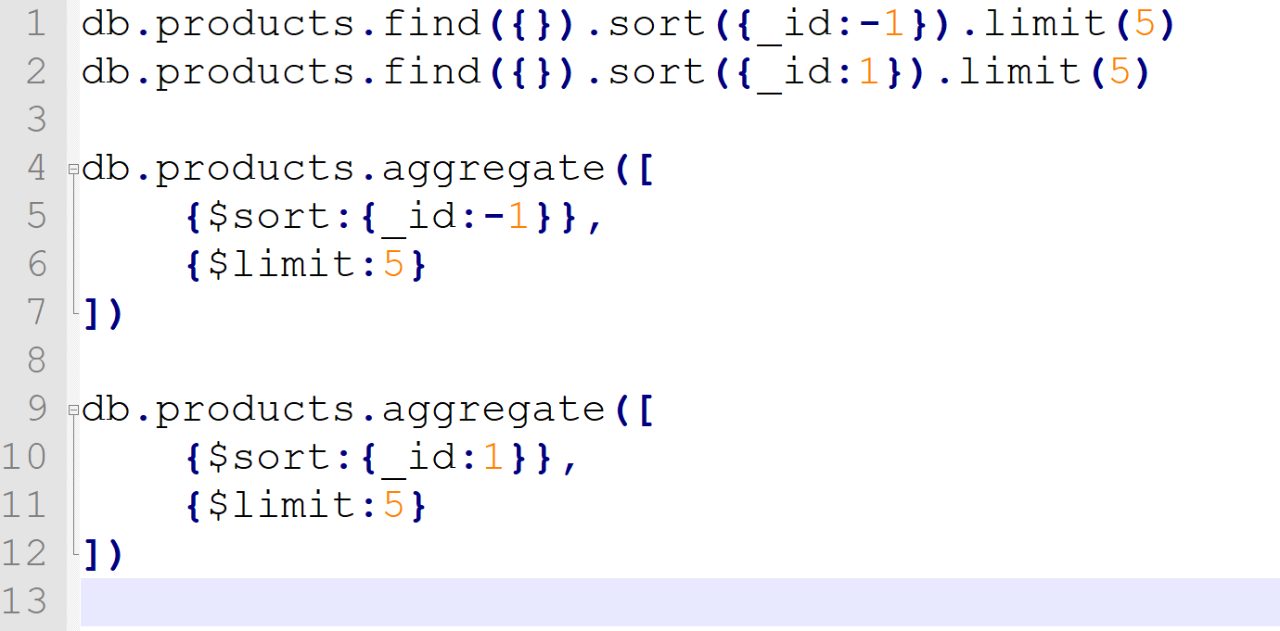
Select First 5 And Last 5
Master

Slide 11
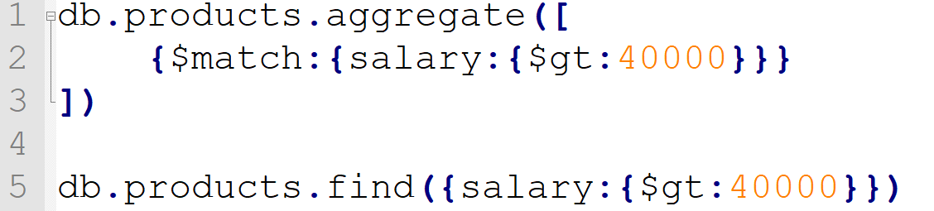
Select by match
Master

Slide 12
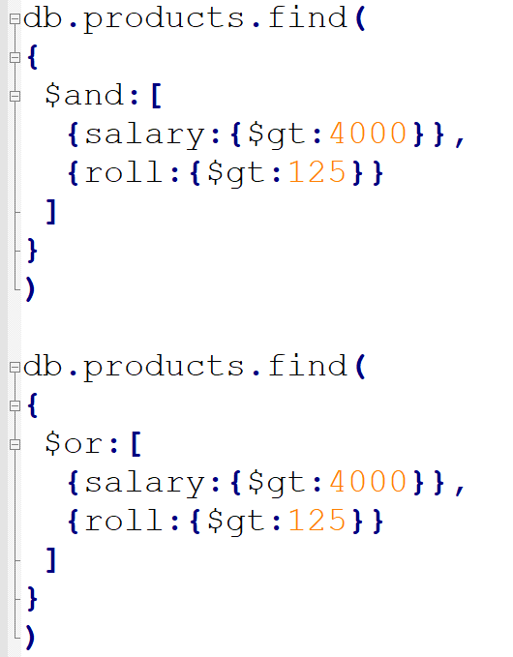
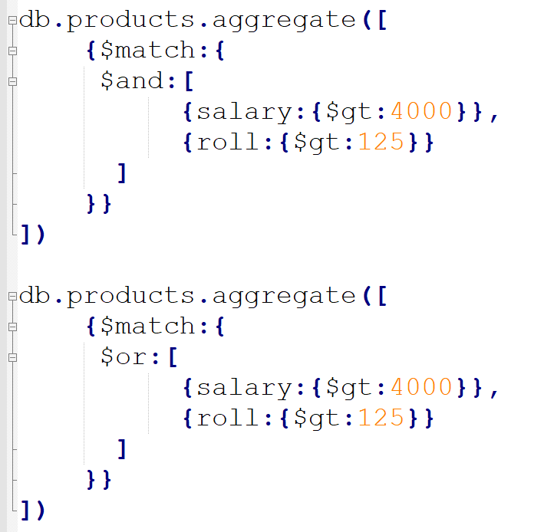
Select by match AND /OR
Master

Slide 13
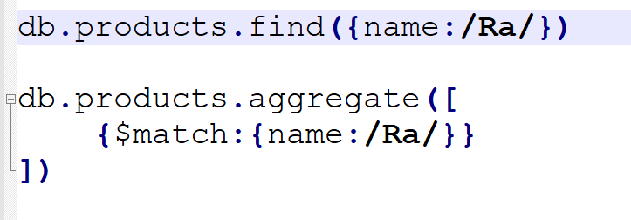
Select by match Like
Master

Slide 14
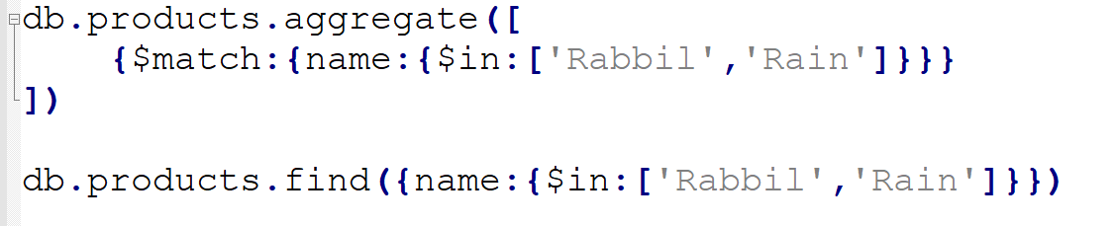
Select by match in
Master

Slide 15
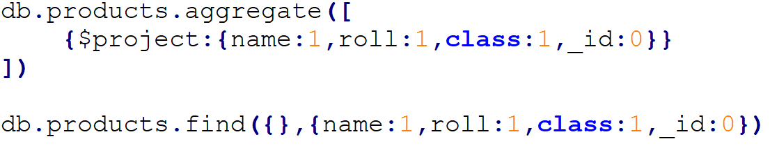
Projection
Master

Slide 16
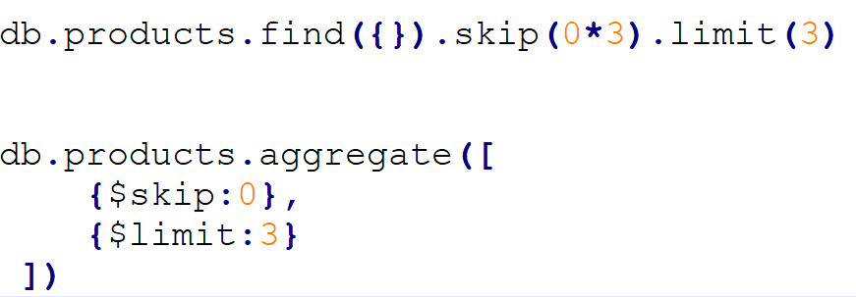
Find SKIP With LIMIT
Master

Slide 17
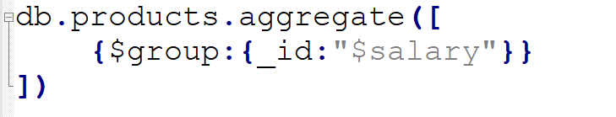
Group By
Master

Slide 18
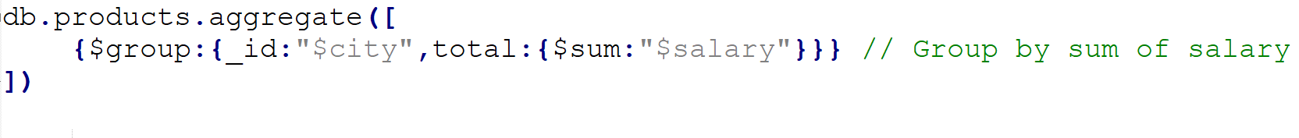
Group By SUM
Master

Slide 19
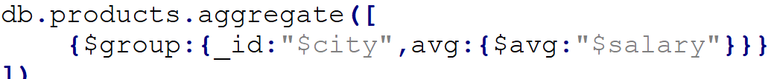
Group By Avg
Master

Slide 20
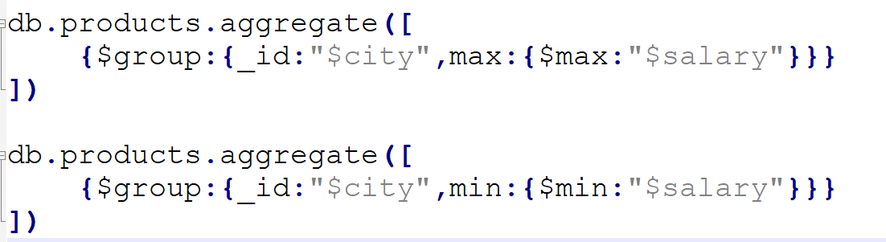
Group By Max Min
Master

Slide 21
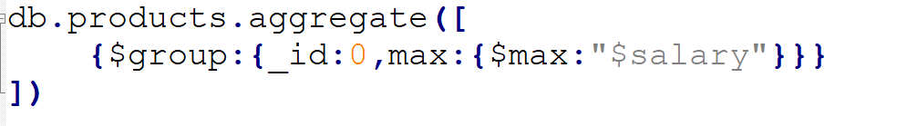
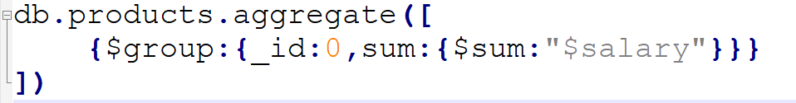
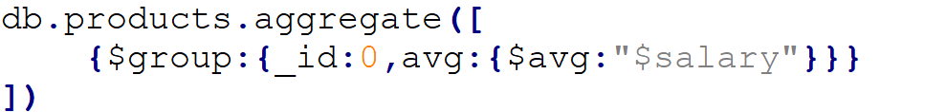
Without Group By SUM /AVG /Max/ Min
Master

Slide 22
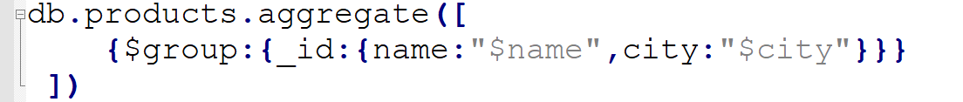
Group By Multiple
Master

Slide 23
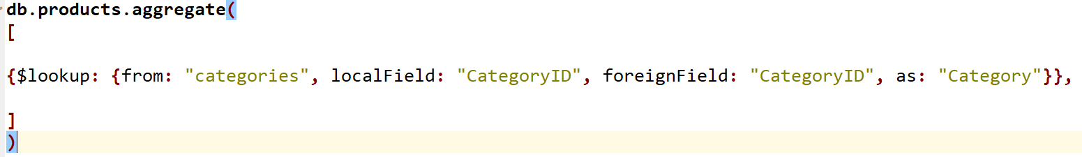
Join By lookup operator
Master

Slide 24
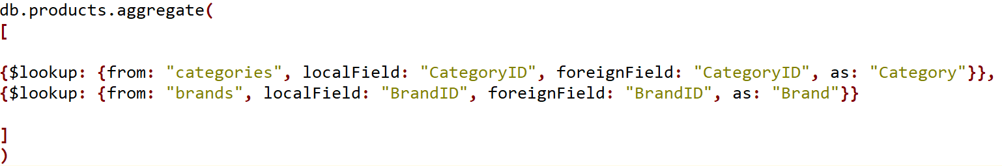
Join By lookup operator
Master

Slide 25
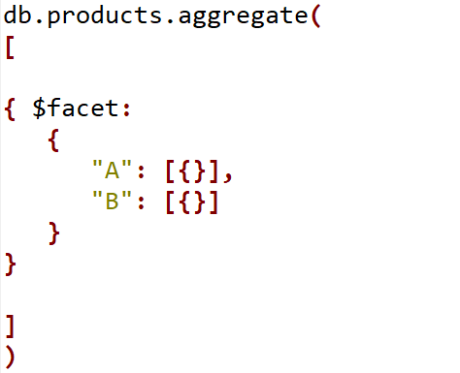
Facet operator
Master

Slide 26
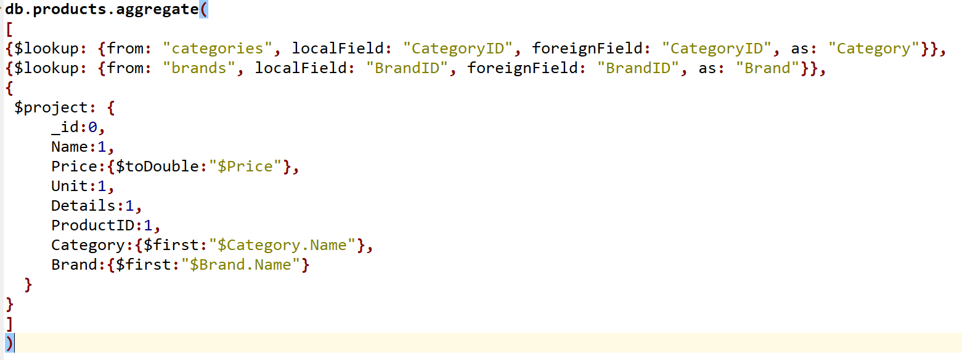
Project after Join
Master

Slide 27
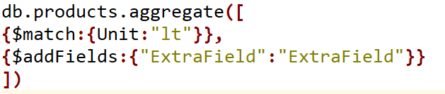
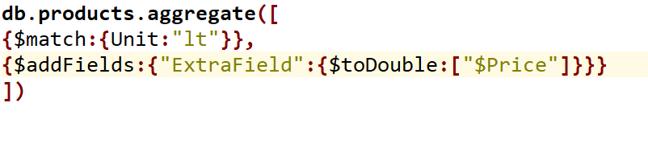
Add Extra Field
Master

Slide 28
Arithmetic Aggregation Operators
$abs | Returns the absolute value of a number.
$add | Adds numbers to return the sum, or adds numbers and a date to return a new date. If adding numbers and a date, treats the numbers as milliseconds. Accepts any number of argument expressions, but at most, one expression can resolve to a date.
$ceil | Returns the smallest integer greater than or equal to the specified number.
$divide | Returns the result of dividing the first number by the second. Accepts two argument expressions.
$exp | Raises e to the specified exponent.
$floor | Returns the largest integer less than or equal to the specified number.
$ln | Calculates the natural log of a number.
$log | Calculates the log of a number in the specified base.
Master

Slide 29
Arithmetic Aggregation Operators
$log10 | Calculates the log base 10 of a number.
$mod | Returns the remainder of the first number divided by the second. Accepts two argument expressions.
$multiply | Multiplies numbers to return the product. Accepts any number of argument expressions.
$pow | Raises a number to the specified exponent.
$sqrt | Calculates the square root.
$subtract | Returns the result of subtracting the second value from the first. If the two values are numbers, return the difference. If the two values are dates, return the difference in milliseconds.
$trunc | Truncates a number to its integer.
Master

Slide 30
String Aggregation Operators
$concat | Concatenates any number of strings.
$split | Splits a string into substrings based on a delimiter. Returns an array of substrings.
$toLower | Converts a string to lowercase.
$toUpper | Converts a string to uppercase
$substrBytes | Returns the substring of a string
$indexOfBytes | Searches a string for an occurrence of a substring and returns the UTF-8 byte index of the first occurence
$indexOfCP | Searches a string for an occurrence of a substring and returns the UTF-8 code point index of the first occurence.
Master

Slide 31
String Aggregation Operators
$strcasecmp | Performs case-insensitive string comparison and returns: 0 if two strings are equivalent
$strLenBytes | Returns the number of UTF-8 encoded bytes in a string
$strLenCP | Returns the number of UTF-8 code points in a string.
$strcasecmp | Performs case-insensitive string comparison and returns: 0 if two strings are equivalent
$substrCP | Returns the substring of a string. Starts with the character at the specified UTF-8 code point (CP)
Master

Slide 32
Date Aggregation Operators
$dayOfYear | Returns the day of the year for a date as a number between 1 and 366 (leap year).
$dayOfMonth | Returns the day of the month for a date as a number between 1 and 31
$dayOfWeek | Returns the day of the week for a date as a number between 1 (Sunday) and 7 (Saturday)
$year | Returns the year for a date as a number
$month | Returns the month for a date as a number between 1 (January) and 12 (December).
$week | Returns the week number for a date as a number between 0 (the partial week that precedes the first Sunday of the year) and 53 (leap year).
$hour | Returns the hour for a date as a number between 0 and 23.
Master

Slide 33
Date Aggregation Operators
$minute | Returns the minute for a date as a number between 0 and 59.
$second | Returns the seconds for a date as a number between 0 and 60 (leap seconds).
$millisecond | Returns the milliseconds of a date as a number between 0 and 999.
$dateToString | Returns the date as a formatted string.
Master

Slide 34
Comparison Aggregation Operators
$eq | Returns true if the values are equivalent
$gt | Returns true if the first value is greater than the second.
$gte | Returns true if the first value is greater than or equal to the second.
$lt | Returns true if the first value is less than the second.
$lte | Returns true if the first value is less than or equal to the second.
$ne | Returns true if the values are not equivalent.
Master

Slide 35
Boolean Aggregation Operators
$and Operator
Returns true only when all its expressions evaluate to true.
Accepts any number of argument expressions.
$or Operator
Returns true only when any its expressions evaluate to true.
Accepts any number of argument expressions.
$not Operator
Master
Returns the boolean value that is the opposite of its argument expression.
Accepts a single argument expression.

Slide 36
Practices to write mongo queries
More concentration over projection
Prepare projection map before running queries
Projection will describe your output
In Projection section, we will solve the logics, calculation, conversion and others
Benefit: More control over database quires
Benefit: Centralize the application business logics
Benefit: Reduce application server side complexities
Benefit: Reduce front-end complexities
Master

Slide 37
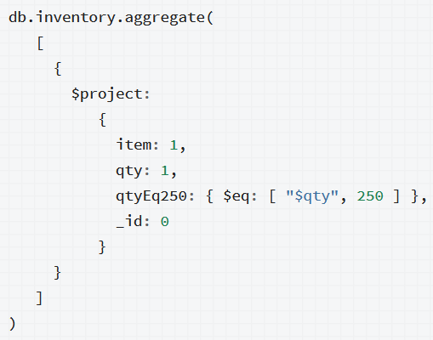
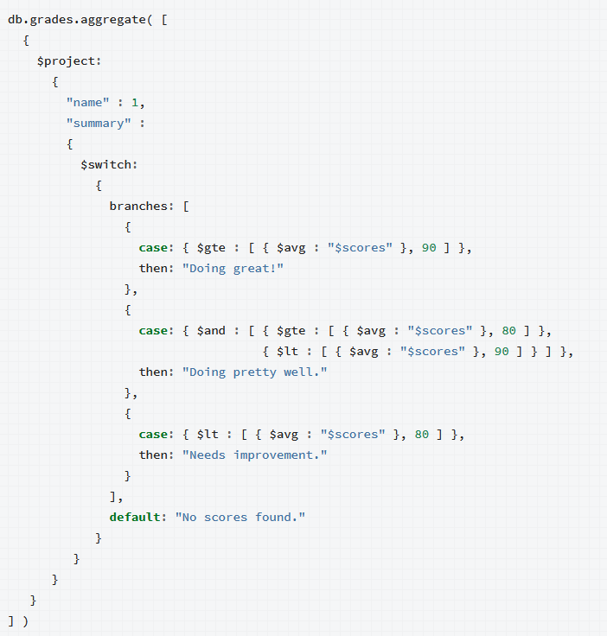
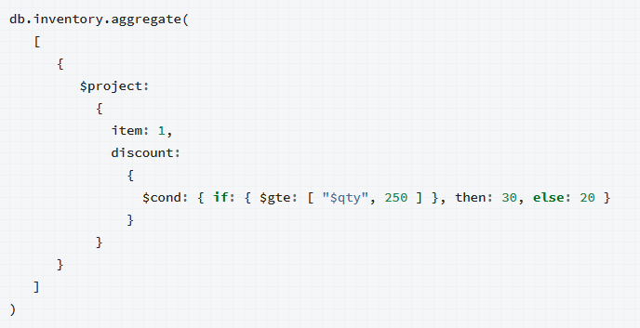
Practices to write mongo queries
Master

Slide 38
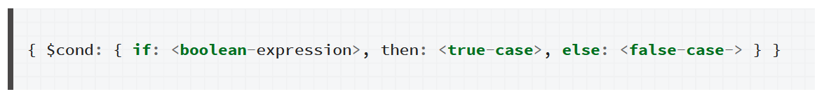
Conditional Aggregation Operators
$cond Operator
A ternary operator that evaluates one expression, and depending on the result, returns the value of one of the other two
Accepts either three expressions in an ordered list or three named parameters.
Master

Slide 39
Conditional Aggregation Operators
$switch Operator
Evaluates a series of case expressions.
When it finds an expression which evaluates to true
Master

