Slide 1
CloudFaces – Quick Review
Georg Regal

Slide 2
Heuristics and Concepts
The following UI Heuristics and Concepts have been applied during the review.
http://code.w3.org/privacy-dashboard/wiki/UIHeuristicsAndConcepts
Consistency
Feedback
Efficiency
Flexibility
Clearly marked exits
Wording in users‘ language
Control
Recovery and forgiveness
Minimize memory load
Transparency
Aesthetics and emotional effect
Task orientation
Notes:
Consistency: Consistency describes a common design of elements and processes. All user interface concepts should thus be consistently designed
Feedback: Feedback means that users expect a sufficient system reaction to all of their actions
Efficiency: The user interface must enable the users to carry out their tasks efficiently
Flexibility: the system must allow different users to work differently, or a single user to work differently if she wishes or needs to, in order to accomplish goals
Clearly marked exits: the user must always know how she can leave a specific context, window or display when working with a user interface, and how she can return to her starting position
Wording in users‘ language: Wording in the user interface must be known and easily understandable to the user
Task orientation: a user interface shall always be designed to best possibly suit the users‘ tasks; Never shall a user need to adapt to a system
Control: the user must always be in control of the system; the user must never have the feeling of the system controlling her
Recovery and forgiveness: the system must prevent the user from (unknowingly) taking severe actions; The user shall be able to undo changes or actions easily
Minimize memory load: the user shall be enabled to focus totally on her task, not being troubled with the user interface as such; Therefore the user interface must require as little cognitive effort as possible
Transparency: the user must always know what will happen when she takes an action- the user interface must be transparent
Aesthetics and emotional effect: everything has an emotional effect; If a user interface has an un appropriate emotional effect, it will interfere with the user tasks

Slide 3
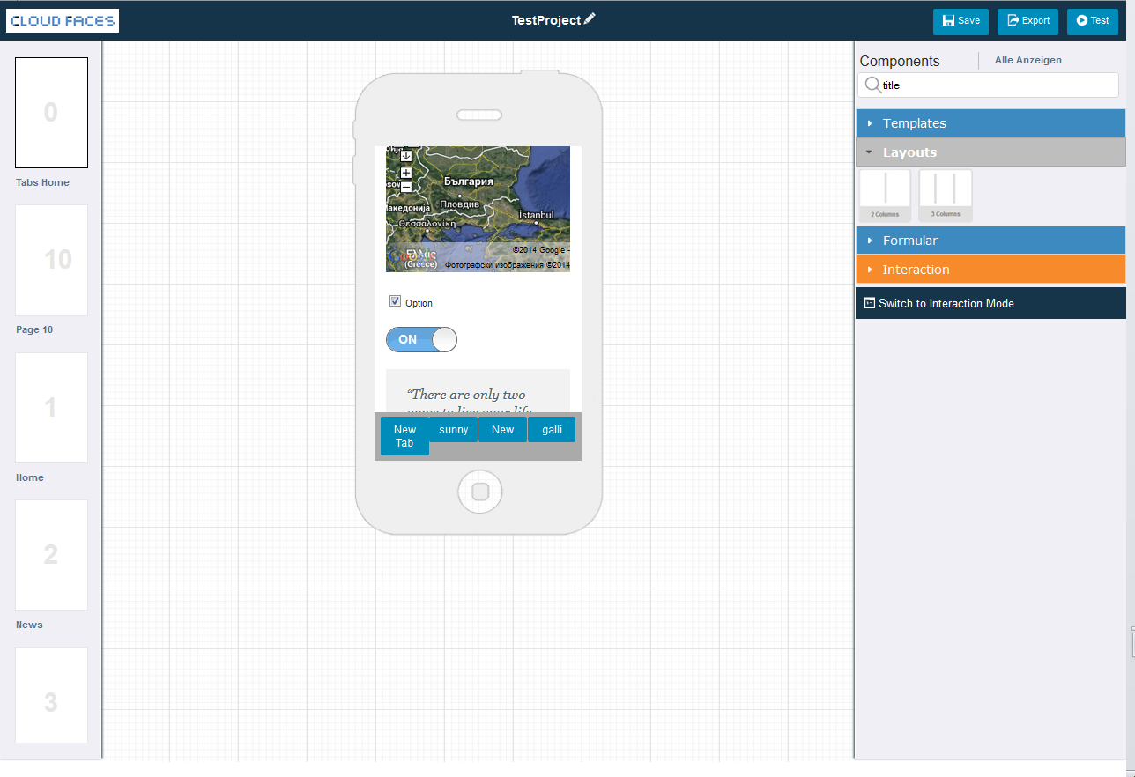



Cloudfaces Review
Task Orientation
Function unclear/ not needed! Delete that!
Task Orientation
Add new Page shouldn´t belong to an existing page.
Suggestion
Button is at the bottom and always visible. Pages can be moved. Drag and drop.

Slide 4
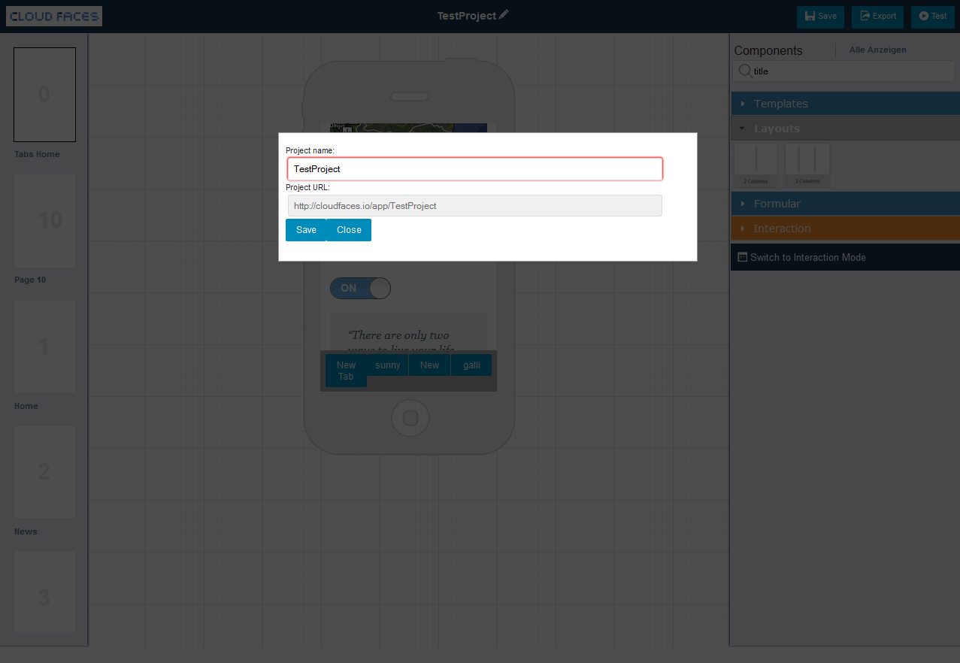
Cloudfaces Review
Efficiency
Copy Paste not possible.

Slide 5
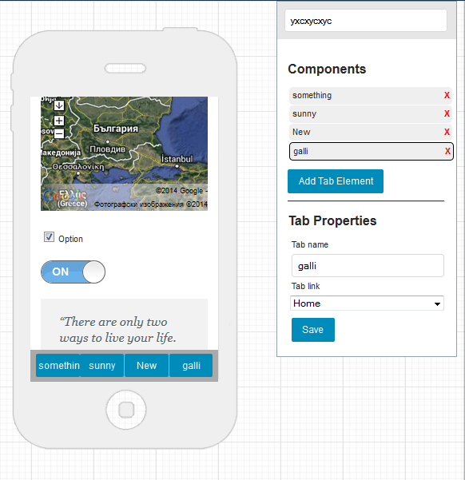
Cloudfaces Review
Task Orientation
Necessary?
I forgot to press it several times.

Slide 6
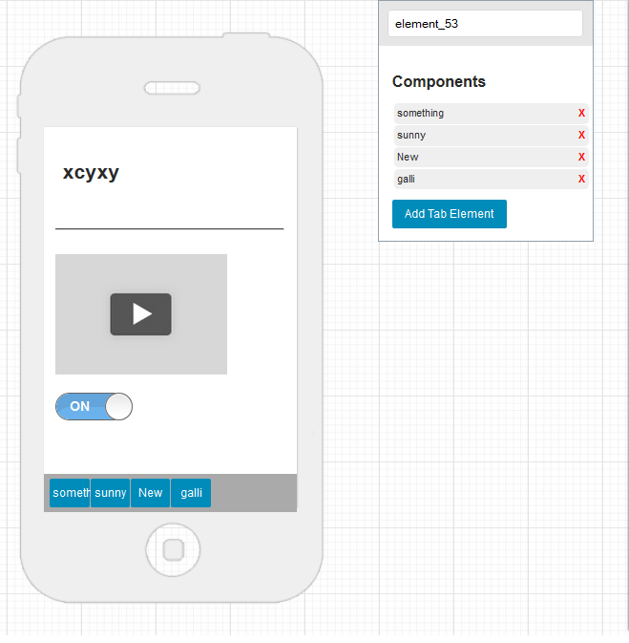
Cloudfaces Review
Minimize memory load
Rule of proximity.
Properties menu should be closer to the elements.
Minimize memory load
Rule of proximity.
Properties menu should be closer to the elements.

Slide 7
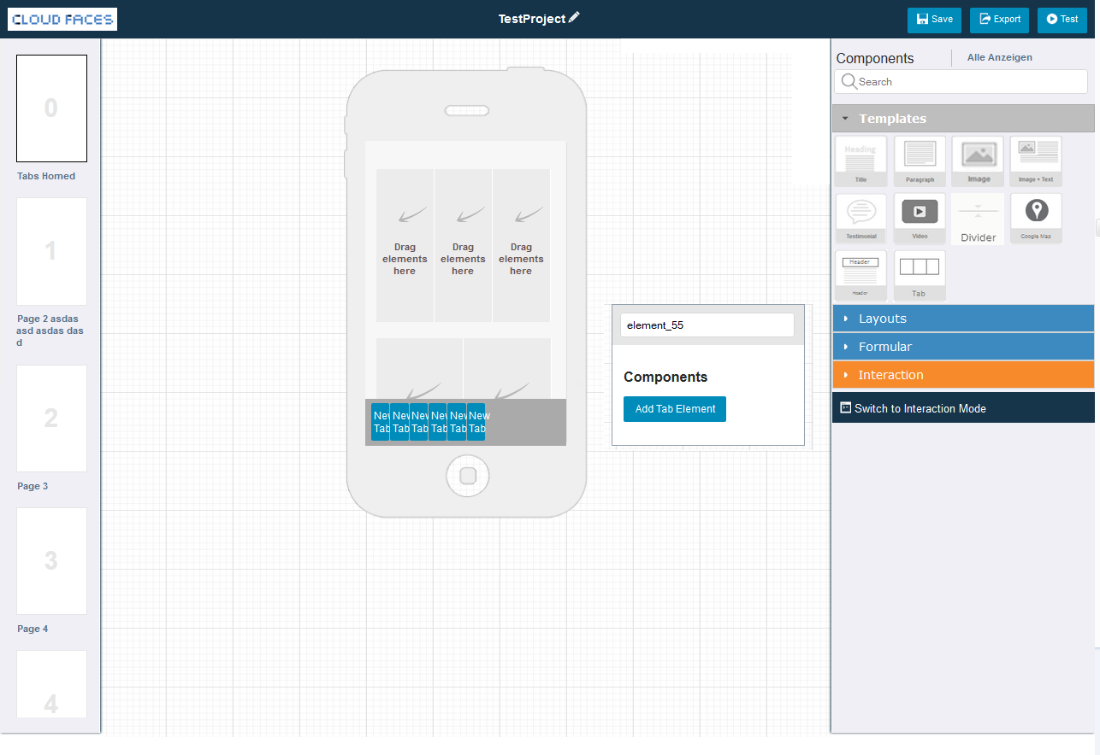

Cloudfaces Review
Suggestion
Put Dialog closer to Element

Slide 8
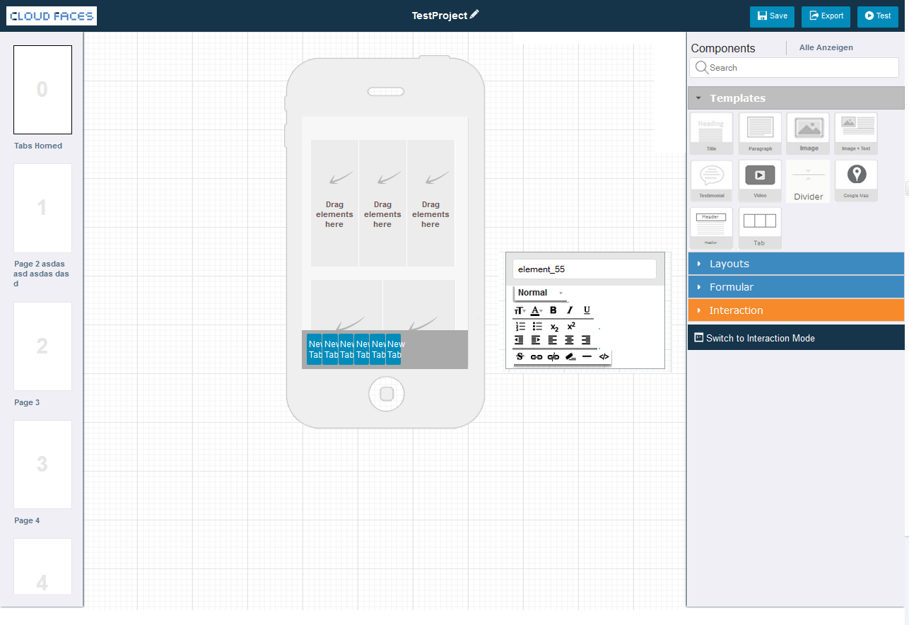
Cloudfaces Review
Suggestion
More consistent text-dialog

Slide 9
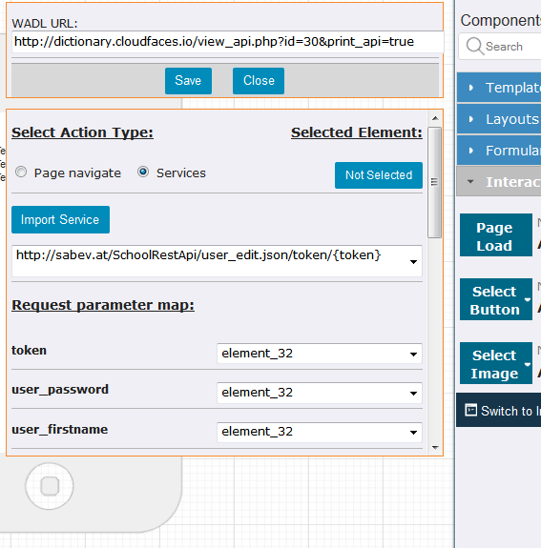
Cloudfaces Review
Efficiency & Consistency
Integrate into Menue
Even better: is the URL iInput necessary. Would be better to replace with a Selection Menue / Dropdown of available Services.
Wording in users‘ language
Better: Sent to Service
Feedback
Save / Close not visible. Question: Save / Close necessary anyway?

Slide 10
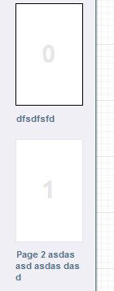
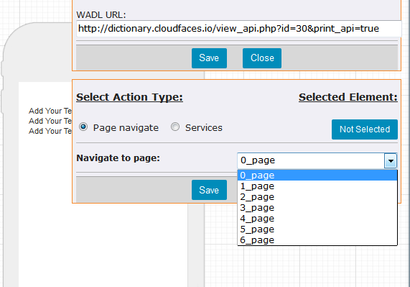
Cloudfaces Review
Control
Radiobuttons that act like tabs….
Inconsistency
Use Same Names As in Sidebar

Slide 11
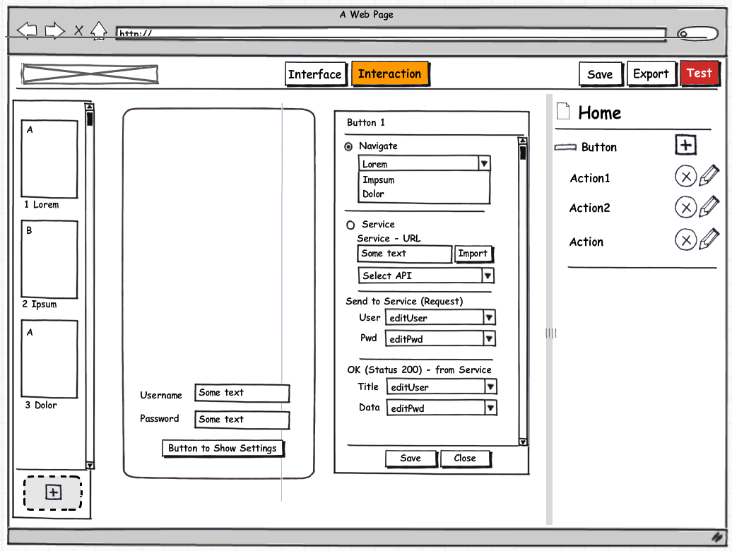
Cloudfaces Review
Same names as In Sidebar
May direct selection of elements possible as well…..Tbd.
Wording in User Language

Slide 12

Contact
Georg Regal
regal@cure.at
CURE – Center for Usability Research & Engineering
Businesspark Marximum
Modecenterstraße 17 / Objekt 2
1110 Vienna, Austria
http://www.cure.at

